Slide 1
Welcome to FIN323
Introductory Financial Management

Slide 2
About me
Name:
  Reza Kahibavil
Contact Information:
  Email: Rkahi001@odu.edu
Academic Background:
  PhD student in finance
Professional Achievements:
  Passed CFA Level I
Interest:
  Passionate about investment

Slide 3
Abou You
Now that you know a bit about me, I’d like to get to know you.
Let’s take a few minutes for introductions. just a quick way to learn more about each other.
Your name and your academic background
Your career goals (If you want)
Your comfort level with math
What you expect from this course: have you studied finance before? Are there specific topics you're curious about or skills you want to develop?

Slide 4
Course objectives
Maximize Firm Values
  The fundamental goal of financial management
Valuation Principles
Time Value of Money (TVM)
Financial Market Understanding
Application of Financial Tools
  Capital budgeting, optimal capital structure, dividend policy, working capital, and financial forecasting.

Slide 5
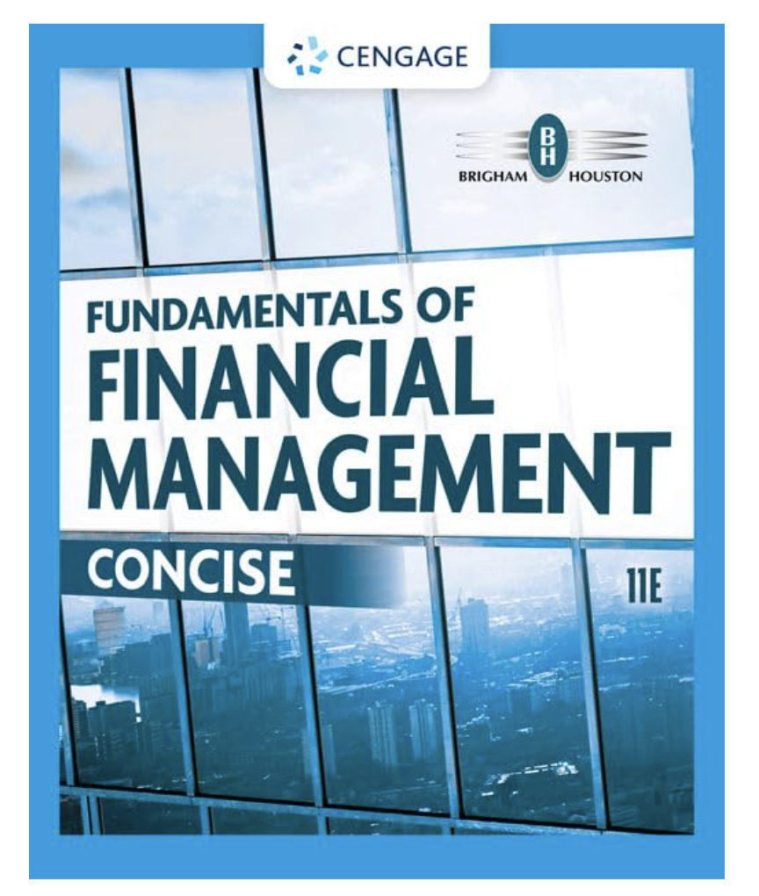
Textbook
Fundamentals of Financial Management: Concise
By Eugene F. Brigham, Joel F. Houston, 11th edition

Slide 6
Financial calculator
Texas Instruments BAII Plus/Professional
Please remember to bring your calculator to every session!!

Slide 7
Course grade
 | Participation |  | (5%)
 | Homework |  | (25%)
 | Midterm(1) |  | (20%)
 | Midterm(2) |  | (20%)
 | Final Exam |  | (30%)
 | Total |  | (100%)

Slide 8
Exam dates
 | Date
Midterms | To be announced
Final exam | May 7, 12:30 pm

Slide 9
STUDENT EVALUATION
Attendance
Class Participation
Homework Assignments
Mid-term Examinations
Final Examination

Slide 10
COURSE OUTLINE
Chapter 1 (An overview of Financial Management)
Forms of Business Organization
The Main Financial Goal: Creating Value for Investors
Stockholder–Manager Conflicts
Stockholder–Debtholder Conflicts
Balancing Shareholder Interests and the Interests of Society

Slide 11
Chapter 3 (Financial Statements, Cash Flow, and Taxes)
  Financial Statements and Reports
  The Balance Sheet
  The Income Statement
  Statement of Cash Flows
  Statement of Stockholders’ Equity
  Free Cash Flow
  MVA and EVA
  Income Taxes

Slide 12
Chapter 4 (Analysis of Financial Statements)
  Ratio Analysis
  Liquidity Ratios
  Asset Management Ratios
  Debt Management Ratios
  Profitability Ratios
  Market Value Ratios
  Tying the Ratios Together: The DuPont Equation
  Using Financial Ratios to Assess Performance

Slide 13
Chapter 5 (Time Value of Money)
  Future Values
  Present Values
  Finding the Interest Rate, Number of Years
  Annuities
  Perpetuities
  Uneven Cash Flows
  Semiannual and Other Compounding Periods
  Comparing Interest Rates
  Amortized Loans

Slide 14
Chapter 6 (Interest Rates)
  The Cost of Money
  Interest Rate Levels
  The Determinants of Market Interest Rates
  The Term Structure of Interest Rates
  What Determines the Shape of the Yield Curve?
  Using the Yield Curve to Estimate Future Interest Rates
  Interest Rates and Business Decisions

Slide 15
Chapter 7 (Bond and Their Valuation)
  Who Issues Bonds?
  Key Characteristics of Bonds
  Bond Valuation
  Bond Yields
  Changes in Bond Values over Time
  Bonds with Semiannual Coupons
  Assessing a Bond’s Riskiness investment Risk
  Default Risk

Slide 16
Chapter 8 (Risk and Rates of Return)
  The Risk-Return Trade-Off
  Stand-Alone Risk
  Risk in a Portfolio Context: The CAPM
  The Relationship between Risk and Rates of Return
  Concerns about Beta and the CAPM

Slide 17
Chapter 9 (Stocks and Their Valuation)
  Legal Rights and Privileges of Common Stockholders
  Types of Common Stock
  Stock Price versus Intrinsic Value
  The Discounted Dividend Model
  Constant Growth Stocks
  Valuing Nonconstant Growth Stocks
  Enterprise-Based Approach to Valuation
  Preferred Stock

Slide 18
Chapter 10 (The cost of capital)
  An Overview of the Weighted Average Cost of Capital (WACC)
  Cost of Debt
  Cost of Preferred Stock
  Cost of Retained Earnings
  Cost of New Common Stock
  Composite, or Weighted Average, Cost of Capital, WACC
  Adjusting the Cost of Capital for Risk

Slide 19
Chapter 11 (The Basic of Capital Budgeting)
  Book, Market, or “Target” Weights?
  Business and Financial Risk
  Determining the Optimal Capital Structure
  Capital Structure Theory
  Variations in Capital Structures

