Slide 1
Chapter-1
An Overview of Financial Management

Slide 2
What Will We Cover in This Chapter?
Role of Finance in businesses and various finance-related careers.
Forms of Business Organization:
  Sole ownership, Partnerships, Corporations.
  Advantages and disadvantages of each structure.
Maximizing Shareholder Wealth:
  True long-run value vs. current stock price.
  Importance of executive incentives for long-term value creation.
Potential Conflicts in Firms:
  Stockholders vs. Managers
  Stockholders vs. Bondholders
  How to mitigate these conflicts.

Slide 3
What is Finance?
The system that includes the circulation of money, the granting of credit, the making of investments, and the provision of banking facilities.
Why Study Finance?
Provides insight into how businesses raise and allocate capital
Prepares students for careers in:
Corporate finance
Investment banking
Financial planning
Risk management
Banking and financial markets

Slide 4
Overview of Finance
Financial Management (Corporate Finance)
Focus: Asset acquisition, capital raising, and maximizing firm value.
Applies to both for-profit and not-for-profit organizations.
Capital Markets
Focus: Determining interest rates, stock, and bond prices.
Includes financial institutions like banks, mutual funds, and investment banks.
Involves governmental organizations (e.g., Federal Reserve, SEC).
Investments
Focus: Decisions related to stocks and bonds.
Security Analysis: Valuing individual securities.
Portfolio Theory: Structuring diversified portfolios.
Market Analysis: Assessing whether markets are overvalued or undervalued.
Behavioral Finance: Examining investor psychology and market anomalies.

Slide 5
Organizational Structure of a Business
Board of Directors
Chief Executive Officer (CEO)
Chief Operating Officer (COO)
Chief Financial Officer (CFO)
Marketing, Production, Human Resources, and Other Operating Departments
Accounting, Treasury, Credit, Legal, Capital Budgeting, and Investor Relations

Slide 6
Organizational Structure of a Business
Board of Directors:
  The highest governing body in a business. The Chairperson of the Board is the top-ranking individual.
Chief Executive Officer (CEO):
  Often serves as the Chairperson of the Board. Responsible for overall management and decision-making.
Chief Operating Officer (COO):
  Often designated as President. Manages operations: marketing, manufacturing, sales, and other departments.
Chief Financial Officer (CFO):
  Senior vice president, usually third in command. Oversees accounting, finance, credit policy, asset acquisition, and investor relations.

Slide 7
Forms of Business Organization
Four Main Types:
Sole ownership
Partnerships
Corporations
Limited Liability Companies (LLCs) & Limited Liability Partnerships (LLPs)
Most Common:
Most businesses are proprietorships by number of entities, but the vast majority 80% of the total dollar value of goods and services sold in the economy comes from corporations.
Notes:
of entities, the vast majority of the total dollar value of goods and services sold in the economy comes from corporations.

Slide 8
Proprietorships or Sole ownership
Definition: Unincorporated business owned by one individual.
Example:
A freelance graphic designer works independently, offering design services to clients. The designer is the sole owner of the business, handling all operations, payments, and profits.
Easy and inexpensive to form.
Few government regulations.
Lower income taxes than corporations.
Advantages
Unlimited personal liability for debts.
Life of business tied to the owner.
Difficulty in raising large sums of capital.
Limitations

Slide 9
Partnerships
Definition: Legal arrangement between two or more people doing business together.
Example:
Two friends decide to open a bakery together. One specializes in baking, and the other in managing the shop. They share profits and responsibilities.
Easy and inexpensive to form.
Avoids corporate income tax.
Limitations
Advantages
Unlimited personal liability.
Difficulty in raising capital.
Actions of one partner can affect all.

Slide 10
Profit Calculation in Partnerships
In a partnership, profits are shared based on the agreement made between the partners.
key elements:
  Agreement Terms: The partnership agreement may include specific terms for sharing profits, such as a fixed percentage or based on other factors like workload or Capital Contribution.
  Capital Contribution: Each partner contributes a certain amount of capital (money, assets, etc.) to the business.

Slide 11
Corporations
Definition: Legal entity separate from its owners and managers.
Example:
A local restaurant decides to expand into a chain and incorporates as a corporation. It allows them to raise capital by selling shares to investors, protecting the owners’ personal assets, and continuing even if the owner leaves.
Limited liability for stockholders.
Unlimited life.
Easier to raise capital and transfer.
Advantages
double taxation.
More regulatory requirements..
Cost of setup and report filing.
Limitations

Slide 12
Shareholder Rights in Corporations
Right to Vote
Election of Board of Directors.
Approval of mergers, acquisitions, or significant business changes.
Amendments to the company’s articles of incorporation or bylaws.
Right to Share in Assets Upon Liquidation
Hierarchy of Claims:
Debts (creditors).
Preferred shareholders (if applicable).
Common shareholders (last in line).
Right to Sue for Wrongdoing
Right to Receive Dividends
Preemptive Rights
Right to Inspect Corporate Records
Right to Transfer Shares

Slide 13
LLCs and LLPs
LLCs (Limited Liability Companies):
  Owners are called members, and an LLC can have one or multiple members. Members can be individuals, corporations, or other LLCs.
  Hybrid between partnerships and corporations.
  Provide limited liability protection but taxed like a partnership.
  Investors have voting rights based on ownership interest.
LLPs (Limited Liability Partnerships):
  Owners are called partners, and an LLP typically requires at least two partners. The partners must be individuals (not corporations or other entities).
  Similar to LLCs, used for professional firms (accounting, law, etc.).
  Provide limited liability but taxed as partnerships.

Slide 14
Adam Smith's Invisible Hand & Profit Maximization
Adam Smith (1776): The “invisible hand” guides firms toward profit maximization, benefiting society.
This refers to the market's self-regulating nature, where individuals pursuing their own self-interest unintentionally contribute to society's overall good.
Free enterprise system viewed as ideal for economic growth and social welfare.
Today’s Challenge:
  Firms are larger, global, and owned by millions of shareholders.
  Should profit maximization remain the sole objective, or should firms balance broader societal interests?

Slide 15
Modern Financial Goal of Firms-1
Primary Goal:
  The main financial objective of public corporations is to maximize shareholder wealth.
  Managers and employees are responsible for making decisions that increase stockholder value.
Stockholders’ Perspective:
  Investors have committed their hard-earned money with the expectation of a return on investment.
  Long-term financial goals of investors may include saving for retirement, a new home, or education.

Slide 16
Modern Financial Goal of Firms-2
How is Stockholder Wealth Determined?
  The value of any asset is the present value of future cash flows.
  Stock prices are influenced by expected future cash flows, not just current performance.
Long-Term View:
  Maximizing stockholder wealth requires a long-term perspective on operations.
  Managerial actions that impact value may not immediately be reflected in the stock price.
  Strategic decisions affect stock prices over time.

Slide 17
Determinants of Value: Cash Flows & Risk
Influence of Managerial Actions & External Factors:
  Managerial actions, economy, taxes, and political conditions affect a company's future cash flows and risk.
  Higher expected cash flows and lower perceived risk lead to a higher stock price.
True vs. Perceived Cash Flows and Risk
  True Cash Flows and Risk: What investors would expect with full information about the company.
  Perceived Cash Flows and Risk: What investors expect based on the limited information available to them.

Slide 18
Intrinsic Value vs. Market Price
Intrinsic Value vs. Market Price:
  Intrinsic Value: The stock’s "true" value, calculated by competent analysts using the best available data.
  Market Price: The actual market price based on the perceived information available to investors, determined by the marginal investor.
Equilibrium:
  When the market price equals the intrinsic value, the stock is in equilibrium.
  No pressure exists for price changes in equilibrium.
  Price Convergence: Over time, market prices and intrinsic values tend to converge as more information becomes available.

Slide 19
Determinants of Value: Example
Full information CFs
$200
$250
$220
$280
$320
0
1
2
3
4
limited information CFs
$200
$260
$270
$310
$350

Slide 20
Determinants of Value: Example
Intrinsic Value = Present Value of True Cash Flows = $1000
Full information CFs
$200
$250
$220
$280
$320
0
1
2
3
4
limited information CFs
$200
$280
$290
$310
$350
Market Price = Present Value of Percieved Cash Flows = $1300
What will happen to the price of this company at the end of first year?

Slide 21
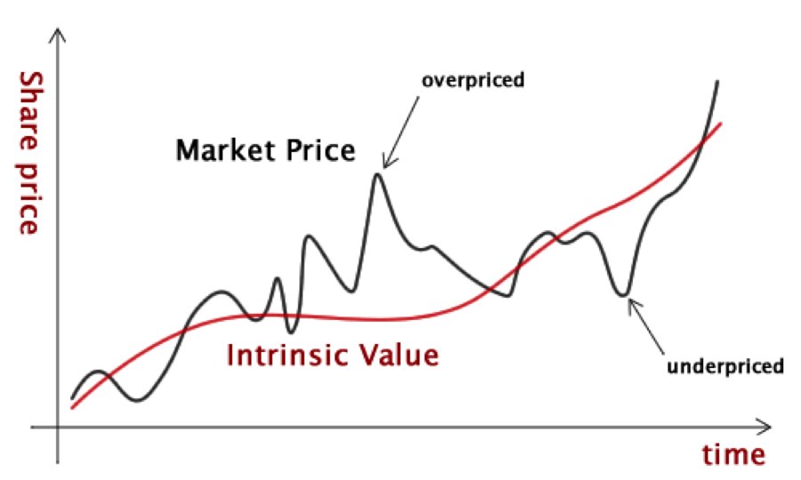
Determinants of Value: Example
Different estimates of intrinsic value distinguish successful from unsuccessful investors.
Managers often have better information about the firm’s prospects, leading to more accurate estimates.

Slide 22
Intrinsic Value: A Long-Run Concept
Stock Price vs. Intrinsic Value Over Time:
  The intrinsic value may increase or decrease over time depending on how the firm’s actions, such as reinvesting earnings, affect future profits and risks.
  Deviations occur due to investor optimism, pessimism, and imperfect knowledge.
Maximizing Intrinsic Value:
  Management should focus on maximizing intrinsic value, not short-term market prices.
  Management should disclose information that helps investors make better intrinsic value estimates—unless it risks helping competitors.
  Over the long run, maximizing intrinsic value leads to higher average stock prices.

Slide 23
Stockholder–Manager Conflicts
Conflict of Interest:
  Managers’ personal goals may not always align with shareholder wealth maximization.
  Example: Excessive salaries or decisions aimed at personal gain.
Motivational Tools:
  Reasonable compensation packages.
  Firing underperforming managers.
  Threat of hostile takeovers.
Compensation Packages:
  Must reward managers for long-term stock performance rather than short-term price fluctuations.
  Use phased-in options or direct stock awards over time.

Slide 24
Direct Stockholder Intervention
Shift in Stock Ownership:
  Majority of stock now owned by institutional investors (e.g., pension funds, mutual funds).
  These investors exert significant influence over company policies.
  Institutional investors and activists can demand changes in management and strategy.
Impact of Activists:
  Growing role of activists in promoting shareholder interests and social responsibility (e.g., ESG initiatives).
  Examples: BlackRock, Vanguard pushing for reduced carbon footprints.

Slide 25
Managers’ Response to Activism and Hostile Takeovers
Hostile Takeovers:
  Undervalued firms attract corporate raiders who buy the firm and replace managers.
  This incentivizes managers to maximize stock value over the long run.
Long-Run Price Focus:
  Managers should focus on increasing the intrinsic value of the stock.
  Effective communication with shareholders helps keep the actual stock price close to intrinsic value.
Value-Based Management:
  Though intrinsic value cannot be observed, managers can use valuation models to estimate it.
  This helps guide decisions that are aligned with long-term value maximization.

Slide 26
Who Are the Debtholders?
Debtholders provide debt capital to a company, typically through:
  Loans (e.g., from banks).
  Bonds (issued by the company and purchased by investors).
Returns to Debtholders:
  Fixed payments, such as interest and principal repayment.
Key Role:
  Debtholders expect the company to maintain low risk to ensure repayment.

Slide 27
Stockholder–Debtholder Conflicts
Conflict arises because:
  Debtholders earn a fixed return regardless of how well the company performs.
  Stockholders earn variable returns and benefit when the company takes on riskier projects.
Example of Conflict:
  Stockholders may prefer riskier investments (higher potential returns).
  Debtholders prefer safer investments to protect their fixed payments.
Stockholders: Benefit from higher risk → higher potential returns.
Debtholders: Prefer lower risk to ensure fixed returns.

Slide 28
Mitigating Stockholder–Debtholder Conflicts
Higher Interest Rates:
  Debtholders demand higher returns to compensate for increased risk.
Restrictive Covenants*:
  Limit Risky Investments: Prevent excessive risk-taking by stockholders.
  Restrict Additional Debt: Control the firm’s leverage to protect existing debt.
Transparent Communication:
  Clear policies to reassure debtholders about risk management practices.
Use of Collateral:
  Securing loans or bonds with assets to reduce perceived risk.
*Covenants are clauses in loan or bond agreements that place restrictions on a borrower to protect the interests of the lender (debtholders).

Slide 29
Shareholder Interests and Society
Key Principles:
  Management's primary financial goal: Shareholder Wealth Maximization.
  Managers must also behave ethically and follow laws and societal constraints.
Ignoring societal interests can lead to:
  Difficulty attracting top employees.
  Boycotts and loss of customers.
  Lawsuits, regulations, and negative publicity.
    These costs reduce shareholder value.
Example:
  Managers who consider societal constraints create long-term value by ensuring sustainability and reducing potential costs.

Slide 30

Thank You

