Slide 1
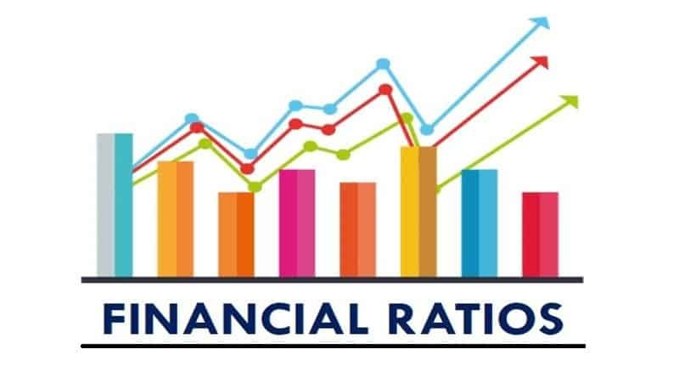

Slide 2



Introduction
Goal of Financial Management:
“Maximize shareholders’ wealth.”
This means increasing the long-term value of the firm.
Imagine you own a small pizza shop...
→ Your goal isn't just to sell lots of pizzas today
→ It's to make the whole business so successful
→ that someone would pay a lot more for it in 5–10 years!

Slide 3
How Do We Know If the Company Is Creating Long-Term Value?
We must analyze the company's current AND future situation
Current situation → Is the company healthy right now? (paying bills, making profit, …)
Future situation → Will it keep growing and stay strong for years? (investing in new products, …)
The Main Tools We Use to Analyze a Company are Financial Statements
Balance Sheet:
What the company owns (assets) vs. what it owes (liabilities) + owners' share (equity)
Income Statement (or Profit & Loss Statement):
How much money came in (revenues) vs. how much went out (expenses)
Cash Flow Statement :
Where actual cash came from and where it went (operating, investing, financing)

Slide 4
Where Financial Ratios Fit In
Financial statements provide raw accounting data (sales, assets, debt, expenses, etc.)
  Raw numbers alone are hard to interpret
    Companies differ in size, structure, and operations
    A higher number does not always mean a better company
Example
  A company may report higher net income
  But it may also have:
    Higher debt
    Lower efficiency
    Greater financial risk
Financial ratios solve this problem
  They relate numbers to each other
  They allow fair comparison

Slide 5
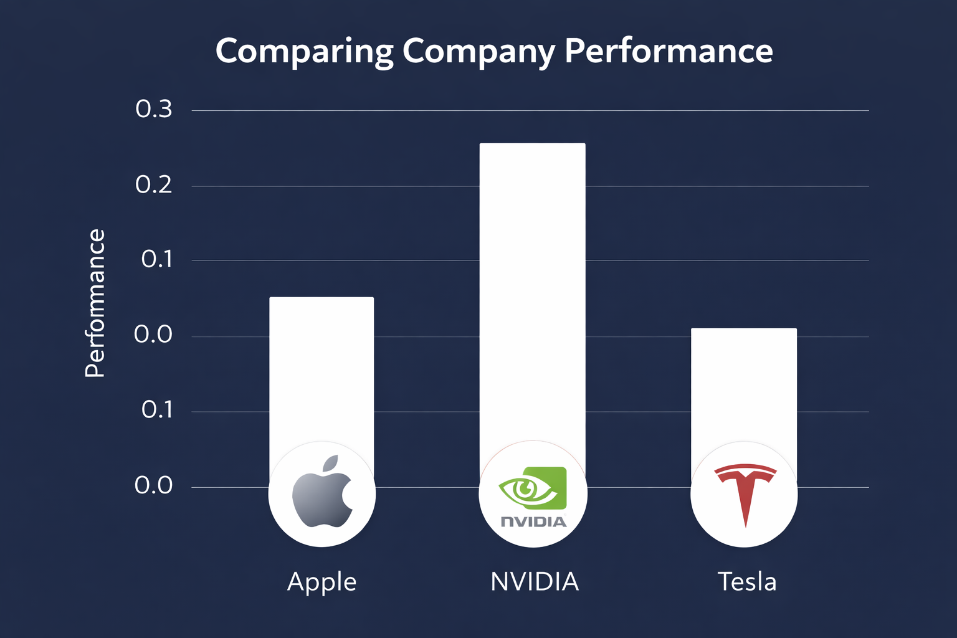
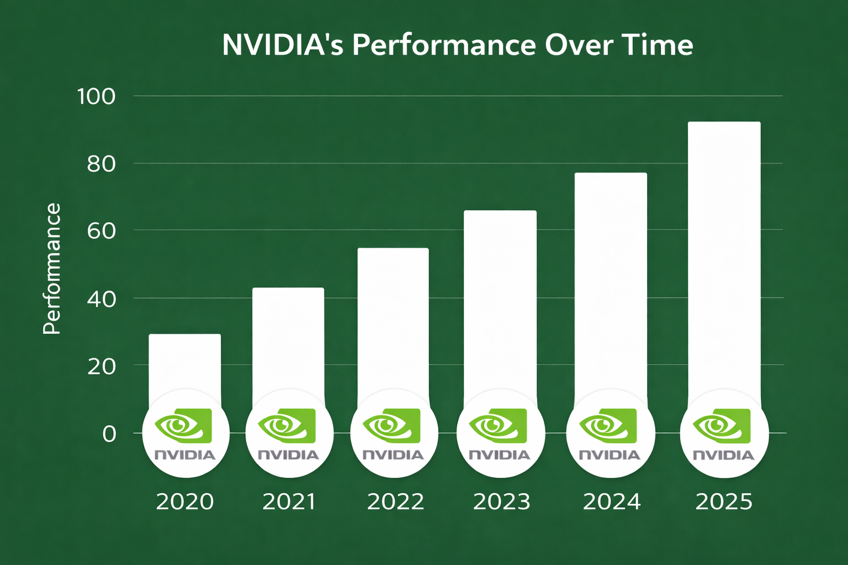
What Are Financial Ratios?
Financial ratios are calculations that compare two or more figures from a company’s financial statements to measure performance and financial health.
Who uses financial ratios?
  Managers, creditors, investors, and analysts
Ratios help evaluate financial health by:
1- Comparing companies across firms or industries
2- Identifying strengths, weaknesses, and trends over time

Slide 6
We Need Different Types of Ratios
Companies must be evaluated from several perspectives
  Short-term financial safety
  Long-term profitability
  Operating efficiency
  Financial risk
Each perspective answers a different economic question
  Can the company pay its bills?
  Is it generating profits?
  Is it using its resources efficiently?
  How risky is its financing structure?
Financial ratios are therefore organized into categories

Slide 7
Categories of Ratios
Liquidity Ratios:
  Measure the ability to pay off short-term debt.
Asset Management Ratios:
  Evaluate how efficiently the firm uses its assets.
Debt Management Ratios:
  Assess how the firm finances its assets and repays long-term debt.
Profitability Ratios:
  Show how profitably the firm operates and utilizes its assets.
Market Value Ratios:
  Reflect investor perceptions of the firm and its prospects.

Slide 8
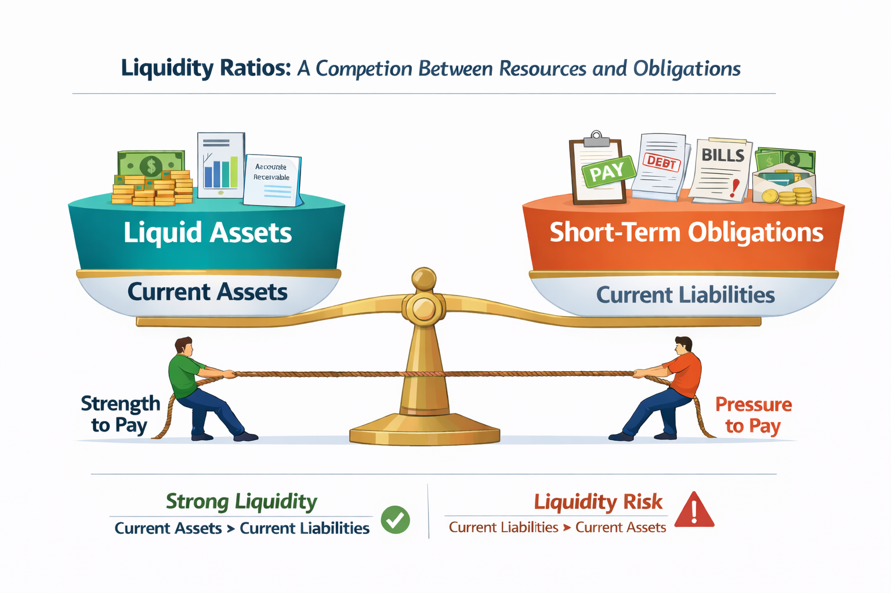
1- Liquidity Ratios
Liquidity measures a company’s ability to pay its short-term obligations
Assess whether a firm can meet its short-term obligations and remain viable.
Common Liquidity Ratios
  Current Ratio
  Quick Ratio (Acid-Test Ratio)
  Cash Ratio

Slide 9
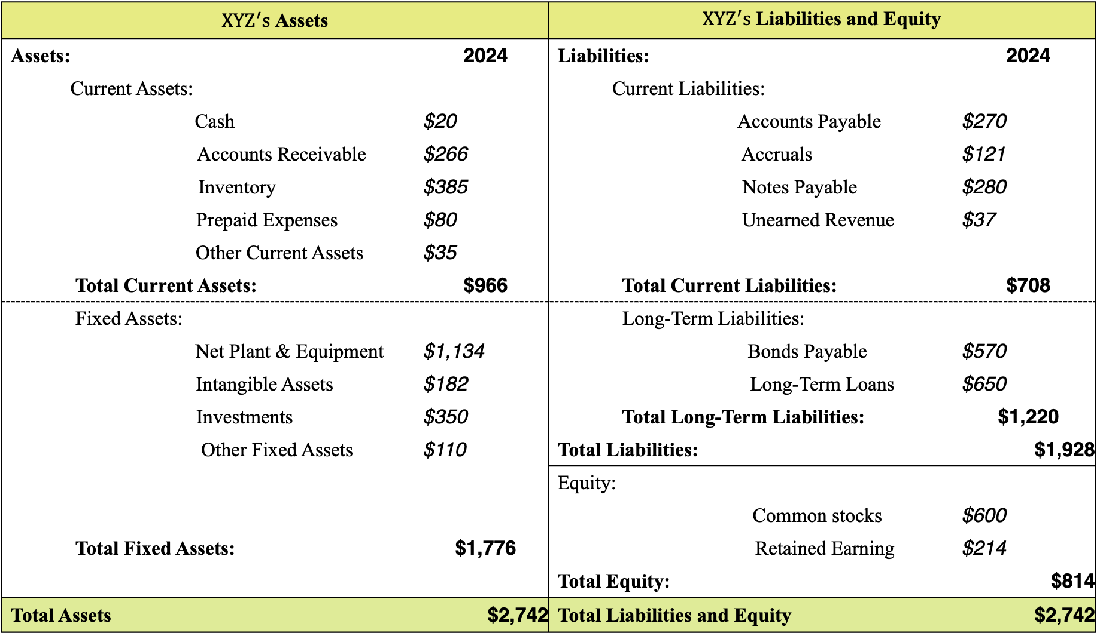
Incremental Cash Flows
${XYZ}^{′}s$Assets |  | ${XYZ}^{′}s$Liabilities and Equity
Assets: | 2024 | Liabilities: | 2024
Current Assets: |  | Current Liabilities:
Cash | $20 | Accounts Payable | $270
Accounts Receivable | $266 | Accruals | $121
Inventory | $385 | Notes Payable | $280
Prepaid Expenses | $80 | Unearned Revenue | $37
Other Current Assets | $35
Total Current Assets: | $966 | Total Current Liabilities: | $708
Fixed Assets: |  | Long-Term Liabilities:
Net Plant & Equipment | $1,134 | Bonds Payable | $570
Intangible Assets | $182 | Long-Term Loans | $650
Investments | $350 | Total Long-Term Liabilities: | $1,220
Other Fixed Assets | $110 | Total Liabilities: | $1,928
 |  | Equity:
 |  | Common stocks | $600
Total Fixed Assets: | $1,776 | Retained Earning | $214
 |  | Total Equity: | $814
Total Assets | $2,742 | Total Liabilities and Equity | $2,742

Slide 10

1-1.Current Ratio
Current Assets
Current Ratio
=
Current Liabilities
The firm’s ability to cover short-term obligations with short-term assets.
Current Assets
966
Current Ratio of XYZ for 2024
=
=
$$≈$$
1.36
Current Liabilities
708
A current ratio of 1.36 means that:
  The company has $1.36 in current assets for every $1 in current liabilities.
Does it mean the company is in a strong or weak position?
  A single ratio doesn’t tell the whole story. Always compare it to:
    Peers, Industry benchmarks, and Historical trends for the same company

Slide 11


1-1.Current Ratio
Question-1
The table below shows XYZ's current assets and current liabilities from 2020 to 2024. First, calculate the current ratio for each year. Then, compare these ratios to the industry average current ratio to assess XYZ's liquidity position over time.
 | 2020 | 2021 | 2022 | 2023 | 2024
Current Assets | 1,600 | 1840 | 1420 | 1000 | 966
Current Liabilities | 530 | 736 | 640 | 570 | 708
Current Ratio
Industry Average | 2.2 | 2.4 | 2.5 | 2.6 | 2.8
3.02
2.50
2.22
1.75
1.36
$$👍$$
$$👎$$

Slide 12

1-2.Quick Ratio or Acid Test
Current Assets - Inventory
Quick Ratio
=
Current Liabilities
Inventories are least liquid among current assets and are more prone to losses during liquidation.
Current Assets - Inventory
966 - 385
Quick Ratio of XYZ for 2024
=
=
$$≈$$
0.82
Current Liabilities
708
A quick ratio of 0.82 means that:
  The company has $0.82 of liquid assets (excluding inventories) available to cover every $1 of current liabilities.

Slide 13
1-2.Quick Ratio or Acid Test
Question-2
A company has current liabilities of $500 million and a current ratio of 2.50. What is the total value of its current assets? If the firm’s inventory is $450 million, what is the quick ratio?
Current Assets
Current Assets - Inventory
Current Ratio
=
Quick ratio
=
Current Liabilities
Current Liabilities
Current Assets
1,250 - 450
=
Quick ratio
=
2.50
500
500
Current Assets = $1,250
Quick ratio = 1.60

Slide 14
1-3.Cash Ratio
Cash + Cash Equivalents
Cash Ratio
=
Current Liabilities
Cash equivalents (very short-term, highly liquid investments)
It is the most conservative measure of liquidity and measures a company’s ability to pay short-term obligations using only cash.
Cash + Cash Equivalents
20 + 0
Quick Ratio of XYZ for 2024
=
=
$$≈$$
0.03
Current Liabilities
708
A cash ratio of 0.03 means that:
  The company has $0.03 of cash available to cover every $1 of current liabilities without selling anything.

Slide 15
2- Asset Management Ratios
Evaluate how effectively a company uses its assets and manages operations to generate sales. often called efficiency ratios.
The Big Question: Are the company’s assets:
    Reasonable?
    Too High? → Unused or underused resources → Increases costs and reduces profits.
    Too Low? → Inability to meet customer demand → Results in lost sales opportunities.
How quickly a company can:
    Convert inventory into sales,
    Collect receivables into cash,
    Use assets to support revenue generation

Slide 16
2-1. Inventory Turnover Ratio
Cost of Good Sold
Inventory Turnover Ratio
=
Average Inventory
Beginning Inventory + Ending Inventory
Average Inventory
=
2
FINISHED GOOD
FINISHED GOOD
.……………
PURCHASE
SALE
PURCHASE
SALE
0
1
Indicates how many times inventory is sold and replaced during a period (usually a year).
  Higher Inventory turnover ➔ better inventory management;
  lower turnover ➔ excess inventory, weak sales, or obsolete products

Slide 17
2-1. Inventory Turnover
Question-3
A company has total net sales of $3,625 million, and its cost of goods sold (COGS) is 80% of net sales. The inventory at the beginning of the year was $520 million, and at the end of the year, it was $640 million. What is the Inventory Turnover Ratio for this company?
Cost of Good Sold
$2,900
Inventory Turnover Ratio
=
=
=
5
Average Inventory
$580
Cost of goods sold = Net sales * 80%,
Cost of goods sold = $3,625 * 80% = $2,900
Beginning Inventory + Ending Inventory
$520 + $640
Average Inventory
=
=
=
$580
2
2

Slide 18
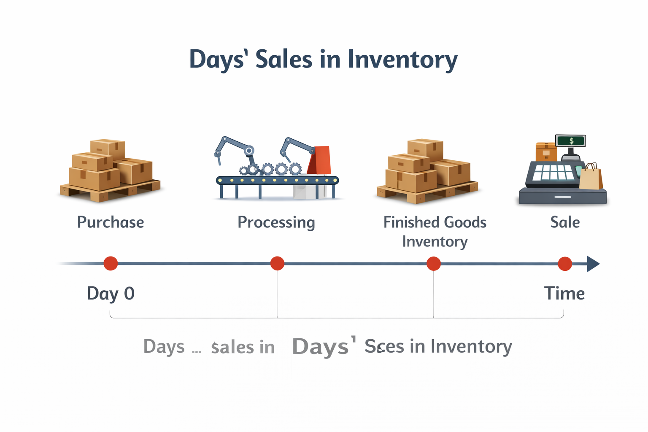
2-2. Days’ sales in inventories
365
Days’ sales in inventories
=
Inventory Turnover
The average number of days inventory stays in the firm
The time between purchasing inventory and selling it
Higher DSI ➔ Inventory moves slowly
Lower DSI ➔ Inventory moves quickly

Slide 19
2-3. Accounts Receivable Turnover
Credit Sales
Accounts Receivable Turnover
=
Ave Accounts Receivables
Beginning AR + Ending AR
Average AR
=
2
Accounts Receivable Turnover measures how often a company collects its average accounts receivable in a given period, typically a year.
A higher ratio indicates efficient collection processes.
A lower ratio may suggest issues in collecting receivables or lenient credit policies.
It helps assess how well a company manages its receivables and how quickly it can convert them into cash.

Slide 20
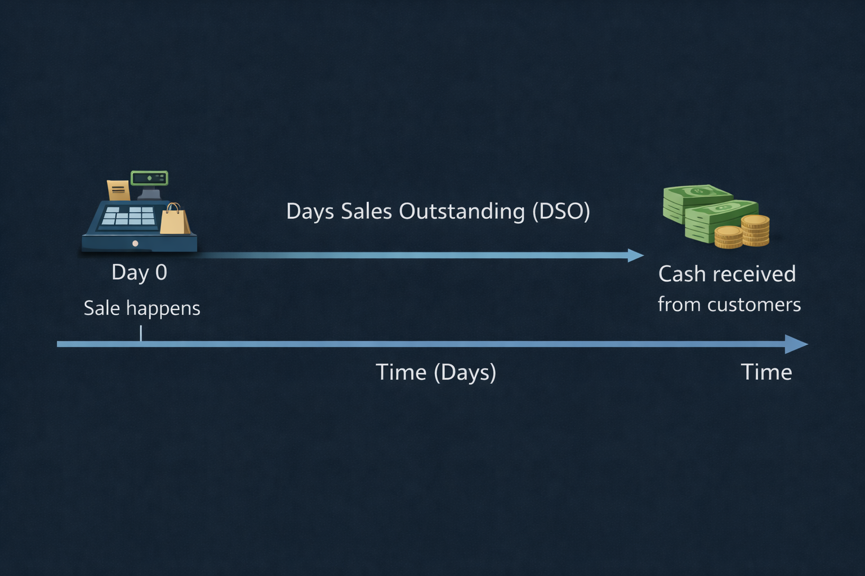
2-4. Days Sales Outstanding (DSO)
365
Days Sales Outstanding
=
Accounts Receivable Turnover
  A high DSO ➔ Company is taking longer to collect payments, which could indicate liquidity problems.
  A low DSO ➔ Faster collections and better cash flow.

Slide 21

2-4. Days Sales Outstanding (DSO)
Question-4
A company has total credit sales of $3,600 million. The Accounts recievable at the beginning of the year was $330 million, and at the end of the year, it was $270 million. What is the Days Sales Outstanding (DSO) for this company?
365
365
Days Sales Outstanding
=
=
$$≈$$
30.42
AR Turnover
12
Credit Sales
$3,600
AR Turnover
=
=
=
12
Ave AR
$300
Beginning AR + Ending AR
$330 + $270
Average AR
=
=
$300
=
2
2

Slide 22
2-5. Accounts Payable Turnover
Credit Purchase
Accounts Payable Turnover
=
Ave Accounts Payable
Beginning AP + Ending AP
Average AP
=
2
Accounts Payable Turnover measures how quickly a company pays its suppliers. It shows the speed at which accounts payable are paid off.
Paying too quickly may strain cash
Paying too slowly may damage supplier relationships

Slide 23
2-6. Fixed Asset Turnover
Net Sales
Fixed Asset Turnover
=
Total Fixed Assets
Measures how effectively a company is using its fixed assets (such as plant and equipment) to generate sales.
Higher Ratio: The firm is using its fixed assets more efficiently to generate sales.
Lower Ratio: Underutilization of fixed assets or a need for asset replacement.
Potential Issues with Interpretation:
  Historical Cost vs. Current Value: This can make older firms appear more efficient than newer ones.

Slide 24
2-6. Fixed Asset Turnover
Question-4
A company has total net sales of $ 3.6 billion and total fixed assets of $2.4 billion. What is the fixed asset turnover for this company?
Net Sales
$3.6 billion
Fixed Asset Turnover
=
=
=
1.5
Total Fixed Assets
$2.4 billion
For every $1 invested in fixed assets, the company generates $1.50 in sales during the period (usually a year).

Slide 25
2-7. Total Asset Turnover
Net Sales
Total Asset Turnover
=
Total Assets
Measures how effectively a company is using its total assets to generate sales.
Higher Ratio: The firm is using its total assets more efficiently to generate sales.
Lower Ratio: Underutilization of total assets or a need for asset replacement.
This ratio is crucial for understanding overall asset efficiency.
A low Total Assets Turnover Ratio may signal the need for better asset management or a reassessment of investment strategies.

Slide 26
2-7. Total Asset Turnover
Question-5
Wie Corp's sales last year were $370,000, and its year-end total assets were $360,000. The average firm in the industry has a total assets turnover ratio (TATO) of 2.4. By how much must the assets be reduced to bring the TATO to the industry average, holding sales constant?
Net Sales
$370,000
Total Asset Turnover
=
=
=
1.03
Total Assets
$360,000
$370,000
2.4
=
,
Total Assets After Selling Excess = $𝟏𝟓𝟒,𝟏𝟔𝟔.𝟕
Total Assets After Selling Excess
Reduction in assets = Total assets - Total Assets After selling excess assets,
Reduction in assets = $360,000 – $154,166.7 = $205,833.3

Slide 27

3- Debt Management Ratios (Also called Leverage or Solvency Ratios)
Debt management ratios evaluate how a company finances its assets and operations
They focus on the use of debt relative to equity and earnings
Why are these ratios important?
  Debt is a fixed obligation
    Interest and principal must be paid regardless of profitability
  Excessive debt increases:
    Risk of financial distress
    Risk of bankruptcy
The goal of debt management ratios:
  To determine whether the company’s capital structure is sustainable

Slide 28
3-1.Total Debt Ratio
Total Assets - Total Equity
Total Debt
Total Debt Ratio
=
=
Total Assets
Total Assets
The Total Debt Ratio measures the extent to which a firm’s assets are financed by debt rather than equity.
It captures the firm’s financial leverage and long-term solvency risk.
Higher Total Debt Ratio
  Larger share of assets financed with debt
  Higher interest repayment obligations
  Greater sensitivity to economic downturns
  Higher financial risk
Lower Total Debt Ratio
  Larger share of assets financed with equity
  Fewer fixed obligations
  Greater financial flexibility
  Lower financial risk

Slide 29
3-2. Debt-to-Equity Ratio
Total Debt
Debt-to-Equity Ratio
=
Total Equity
The Debt-to-Equity Ratio measures the relative contribution of creditors and owners in financing a firm’s assets.
It shows how much debt the firm uses for every dollar of equity.
Higher Debt-to-Equity Ratio
  Creditors finance a larger portion of the business
  Higher interest obligations
  Higher financial risk (but potentially higher return to equity)
Lower Debt-to-Equity Ratio
  Fewer fixed obligations
  Greater financial flexibility
  Lower financial risk

Slide 30
3-3. Equity Multiplier
Total Assets
Equity Multiplier
=
Total Equity
The Equity Multiplier measures how much of a firm’s assets are supported by each dollar of shareholders’ equity.
It captures the firm’s overall financial leverage.
Higher Equity Multiplier
  More assets financed by debt
  Higher financial leverage
  Higher financial risk
Lower Equity Multiplier
  More assets financed by equity
  Lower leverage
  Greater financial stability
  Lower financial risk

Slide 31
3- Example (3-1 to 3-3)
Question-6
The following information is available for ABC Manufacturing Co. at the end of the year:
Total Assets: $1,200,000, Total Debt: $720,000, Shareholders’ Equity: $480,000
Total Debt
$720,000
Total Debt Ratio
=
=
=
0.60
Total Assets
$1,200,000
Total Debt
$720,000
Debt-to-Equity Ratio
=
=
=
1.50
Total Equity
$480,000
Total Assets
$1,200,000
Equity Multiplier
=
=
=
2.50
Total Equity
$480,000

Slide 32
3-4. Long-term Debt Ratio
Long-term Debt
Long-term Debt Ratio
=
Long-term Debt + Total Equity
The Long-Term Debt Ratio measures the proportion of a firm’s permanent capital that is financed by long-term debt.
This ratio focuses on the firm’s long-term financing mix, not short-term obligations.
Higher Long-Term Debt Ratio
  Greater reliance on long-term borrowing
  Higher fixed interest obligations over time
  Increased financial leverage
  Higher long-term financial risk
Lower Long-Term Debt Ratio
  Greater reliance on equity financing
  More financial flexibility
  Lower fixed obligations
  Lower long-term financial risk

Slide 33
3-5. Times Interest Earned Ratio
Earning Before Interest and Tax (EBIT)
Times Interest Earned Ratio
=
Interest Expense
The TIE ratio measures how many times a company’s earnings before interest and taxes (EBIT) can cover its interest payments.
✔ Indicates financial stability ➔ Higher TIE means lower risk.
✔ Uses EBIT (not net income) ➔ Interest is paid with pretax dollars.
✔ Creditors prefer a higher TIE ➔ Ensures a strong margin of safety.

Slide 34
3. Example (3-4 to 3-5)
Question-7
Wie Corp’s total equity last year was $120,000, and its total debt amounted to $360,000. However, out of this, $170,000 was in short-term debt. The company reported an operating income (EBIT) of $84,000 and incurred $12,000 in interest expenses. Calculate the Long-term Debt and TIE ratio.
Long-term Debt
$190,000
Long-term Debt Ratio
=
=
=
0.61
Long-term Debt + Total Equity
$190,000 + $120,000
Long-term Debt
=
Total Debt
-
Short-term Debt
=
$360,000 - $170,000
=
$190,000
EBIT
$84,000
Times Interest Earned Ratio
=
=
=
7 times
Interest Expense
$12,000

Slide 35
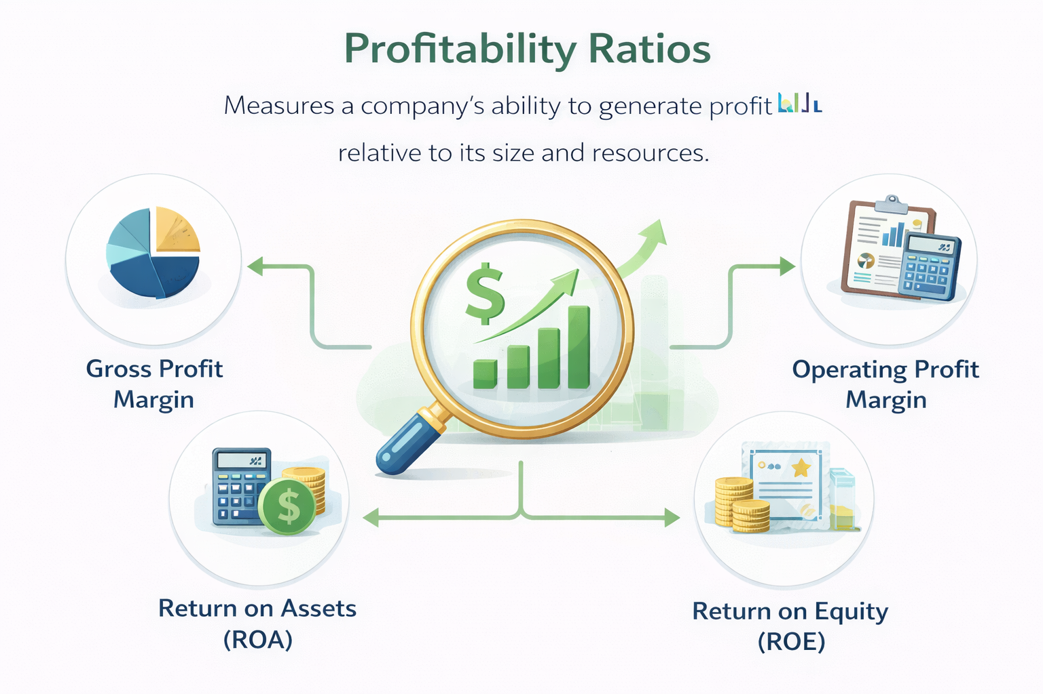
4- Profitability Ratios
Profitability ratios measure a company's ability to generate profit relative to its revenue, assets, or equity.
They reflect the overall effectiveness of a firm’s financing and operational decisions.
Why Do They Matter?
  Indicate financial health & performance
  Help investors assess profitability & efficiency
  Guide management in strategic decision-making
  Impact firm valuation and future growth potential

Slide 36
4-1. Operating Margin
Operating Income (EBIT)
Operating Margin
=
Net Sales
The Operating Margin measures the percentage of sales that remains after covering operating costs, before interest and taxes.
It reflects the firm’s operating efficiency and cost control.
What Does This Ratio Measure?
  How efficiently the firm generates profit from its core operations
  The firm’s ability to control production and operating costs
  Profitability before financing and tax decisions
✔ Higher operating margins indicate better cost control & efficiency.

Slide 37
4-2. Profit Margin or Net Profit Margin
Net Income
Profit Margin
=
Net Sales
The Net Profit Margin measures the percentage of sales that remains as net income after all expenses are deducted.
It reflects the firm’s overall profitability, including operating performance, financing costs, and taxes.
What Does This Ratio Measure?
  The firm’s ability to convert sales into bottom-line profit
  Overall cost efficiency across:
    Operations, Financing decisions, Tax management
✔ Higher net margin indicate Strong overall profitability, Efficient cost, and tax management

Slide 38
4-3. Return on Assets (ROA)
Net Income
Return on Assets (ROA)
=
Total Assets
Return on Assets (ROA) measures how efficiently a firm uses its total assets to generate net income.
It indicates the net income generated per dollar of assets.
What Does This Ratio Measure?
  Overall asset efficiency
  Effectiveness of management in using resources
  Profitability independent of financing structure
✔ Higher ROA means:
✔ Assets are used efficiently and Strong operating and cost performance.

Slide 39
4-5. Return on Invested Capital (ROIC)
NOPAT
EBIT (1-T)
ROIC
=
=
Total Invested Capital
Total Invested Capital
Measures the return a company generates on the capital invested by both shareholders and debtholders.
It is a key indicator of a company’s efficiency in generating profits from its capital investments.
Key Points:
    Measures overall capital efficiency.
    Focuses on after-tax operating income (NOPAT) rather than net income.
    how much return the company is generating for both shareholders and debtholders.
ROIC vs ROA:
  ⚠ ROIC uses invested capital (equity + debt) instead of total assets.
  ⚠ ROIC uses NOPAT instead of net income.

Slide 40
4-6. Basic Earning Power (BEP) Ratio
EBIT
Basic Earning Power (BEP)
=
Total Assets
The BEP ratio measures the raw earning power of a company's assets,
Indicating how efficiently the company can generate operating income (EBIT) before the impact of taxes and interest expenses.
Key Points:
  It is a clear picture of a company's operating performance without the effects of taxes and debt.
  Useful for comparing companies with different debt levels or tax rates.
  Shows how well a company is using its assets to generate income from core operations.

Slide 41
4. Example (4-1 to 4-6)
Question-8
A company has $2,000 of sales and $100 of net income. Its total assets are $1,000 . The company’s total assets equal total invested capital, and its capital consists of half debt and half common equity. The firm’s earnings before interest and tax is $200 , and its tax rate is 25%.
Net Income
$100
Profit Margin
=
=
=
0.05 = 5%
Net Sales
$2,000
Net Income
$100
ROA
=
=
=
0.10 = 10%
Total Assets
$1,000
Net Income
$100
ROE
=
=
=
0.20 = 20%
Total Equity
$500
EBIT (1-T)
$200 (1 - 0.25)
ROIC
=
=
=
0.15 = 15%
Total Invested Capital
$1,000

Slide 42
5- Market Value Ratios
Market value ratios relate a company’s stock price to its sales, earnings and book value.
They are used to assess a company’s market value and investor perceptions about its future performance.
Why Do They Matter?
  Provide insights into how the market values a company based on its performance.
  Help investors to make decisions about buying or selling.
  Assist investment bankers in setting a fair price during initial public offerings (IPOs).
  Aid companies in determining an appropriate offer price in mergers and acquisitions.

Slide 43
5-1. Price-Earnings Ratio (P/E)
Price
Price-Earnings Ratio
=
Earnings per Share
The P/E ratio shows how much investors are willing to pay per dollar of reported profits (earnings).
It is a key indicator of how the market values a company's future growth prospects relative to its current earnings.
Key Points:
  High P/E ratios ➔ Investors expect strong future growth with relatively low risk.
  Low P/E ratios ➔ The market perceives a company as risky or having poor growth prospects.
  Helps investors gauge whether a stock is overvalued or undervalued relative to its earnings.

Slide 44
5-2. PEG Ratio
Price-Earnings Ratio
PEG Ratio
=
Earnings Growth Rate (%)
The PEG Ratio adjusts the Price–Earnings (P/E) ratio for expected earnings growth.
It evaluates whether a stock’s valuation is reasonable given its growth prospects.
Key Points:
    PEG ≈ 1
        Stock is fairly valued relative to growth
    PEG < 1
        Stock may be undervalued given its growth prospects
    PEG > 1
        Stock may be overvalued relative to expected growth

Slide 45
5-3. Price-Sales Ratio (P/S)
Price per Share
Price-Sales Ratio
=
Sales per Share
The Price-to-Sales (P/S) Ratio measures how much investors are willing to pay for each dollar of a firm’s sales.
It is especially useful when earnings are low, volatile, or negative.
Key Points:
  High P/S reflects: Strong growth expectations and Anticipated future profitability
  Low P/S may indicate: Thin margins and Mature or struggling business
  Sales are less manipulable than earnings
  Must be analyzed with profit margins and industry benchmarks
  Particularly relevant for Startups and High-growth firms

Slide 46
5-4. Market-to-Book-Ratio (M/B)
Market Value
Market-to-Book-Ratio
=
Book Value
The Market/Book (M/B) ratio compares a company’s market value (stock price) to its book value.
It gives insight into how the market values the company's assets relative to their historical cost.
Key Points:
  High M/B ratios ➔ Investors view the company as having high growth potential and low risk.
  Reflects market value relative to accounting value.
  Companies with strong growth prospects tend to have M/B ratios greater than 1.

Slide 47
5-5. Tobin’s Q Ratio
Market Value of Assets
Tobin’s Q Ratio
=
Replacement Cost of Assets
Measures the market value of a firm relative to the replacement cost of its assets
Indicates whether the market values the firm more or less than the cost of its assets
Q > 1: Market values the firm more than its asset cost
    Suggests strong growth opportunities or intangible assets
    Higher Q encourages new investment
Q < 1: Market values the firm below asset replacement cost
    Indicates poor growth prospects or undervaluation
    Lower Q discourages investment

Slide 48
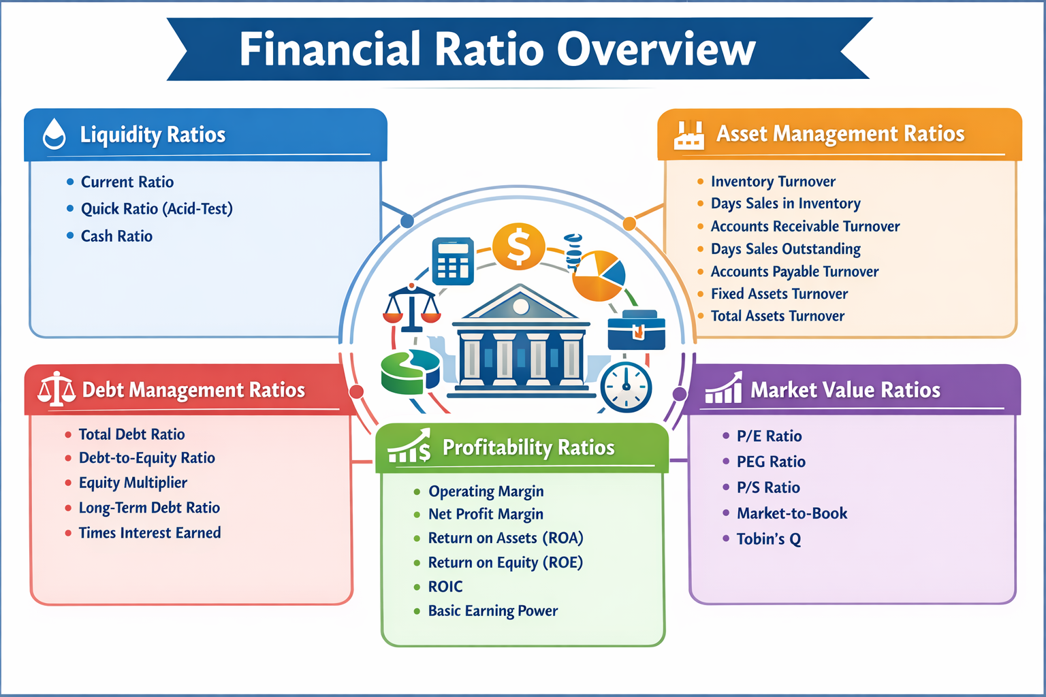

Slide 49
DuPont Equation
The DuPont equation breaks down Return on Equity (ROE) into three key components:
ROE = Profit Margin × Total Asset Turnover × Equity Multiplier
Net Income
Net Income
Net Sales
Total Assets
=
×
×
Total Equity
Net Sales
Total Assets
Total Equity
Key Components:
  Profit Margin: Measures profitability per dollar of sales.
    Higher profit margins indicate better cost control and premium pricing power.
  Total Asset Turnover: Measures how efficiently assets generate revenue.
    Higher turnover means the firm uses assets effectively to drive sales.
  Equity Multiplier: Measures financial leverage (debt usage).
    High leverage boosts ROE but also increases financial risk.

Slide 50
DuPont Equation
Question-9
A company has $17,000 in sales, its ROE is 17%, and its total assets turnover is 3.2. Common equity on the firm’s balance sheet is 50% of its total assets. What is its net income?
ROE = Profit Margin × Total Asset Turnover × Equity Multiplier
Net Income
Net Income
Net Sales
Total Assets
=
×
×
Total Equity
Net Sales
Total Assets
Total Equity
Net Income
0.17 =
×
3.2
×
2
$17,000
Net Income
0.17 =
×
6.4
$17,000
Net Income = 451.56

Slide 51

Thank you

