Slide 1

Chapter 6

Slide 2
Understanding the Cost of Money
Four Fundamental Factors Affecting the Cost of Money:
  Production Opportunities
    The ability of investments to generate returns.
  Time Preferences for Consumption vs. Willingness to Save
    How much individuals value present consumption versus future consumption.
  Risk
    The uncertainty associated with investment returns.
  Inflation
    The expected change in the purchasing power of money over time.
Cost of Borrowing Debt Capital:
Interest rate
Cost of Equity:
sum of dividends and capital gains

Slide 3
How Interest Rate Levels Are Determined
Interest rates are determined by supply and demand for capital.
Interest Rate
Interest Rate
D
S₂
S₁
S₁
S₂
D
8
7
5
4
0
Dollars
0
Dollars
Low Risk Market
High Risk Market

Slide 4
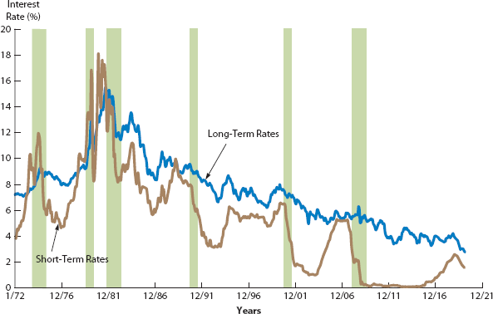
Interest Rates, Inflation, Economic Conditions
Long-term rates are influenced by:
  Expected inflation
  Economic policies
Short-term rates:
  They are volatile;
  Rising during Booms
    Due to Higher capital demand
  Falling during Recessions
    Due to Lower capital demand
Real Interest Rate = Nominal Interest Rate - Inflation Rate

Slide 5
Components of Market Interest Rates
Quoted (nominal) interest rate (r):
r = r* + IP + DRP + LP + MRP
Quoted (nominal) risk-free rate r_{RF}:
r_{RF} = r* + IP
Real Risk-Free Rate
Maturity Risk Premium
Inflation Premium
Liquidity Premium
Default Risk Premium

Slide 6
T-bill, T-bond, and Corporate bond
T-bill & T-bond:
r = r* + IP + MRP
Corporate bond
r = r* + IP + DRP + LP + MRP

Slide 7
Short-Term vs. Long-Term Bonds – Risk Trade-offs
Interest Rate Risk vs. Reinvestment Rate Risk
  Long-Term Bonds → Higher Interest Rate Risk
    If rates rise, bond prices fall.
  Short-Term Bonds → Higher Reinvestment Rate Risk
    If rates fall, reinvesting principal earns lower returns.
$2,000
$100
$100
$100
$100
r₁ = 10%
r₂ = 15%
0
1
2
3
4
PV₁ = 1683
Investor(b)
Investor(a)
PV₂ = 1440
Investor(a): Loss
Reinvest at r₂

Slide 8
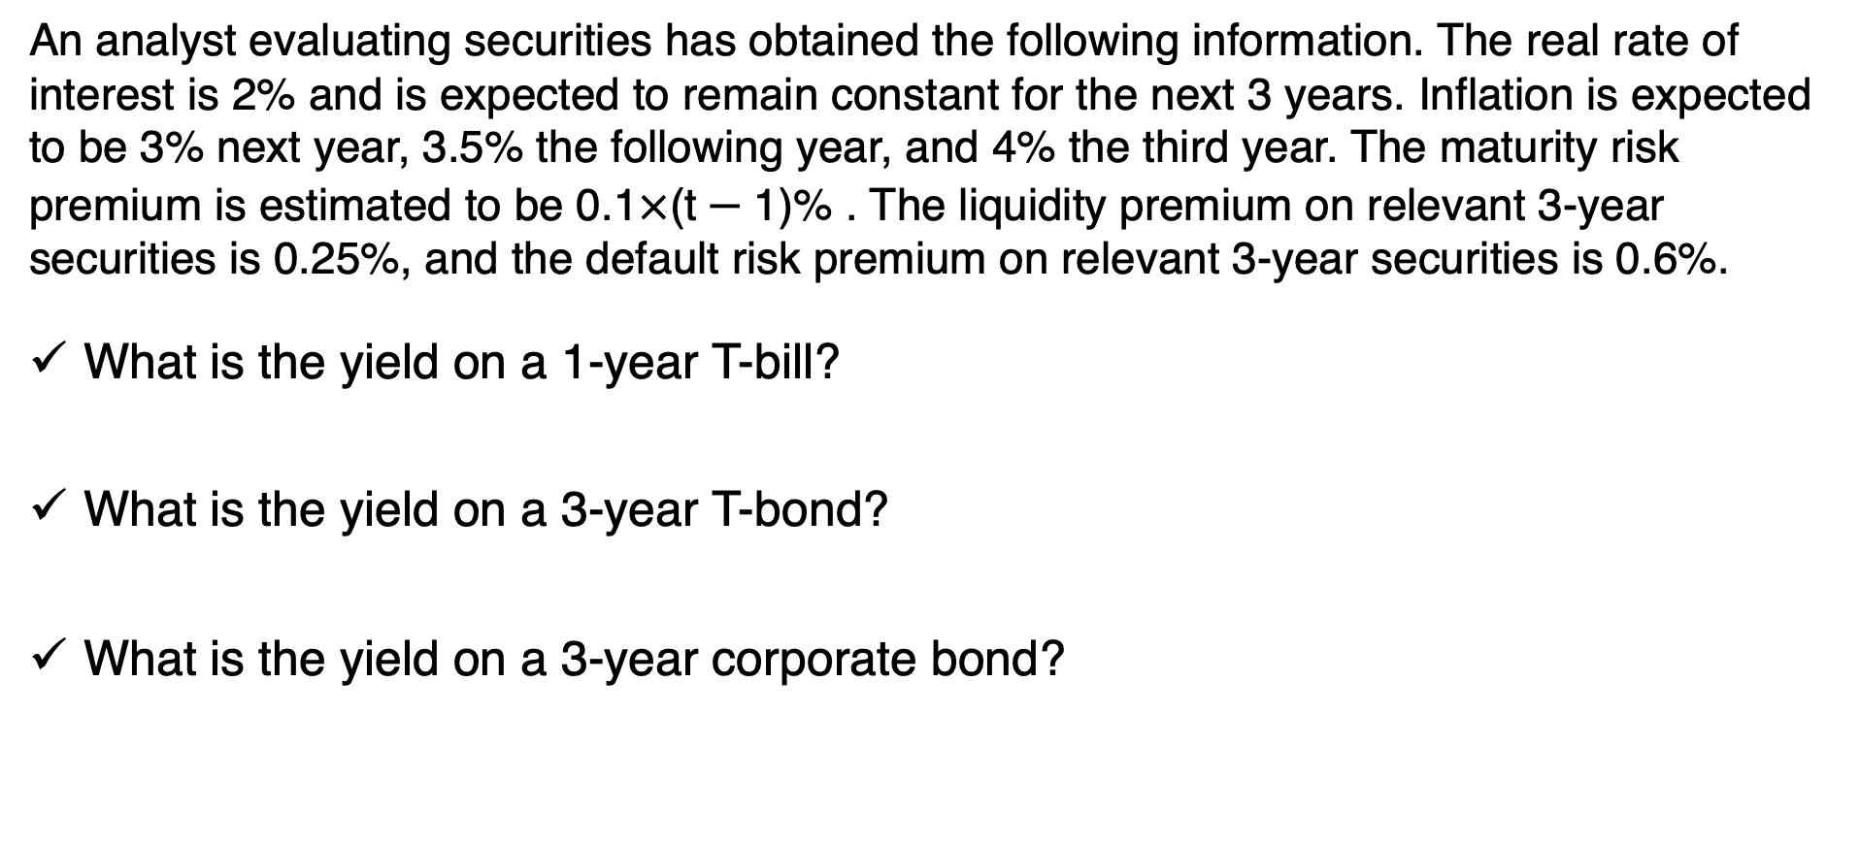
Question-1
An analyst evaluating securities has obtained the following information. The real rate of interest is 2% and is expected to remain constant for the next 3 years. Inflation is expected to be 3% next year, 3.5% the following year, and 4% the third year. The maturity risk premium is estimated to be 0.1$×$(t $−$1)% . The liquidity premium on relevant 3-year securities is 0.25%, and the default risk premium on relevant 3-year securities is 0.6%.
What is the yield on a 1-year T-bill?
What is the yield on a 3-year T-bond?
What is the yield on a 3-year corporate bond?

Slide 9
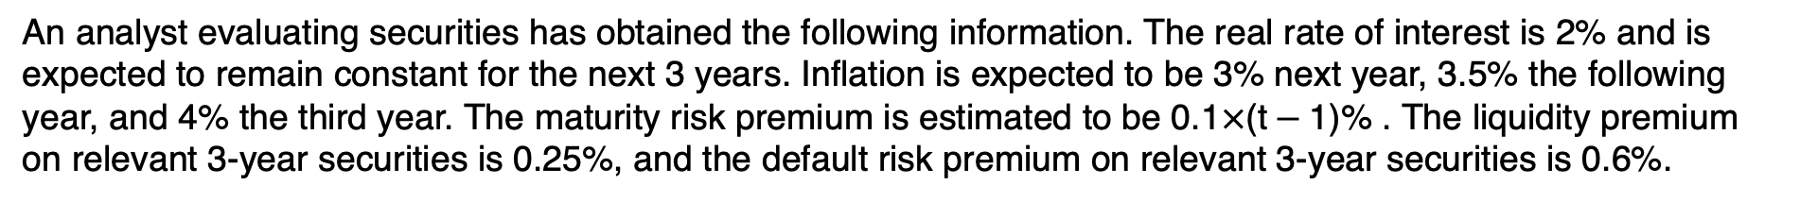


An analyst evaluating securities has obtained the following information. The real rate of interest is 2% and is expected to remain constant for the next 3 years. Inflation is expected to be 3% next year, 3.5% the following year, and 4% the third year. The maturity risk premium is estimated to be 0.1$×$(t $−$1)% . The liquidity premium on relevant 3-year securities is 0.25%, and the default risk premium on relevant 3-year securities is 0.6%.
Categorizing information:
Real rate of interest is 2% ➔ r*
Maturity risk premium is 0.1$×$(t $−$1)% ➔ MRP_{n}
Liquidity premium on 3-year is 0.25% ➔ LP
Default risk premium on 3-year is 0.6% ➔ DRP
3% next year, 3.5% the following year, and 4% the third year ➔ IP_{n}
What is the yield on a 1-year T-bill?
r_{T1} = r* + IP₁ + MRP₁
r_{T1} = 2% + 3% + 0.1$×$(1 $−$1)%
r_{T1} = 5%
What is the yield on a 3-year T-bond?
r_{T3} = r* + IP₃ + MRP
IP₃ = (3%+ 3.5%+ 4%) / 3 ➔ 3.5%
r_{T3} = 2% + 3.5% + 0.1$×$(3 $−$1)%
r_{T3} = 5.7%
What is the yield on a 3-year corporate bond?
r_{C3} = r* + IP₃ + DRP₃ + LP + MRP
r_{C3} = 2% + 3.5% + 0.1$×$(3 $−$1)% +0.6% + 0.25%
r_{C3} = 6.55%

Slide 10
The Term Structure of Interest Rates
What is the Term Structure of Interest Rates?
  It describes the relationship between short-term and long-term interest rates.
  Helps corporate treasurers decide whether to issue short- or long-term debt.
  Helps investors decide whether to buy short- or long-term bonds.
Yield curve
  A yield curve is created by plotting interest rates for bonds with different maturities.
  The shape of the yield curve changes over time based on inflation expectations and market conditions.

Slide 11
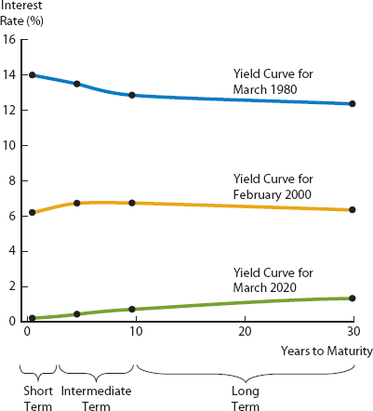
Yield Curve Shapes and Their Implications
Normal Yield Curve (Upward-Sloping)
  Long-term rates > Short-term rates
  Common due to the maturity risk premium (MRP).
Inverted Yield Curve (Downward-Sloping)
  Short-term rates > Long-term rates
  Signals economic downturns or declines in inflation.
Humped Yield Curve
  Intermediate-term rates > Short- and Long-term rates
  Uncommon, suggests uncertainty in economic conditions.

Slide 12
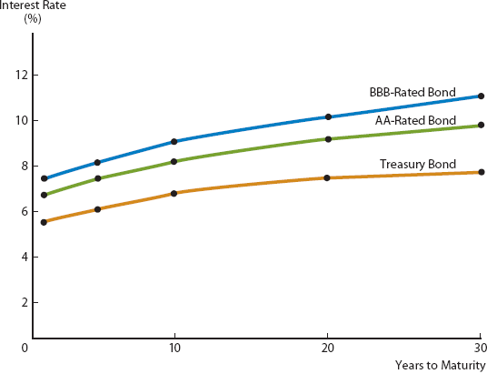
Yield Curve Shapes and Their Implications
r = r* + IP + DRP + LP + MRP
r = r* + IP + MRP

Slide 13
The Pure Expectations Theory-1
What is the Pure Expectations Theory?
  A theory that states that the shape of the yield curve depends on investors’ expectations about future interest rates.
  The Pure Expectations Theory states that long-term interest rates are determined solely by expected future short-term interest rates.
  Assumes no maturity risk premium (MRP = 0) → Investors are indifferent between holding long-term or rolling over short-term bonds.

Slide 14


The Pure Expectations Theory-2
To illustrate the pure expectations theory, assume that a 1-year Treasury bond currently yields 6.00%, and a 2-year bond yields 7%. Investors who want to invest for a 2-year horizon have two primary options:
Option 1: Buy a 2-year security and hold it for 2 years.
0
1
2
3
4
r₂ = 7%
r₂ = 7%
(1 + 0.08) $×$ (1 + 0.08) = 1.1664
Option 2: Buy a 1-year security, hold it for 1 year, and then at the end of the year reinvest the proceeds in another 1-year security.
0
1
2
3
4
r₁ = 6%
r_{1,1} = ??
(1 + 0.06) $×$ (1 + X) = 1.1664
(1 + X) = 1.1664 / (1 + 0.06) = 1.1004
X = 10.04%

Slide 15

Question-2
Let’s suppose that the yield curve looks as: 1-year T-bond: 4.00%, 4-year T-bond: 6.50%.
Determine the expected yield on the 3-year T-bond 1 year from today.
r₁ =4%
r₄ =6.5%
r_{3,1}=??
0
r₄ =6.5%
1
r₄ =6.5%
2
r₄ =6.5%
3
r₄ =6.5%
4
(1 + 0.065)⁴ = 1.2865
0
r₁ =4%
1
r_{3,1} =??%
2
r_{3,1} =??%
3
r_{3,1} =??%
4
(1 + 0.04) $×$ (1 + X)³ = 1.2864
(1 + X)³ = 1.2864 / (1.04) = 1.2369
(1 + X) = 1.0734
X = 7.34%

Slide 16

Question-3
Suppose that the yield curve looks as: 3-year T-bond: 8.00%, 4-year T-bond: 10%.
Determine the expected yield on the 1-year T-bond 3 year from today.
r₃ =8%
r₄ =10%
r_{1,3}=??
0
r₄ =10%
1
r₄ =10%
2
r₄ =10%
3
r₄ =10%
4
(1 + 0.10)⁴ = 1.4641
0
r₃ =8%
1
r₃ =8%
2
r₃ =8%
3
r_{1,3} =??%
4
(1 + 0.08)³ $×$ (1 + X) = 1.4641
(1 + X) = 1.4641 / (1.2597) = 1.1623
X = 16.23%

