Slide 1
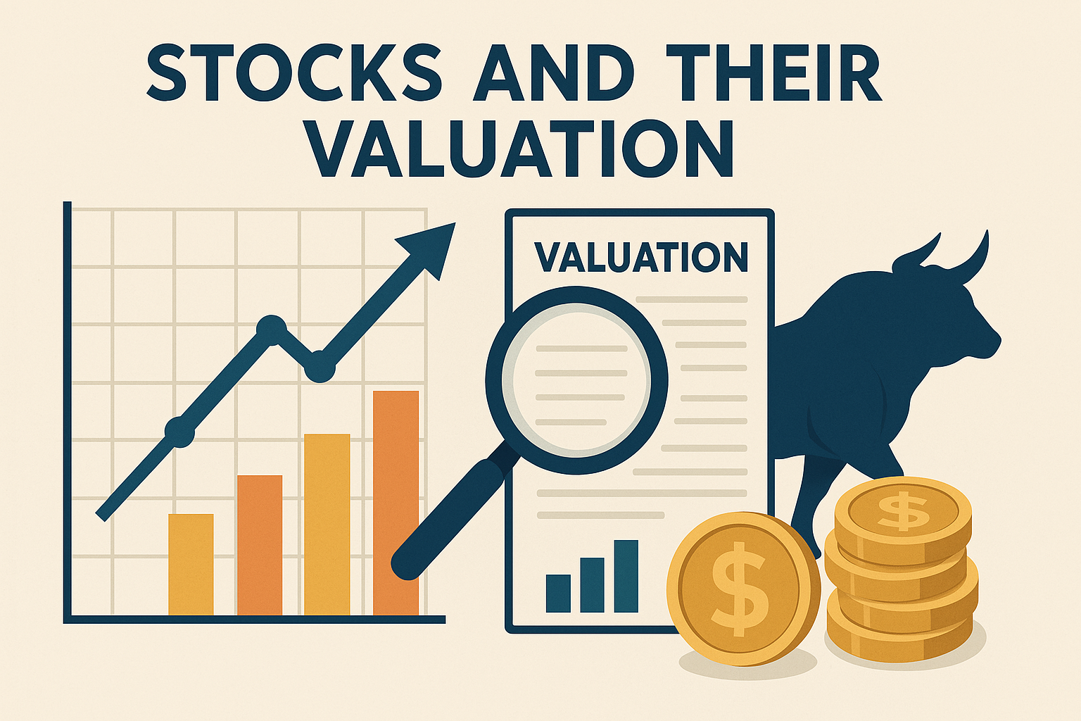
Chapter 9

Slide 2



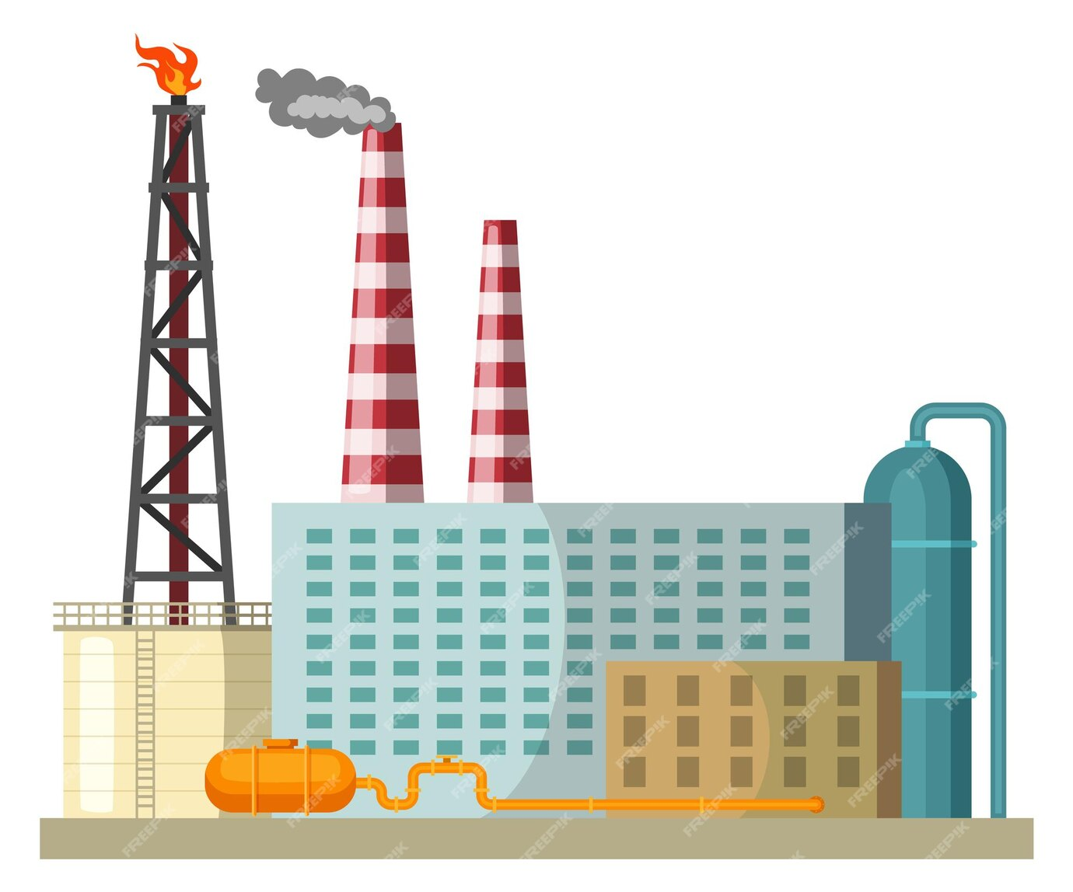




Vote
Shares
Manage

Slide 3
Stockholders’ Rights & Protections
Who Really Controls a Corporation?
    Common stockholders elect directors
    Directors choose managers
    Most shareholders vote using proxy forms instead of attending in person.
  Proxy Fights & Takeovers:
    Shareholders can push out weak management
    Hostile takeovers = buying enough shares to take control
Preemptive Right:
  Let current shareholders buy new shares first
  Prevents dilution of value and control
  Ex: Issuing shares below market price can hurt existing owners

Slide 4
Stock Price vs. Intrinsic Value
What’s the Difference?
  Stock Price: The current market price (what it sells for today)
  Intrinsic Value: The stock’s true, estimated worth based on fundamentals (not directly observable)
Market Equilibrium:
  When Stock Price = Intrinsic Value, the market is in equilibrium
  But prices can deviate due to irrational investor behavior or incomplete information
Why It Matters:
  Investors aim to buy undervalued stocks (Price < Intrinsic Value)
  Managers need to understand how decisions affect value, especially before issuing new shares

Slide 5
How Do We Value Stocks?
Stock valuation is trickier than bond valuation because common stock dividends aren't guaranteed—they depend on company earnings.
Two Models to Estimate a Stock’s Value:
  Discounted Dividend Model
  Corporate Valuation Model
Rule of Thumb:
  Buy a stock if its price < intrinsic value
  Sell if its price > intrinsic value
Preferred stock is easier to value (fixed dividend = bond-like).
But the common stock is more uncertain—earnings vary!

Slide 6
A. The Discounted Dividend Model (DDM)
Cash Flows from Stocks:
1- Dividends received each year
2- Capital gain when the stock is sold
Key Idea:
A stock’s value = present value of (all expected future dividends + price when sold)
If we assume we want to buy Stock A today and plan to sell it after N years, then:
P_{N}
+
D₁
D₂
D₃
….
D_{N}
….
0
1
2
3
N

Slide 7
A1. DDM - Important Terms
D₁, D₂, ... = expected future dividends
P₀ = current stock price
P̂ₜ = expected future price
g = expected growth rate of dividends
rₛ = required rate of return (based on risk)
r̂ₛ = expected rate of return
r̄ₛ = actual, realized return
Dividend Yield = D₁ / P₀
Capital Gains Yield = % change in price
Total Return = Dividend Yield + Capital Gains Yield

Slide 8
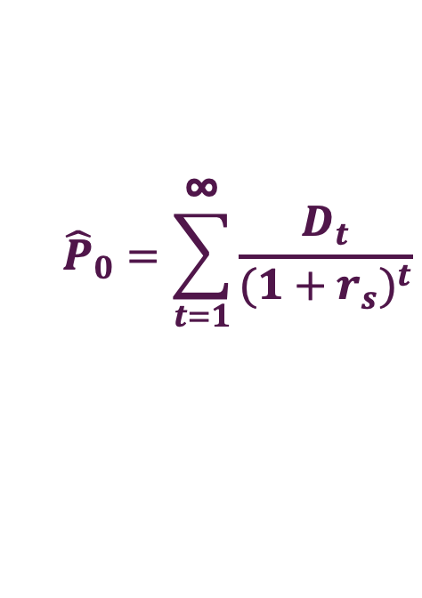

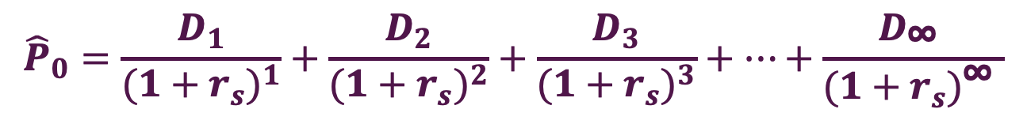



A2. Expected Dividends as the Basis for Stock Values
D₁
D₂
D₃
….
D∞
….
0
$$r_{s}$$
1
2
3
∞
$$r_{s}$$
$$r_{s}$$
$$r_{s}$$
$${\hat{P}}_{0}=\frac{D_{1}}{{(1+r_{s})}^{1}}+\frac{D_{2}}{{(1+r_{s})}^{2}}+\frac{D_{3}}{{(1+r_{s})}^{3}}+…+\frac{D_{\text{∞ }}}{{(1+r_{s})}^{\text{∞ }}}$$
$${\hat{P}}_{0}=\sum_{t=1}^{\text{∞}}{\frac{D_{t}}{{(1+r_{s})}^{t}}}$$
This is a generalized stock valuation model in the sense that the time pattern of D_{t} can be anything

Slide 9
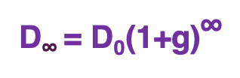
A3. Constant Growth Stocks
Generalized stock valuation model
D₁
D₂
D₃
….
D∞
….
0
1
2
3
∞
Constant Growth Stocks
Stocks where dividends are expected to grow at a constant rate (g) forever.
D₀
D₁ = D₀(1+g)
D₂ = D₀(1+g)²
D₃ = D₀(1+g)³
….
D$\text{∞}$= D₀(1+g)∞
….
0
1
2
3
∞

Slide 10
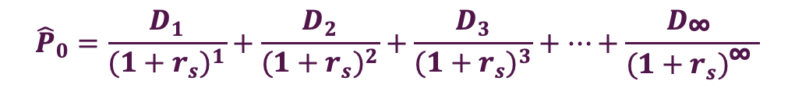
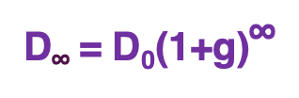

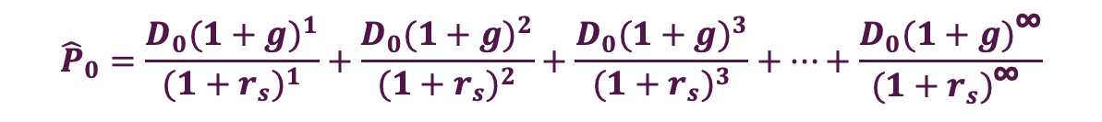
A4. The Constant Growth (Gordon) Model
A model used to value a stock that pays dividends growing at a constant rate forever.
D₀
D₁= D₀(1+g)
D₂ = D₀(1+g)²
D₃ = D₀(1+g)³
….
D$\text{∞}$= D₀(1+g)∞
….
0
1
2
3
∞
$${\hat{P}}_{0}=\frac{D_{1}}{{(1+r_{s})}^{1}}+\frac{D_{2}}{{(1+r_{s})}^{2}}+\frac{D_{3}}{{(1+r_{s})}^{3}}+…+\frac{D_{\text{∞ }}}{{(1+r_{s})}^{\text{∞ }}}$$
$${\hat{P}}_{0}=\frac{D_{0}{(1+g)}^{1}}{{(1+r_{s})}^{1}}+\frac{D_{0}{(1+g)}^{2}}{{(1+r_{s})}^{2}}+\frac{D_{0}{(1+g)}^{3}}{{(1+r_{s})}^{3}}+…+\frac{D_{0}{(1+g)}^{\text{∞}}}{{(1+r_{s})}^{\text{∞ }}}$$
$${\hat{P}}_{0}=\frac{D_{0}{(1+g)}^{1}}{r_{s}−g}=\frac{D_{1}}{r_{s}−g}$$

Slide 11
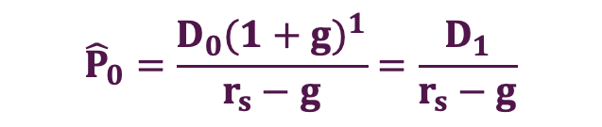
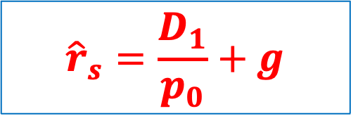
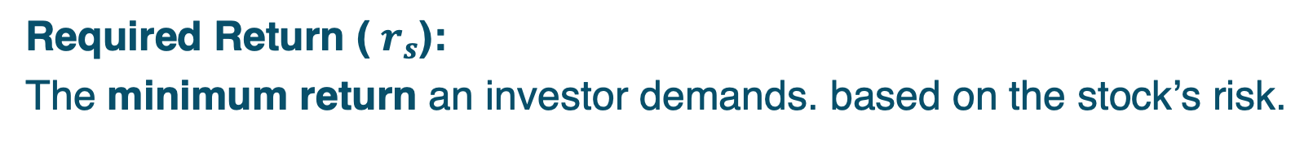
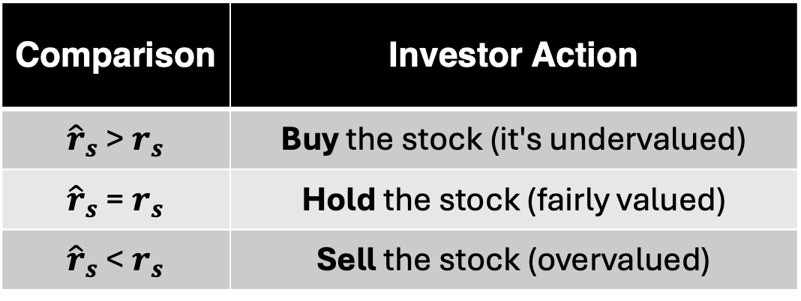
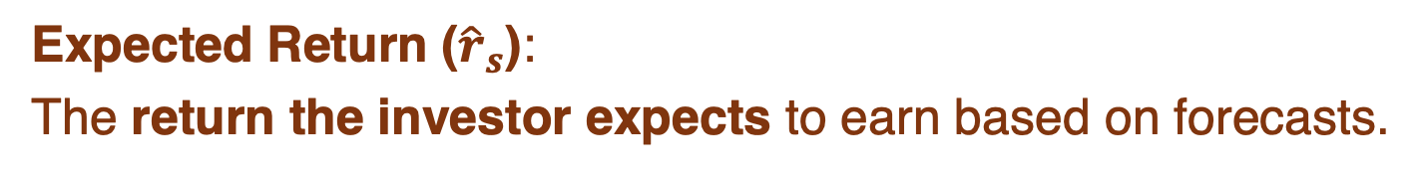
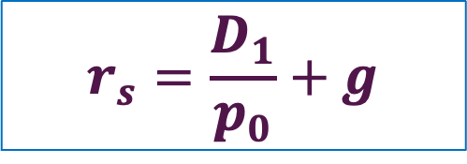
A6. Expected Return from (Gordon) Model
Required Return (​ $r_{s}$):
The minimum return an investor demands. based on the stock’s risk.
➔ from CAPM
Expected Return (${\hat{r}}_{s}$):
The return the investor expects to earn based on forecasts.
$${\hat{P}}_{0}=\frac{D_{0}{(1+g)}^{1}}{r_{s}−g}=\frac{D_{1}}{r_{s}−g}$$
Comparison | Investor Action
${\hat{r}}_{s}$ >${ r}_{s}$ | Buy the stock (it's undervalued)
${\hat{r}}_{s}$ =${ r}_{s}$ | Hold the stock (fairly valued)
${\hat{r}}_{s}$ <${ r}_{s}$ | Sell the stock (overvalued)
$$r_{s}=\frac{D_{1}}{p_{0}}+g$$
$${\hat{r}}_{s}=\frac{D_{1}}{p_{0}}+g$$

Slide 12
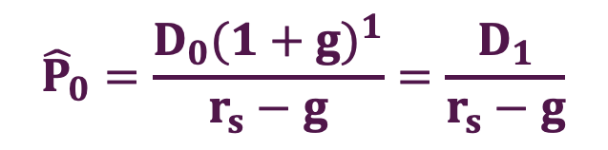
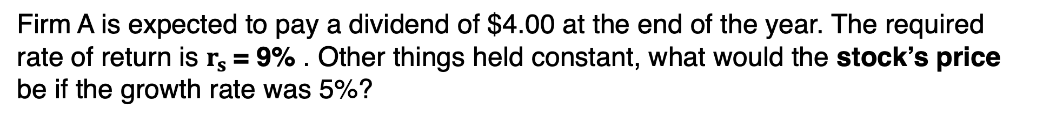


Question-1
Firm A is expected to pay a dividend of $4.00 at the end of the year. The required rate of return is $r_{s}$= 9% . Other things held constant, what would the stock’s price be if the growth rate was 5%?
$${\hat{P}}_{0}=\frac{D_{0}{(1+g)}^{1}}{r_{s}−g}=\frac{D_{1}}{r_{s}−g}$$
$${\hat{P}}_{0}=\frac{4}{9\%−5\%}$$
$${\hat{P}}_{0}=\frac{4}{4\%}=\$100$$

Slide 13
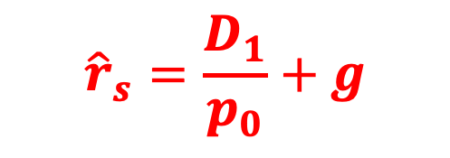


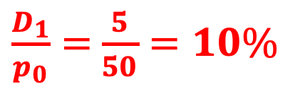
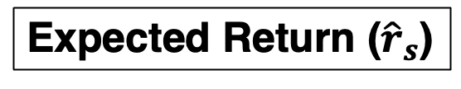
Question-2
If $D_{1}$ =$5, $g$ = 8%, and $p_{0}$=50, what are the stock’s expected dividend yield, capital gains yield, and total expected return for the coming year?
$${\hat{r}}_{s}=\frac{D_{1}}{p_{0}}+g$$
Expected Return (${\hat{r}}_{s}$)
Dividend yield
capital gains yield
$${\hat{r}}_{s}=18\%$$
$\frac{D_{1}}{p_{0}}=$ $\frac{5}{50}=10\%$
$$g=8\%$$

Slide 14
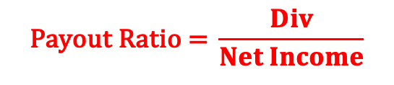
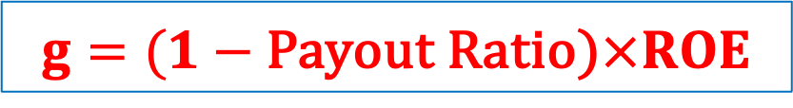
A7. Dividends vs. Growth: The Trade-off
Dividends and growth are linked through earnings and how they are used.
The Logic Behind It:
  Dividends come from earnings
  Earnings grow when the firm retains and reinvests part of those earnings
  Growth in dividends = Retention Ratio × ROE
$$g=(1−\text{Payout} \text{Ratio}\text{)}×ROE$$
$$\text{Payout} \text{Ratio}\text{ = }\frac{Div}{Net Income}$$
Pay out 100% of earnings → High dividend today, no growth
Retain some earnings → Lower dividend now, but dividends grow over time

Slide 15
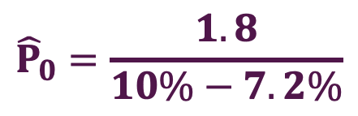



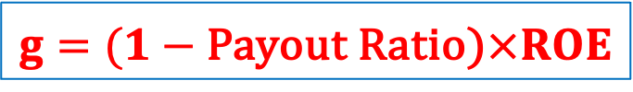
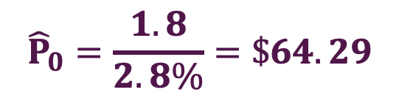
Question-3
Firm X has a return on equity (ROE) of 12% and currently pays out 40% of its earnings as dividends. The company is expected to pay a dividend of $1.80 per share next year. If the required rate of return on the stock is 10%, calculate the expected growth rate of dividends. Then, using the constant growth (Gordon) model, estimate the intrinsic value of the stock.
$${\hat{P}}_{0}=\frac{D_{0}{(1+g)}^{1}}{r_{s}−g}=\frac{D_{1}}{r_{s}−g}$$
$$g=(1−\text{Payout} \text{Ratio}\text{)}×ROE$$
$${\hat{P}}_{0}=\frac{1.8}{10\%−7.2\%}$$
$$g=(1−\text{40\%}\text{)}×12\%$$
$$g=7.2\%$$
$${\hat{P}}_{0}=\frac{1.8}{2.8\%}=\$64.29$$

Slide 16
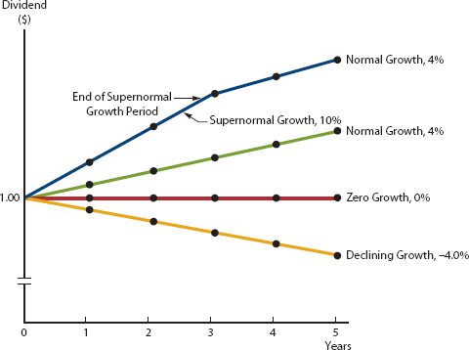
A8. Valuing Nonconstant Growth Stocks
Why Not Constant Growth?
Many companies go through life cycles:
Early high growth → Stable growth → Slower growth
A constant growth model doesn’t fit all stages
Instead, we use a two-stage valuation:
  Nonconstant (supernormal) growth period
  Constant growth thereafter

Slide 17
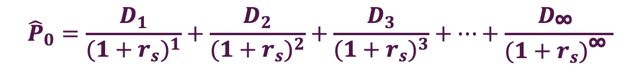
A8. Valuing Nonconstant Growth Stocks
$${\hat{P}}_{0}=\frac{D_{1}}{{(1+r_{s})}^{1}}+\frac{D_{2}}{{(1+r_{s})}^{2}}+\frac{D_{3}}{{(1+r_{s})}^{3}}+…+\frac{D_{\text{∞ }}}{{(1+r_{s})}^{\text{∞ }}}$$
D₀
D₁
D₂
D₃
D₄
D₅
D₆
….
D∞
….
0
1
2
3
4
5
6
∞

Slide 18


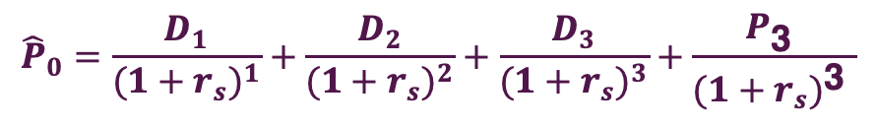
A8. Nonconstant Growth Stocks(2 stage)
$${\hat{P}}_{0}=\frac{D_{1}}{{(1+r_{s})}^{1}}+\frac{D_{2}}{{(1+r_{s})}^{2}}+\frac{D_{3}}{{(1+r_{s})}^{3}}+\frac{P_{\text{3} }}{{(1+r_{s})}^{\text{3} }}$$
$${\hat{P}}_{3}=\frac{D_{4}}{r_{s}−g_{2}}$$
$${\hat{P}}_{3}$$
+
D₀
D₁
D₂
D₃
D₄
D₅
D₆
….
D∞
….
0
1
2
3
4
5
6
∞
g₁
g₂

Slide 19

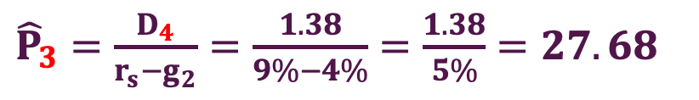
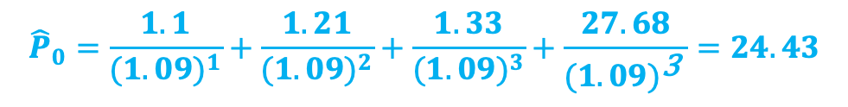
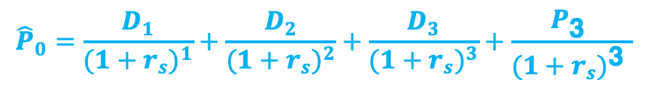
Question-4
Assume: D₀ = $1, Dividends grow at 10% for 3 years, then 4% constant thereafter, and Required return: $r_{s}=$ 9%
$${\hat{P}}_{0}=\frac{D_{1}}{{(1+r_{s})}^{1}}+\frac{D_{2}}{{(1+r_{s})}^{2}}+\frac{D_{3}}{{(1+r_{s})}^{3}}+\frac{P_{\text{3} }}{{(1+r_{s})}^{\text{3} }}$$
$${\hat{P}}_{0}=\frac{1.1}{{(1.09)}^{1}}+\frac{1.21}{{(1.09)}^{2}}+\frac{1.33}{{(1.09)}^{3}}+\frac{27.68}{{(1.09)}^{\text{3 }}}=24.43$$
${\hat{P}}_{3}=\frac{D_{4}}{r_{s}−g_{2}}=\frac{1.38}{9\%−4\%}$ $=\frac{1.38}{5\%}=27.68$
$$27.68$$
+
D₀ = 1
D₁ = 1.1
D₂ = 1.21
D₃ = 1.33
D₄ = 1.38
D₅
D₆
….
D∞
….
0
1
2
3
4
5
6
∞
g₁=10%
g₂ = 4 %

Slide 20
B. Enterprise-Based Approach to Valuation
Instead of focusing on dividends, this model estimates a firm’s value based on future Free Cash Flows (FCFs).
Why Use It?
  Dividends may be hard to forecast—especially for growing or non-dividend-paying firms
  Free Cash Flow is more directly tied to the firm’s operating performance
Free Cash Flow Formula:
FCF = EBIT(1−T) + Dep & Amort − (Capital Expenditures + Δ Net Operating Working Capital)
Interpretation:
  FCF > 0 → Firm generates cash beyond what it needs for growth
  Used to value the firm’s operations, then subtract debt to estimate equity value

Slide 21


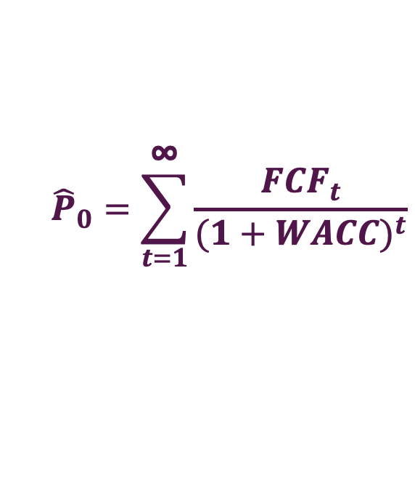
B1. The Corporate Valuation Model
FCF₁
FCF₂
FCF₃
….
FCF$\text{∞}$
….
0
1
2
3
$$\text{∞}$$
Key Idea:
Market value of company’s operations = PV of expected future Free Cash Flow =
$$\frac{{FCF}_{1}}{{(1+WACC)}^{1}}+\frac{{FCF}_{2}}{{(1+WACC)}^{2}}+\frac{{FCF}_{3}}{{(1+WACC)}^{3}}+…+\frac{{FCF}_{\text{∞ }}}{{(1+WACC)}^{\text{∞ }}}$$
$${\hat{P}}_{0}=\sum_{t=1}^{\text{∞}}{\frac{{FCF}_{t}}{{(1+WACC)}^{t}}}$$

Slide 22
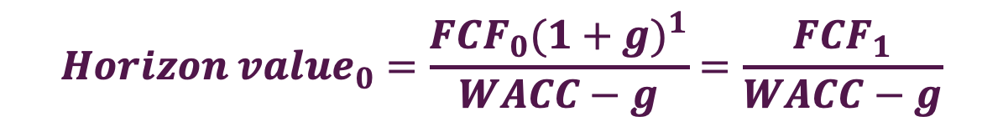
B2. The Constant Growth on FCF
A model used to value a stock that pays dividends growing at a constant rate forever.
FCF₀
FCF₁= FCF₀(1+g)¹
FCF₂= FCF₀(1+g)²
FCF₃= FCF₀(1+g)³
….
FCF∞= FCF₀(1+g)∞
….
0
1
2
3
∞
$${Horizon value}_{0}=\frac{{FCF}_{1}}{{(1+WACC)}^{1}}+\frac{{FCF}_{2}}{{(1+WACC)}^{2}}+\frac{{FCF}_{3}}{{(1+WACC)}^{3}}+…+\frac{{FCF}_{\text{∞ }}}{{(1+WACC)}^{\text{∞ }}}$$
$${Horizon value}_{0}=\frac{{FCF}_{0}{(1+g)}^{1}}{WACC−g}=\frac{{FCF}_{1}}{WACC−g}$$
$${Horizon value}_{0}=MV of the company’s operations$$

Slide 23
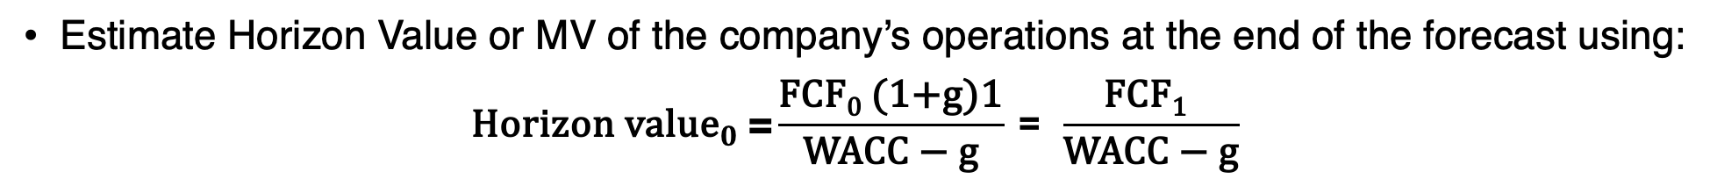
B3. Market Value of Company
Step-by-Step Valuation Process:
Forecast Free Cash Flows (FCF) for the next 5–10 years
FCF = EBIT(1−T) + Dep & Amort − (Capital Expenditures + ΔNet Operating Working Capital)
Discount each FCF back to today using the WACC (Weighted Average Cost of Capital)
Estimate Horizon Value or MV of the company’s operations at the end of the forecast using:
$${\text{Horizon} \text{value}}_{0} \text{=}\frac{\text{FCF}\text{0}\text{ (1+}\text{g}\text{)1}}{\text{WACC}\text{ − }\text{g}}\text{ = }\frac{\text{FCF}\text{1} }{\text{WACC}\text{ − }\text{g}}$$
Add Nonoperating Assets (if any), like excess cash or minority investments
$\text{Market} \text{Value} \text{of} \text{Company}$= MV of company’s operations + MV of company’s non-operating assets
$\text{Intrinsic} \text{Value} \text{per} \text{Share}\text{ =} \frac{\text{Market} \text{Value} \text{of} \text{Company} − \text{debt} − \text{preferred} \text{stock}}{\text{\#}\text{shares}}$

Slide 24
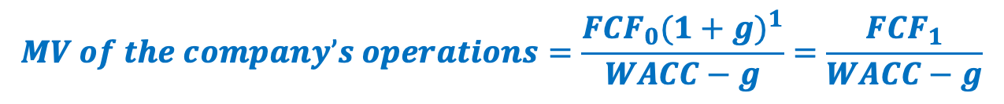
Question-5
Suppose Boyson Corporation's projected free cash flow for next year is FCF₁ = $200,000, and FCF is expected to grow at a constant rate of 8%. Assume the firm has zero non-operating assets. If the company's weighted average cost of capital is 11.5%, then what is the firm's total corporate value?
$\text{MV} \text{of} \text{Company}$= MV of company’s operations + MV of company’s non-operating assets
$$MV of the company’s operations=\frac{{FCF}_{0}{(1+g)}^{1}}{WACC−g}=\frac{{FCF}_{1}}{WACC−g}$$
$$MV of the company’s operations=\frac{\$200,000}{11.5\%−8\%}=\$5,714,285.7$$
$$\text{MV} \text{of} \text{Company} =\$5,714,285.7+0=\$5,714,285.7$$

Slide 25

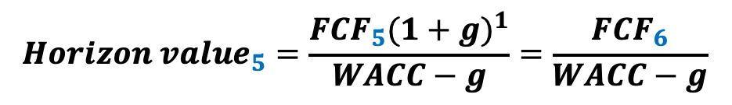
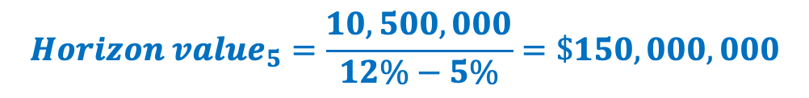
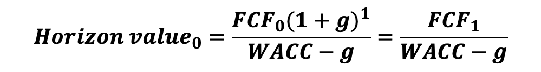
XYZ Corporation is undergoing a restructuring, and its free cash flows are expected to vary considerably during the next few years. However, the FCF is expected to be $10 million in Year 5, and the FCF growth rate is expected to be a constant 5% beyond that point. The weighted average cost of capital is 12.0%. What is the horizon value at t = 5?
$× (1+g)$¹
10,000,000
10,500,000
….
….
0
5
6
7
∞
$${Horizon value}_{0}=\frac{{FCF}_{0}{(1+g)}^{1}}{WACC−g}=\frac{{FCF}_{1}}{WACC−g}$$
$${Horizon value}_{5}=\frac{{FCF}_{5}{(1+g)}^{1}}{WACC−g}=\frac{{FCF}_{6}}{WACC−g}$$
$${Horizon value}_{5}=\frac{10,500,000}{12\%−5\%}=\$150,000,000$$

Slide 26
C. Dividend Model vs. Corporate Valuation Model
 | Discounted Dividend Model | Corporate Valuation Model
Best for | Mature, dividend-paying firms | All firms, especially non-dividend-paying or high-growth
Focus | Forecasting dividends | Forecasting Free Cash Flows (FCFs)
Output | Intrinsic value per share | Value of operations → Equity value → Per share value

Slide 27
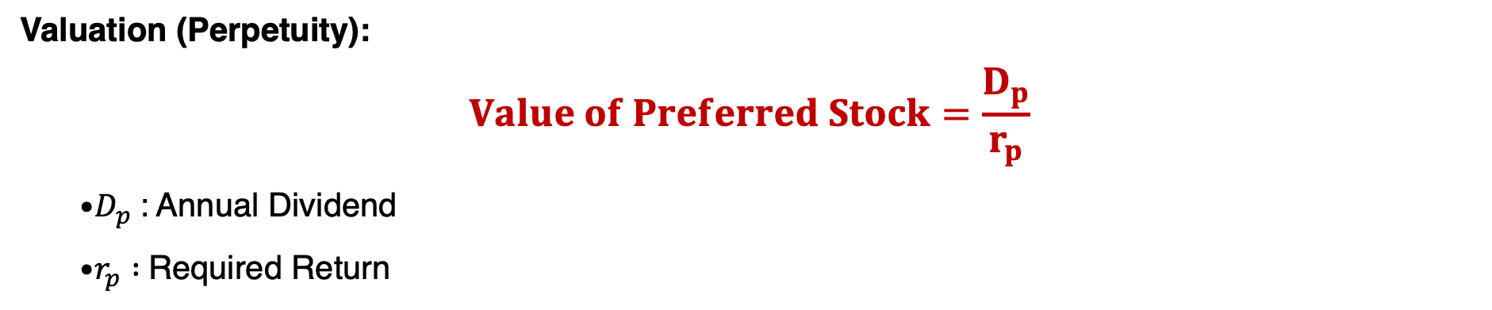
D. Preferred Stock: Hybrid Security
Hybrid Nature: Combines characteristics of bonds and common stock.
Bond-like Features | Stock-like Features
Fixed dividend payments | Dividends can be omitted without bankruptcy
Par value and priority over common stock | Typically perpetual, no obligation to repay principal
Valuation (Perpetuity):
$$Value of Preferred Stock=\frac{D_{p}}{r_{p}}$$
  $D_{p}$: Annual Dividend
  $r_{p} :$Required Return

Slide 28
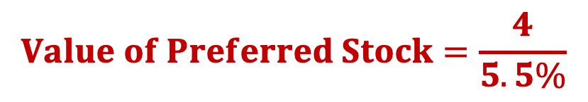
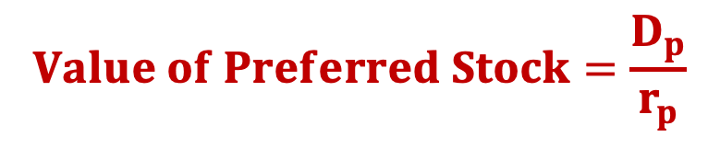

Question-7
Molen Inc. has an outstanding issue of perpetual preferred stock with an annual dividend of $4.00 per share. If the required return on this preferred stock is 5.5%, then at what price should the stock sell?
$$Value of Preferred Stock=\frac{D_{p}}{r_{p}}$$
$$Value of Preferred Stock=\frac{4}{5.5\%}$$
$$Value of Preferred Stock=72.7$$

Slide 29
E. Risk vs. Return for Financial Assets
Return
Common Stocks
Preferred Stocks
Corporate bonds
T-bills
Risk

