Slide 1


Slide 2
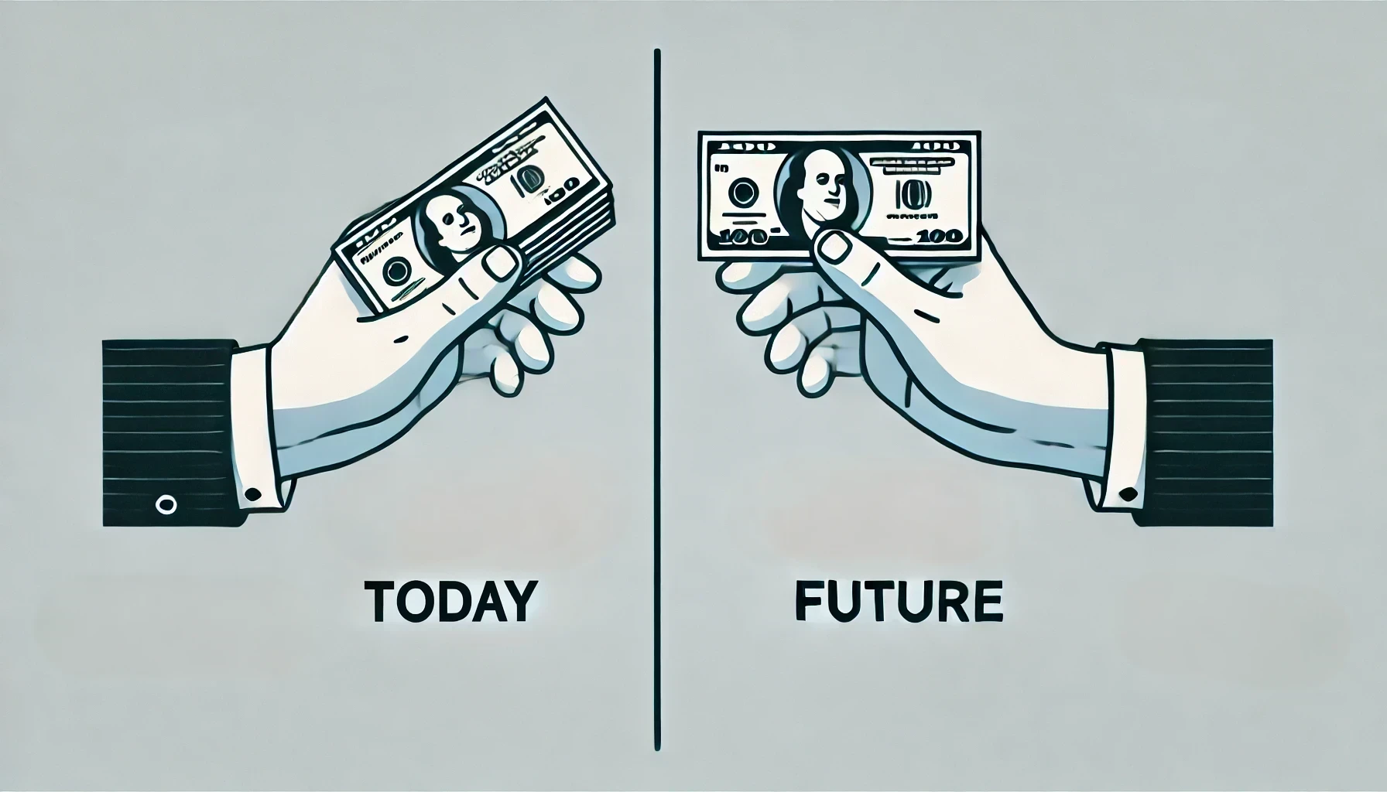
What Would You Rather Have?
$100
$108
Interest rate??
When??

Slide 3



What is an interest rate?
Interest Rate
Opportunity Cost
Default Risk
Purchasing Power
An interest rate is the cost of borrowing money or the reward for saving it.
  For example,
    If you borrow $100 at a 5% interest rate, you will pay $5 extra
    If you save $100 at a 5% interest rate, you will earn $5

Slide 4
What Would You Rather Have?
$100
$108
Interest rate = 10%
When = Next year

Slide 5
The Power of Time in Finance
Money today is worth more because you can invest it and earn interest.
This is the Time Value of Money—a core principle in finance.
i = 10%
$100
$??
0
1
2
3
4

Slide 6

Future Value
Future value is the amount of money you will have in the future if you invest or save a certain amount today, and it grows with interest over time.
$100 + ( $100$×$ 10% )
i = 10%
$100
$110
0
1
2
3
4

Slide 7

Future Value
$100 + ( $100$×$ 10% )
$100 Today
$108 Next year
i = 10%
$100
$110
0
1
2
3
4

Slide 8


Future Value
$110 + ( $110$×$ 10% )
$100 + ( $100$×$ 10% )
i = 10%
i = 10%
$100
$110
$121
0
1
2
3
4

Slide 9


Future Value
$110 + ( $110$×$ 10% )
$100 + ( $100$×$ 10% )
i = 10%
i = 10%
i = 10%
i = 10%
$100
$110
$121
$133.1
$146.41
0
1
2
3
4

Slide 10
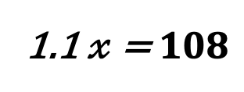
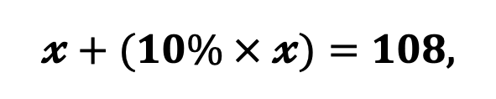
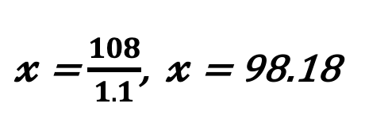
Present Value
Present value is the amount of money you would need today to equal a certain amount in the future, after accounting for interest.
The Present Value (PV) helps us decide if waiting is worth it.
0
1
2
$??
i = 10%
$108
$𝔁+(10\% × 𝔁)=108$,
1.1 $𝓍$ = $108$
$𝔁$ = $\frac{108}{1.1}$, $𝔁$ = 98.18

Slide 11
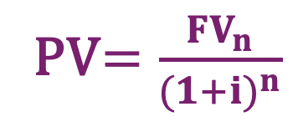
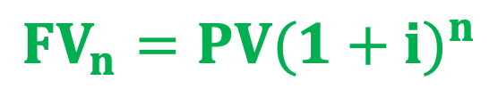
Basic Formula
Future Value
Compounding
$${FV}_{n}=PV{(1+i)}^{n}$$
i = 10%
i = 10%
i = 10%
i = 10%
0
1
2
3
4
n: Number of periods
i: Interest rate
FV: Future Value
PV: Present Value
Present Value
Discounting
PV$=\frac{{FV}_{n}}{{(1+i)}^{n}}$

Slide 12

Impact of Time and Interest on FV
Future Value
Increases when time (n) or interest rate (i) increases – more compounding!
Decreases when time or interest rate is lower – less growth.
$${FV}_{n}=PV{(1+i)}^{n}$$

Slide 13
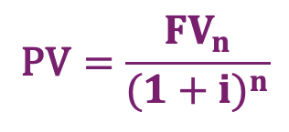
Impact of Time and Interest on PV
$$\text{PV}=\frac{{FV}_{n}}{{(1+i)}^{n}}$$
Present Value
Decreases when time or interest rate increases – more discounting!
Increases when time or interest rate is lower – less discounting.
Time

Slide 14
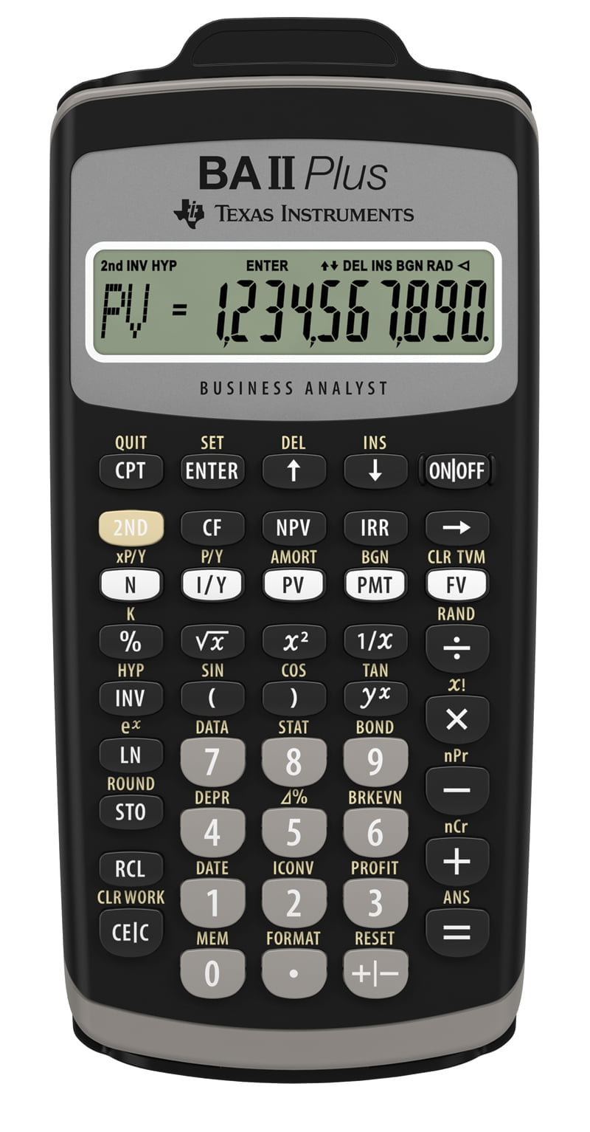
Calculator Tip #1
Five keys in the basic time value equations
N: Number of periods. Some calculators use n rather than N.
1/Y: Interest rate per period. Some calculators use i or I rather than I/Y.
PV: Present value. If we deposit money, it must be negative number. Because it’s cash outflow.
PMT: Payment. This key is used when we have a series of equal, or constant, payments.
FV: Future value.

Slide 15
Calculator Tip #2
Steps to Calculate FV Using a Calculator:
Enter the Number of Periods → Press N
Enter the Interest Rate Per Period → Press I/Y
Enter the Payment Amount (if applicable) → Press PMT
Enter the Present Value (PV) (use a negative sign for cash outflows) → Press PV
Press CPT (Compute) → Press FV

Slide 16


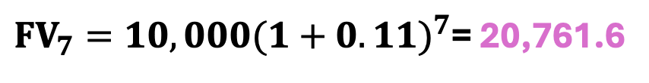
7 Years
i = 11%
Saving for a Dream Car
Will your $10,000 investment today be enough to buy the car in 7 years?
$${FV}_{n}=PV{(1+i)}^{n}$$
$ 20,000
${FV}_{7}=10,000{(1+0.11)}^{7}$= 20,761.6
Usin Calculator
N | I/Y | PV | PMT | FV
7 | 11 | -10,000 | 0 | ??

Slide 17
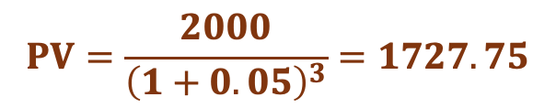

Example
Old Dominion University aims to reward top students with $5,000 for maintaining the highest GPA for two years, plus an additional $2,000 for excelling in a third year. Jack wants to know the present value of these awards if he earns them (i= 5%).
$$PV=\frac{2000}{{\left(1+0.05\right)}^{3}}=1727.75$$
i = 5%
i = 5%
i = 5%
0
1
2
3
$5000
$2000
$$PV=\frac{5000}{{\left(1+0.05\right)}^{2}}=4535.15$$
$$Total PV={PV}_{First Award}+{PV}_{Second Award}$$
Total PV= 4535.15 + 1727.75 = $ 6262.90

Slide 18
Question-1
A company's sales were $100 million in 2012 and increased to $215.89 million by 2022. What was the annual growth rate over this period?
N = 10 years
$100
$215.89
i = ??
2012
Using Calculator
N | PV | PMT | FV | I/Y
10 | -100 | 0 | 215.89 | ??
2022
I/Y = 8%

Slide 19
Question-2
How long would it take $6,000 to double if it was invested in a bank that paid 8% per year?
i = 9%
$6,000
$12,000
N = ??
0
Using Calculator
I/Y | PV | PMT | FV | N
8 | -6,000 | 0 | 12,000 | ??
N
N = 9 Years

Slide 20
Lump Sum vs. Annuities
A lump sum is a single payment made at one time, rather than in multiple installments.
Annuities are a series of equal payments made at regular intervals over a specified period.
  Types of Annuities
    Ordinary Annuity: Payments occur at the end of each period.
    Annuity Due: Payments are made at the beginning of each period.
    Fixed Annuity: Provides guaranteed payments of a specific amount.
    Perpetuity: An annuity that pays indefinitely with no end date.
Uneven payments: Payments vary based on the performance of underlying investments.

Slide 21
Annuities
Ordinary (or Deferred) Annuity
$100
$100
$100
$100
0
1
2
3
4
Annuity Due
$100
$100
$100
$100
0
1
2
3
4
would you prefer an annuity due of $100 per year for 4 years over an ordinary annuity?

Slide 22
Annuities FV vs. PV
Future Value
step-by-step approach
Using a Formula
Financial Calculator
Ordinary Annuity
Present Value
Future Value
step-by-step approach
Using a Formula
Financial Calculator
Annuity Due
Present Value

Slide 23
FV of an Ordinary Annuity-1
Step-by-step approach:
$100
$100
$100
$100
0
1
2
3
4
i = 10%
$100
$110
$121
$133.1
$464.1

Slide 24

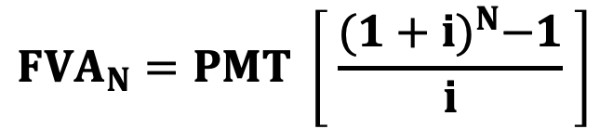

FV of an Ordinary Annuity-2
Formula:
$${FVA}_{N}=PMT \left[ \frac{{(1+i)}^{N}−1}{i} \right]$$
$100
$100
$100
$100
0
1
2
3
4
i = 10%
$${FVA}_{4}=100 \left[ \frac{{(1+0.1)}^{4}−1}{0.1} \right]$$
$${FVA}_{4}=100 \left[ \frac{1.4641−1}{0.1} \right]$$
$${FVA}_{4}=100 × 4.641$$
$${FVA}_{4}=464.1$$

Slide 25
FV of an Ordinary Annuity-3
Financial Calculator:
$100
$100
$100
$100
0
1
2
3
4
i = 10%
Using Calculator
N | I/Y | PV | PMT | FV
4 | 10 | 0 | -100 | ??
FV = $464.1

Slide 26
FV of an Annuity Due-1
Step-by-step approach:
$100
$100
$100
$100
i = 10%
0
1
2
3
4
$100
$110
$121
$133.1
$464.1
$510.51

Slide 27

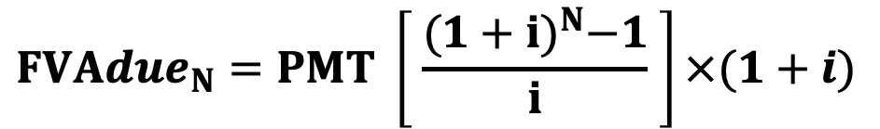

FV of an Annuity Due-2
Formula:
$${FVAdue}_{N}=PMT \left[ \frac{{(1+i)}^{N}−1}{i} \right]×(1+i)$$
$100
$100
$100
$100
0
1
2
3
4
${FVAdue}_{4}=100 \left[ \frac{{(1+0.1)}^{4}−1}{0.1} \right]$ $×(1+0.1)$
i = 10%
${FVAdue}_{4}=100 \left[ \frac{1.4641−1}{0.1} \right]$ $×(1+0.1)$
$${FVAdue}_{4}=100 × 4.641 × 1.1$$
$${FVAdue}_{4}=\text{\$510.51}$$

Slide 28
FV of Annuity Due Using Calculator
Two Calculation Methods:
  Using End Mode (Ordinary Annuity Method)
    Calculate the Future Value (FV) as if it's an ordinary annuity.
    Adjust for Annuity Due: Multiply the result by (1 + i) to account for earlier payments.
  Using Begin Mode (Annuity Due Method)
    Set your calculator to BGN mode (payments at the beginning).
    Directly calculate the Future Value without further adjustment.
    Press 2nd → PMT → 2nd → SET → 2nd → QUIT
    👉 To switch back to End Mode: Repeat the steps and ensure BGN disappears.
Both methods give the same result!

Slide 29
FV of an Annuity Due-3
Financial Calculator:
$100
$100
$100
$100
0
1
2
3
4
i = 10%
SET Calculator to BGN Mode
Press: 2nd → PMT → 2nd → SET → 2nd → QUIT
Using Calculator
N | I/Y | PV | PMT | FV
4 | 10 | 0 | -100 | ??
FV = $ 510.51

Slide 30
PV of an Ordinary Annuity-1
Step-by-step approach:
$100
$100
$100
$100
0
1
2
3
4
i = 10%
$90.91
$82.64
$75.13
$68.30
$316.98

Slide 31

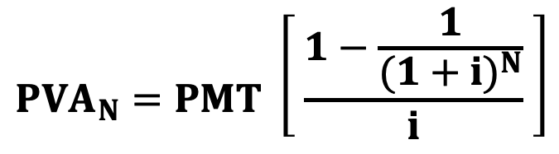

PV of an Ordinary Annuity-2
Formula:
$${PVA}_{N}=PMT \left[ \frac{1−\frac{1}{{(1+i)}^{N}}}{i} \right]$$
$100
$100
$100
$100
0
1
2
3
4
i = 10%
$${PVA}_{4}=100 \left[ \frac{1−\frac{1}{{(1+0.1)}^{4}}}{0.1} \right]$$
$${PVA}_{4}=100 \left[ \frac{1−0.683}{0.1} \right]$$
$${PVA}_{4}=100 × 3.1698$$
$${PVA}_{4}=316.98$$

Slide 32
PV of an Ordinary Annuity-3
Financial Calculator:
$100
$100
$100
$100
0
1
2
3
4
i = 10%
Using Calculator
N | I/Y | PV | PMT | FV
4 | 10 | ?? | -100 | 0
PV = $316.98

Slide 33
Question-3
John's parents decide to invest $3,000 at the end of each year for the next 14 years in an account earning 8% annual interest, compounded annually. If John's university costs will be $70,000 at the end of the 14th year, will this investment be enough to cover the tuition? Show your calculations.
$3,000
$3,000
$3,000
….
$3,000
….
0
1
2
3
14
Using Calculator
I/Y | N | PV | PMT | FV
8 | 14 | 0 | -3,000 | ??
FV = $72,644.76

Slide 34
Question-4
Sarah plans to save $1,500 at the beginning of each year for the next 12 years in an account earning 6% annual interest, compounded annually. How much will Sarah’s savings be worth at the end of 12 years?
$1,500
$1,500
$1,500
$1,500
….
$1,500
….
0
1
2
3
11
12
Change to BGN
Using Calculator
I/Y | N | PV | PMT | FV
6 | 12 | 0 | -1,500 | ??
FV = $26,823.20

Slide 35


Perpetuities
A perpetuity is simply an annuity with an extended life. Because the payments go on forever, you can’t apply the step-by-step approach.
$100
$100
$100
$100
…
…
0
1
2
3
4
Formula for Present Value of a Perpetuity:
$${PV}_{Perpetuity Ordinary}=\frac{PMT}{i}$$
$${PV}_{Perpetuity Due}=PMT+\frac{PMT}{i}$$

Slide 36
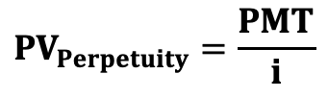
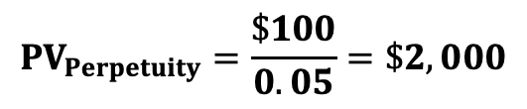
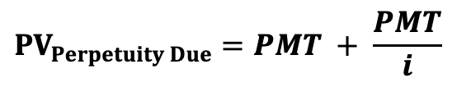
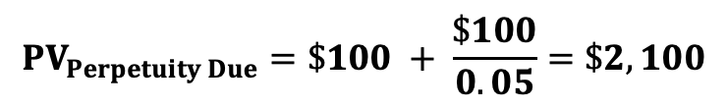
Question-5
What’s the present value of a perpetuity that pays $1,000 per year beginning 1 year from now, if the appropriate interest rate is 5%?
$100
$100
$100
$100
…
…
0
1
2
3
4
$${PV}_{Perpetuity}=\frac{PMT}{i}$$
$${PV}_{Perpetuity}=\frac{\$100}{0.05}=\$2,000$$
,
What would the value be if payments on the annuity began immediately?
$100
$100
$100
$100
$100
…
…
0
1
2
3
4
$${PV}_{Perpetuity Due}=PMT + \frac{PMT}{i}$$
$${PV}_{Perpetuity Due}=\$100 + \frac{\$100}{0.05}=\$2,100$$

Slide 37
Uneven Cash Flow
There are two important classes of uneven cash flows:
  A stream that consists of a series of annuity payments plus an additional final lump sum.
  All other uneven streams.
$2,000
$100
$100
$100
$100
0
1
2
3
4
$200
$300
$100
$900
0
1
2
3
4

Slide 38
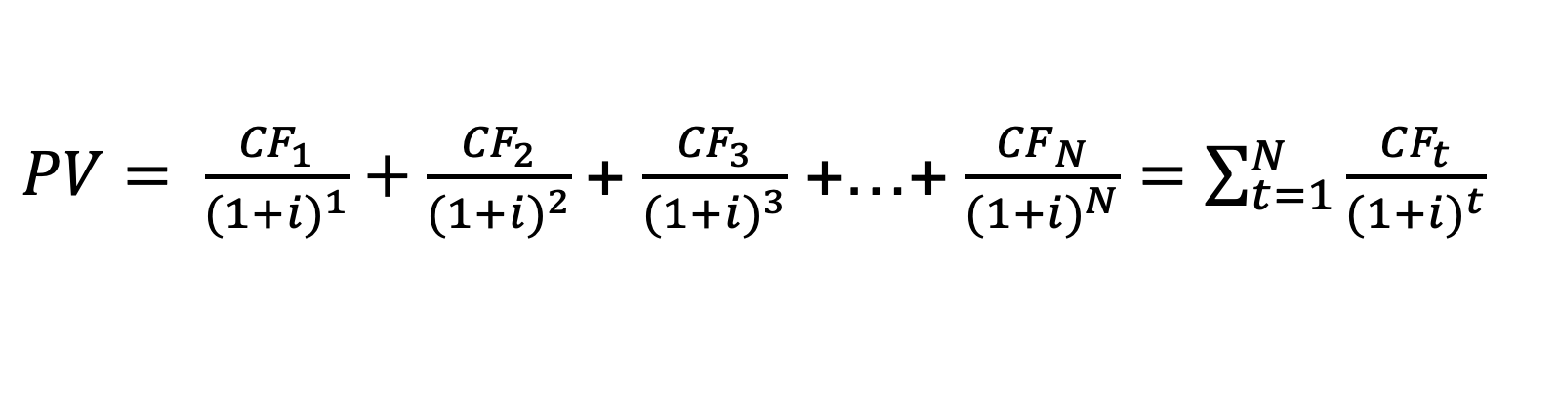
PV of an Uneven Cash Flow
CF₁
CF₂
CF₃
CF_{N}
…
…
0
1
2
3
N
$PV= \frac{{CF}_{1}}{{(1+i)}^{1}}+\frac{{CF}_{2}}{{(1+i)}^{2}}$+ $\frac{{CF}_{3}}{{(1+i)}^{3}}$ +…+ $\frac{{CF}_{N}}{{(1+i)}^{N}}=\sum_{t=1}^{N}{\frac{{CF}_{t}}{{(1+i)}^{t}}}$
Present Value of A stream that consists of a series of annuity payments plus an additional final lump sum are easy to calculate by financial calculator.
  For the annuity: Input PMT, i, and N.
  For the lump sum: Input FV.

Slide 39
Question-6
What’s the present value of a 15-year ordinary annuity of $900 plus an additional $3,000 at the end of Year 15 if the interest rate is 6%?
$3,000
$900
$900
$900
….
$900
….
0
1
2
3
15
Using Calculator
I/Y | N | PV | PMT | FV
6 | 15 | ?? | 900 | 3,000
PV = $9,928.19

Slide 40
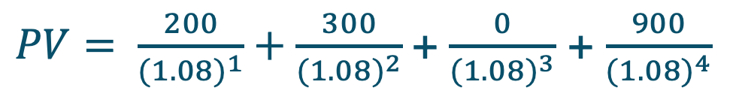
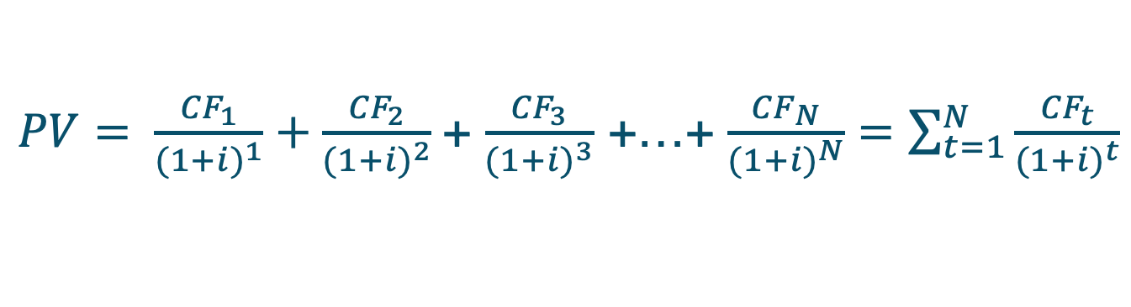

Question-7
What’s the present value of the following uneven cash flow stream: $0 at Time 0, $200 in Year 1 (or at Time 1), $300 in Year 2, $0 in Year 3, and $900 in Year 4 if the interest rate is 8%?
$200
$300
0
$900
0
1
2
3
4
For this type of cash flow, we need to calculate the present value of each payment individually.
$PV= \frac{{CF}_{1}}{{(1+i)}^{1}}+\frac{{CF}_{2}}{{(1+i)}^{2}}$+ $\frac{{CF}_{3}}{{(1+i)}^{3}}$ +…+ $\frac{{CF}_{N}}{{(1+i)}^{N}}=\sum_{t=1}^{N}{\frac{{CF}_{t}}{{(1+i)}^{t}}}$
$PV= \frac{200}{{(1.08)}^{1}}+\frac{300}{{(1.08)}^{2}}$+ $\frac{0}{{(1.08)}^{3}}$ + $\frac{900}{{(1.08)}^{4}}$
$$PV=1,103.91$$

Slide 41
Semiannual and Other Compounding Periods
In all our previous examples, we assumed that interest was compounded once a year, known as annual compounding.
However, interest is often compounded more frequently, such as semiannually, quarterly, monthly, or even daily.
When interest is compounded more than once a year, the accumulated amount grows faster because interest is calculated and added to the principal multiple times within a year.
This is referred to as nonannual compounding.

Slide 42
Semiannual Compounding
If you invest $100 at 8% annual interest rate for 1 year, the amount you will have at the end of the year:
8% annual interest
$100
$108
0
1
What if it compound every 6 month:
4% interest
$104
4% interest
$108.16
$100
0
1

Slide 43
Quarterly Compounding
If you invest $100 at 8% annual interest rate for 1 year, the amount you will have at the end of the year:
8% annual interest
$100
$108
0
1
What if it compound every 3 month:
2%
2%
2%
2%
$108.24
$100
0
1

Slide 44
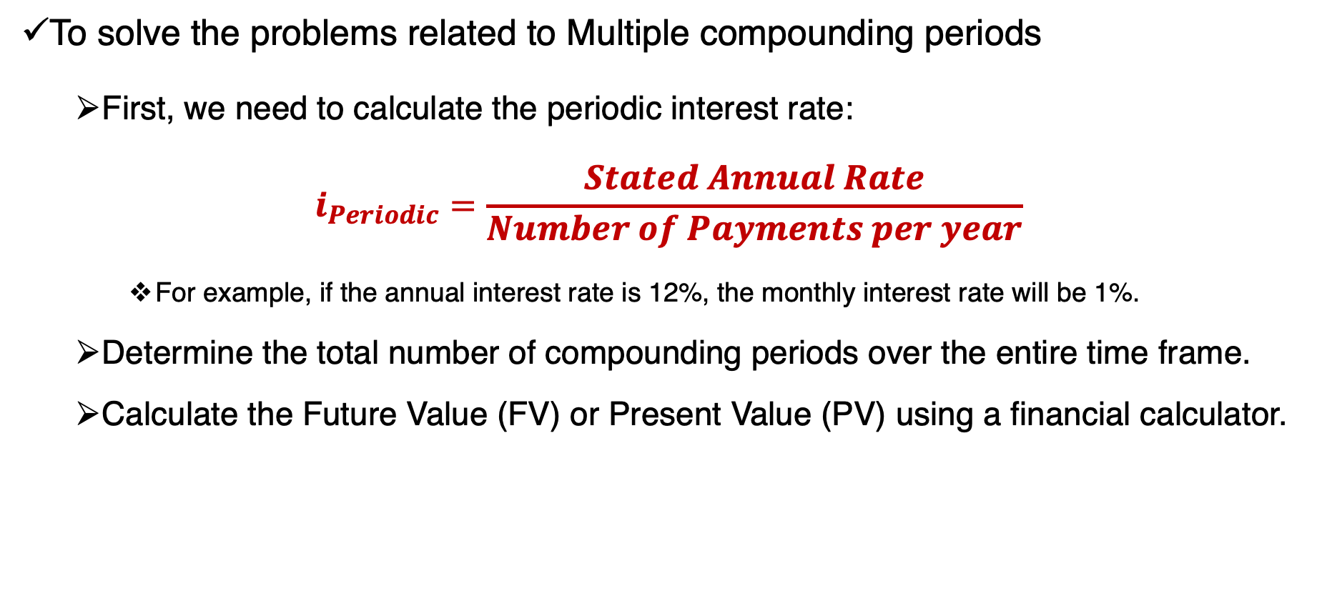
Multiple Compounding Periods
To solve the problems related to Multiple compounding periods
  First, we need to calculate the periodic interest rate:
$$i_{Periodic}=\frac{Stated Annual Rate}{Number of Payments per year}$$
    For example, if the annual interest rate is 12%, the monthly interest rate will be 1%.
  Determine the total number of compounding periods over the entire time frame.
  Calculate the Future Value (FV) or Present Value (PV) using a financial calculator.

Slide 45
Question-8
Calculate the future value (FV) of $2,000 after 8 years at an annual interest rate of 12%, under the following compounding frequencies:
A) Annually
B) Semiannually
C) Quarterly
D) Monthly
 | N | I/Y | PV | PMT | FV
A | 8 | 12 | 2,000 | 0 | 4,951.92
 | N | I/Y | PV | PMT | FV
B | 16 | 6 | 2,000 | 0 | 5,080.70
 | N | I/Y | PV | PMT | FV
C | 32 | 3 | 2,000 | 0 | 5,150.16
 | N | I/Y | PV | PMT | FV
D | 96 | 1 | 2,000 | 0 | 5,198.54

Slide 46
Summary of PV vs. FV
lump Sum
Annuities
Uneven payments
Multiple Compounding Periods
Ordinary Annuity
Fixed Annuity
Perpetuity
Annuity Due
Annuity payments plus an additional final lump sum
All other uneven streams

Slide 47
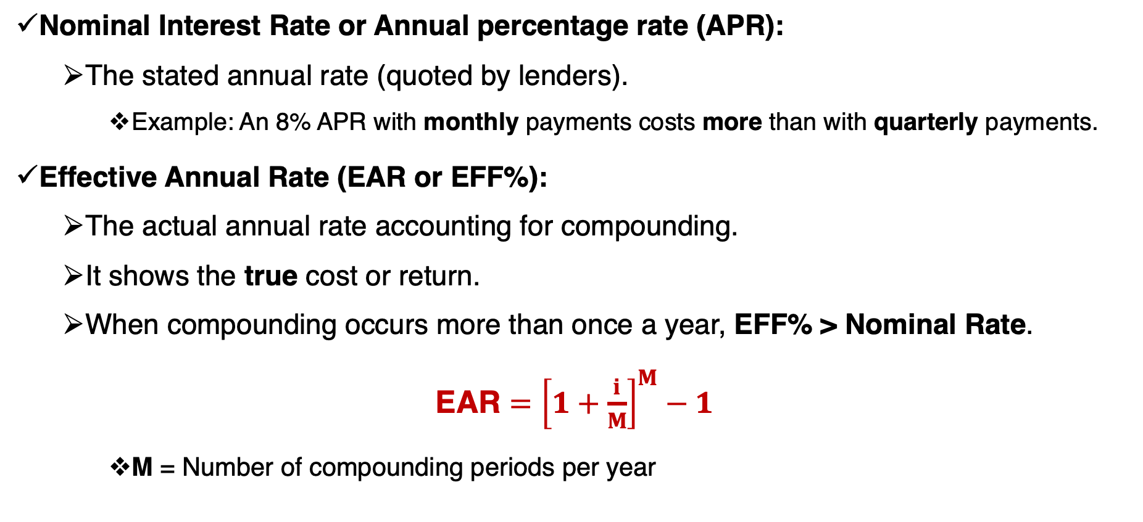
Comparing Interest Rates
Nominal Interest Rate or Annual percentage rate (APR):
  The stated annual rate (quoted by lenders).
    Example: An 8% APR with monthly payments costs more than with quarterly payments.
Effective Annual Rate (EAR or EFF%):
  The actual annual rate accounting for compounding.
  It shows the true cost or return.
  When compounding occurs more than once a year, EFF% > Nominal Rate.
$\text{EAR}={\left[1+\frac{i}{M}\right]}^{M}−1$
    M = Number of compounding periods per year

Slide 48
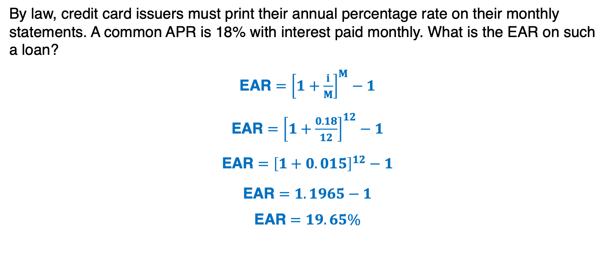
Question-9
By law, credit card issuers must print their annual percentage rate on their monthly statements. A common APR is 18% with interest paid monthly. What is the EAR on such a loan?
$\text{EAR}={\left[1+\frac{i}{M}\right]}^{M}−1$
$\text{EAR}={\left[1+\frac{0.18}{12}\right]}^{12}−1$
$\text{EAR}={\left[1+0.015\right]}^{12}−1$
$\text{EAR}=1.1965−1$
$$\text{EAR}=19.65\%$$

Slide 49
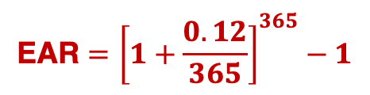
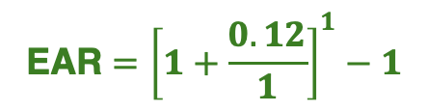
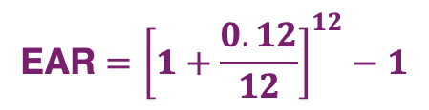

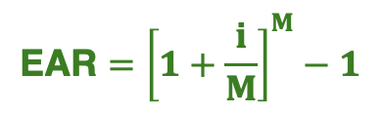
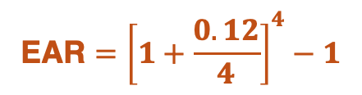

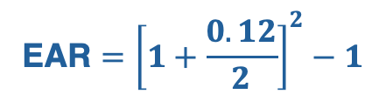



Question-10
Calculate the EAR of an annual interest rate of 12%, under the following compounding frequencies:
Annually
Semiannually
Quarterly
Monthly
Daily
$$\text{EAR}={\left[1+\frac{i}{M}\right]}^{M}−1$$
$$\text{EAR}={\left[1+\frac{0.12}{1}\right]}^{1}−1$$
$$\text{EAR}=12\%$$
$$\text{EAR}={\left[1+\frac{0.12}{2}\right]}^{2}−1$$
$$\text{EAR}=12.36\%$$
$$\text{EAR}={\left[1+\frac{0.12}{4}\right]}^{4}−1$$
$$\text{EAR}=12.55\%$$
$$\text{EAR}={\left[1+\frac{0.12}{12}\right]}^{12}−1$$
$$\text{EAR}=12.68\%$$
$$\text{EAR}={\left[1+\frac{0.12}{365}\right]}^{365}−1$$
$$\text{EAR}=12.75\%$$

Slide 50
Amortized Loans
What is an Amortized Loan?
  A loan repaid in equal installments over time.
  Payments are made on a monthly, quarterly, or annual basis.
Examples of Amortized Loans:
  Home mortgages
  Auto loans
  Student loans
  Business loans
Key Idea: Each payment covers both interest and a portion of the principal (the original loan amount).

Slide 51
Amortized Loans’ Payment
Imagine you take out a loan of $200,000 at an 8% APR for 5 years.
If the loan is amortized, the payments will be in equal amounts.
If payments happen at the end of each year:
$200,000
PMT
PMT
PMT
PMT
PMT
0
1
2
3
4
5
Since this cash flow structure is an ordinary annuity; we can calculate the amount of each PMT.
I/Y | N | PV | PMT | FV
8 | 5 | 200,000 | ?? | 0
PMT = $50,091.29

Slide 52

Principal vs. Interest Payment
Imagine you take out a loan of $200,000 at an 8% APR for 5 years.
Now we know the amount of total payment at the end of each year.
The total payment consist of principal payment and interest payment
Year | Payment | Interest | Principal | Balance
0 |  |  |  | 200,000
200,000 $×$ 0.08
50,091.29 - 16,000
200,000 - 34,091.29
50,091.29
16,000
34,091.29
165,908.71
1
50,091.29
13,272.70
129,090.11
2
36,818.59

Slide 53
Amortized Loan’s Table
Imagine you take out a loan of $200,000 at an 8% APR for 5 years.
Year | Payment | Interest | Principal | Balance
0 |  |  |  | 200,000
1 | 50,091.29 | 16,000 | 34,091.29 | 165,908.71
2 | 50,091.29 | 13,272.69 | 36,818.59 | 129,090.12
3 | 50,091.29 | 10,327.20 | 39,764.08 | 89,326.03
4 | 50,091.29 | 7,146.08 | 42,945.21 | 46,380.83
5 | 50,091.29 | 3,710.46 | 46,380.82 | 0.00

Slide 54
Question-11
Suppose you borrowed $30,000 on a student loan at a rate of 8% and must repay it in three equal installments at the end of each of the next 3 years. Calculate the amount of principal and interest at the third year.
I/Y | N | PV | PMT | FV
8 | 3 | 30,000 | ?? | 0
Year | Payment | Interest | Principal | Balance
0
30,000
11,641
2,400
20,759
1
9,241
11,641
1,660.72
9,980.28
10,778.72
2
862.30
10778.72
3
11,641
0

