Slide 1
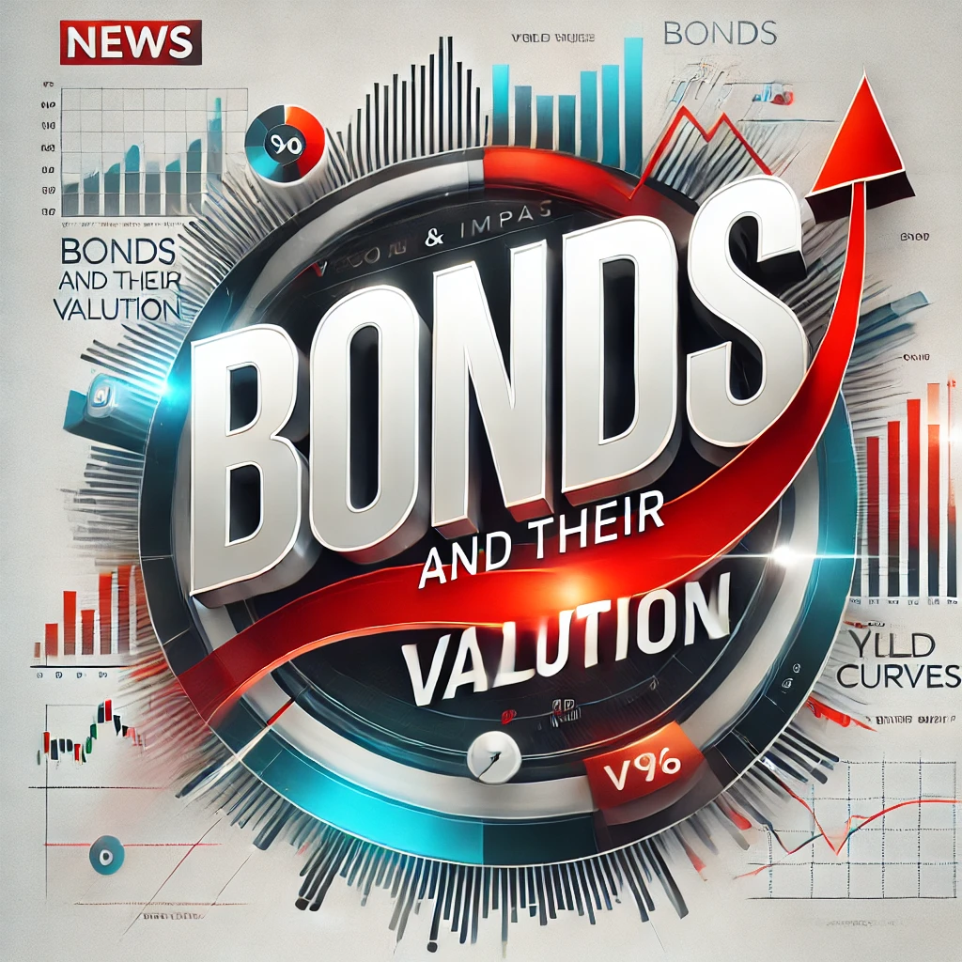
Chapter 7

Slide 2
What is a Bond?
A bond is a fixed-income instrument that represents a loan made by an investor to a borrower. It’s a way for organizations to raise money.
The borrower agrees to pay back the principal amount (face value) on a specific date (maturity date).
During the life of the bond, the borrower typically pays interest (called a coupon) to the investor at regular intervals.
Who Issues Bonds?
  Corporations
  Government agencies (Federal, State, Local)
  Foreign governments and corporations

Slide 3
Types of Bonds by Issuer
U.S. Treasury Bonds (Treasuries):
  Issued by the federal government
  Virtually no default risk
  Interest is tax-exempt
Corporate Bonds:
  Issued by business firms
  Exposed to default risk (credit risk)
  Higher risk = higher interest rates
Municipal Bonds (Munis):
  Issued by state/local governments
  Some default risk
  Interest is tax-exempt
Foreign Bonds:
  Issued by foreign governments/companies
  Exposed to default & currency risk
  Example: Venezuela defaulted in 2017
Prices fluctuate with interest rates

Slide 4
Risks in Bond Investments
Interest Rate Risk
Credit (Default) Risk
Risks in bond investments
Event Risk
Inflation Risk
Exchange Rate Risk
Reinvestment Risk
Political/Legal Risk
Liquidity Risk

Slide 5
Key Characteristics of Bonds
Key Features:
  Par Value:
      Standard is $1,000 (or multiples thereof). Represents the principal the issuer agrees to repay.
  Coupon Interest Rate:
      Determines the interest income an investor receives annually.
  Maturity Date:
      Specifies when the bond’s par value must be repaid.

Slide 6
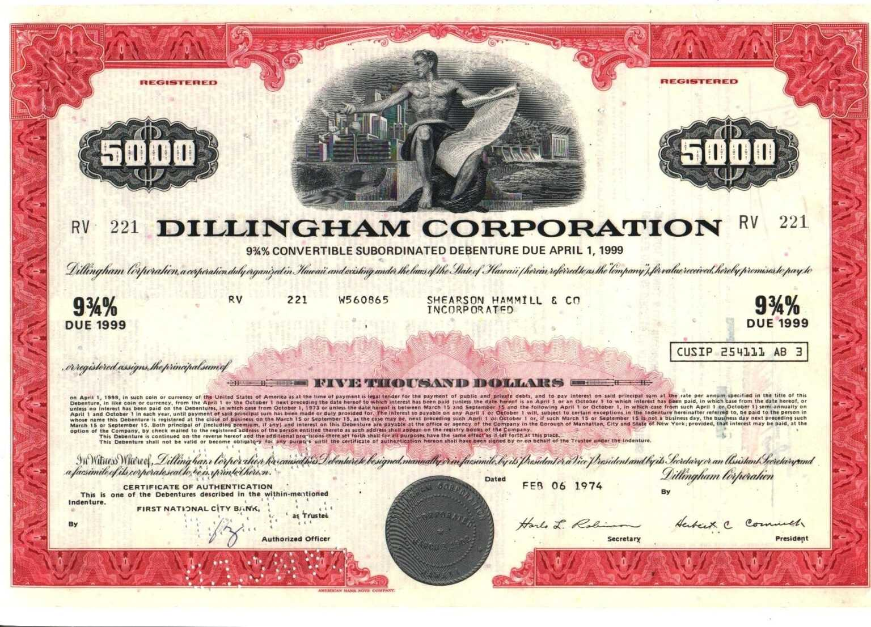
Common Characteristics of Bonds
Par Value
Maturity Date
Coupon Rate

Slide 7
Coupon Interest Rate & Types
Coupon Interest Rate
  Fixed payment, usually paid annually or semi-annually.
  Coupon Rate = Coupon Payment / Par Value.
  Example: $1,000 par bond with an $80 coupon → Coupon Rate = 8%.
Types of Bonds by Coupon
  Fixed-Rate Bonds: Same coupon rate throughout life.
  Floating-Rate Bonds: Coupon adjusts periodically (e.g., Treasury Rate + 1.5%).
  Zero Coupon Bonds: No interest payments; issued at a discount.
  OID Bonds (Original Issue Discount): Issued at a price below par.

Slide 8
Maturity Date & Call Provisions
Maturity Date
  Specifies when par value must be repaid.
  Maturity decreases over time.
Call Provisions
  Allows issuer to redeem bonds before maturity.
  Issuer pays par value + call premium.
  Deferred Call: Bonds not callable for 5-10 years.
  Investor Risk: Callable bonds typically offer higher coupon rates.
Protect from Reinvestment Risk
Protect from Reinvestment Risk

Slide 9
Other Bond Features
Convertible Bonds
  Convert into common stock at a fixed price.
  Typically, lower coupon rates than regular bonds.
Putable Bonds
  Investor can force issuer to buy back bonds early.
  Useful if interest rates rise and better investments exist.
Income Bonds
  Pay interest only if issuer earns enough.
  Higher risk for investors.
Indexed (Inflation-Linked) Bonds
  Coupon payments adjust with inflation index (e.g., CPI).
  U.S. Treasury is the main issuer.

Slide 10
Bond Valuation (1)
The value of any financial asset—a stock, a bond, or even a physical asset—is the present value of the cash flows the asset is expected to produce.
Imagine a bond:
Annual coupon 5%,
Par value of $1,000,
Remaining maturity of 10 years,
And the market interest rate is currently 7%.
Par
+
CF₁
CF₂
CF₃
…
CF₁₀
…
0
1
2
3
10

Slide 11

Bond Valuation (2)
Imagine a bond:
Annual coupon rate 5%,
Par value of $1,000,
Remaining maturity of 10 years,
And the market interest rate is currently 7%.
Annual Coupon Amount = Par value $×$ Coupon Rate
= $1000 $×$ 5% = $50
$1,000
+
$50
$50
$50
$50
Par
+
CF₁
CF₂
CF₃
…
CF₁₀
…
0
1
2
3
10

Slide 12
Bond Valuation (2)
Imagine a bond:
Annual coupon rate 5%,
Par value of $1,000,
Remaining maturity of 10 years,
And the market interest rate is currently 7%.
$1,000
+
PV=??
$50
$50
$50
…
$50
…
0
1
2
3
10
N | I/Y | PV | PMT | FV
10 | 7 | ?? | 50 | 1,000
PV = Value of Bond = 859.53

Slide 13
Interest Rates: Impact on Bond Price
What is the price for a bond that matures in 8 years has a par value of $1,000 and an annual coupon rate is 9%;
A. If its market interest rate is 9%:
N | I/Y | PV | PMT | FV
PV = $1,000
8 | 9 | ?? | 90 | 1,000
B. If its market interest rate is 6%:
N | I/Y | PV | PMT | FV
PV = $1,186.3
8 | 6 | ?? | 90 | 1,000
C. If its market interest rate is 12%:
N | I/Y | PV | PMT | FV
PV = $850.98
8 | 12 | ?? | 90 | 1,000

Slide 14
Interest Rates & Coupon Rates
Coupon rate = Interest rate | Bond trades at Par | Par Bond
Coupon rate > Interest rate | Bond trades more than Par | Premium Bond
Coupon rate < Interest rate | Bond trades less than Par | Discount Bond

Slide 15
Question-1
1- A bond that matures in 10 years has a par value of $1,000 and an annual coupon payment of $70; its market interest rate is 11%. What is its price?
N | I/Y | PV | PMT | FV
PV = $764.43
10 | 11 | ?? | 70 | 1,000
2- A bond that matures in 14 years has a par value of $1,000 and an annual coupon rate of 12%; the market interest rate is 8%. What is its price?
N | I/Y | PV | PMT | FV
PV = $1329.77
14 | 8 | ?? | 120 | 1,000
3- Which of those two bonds is a discount bond, and which is a premium bond?

Slide 16
Yield to maturity (YTM)
Yield to maturity (YTM):
  Rate of interest you earn on your investment if you bought the bond, held it to maturity, and received the promised interest payments and maturity value.
You have just purchased an outstanding 15-year bond with a par value of $1,000 for $1,264.50. Its annual coupon payment is $75. What is the bond’s yield to maturity?
$1,000
+
$1,264.50
$75
$75
$75
$75
…
…
0
1
2
3
15
N | I/Y | PV | PMT | FV
15 | ?? | -1,264.50 | 75 | 1,000
YTM = 4.959%

Slide 17
Yield to Maturity (YTM)
Yield to maturity (YTM):
  Rate of interest you earn on your investment if you bought the bond, held it to maturity, and received the promised interest payments and maturity value.
  Key Points:
  YTM = Promised Rate of Return
  YTM = Expected Return only if:
    No default risk
    Bond is non-callable
  YTM changes daily with market interest rates
  If held to maturity, you earn the YTM on the purchase date

Slide 18
Yield to Call (YTC)
Definition:
    The Yield to Call (YTC) is the rate of return an investor earns if the bond is called (redeemed early) by the issuer before maturity, on the earliest call date.
When It’s Relevant:
    Applies to Callable Bonds, where issuers have the right to repay the bond early.
    Typically happens when interest rates fall, and the issuer wants to refinance at a lower cost.
YTC Calculation Includes:
    Coupon payments until the call date
    Call price (usually par or a slight premium)
    Time until the bond is called, not until maturity

Slide 19
Yield to Call (YTC)
The Henderson Company’s bonds currently sell for $1,275. They pay a $120 annual coupon, have a 20-year maturity, and a par value of $1,000, but they can be called in 3 years at $1,080. What is their YTC?
$1,080
✔
$1,000
+
$1,275
$120
$120
$120
$120
…
…
0
1
2
3
20
N | I/Y | PV | PMT | FV
3 | ?? | -1275 | 120 | 1080
YTC = 4.538%

Slide 20
Question-2
Halley Enterprises’s bonds currently sell for $975. They have a 7-year maturity, an annual coupon of $90, and a par value of $1,000. What is their yield to maturity?
N | I/Y | PV | PMT | FV
YTM = 9.51%
7 | ?? | -975 | 90 | 1,000
The XYZ Company’s bonds currently sell for $1,300. They pay a $160 annual coupon, have a 20-year maturity, and a par value of $1,000, but they can be called in 8 years at $1,120. What is their YTC?
N | I/Y | PV | PMT | FV
YTC = 11.146%
8 | ?? | -1,300 | 160 | 1120

Slide 21
Bonds with Semiannual Coupons
Although some bonds pay interest annually, the vast majority actually make payments semiannually. To evaluate semiannual bonds, we must modify the valuation model as follows:
  Divide the annual coupon interest payment by 2 to determine the dollars of interest paid each 6 months.
  Multiply the years to maturity, N, by 2 to determine the number of semiannual periods.
  Divide the nominal (quoted) interest rate, by 2 to determine the periodic (semiannual) interest rate.

Slide 22
Bonds with Semiannual Coupons
Hartwell Corporation’s bonds have a 20-year maturity, an 10% semiannual coupon, and a face value of $1,000. The going nominal annual interest rate is 8%. What is the bond’s price?
N | I/Y | PV | PMT | FV
40 | 4 | ?? | 50 | 1,000
PV = 1197.92

Slide 23
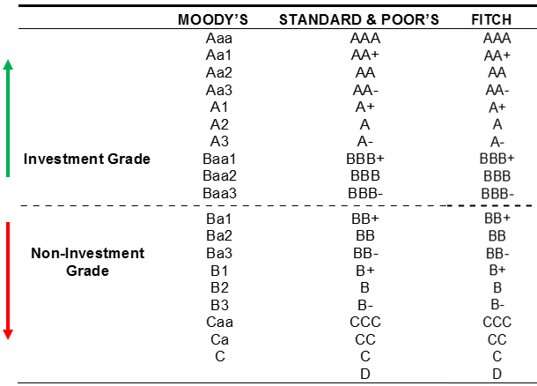
Bond Ratings – What & Why?
What Are Bond Ratings?
  Assigned by Moody’s, S&P, and Fitch
  Reflect a bond’s default risk
Categories
  Investment-Grade Bonds
      AAA, AA → Extremely safe
      A, BBB → Strong; widely held by institutions
  Speculative-Grade Bonds (Junk Bonds)
      BB and below → Higher risk of default
Example Default Rates (5 Years):
  A-rated bonds → 0.46%
  C-rated bonds → 36.19%

Slide 24
How Are Bond Ratings Determined?
Quantitative Factors
  Financial Ratios (Debt ratio, Times-Interest-Earned)
  Forecasted future performance
Qualitative Factors
  Business Risk
  Competitiveness
  Management quality
  Bond Contract Terms
    Security & Collateral
    Sinking fund provisions
    Covenants
Other Factors
  Economic sensitivity
  Industry/country risk
  Exposure to subprime loans
  Environmental/Legal risks

