Slide 1
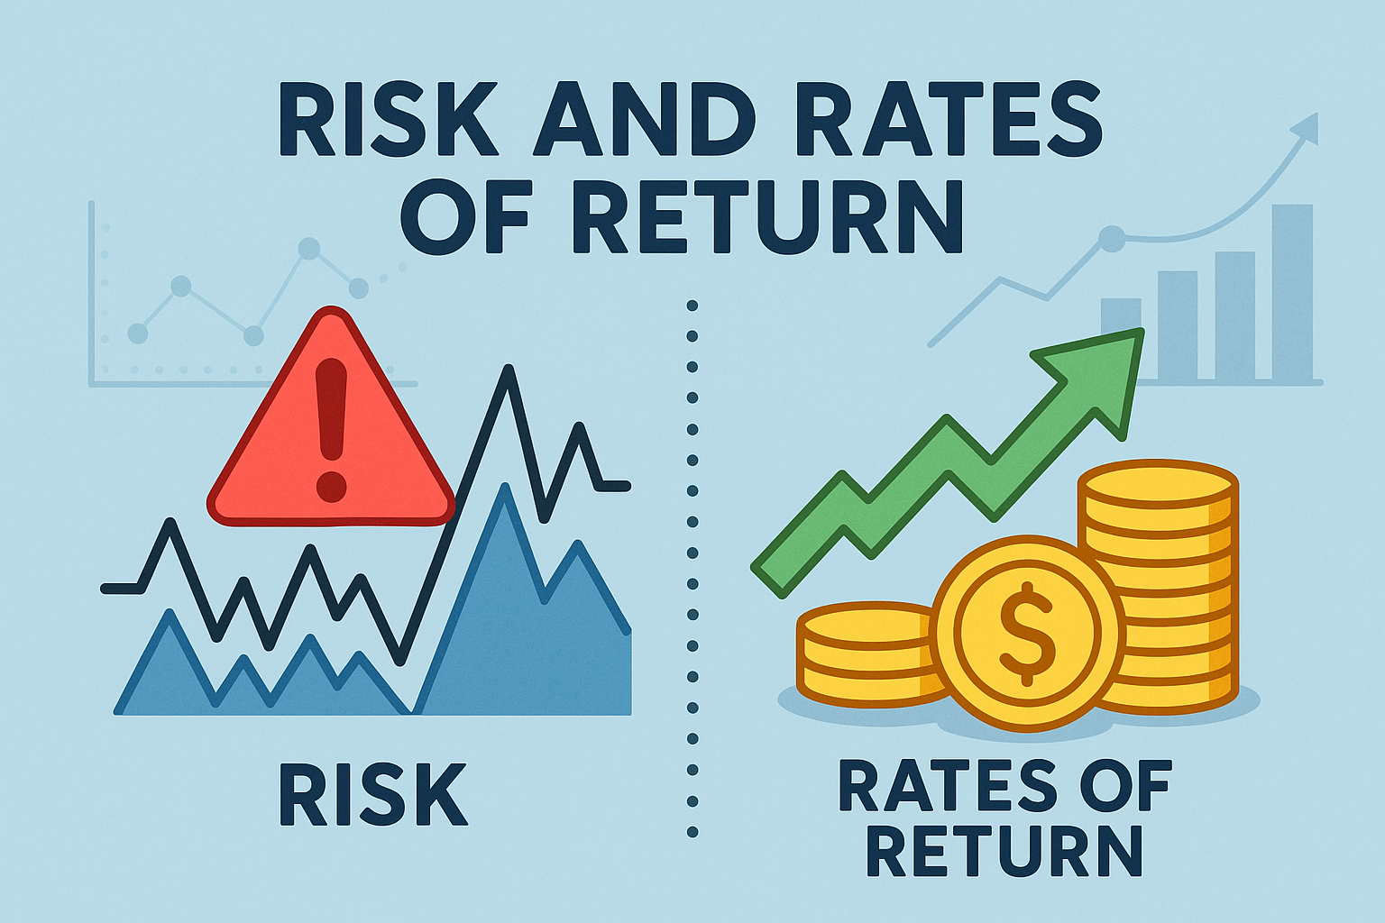
Chapter 8

Slide 2
The Risk–Return Trade-Off: Investor Perspective
Investors prefer higher returns and dislike risk.
To attract investors to riskier assets, higher expected returns are needed.
Return
Return
Flat slope → More comfort with risk
Steep slope → High risk aversion
10%
6%
5%
5%
0
5%
10%
Risk
0
5%
10%
Risk
The slope of the risk–return line reflects an investor’s risk tolerance.

Slide 3
The Risk–Return Trade-Off: Company Perspective
Companies must offer higher returns on riskier projects to attract capital.
Riskier companies:
    Pay higher yields to bondholders (default risk).
    Must generate higher stock returns (equity risk).
The risk–return line shows the company’s cost of capital.
Firms create value by investing in projects that yield returns above their cost of capital.
Firms destroy value by investing in projects that yield returns below their cost of capital.

Slide 4
What is Return?
Return is the gain or loss made on an investment over a period of time, usually expressed as a percentage of the original investment.
    It answers: "How much did I earn (or lose) from this investment?”
Ways to Calculate Return:
    Basic (Total) Return
        Used for a one-period investment (e.g., buying a stock and selling it later).
    Expected Return (r̂)
        Used when there are multiple possible outcomes and probabilities.
    Historical (Average) Return (r̄)
        Used when looking at past data over several periods.

Slide 5
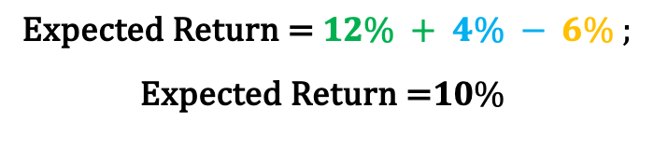
Expected Return
Expected Return is the weighted average of possible returns from an investment, based on their probabilities.
Expected Return = ∑(Probability of Outcome × Return of Outcome)
Outcome | Probability | Return
Boom | 40% | 30%
Normal | 20% | 20%
Recession | 40% | -15%
$$\text{Expected} \text{Return}\text{ = (40\% }× 30\%)+\left(20\% × 20\%\right)+\left(40\% × \left(−15\%\right)\right);$$
$$\text{Expected} \text{Return}\text{ = }12\% + 4\% − 6\% ;$$
$$\text{Expected} \text{Return}\text{ =}10\%$$

Slide 6
Understanding Stand-Alone Risk
Risk = the chance of an unfavorable outcome.
Stand-alone risk: Risk of holding a single asset by itself.
Concepts to Understand or Measure Risk:
  Probability Distributions (Understand)
    Framework to describe uncertainty in possible returns.
  Standard Deviation (σ) (Measure)
    How spread out the returns are (volatility).
  Coefficient of Variation (CV) (Measure)
    Risk per unit of return. Useful when comparing assets with different expected returns.
  Sharpe Ratio (Measure)
    How much excess return (over the risk-free rate) you earn per unit of risk.

Slide 7


Drawing Probability Distributions
A probability distribution shows possible outcomes and their likelihood.
Outcome | Probability | Return
Boom | 40% | 30%
Normal | 20% | 20%
Recession | 40% | -15%
Outcome | Probability | Return
Boom | 40% | 20%
Normal | 20% | 6%
Recession | 40% | 2%
$$\text{Expected} \text{Return}\text{ (}\text{A}\text{) =}10\%$$
$$\text{Expected} \text{Return}\text{ (}\text{B}\text{) =}10\%$$
Prob
Prob
-15%
30%
Return
2%
20%
Return

Slide 8
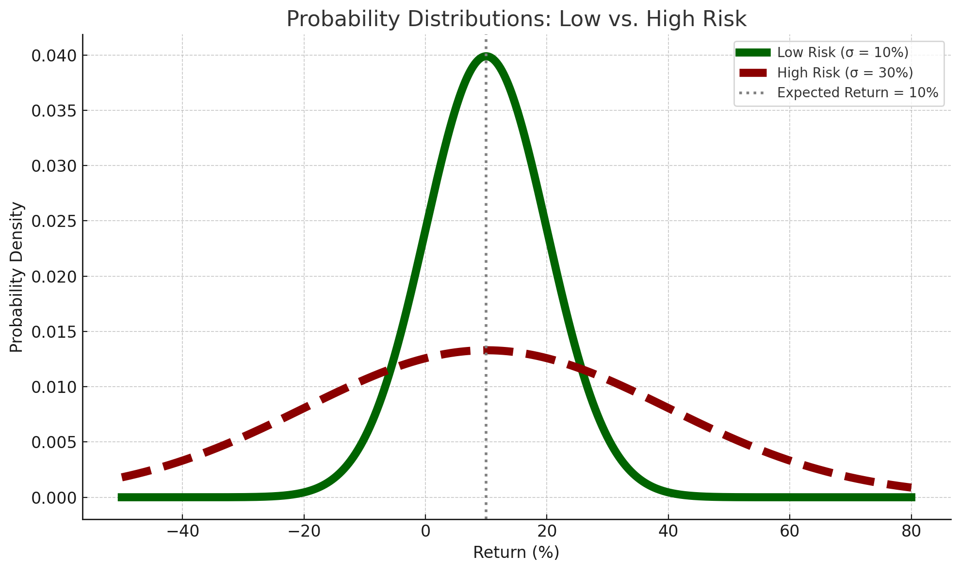
Probability Distributions & Risk
Extreme Outcomes with Higher Prob

Slide 9
Understanding Standard Deviation
Standard Deviation (σ) measures how spread out or volatile returns are around the average (mean).
It shows how much actual returns deviate from the expected return.
Low σ
High σ
0%
Average
20%
Return
0%
Average
20%
Return
A higher σ = more variability = more uncertainty

Slide 10
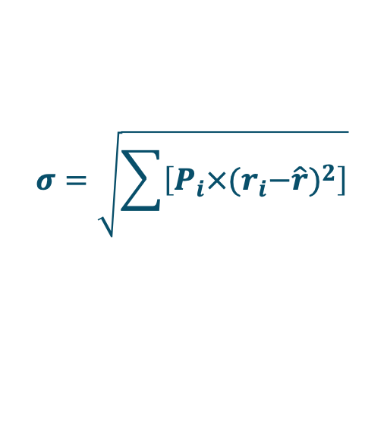
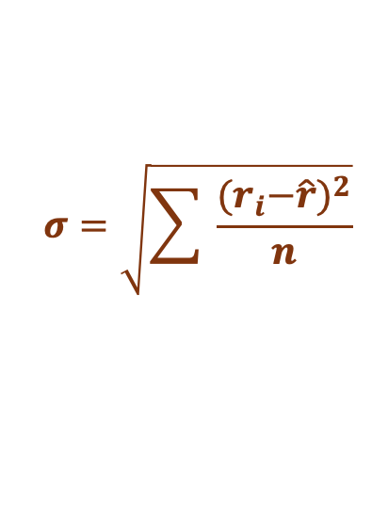
Calculating Risk with Standard Deviation (1)
We can measure risk using standard deviation in two ways:
From a Probability Distribution
    When future scenarios and probabilities are known
    Use weighted formula to calculate σ
$$σ=\sqrt{\sum{\left[P_{i}×{{(r}_{i}−\hat{r})}^{2}\right]}}$$
From Historical Data
    Based on actual past returns
    Use sample standard deviation formula
$$σ=\sqrt{\sum{ \frac{{{(r}_{i}−\hat{r})}^{2}}{n}}}$$
Both methods give a numerical estimate of stand-alone risk.

Slide 11
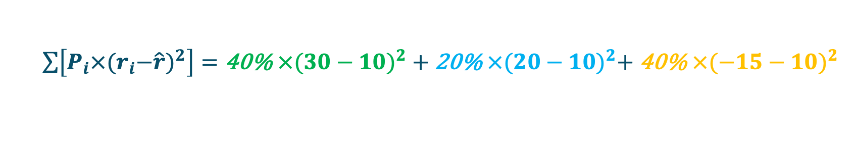
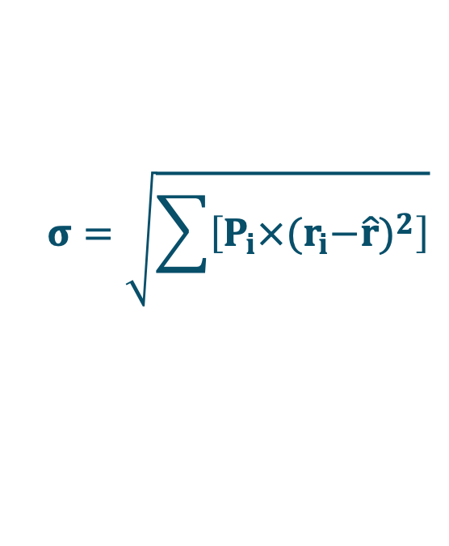

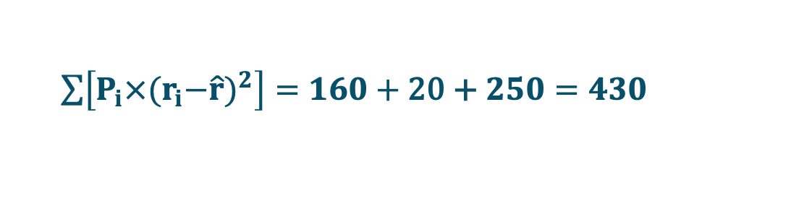
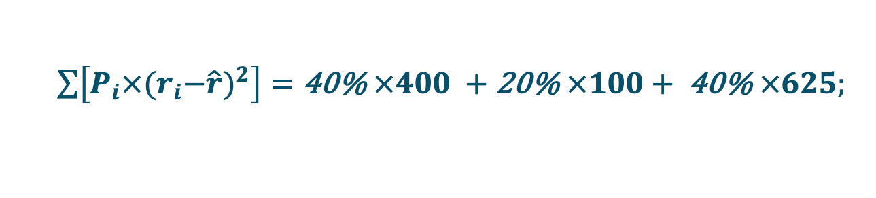
Calculating Risk with Standard Deviation (2)
Measure risk using standard deviation from a probability distribution.
Outcome | Probability | Return
Boom | 40% | 30%
Normal | 20% | 20%
Recession | 40% | -15%
$$σ=\sqrt{\sum{\left[P_{i}×{{(r}_{i}−\hat{r})}^{2}\right]}}$$
$\sum{\left[P_{i}×{{(r}_{i}−\hat{r})}^{2}\right]=\text{40\% }×{(30−10)}^{2} +}$ $\text{20\% }×{(20−10)}^{2}+ \text{40\% }×{(−15−10)}^{2}$
$\sum{\left[P_{i}×{{(r}_{i}−\hat{r})}^{2}\right]=\text{40\% }×400 +}$ $\text{20\% }×100+ \text{40\% }×625;$
$\sum{\left[P_{i}×{{(r}_{i}−\hat{r})}^{2}\right]=160+}$ $\text{2}\text{0}\text{ + }250=430$
$$σ=\sqrt{430}=20.73\%$$

Slide 12
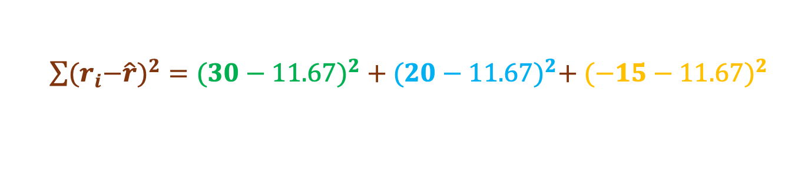

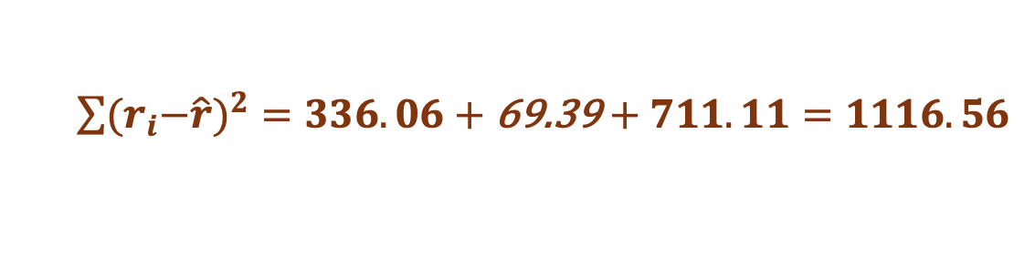
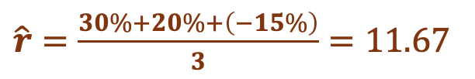
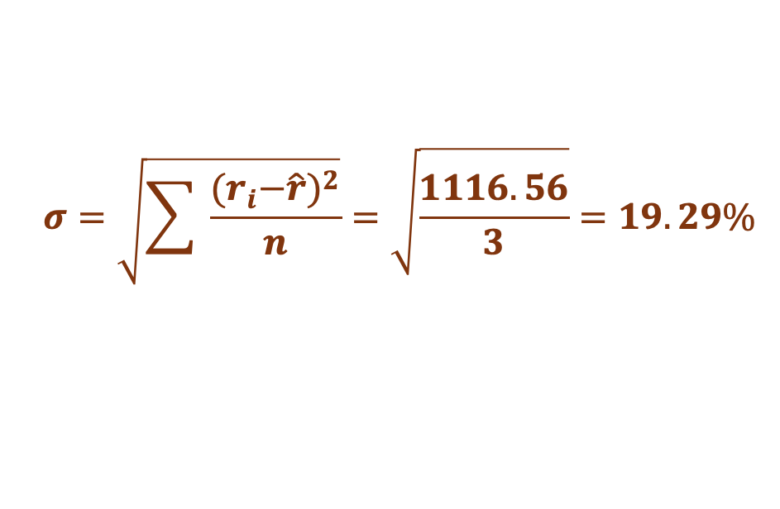
Calculating Risk with Standard Deviation (3)
Measure risk using standard deviation from From Historical Data.
YEAR | Return
2021 | 30%
2022 | 20%
2023 | -15%
$$σ=\sqrt{\sum{ \frac{{{(r}_{i}−\hat{r})}^{2}}{n}}}$$
$\hat{r}=\frac{30\%+20\%+\left(−15\%\right)}{3}=11.67$
$\sum{{{(r}_{i}−\hat{r})}^{2}={(30−11.67)}^{2} +}$ ${(20−11.67)}^{2}+ {(−15−11.67)}^{2}$
$\sum{{{(r}_{i}−\hat{r})}^{2}=336.06+}$ 69.39 $+ 711.11=1116.56$
$$σ=\sqrt{\sum{ \frac{{{(r}_{i}−\hat{r})}^{2}}{n}}}=\sqrt{\frac{1116.56}{3}}=19.29\%$$

Slide 13
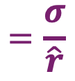









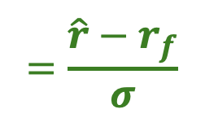
Selecting the Best Investment Opportunity
Three Scenarios to Consider:
Scenario 1: Same Risk, Different Return
Option A: Risk = 10%, Return = 20%
Option B: Risk = 10%, Return = 30%
Scenario 2: Same Return, Different Risk
Option A: Risk = 10%, Return = 20%
Option B: Risk = 30%, Return = 20%
$$✅$$
$$✅$$
$$✅$$
$$✅$$
$$✅$$
$$✅$$
Coefficient of Variation (CV)
$$=\frac{σ}{\hat{r}}$$
Scenario 3: Higher Return, Higher Risk
Option A: Risk = 10%, Return = 20%
Option B: Risk = 20%, Return = 30%
Lower CV = better risk efficiency
$$✅$$
$$✅$$
$$✅$$
$$=\frac{\hat{r}−r_{f}}{σ}$$
Sharpe Ratio
Higher Sharpe = better risk-adjusted return

Slide 14

Question-1
An investment has a 30% chance of producing a 30% return, a 20% chance of producing an 15% return, a 10% chance of producing a 5% return, and a 40% chance of producing a -15% return. What is its expected return?
Scenario | Probability | Return
1 | 30% | 30%
2 | 20% | 10%
3 | 10% | 0%
4 | 40% | -15%
Expected Return = ∑(Probability of Outcome × Return of Outcome)
$$\text{Expected} \text{Return}\text{ = (30\% }× 30\%)+\left(20\% × 10\%\right)+\left(10\% × \left(0\%\right)\right)+\left(40\% × \left(−15\%\right)\right);$$
$$\text{Expected} \text{Return}\text{ = }9\% +2\%+0\%−6\% ;$$
$$\text{Expected} \text{Return}\text{ =} 5\%$$

Slide 15
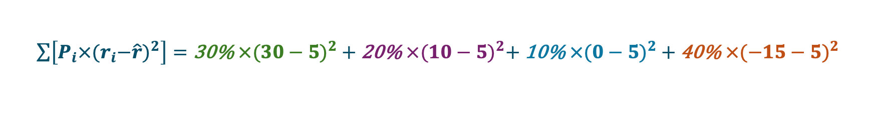

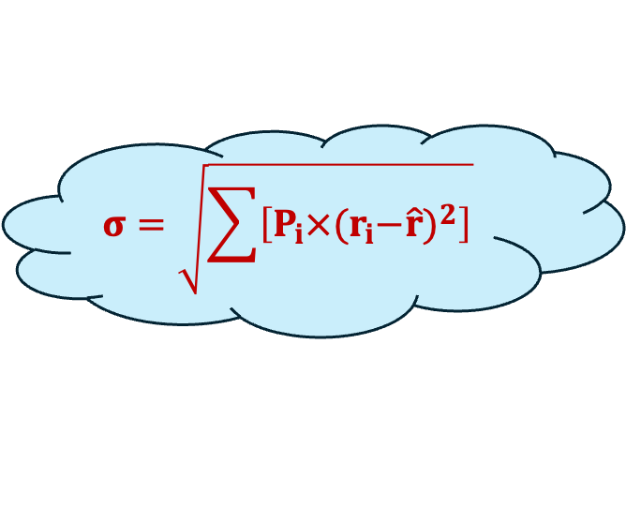

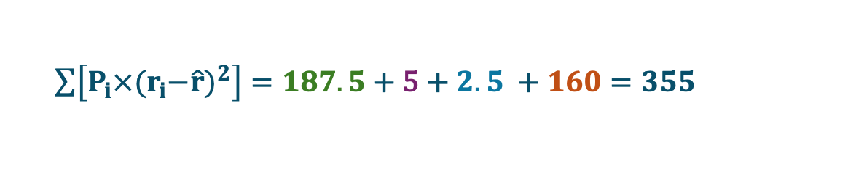
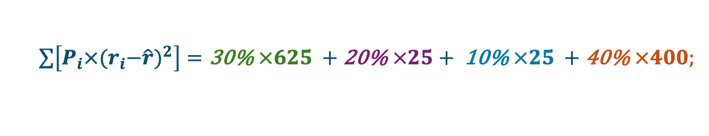
Question-2
An investment has a 30% chance of producing a 30% return, a 20% chance of producing an 15% return, a 10% chance of producing a 5% return, and a 40% chance of producing a -15% return. Calculate the risk of this investment?
Scenario | Probability | Return
1 | 30% | 30%
2 | 20% | 10%
3 | 10% | 0%
4 | 40% | -15%
$$σ=\sqrt{\sum{\left[P_{i}×{{(r}_{i}−\hat{r})}^{2}\right]}}$$
$\hat{r}$ = $\text{Expected} \text{Return}$= 5%
$\sum{\left[P_{i}×{{(r}_{i}−\hat{r})}^{2}\right]=\text{30\% }×{(30−5)}^{2} +}$ $\text{20\% }×{(10−5)}^{2}+ \text{1}\text{0\% }×{(0−5)}^{2}$ $+ \text{4}\text{0\% }×{(−15−5)}^{2}$
$\sum{\left[P_{i}×{{(r}_{i}−\hat{r})}^{2}\right]=\text{3}\text{0\% }×625 +}$ $\text{20\% }×25+ \text{1}\text{0\% }×25 +\text{4}\text{0\% }×400;$
$\sum{\left[P_{i}×{{(r}_{i}−\hat{r})}^{2}\right]=187.5+}$ $\text{5} \text{+ }2.5 +160=355$
$$σ=\sqrt{355}=18.84\%$$

Slide 16
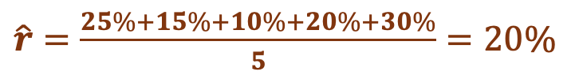
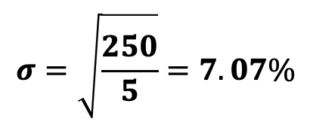

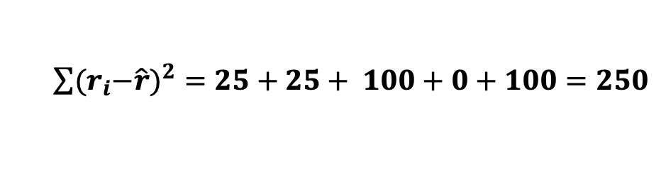
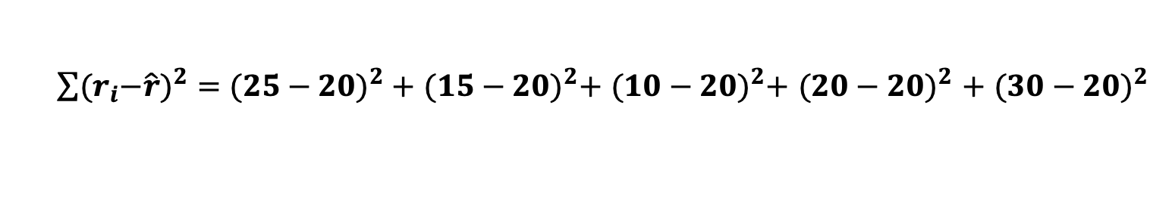
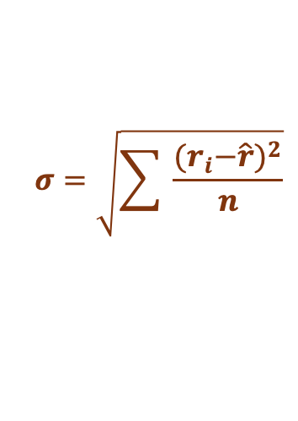
Question-3
Historical returns for Stock A over the past 5 years is listed here. What are the coefficient of variation for Stock A ?
$$\text{Coefficient} \text{of} \text{Variation}\text{ (}\text{CV}\text{) }=\frac{σ}{\hat{r}}$$
Year | Return
2020 | 25%
2021 | 15%
2022 | 10%
2023 | 20%
2024 | 30%
$$σ=\sqrt{\sum{ \frac{{{(r}_{i}−\hat{r})}^{2}}{n}}}$$
$\hat{r}=\frac{25\%+15\%+10\%+20\%+30\%}{5}=20\%$
$\sum{{{(r}_{i}−\hat{r})}^{2}={(25−20)}^{2} +}$ ${(15−20)}^{2}+ {(10−20)}^{2}+ {(20−20)}^{2}$ $+ {(30−20)}^{2}$
$\sum{{{(r}_{i}−\hat{r})}^{2}=25+}$ $25+ 100+0+100=250$
$$σ=\sqrt{\frac{250}{5}}=7.07\%$$
$\text{Coefficient} \text{of} \text{Variation}\text{ (}\text{CV}\text{) }=\frac{σ}{\hat{r}}=\frac{7.07}{20}=0.3536 or 35.36\%$

Slide 17
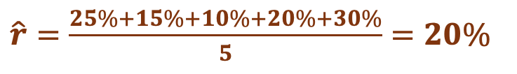

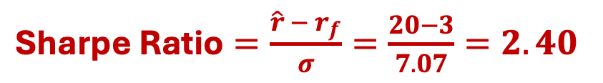
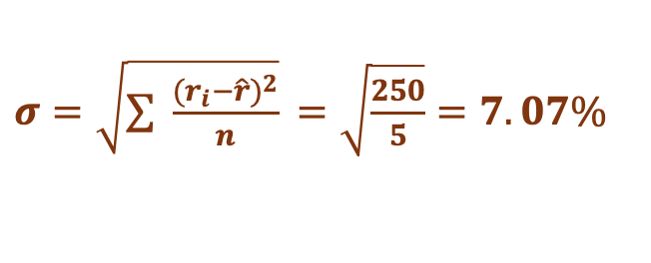
Question-4
Historical returns for Stock A over the past 5 years is listed here. What are the Sharpe ratio for Stock A ? (The risk-free rate is 3%)
Year | Return
2020 | 25%
2021 | 15%
2022 | 10%
2023 | 20%
2024 | 30%
$$\text{Sharpe} \text{Ratio}=\frac{\hat{r}−r_{f}}{σ}$$
$\hat{r}=\frac{25\%+15\%+10\%+20\%+30\%}{5}=20\%$
$\text{Sharpe} \text{Ratio}=\frac{\hat{r} − r_{f}}{σ}=\frac{20−3}{7.07}=2.40$
$σ=\sqrt{\sum{ \frac{{{(r}_{i}−\hat{r})}^{2}}{n}}}$ $=\sqrt{\frac{250}{5}}=7.07\%$

Slide 18
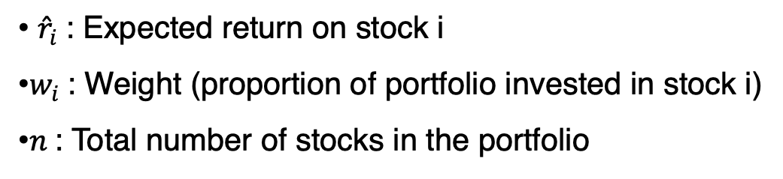
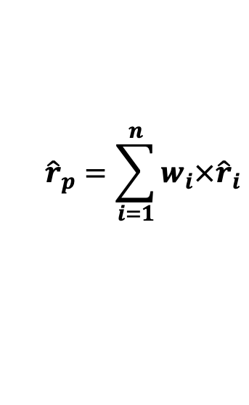
Expected Portfolio Return
The expected return on a portfolio is a weighted average of the expected returns of the individual assets:
$${\hat{r}}_{p}=\sum_{i=1}^{n}{w_{i}×{\hat{r}}_{i}}$$
​ ${\hat{r}}_{i}$: Expected return on stock i
$w_{i}$: Weight (proportion of portfolio invested in stock i)
$n$: Total number of stocks in the portfolio
Stock | Expected Return | Investment ($)
Microsoft | 7.75% | 25,000
IBM | 7.25% | 25,000
GE | 8.75% | 25,000
ExxonMobil | 7.75% | 25,000
Total |  | 100,000
Weight (%)
25.0%
25.0%
25.0%
25.0%
100%
Weighted Return
1.9375%
1.8125%
2.1875%
1.9375%
7.875%

Slide 19
Portfolio Risk
The portfolio’s risk, σ_{P}, is not the weighted average of the individual stocks’ standard deviations.
The portfolio’s risk is generally smaller than the average of the stocks’ σ because:
Diversification lowers the portfolio’s risk.
σ_{a}= 20% and σ_{b}= 20%
σ_{p}= 0%
The tendency of two variables to move together is called correlation, and;
The correlation coefficient, measures this tendency.

Slide 20
What Is Correlation in Portfolio Risk?
Correlation (ρ) measures how two assets move in relation to each other. It ranges from –1 to +1:
Lower (or negative) correlation = greater diversification benefits
Portfolio risk is reduced not just by more assets, but by combining uncorrelated or inversely correlated assets
ρ= -1
ρ= 0
ρ= +1

Slide 21
The Beta Coefficient
Beta (β) measures a stock’s sensitivity to movements in the overall market.
It shows how much the stock’s return responds to changes in market return.
Helps investors understand systematic (market) risk.
Interpretation of Beta
β Value | Meaning | Risk Level
β = 1 | Same volatility as the market | Market risk
β > 1 | More volatile than the market | Higher risk
β < 1 | Less volatile than the market | Lower risk
β < 0 | Moves opposite to the market | Hedge characteristics

Slide 22
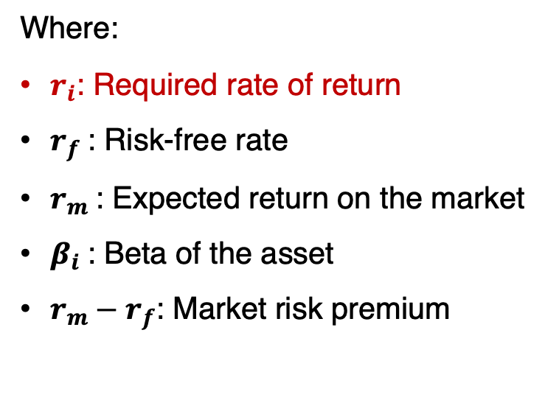
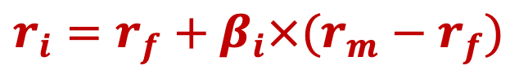
Capital Asset Pricing Model (CAPM)
It explains the relationship between an asset’s systematic risk (beta) and its expected return.
It is used to estimate the minimum return an investor should expect for taking on additional risk.
$$r_{i}=r_{f}+β_{i}×(r_{m}−r_{f})$$
Where:
$r_{i}$: Required rate of return
$r_{f}$: Risk-free rate
$r_{m}$: Expected return on the market
$β_{i}$: Beta of the asset
$r_{m}−r_{f}$: Market risk premium
Key Insights
Higher β → higher expected return
Only systematic (market) risk matters; unsystematic risk is assumed to be diversified away
Foundation for estimating cost of equity

Slide 23






Question-5
The risk-free rate is 3%, and the market risk premium is 4%. Stock A has a beta of 1.2, and Stock B has a beta of 0.8.
$$r_{i}=r_{f}+β_{i}×(r_{m}−r_{f})$$
Stock A
Stock B
$${\hat{r}}_{i}=3\%+1.2×(4\%)$$
$${\hat{r}}_{i}=3\%+0.8×(4\%)$$
$${\hat{r}}_{i}=3\%+4.8\%$$
$${\hat{r}}_{i}=3\%+3.2\%$$
$${\hat{r}}_{i}=7.8\%$$
$${\hat{r}}_{i}=6.2\%$$

