Slide 1

Lecturer : Reza Arjmandi

Slide 2
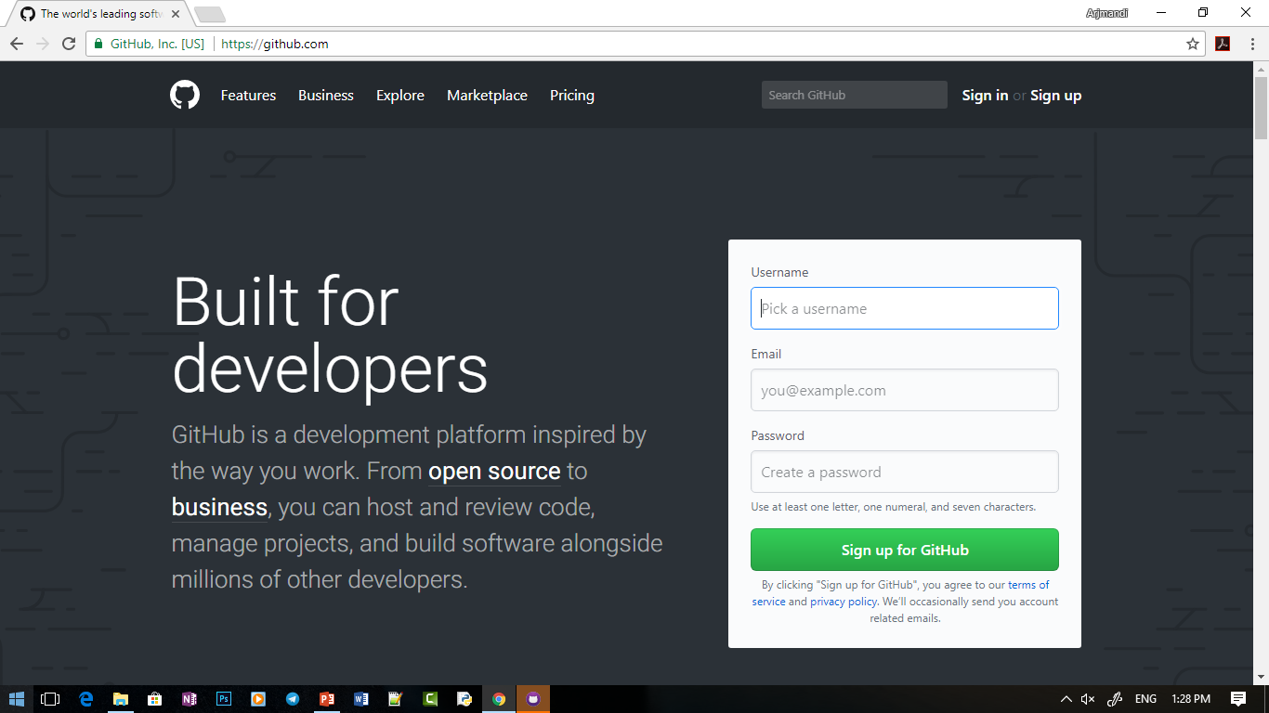
Sign up in github .com

Slide 3
Configure git
git config --global user.email “example@email.com
git config --global user.name “user name”

Slide 4

create repository
git init

Slide 5
check staus of repository
git status

Slide 6
add files to repository
git add file
for add all files in directory:
git add .

Slide 7

commit changes
git commit –m “initial commit”
initial commit

Slide 8
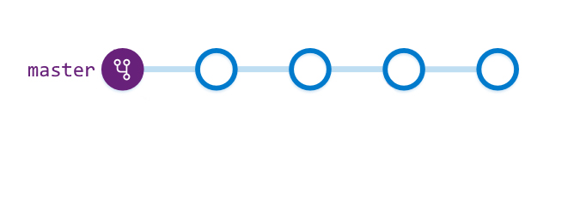
History of repository
git log
Add feature1
Add feature3
initial commit
Add feature2

Slide 9
discard changes
git checkout file
initial commit

Slide 10
add remote repository
git remote add origin url
initial commit

Slide 11
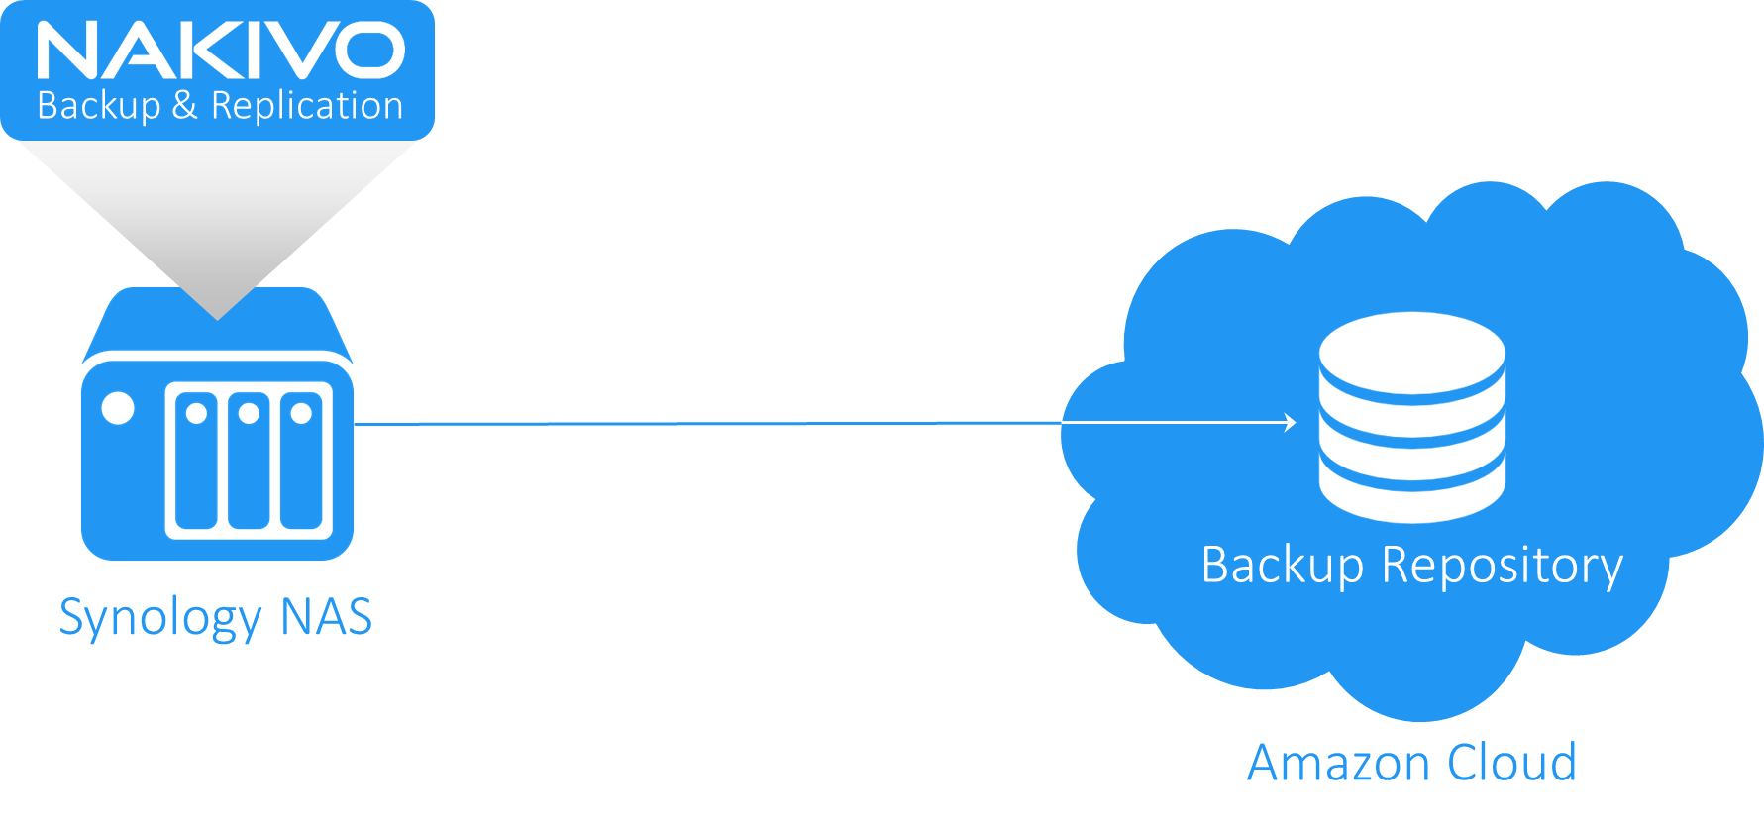


push to remote repository
git push –u origin master

Slide 12
Update local repository
git pull

Slide 13

Distributed application development

Slide 14
Clone repository
git clone url

Slide 15
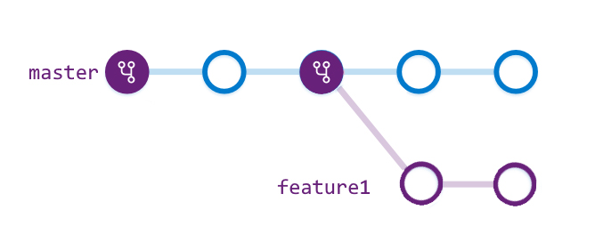
Create new branch
git branch feature1
Commit2
Commit1

Slide 16
Switch to new branch
git checkout feature1
Commit2
Commit1

Slide 17
push branch
git push origin feature1

Slide 18
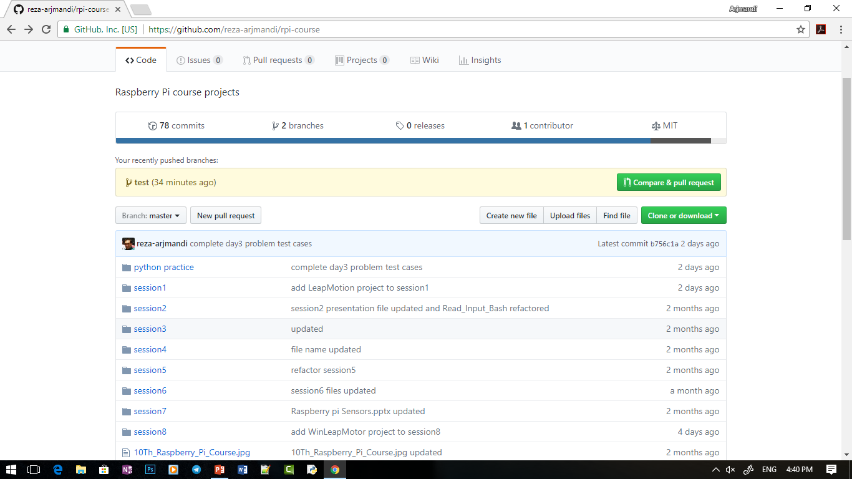
Create pull request

Slide 19
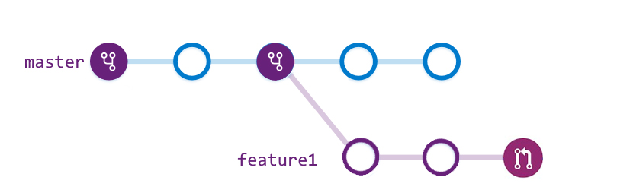
Create pull request

Slide 20
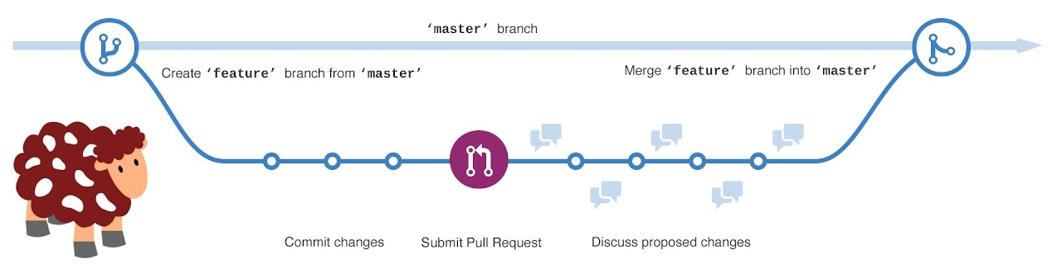
GitHub workflow

