Slide 1

Python Advanced
Lecturer: Reza Arjmandi
Summer 2016
Preface:
In this chapter, we will explore some of the more advanced concepts in the Python language—in particular, filesystem, comprehensions, object-oriented and Internet programming.

Slide 2
Working With Files And Directories
Python 3 comes with a module called os, which stands for “operating system.”
The os module contains a plethora of functions to get information on — and in some cases, to manipulate — local directories, files, processes, and environment variables.
Python does its best to offer a unified API across all supported operating systems so your programs can run on any computer with as little platform-specific code as possible.

Slide 3
The Current Working Directory
If you import your own module, will probably fail with an ImportError. Why?
Because Python will look for the module in the import search path, but it won’t find it because the your module folder isn’t one of the directories in the search path.
To get past this, you can do one of two things:
Add the module folder address to the import search path
Change the current working directory to the module folder address
The current working directory is an invisible property that Python holds in memory at all times.
There is always a current working directory, whether you’re in the Python Shell, running your own Python script from the command line, or running a Python CGI script on a web server somewhere.

Slide 4
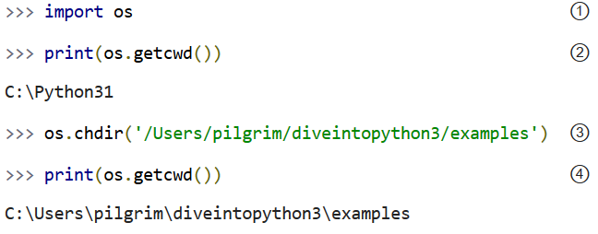
The Current Working Directory
The os module contains two functions to deal with the current working directory.

Slide 5
The Current Working Directory
① The os module comes with Python; you can import it anytime, anywhere.
② Use the os.getcwd() function to get the current working directory.
When you run the graphical Python Shell, the current working directory starts as the directory where the Python Shell executable is.
③ Use the os.chdir() function to change the current working directory.
④ When I called the os.chdir() function, I used a Linux-style pathname (forward slashes, no drive letter) even though I’m on Windows. This is one of the places where Python tries to paper over the differences between operating systems.

Slide 6
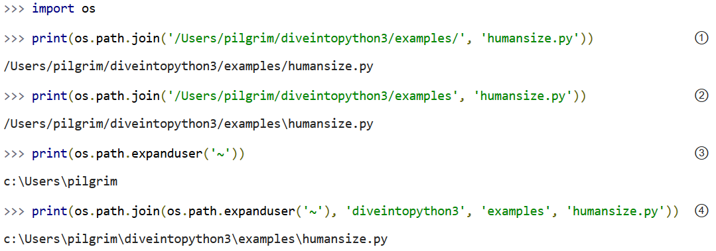
Working With Filenames and Directory Names
While we’re on the subject of directories, I want to point out the os.path module.
os.path contains functions for manipulating filenames and directory names.

Slide 7
Working With Filenames and Directory Names
① The os.path.join() function constructs a pathname out of one or more partial pathnames. In this case, it simply concatenates strings.
② In this slightly less trivial case, calling the os.path.join() function will add an extra slash to the pathname before joining it to the filename. It’s a backslash instead of a forward slash, because I constructed this example on Windows. If you replicate this example on Linux or Mac OS X, you’ll see a forward slash instead. Don’t fuss with slashes; always use os.path.join() and let Python do the right thing.
③ The os.path.expanduser() function will expand a pathname that uses ~ to represent the current user’s home directory. This works on any platform where users have a home directory, including Linux, Mac OS X, and Windows. The returned path does not have a trailing slash, but the os.path.join() function doesn’t mind.
④ Combining these techniques, you can easily construct pathnames for directories and files in the user’s home directory. The os.path.join() function can take any number of arguments. I was overjoyed when I discovered this, since addSlashIfNecessary() is one of the stupid little functions I always need to write when building up my toolbox in a new language. Do not write this stupid little function in Python; smart people have already taken care of it for you.

Slide 8
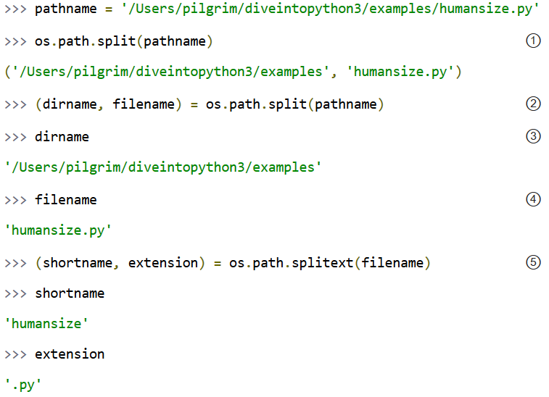
Working With Filenames and Directory Names
os.path also contains functions to split full pathnames, directory names, and filenames into their constituent parts.

Slide 9
Working With Filenames and Directory Names
① The split function splits a full pathname and returns a tuple containing the path and filename.
② Remember when I said you could use multi-variable assignment to return multiple values from a function? The os.path.split() function does exactly that. You assign the return value of the split function into a tuple of two variables. Each variable receives the value of the corresponding element of the returned tuple.
③ The first variable, dirname, receives the value of the first element of the tuple returned from the os.path.split() function, the file path.
④ The second variable, filename, receives the value of the second element of the tuple returned from the os.path.split() function, the filename.
⑤ os.path also contains the os.path.splitext() function, which splits a filename and returns a tuple containing the filename and the file extension. You use the same technique to assign each of them to separate variables.

Slide 10
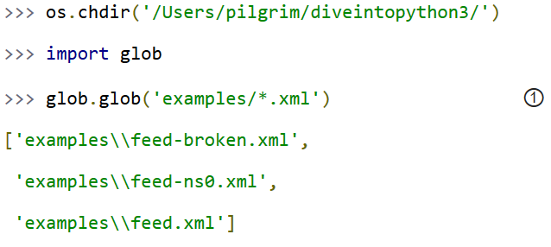
Listing Directories
The glob module is another tool in the Python standard library.
It’s an easy way to get the contents of a directory programmatically, and it uses the sort of wildcards that you may already be familiar with from working on the command line.
① The glob module takes a wildcard and returns the path of all files and directories matching the wildcard. In this example, the wildcard is a directory path plus “*.xml”, which will match all .xml files in the examples subdirectory.

Slide 11
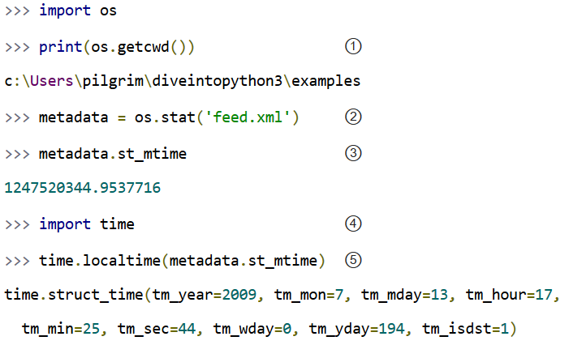
Getting File Metadata
Every modern file system stores metadata about each file: creation date, last-modified date, file size, and so on.
Python provides a single API to access this metadata. You don’t need to open the file; all you need is the filename.

Slide 12
Getting File Metadata
① The current working directory is the examples folder.
② feed.xml is a file in the examples folder. Calling the os.stat() function returns an object that contains several different types of metadata about the file.
③ st_mtime is the modification time, but it’s in a format that isn’t terribly useful. (Technically, it’s the number of seconds since the Epoch, which is defined as the first second of January 1st, 1970. Seriously.)
④ The time module is part of the Python standard library. It contains functions to convert between different time representations, format time values into strings, and fiddle with timezones.
⑤ The time.localtime() function converts a time value from seconds-since-the-Epoch (from the st_mtime property returned from the os.stat() function) into a more useful structure of year, month, day, hour, minute, second, and so on. This file was last modified on July 13, 2009, at around 5:25 PM.

Slide 13
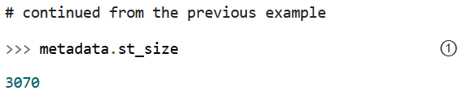
Getting File Metadata
① The os.stat() function also returns the size of a file, in the st_size property.
The file feed.xml is 3070 bytes.

Slide 14
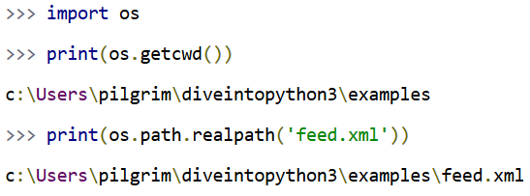
Constructing Absolute Pathnames
In the previous section, the glob.glob() function returned a list of relative pathnames.
The first example had pathnames like 'examples\feed.xml‘.
As long as you stay in the same current working directory, these relative pathnames will work for opening files or getting file metadata. But if you want to construct an absolute pathname — i.e. one that includes all the directory names back to the root directory or drive letter — then you’ll need the os.path.realpath() function.

Slide 15
Applying a Function to a List
Use the Python language feature called comprehensions.
The following example will convert each string element of the list to uppercase and return a new list the same length as the old one, but with all the strings in uppercase:
>>> l = ["abc", "def", "ghi", "ijk"]
>>> [x.upper() for x in l]
['ABC', 'DEF', 'GHI', 'IJK']
This is a very concise way of doing comprehensions. The whole expression has to be enclosed in brackets ([]). The first element of the comprehension is the code to be evaluated for each element of the list. The rest of the comprehension looks rather like a normal list iteration command . The loop variable follows the for keyword and then after the in keyword is the list to be used.

Slide 16
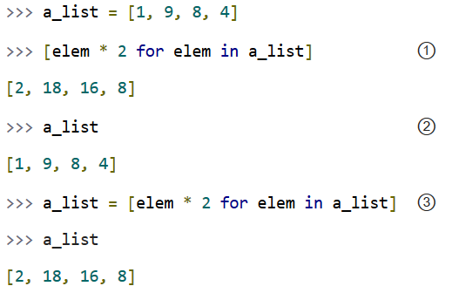
List Comprehensions
A list comprehension provides a compact way of mapping a list into another list by applying a function to each of the elements of the list.

Slide 17
List Comprehensions
① To make sense of this, look at it from right to left. a_list is the list you’re mapping.
The Python interpreter loops through a_list one element at a time, temporarily assigning the value of each element to the variable elem.
Python then applies the function elem * 2 and appends that result to the returned list.
② A list comprehension creates a new list; it does not change the original list.
③ It is safe to assign the result of a list comprehension to the variable that you’re mapping.
Python constructs the new list in memory, and when the list comprehension is complete, it assigns the result to the original variable.

Slide 18
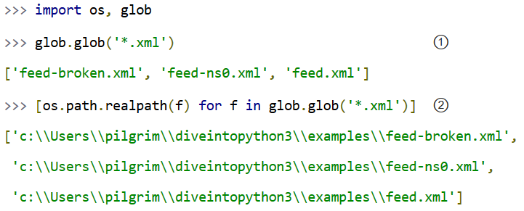
List Comprehensions
You can use any Python expression in a list comprehension, including the functions in the os module for manipulating files and directories.
① This returns a list of all the .xml files in the current working directory.
② This list comprehension takes that list of .xml files and transforms it into a list of full pathnames.

Slide 19
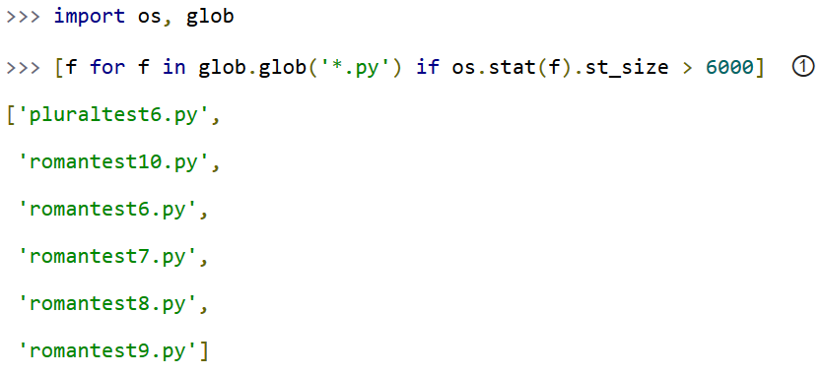
List Comprehensions
List comprehensions can also filter items, producing a result that can be smaller than the original list.

Slide 20
List Comprehensions
① To filter a list, you can include an if clause at the end of the list comprehension.
The expression after the if keyword will be evaluated for each item in the list.
If the expression evaluates to True, the item will be included in the output.
This list comprehension looks at the list of all .py files in the current directory, and the if expression filters that list by testing whether the size of each file is greater than 6000 bytes. There are six such files, so the list comprehension returns a list of six filenames.

Slide 21
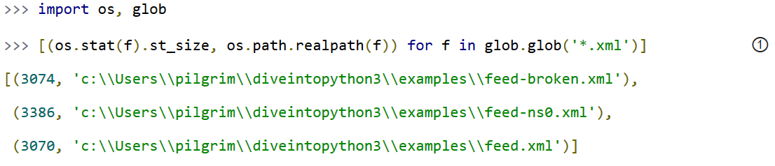
List Comprehensions
All the examples of list comprehensions so far have featured simple expressions — multiply a number by a constant, call a single function, or simply return the original list item (after filtering). But there’s no limit to how complex a list comprehension can be.
① This list comprehension finds all the .xml files in the current working directory, gets the size of each file (by calling the os.stat() function), and constructs a tuple of the file size and the absolute path of each file (by calling the os.path.realpath() function).

Slide 22
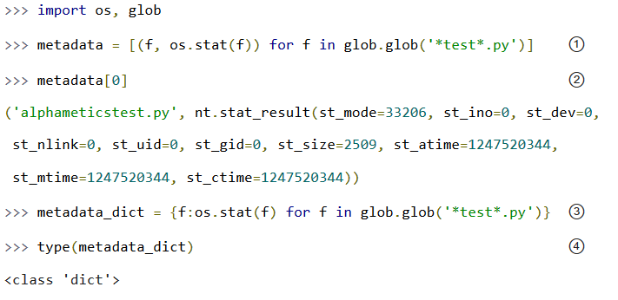
Dictionary Comprehensions
A dictionary comprehension is like a list comprehension, but it constructs a dictionary instead of a list.

Slide 23
Dictionary Comprehensions
① This is not a dictionary comprehension; it’s a list comprehension. It finds all .py files with test in their name, then constructs a tuple of the filename and the file metadata (from calling the os.stat() function).
② Each item of the resulting list is a tuple.
③ This is a dictionary comprehension. The syntax is similar to a list comprehension, with two differences. First, it is enclosed in curly braces instead of square brackets. Second, instead of a single expression for each item, it contains two expressions separated by a colon. The expression before the colon (f in this example) is the dictionary key; the expression after the colon (os.stat(f) in this example) is the value.
④ A dictionary comprehension returns a dictionary.

Slide 24
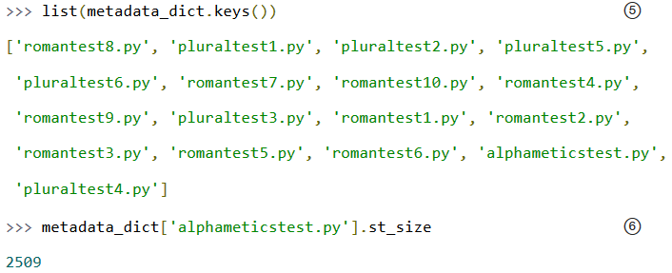
Dictionary Comprehensions
⑤ The keys of this particular dictionary are simply the filenames returned from the call to glob.glob('*test*.py').
⑥ The value associated with each key is the return value from the os.stat() function. That means we can “look up” a file by name in this dictionary to get its file metadata. One of the pieces of metadata is st_size, the file size. The file alphameticstest.py is 2509 bytes long.

Slide 25
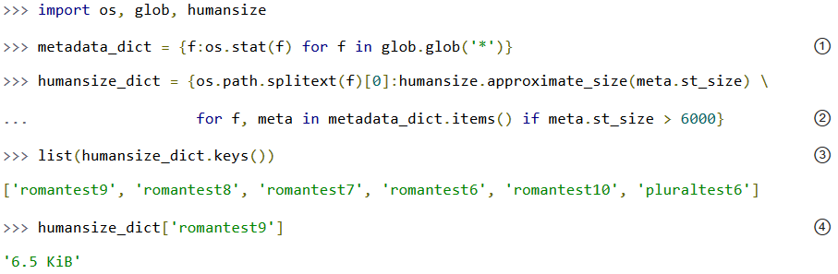
Dictionary Comprehensions
Like list comprehensions, you can include an if clause in a dictionary comprehension to filter the input sequence based on an expression which is evaluated with each item.

Slide 26
Dictionary Comprehensions
① This dictionary comprehension constructs a list of all the files in the current working directory (glob.glob('*')), gets the file metadata for each file (os.stat(f)), and constructs a dictionary whose keys are filenames and whose values are the metadata for each file.
② This dictionary comprehension builds on the previous comprehension, filters out files smaller than 6000 bytes (if meta.st_size > 6000), and uses that filtered list to construct a dictionary whose keys are the filename minus the extension (os.path.splitext(f)[0]) and whose values are the approximate size of each file (humansize.approximate_size(meta.st_size)).
③ As you saw in a previous example, there are six such files, thus there are six items in this dictionary.
④ The value of each key is the string returned from the approximate_size() function.

Slide 27
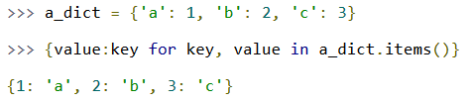
Other Fun Stuff To Do With Dictionary Comprehensions
Here’s a trick with dictionary comprehensions that might be useful someday: swapping the keys and values of a dictionary.

Slide 28
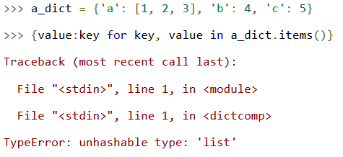
Other Fun Stuff To Do With Dictionary Comprehensions
Of course, this only works if the values of the dictionary are immutable, like strings or tuples. If you try this with a dictionary that contains lists, it will fail most spectacularly.

Slide 29
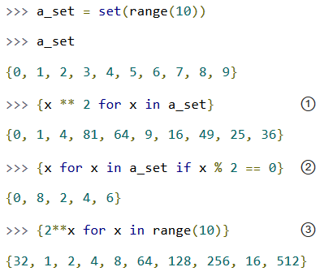
Set Comprehensions
Not to be left out, sets have their own comprehension syntax as well.
It is remarkably similar to the syntax for dictionary comprehensions. The only difference is that sets just have values instead of key:value pairs.

Slide 30
Set Comprehensions
① Set comprehensions can take a set as input. This set comprehension calculates the squares of the set of numbers from 0 to 9.
② Like list comprehensions and dictionary comprehensions, set comprehensions can contain an if clause to filter each item before returning it in the result set.
③ Set comprehensions do not need to take a set as input; they can take any sequence.

Slide 31
Formatting Numbers
Apply a format string to the number. For example:
>>> x = 1.2345678
>>> "number={:.2f}".format(x)
'number=1.23'
>>>
The formatting string can contain a mixture of regular text and markers delimited by { and }. The parameters to the format function (there can be as many as you like) will be substituted in place of the marker, according to the format specifier.
In the preceding example, the format specifier is :.2f, which means that the number will be specified with two digits after the decimal place and is a float f.

Slide 32
Formatting Numbers
If you wanted the number to be formatted so the total length of the number is always seven digits (or padding spaces), then you would add another number before the decimal place like this:
>>> “number={:7.2f}".format(x)
‘number= 1.23'
>>>
In this case, since the number is only three digits long, there are four spaces of padding before the 1.
Example2:
>>> c = 20.5
>>> "Temperature {:5.2f} deg C, {:5.2f} deg F.".format(c, c * 9 / 5 + 32)
'Temperature 20.50 deg C, 68.90 deg F.'
>>>

Slide 33
Formatting Dates
You want to convert a date into a string and format it in a certain way.
Apply format string to the date object.
Example:
>>> from datetime import datetime
>>> d = datetime.now()
>>> "{:%Y-%m-%d %H:%M:%S}".format(d)
'2013-05-02 16:00:45'
>>>
The Python formatting language includes some special symbols for formatting date. %Y, %m, and %d correspond to year, month, and day numbers, respectively.

Slide 34
Defining a Class
You need to group together related data and functionality into a class.
Example:
class Person:
'''This class represents a person object'''
def __init__(self, name, tel):
self.name = name
self.tel = tel
The first line inside the class definition uses the triple, single, or double quotes to denote a documentation string. This should explain the purpose of the class. Although entirely optional, adding a documentation string to a class allows others to see what the class does. This is particularly useful if the class is made available for others to use.
Doc strings are not like normal comments because, although they are not active lines of code, they do get associated with the class, so, at any time, you can read the doc string for a class using the following command:
Person.__doc__

Slide 35
Defining a Class
Inside the class definition is the constructor method, which will be called automatically whenever you create a new instance of the class.
def __init__(self, name, tel):
self.name = name
self.tel = tel
The constructor method must be named as shown with double underscores on either side of the word init.
One way in which Python differs from most object-oriented languages is that you have to include the special variable self as a parameter to all the methods that you define within the class. This is a reference to, in this case, the newly created instance. The variable self is the same concept as the special variable this that you find in Java and some other languages.

Slide 36
Defining a Class
The code in this method transfers parameters that were supplied to it into member variables. The member variables do not need to be declared in advance, but do need to be prefixed by self..
So the following line:
self.name = name
creates a variable called name that’s accessible to every member of the class Person and initializes it with the value passed into the call to create an instance, which looks like this:
p = Person("Simon", "1234567")
We can then check that our new Person object, p, has a name of “Simon” by typing the following:
>>> p.name
Simon
In a complex program, it is good practice to put each class in its own file with a filename that matches the class name. This also makes it easy to convert the class into a module

Slide 37
Defining a Method
You need to add a method to a class.
Example:
class Person:
'''This class represents a person object'''
def __init__(self, first_name, surname, tel):
self.first_name = first_name
self.surname = surname
self.tel = tel
def full_name(self):
return self.first_name + " " + self.surname
If one method calls another within the same class, the call to the method has to be prefixed with self

Slide 38
Inheritance
Use inheritance to create a subclass of an existing class and add new member variables and methods.
By default, all new classes that you create are subclasses of object. You can change this by specifying the class you want to use as a superclass in parentheses after the class name in a class definition. The following example defines a class (Employee) as a subclass (Person) and adds a new member variable (salary) and an extra method (give_raise):
class Employee(Person):
def __init__(self, first_name, surname, tel, salary): super().__init__(first_name, surname, tel)
self.salary = salary
def give_raise(self, amount):
self.salary = self.salary + amount

Slide 39
Inheritance
Note that the preceding example is for Python 3. For Python 2, you can’t use super the same way. Instead, you must write:
class Employee(Person):
def __init__(self, first_name, surname, tel, salary): Person.__init__(self, first_name, surname, tel)
self.salary = salary
def give_raise(self, amount):
self.salary = self.salary + amount
In both these examples, the initializer method for the subclass first uses the initializer method of the parent class (superclass) and then adds the member variable. This has the advantage that you do not need to repeat the initialization code in the new subclass.
The Python inheritance mechanism is actually very powerful and supports multiple inheritance—where a subclass inherits from more than one superclass. For more on inheritance, see the official documentation for Python.

Slide 40
Pickling
Use the Python pickling feature to dump the data structure to file in a format that can be automatically read back into memory as an equivalent data structure later on.
Example:
>>> import pickle
>>> mylist = ['some text', 123, [4, 5, True]]
>>> f = open('mylist.pickle', 'w')
>>> pickle.dump(mylist, f)
>>> f.close()
To unpickle the contents of the file into a new list, use the following:
>>> f = open('mylist.pickle')
>>> other_array = pickle.load(f)
>>> f.close()
>>> other_array
['some text', 123, [4, 5, True]]

Slide 41
Pickling
Pickling will work on pretty much any data structure you can throw at it. It does not need to be a list.
The file is saved in a text format that is sort of human-readable, but you will not normally need to look at or edit the text file.

Slide 42
Making Web Requests from Python
You need to read the contents of a web page into a string using Python 2
Python has an extensive library for making HTTP requests.
The following example reads the contents of the Google home page into the string contents:
import urllib2
contents = urllib2.urlopen("https://www.google.com/").read()
print(contents)

Slide 43
Command-Line Arguments in Python
You want to run a Python program from the command line and pass it parameters.
Import sys and use its argv property, as shown in the following example. This returns an array, the first element of which is the name of the program. The other elements are any parameters (separated by spaces) that were typed on the command line after the program name.
Example:
import sys
for (i, value) in enumerate(sys.argv):
print("arg: %d %s " % (i, value))
Running the program from the command line, with some parameters after it, results in the following output:
$ python cmd_line.py a b c
arg: 0 cmd_line.py
arg: 1 a
arg: 2 b
arg: 3 c

Slide 44
Sending Email from Python
You want to send an email message from a Python program.
Python has a library for the Simple Mail Transfer Protocol (SMTP) that you can use to send emails:
Attach library to your code: import smtplib
Create SMTP Session Client Object: smtpserver = smtplib.SMTP(SMTP_SERVER, SMTP_PORT)
Start Security connection: SSL or TLS: smtpserver.starttls()
Login to smtp server: smtpserver.login(GMAIL_USER, GMAIL_PASS)
Send email to your recipient: smtpserver.sendmail(GMAIL_USER, recipient, msg)
Close Connection: smtpserver.quit()

Slide 45
Send_Email project
Example:
import smtplib
import RPi.GPIO as GPIO
GMAIL_USER = ‘YOUR_RASPBERY_PI_GMAIL'
GMAIL_PASS = ‘YOUR_GMAIL_PASSWORD'
SMTP_SERVER = 'smtp.gmail.com'
SMTP_PORT = 587
GPIO.setmode(GPIO.BCM)
GPIO.setup(18,GPIO.IN,pull_up_down=GPIO.PUD_UP)

Slide 46
Send_Email project
def send_email(recipient, subject, text):
smtpserver = smtplib.SMTP(SMTP_SERVER, SMTP_PORT)
smtpserver.starttls()
smtpserver.login(GMAIL_USER, GMAIL_PASS)
header = 'To:' + recipient + '\n' + 'From: ' + GMAIL_USER
header = header + '\n' + 'Subject:' + subject + '\n'
msg = header + '\n' + text + ' \n\n'
smtpserver.sendmail(GMAIL_USER, recipient, msg)
smtpserver.quit()
counter=0
while(1):
if(GPIO.input(18)==0):
print("Danger!!!!!!")
print("sending email...")
send_email('arjmandi.re@gmail.com', 'Danger: home security!', 'Button Pressed-number: ' + str(counter))
print("send complete")
counter = counter + 1

Slide 47
Send_Email project
If you are not using Gmail, then you will also need to change the values of the SMTP_SERVER and possibly SMTP_PORT.
The send_email message simplifies the use of the smtplib library into a single function that you can reuse in your projects.

Slide 48
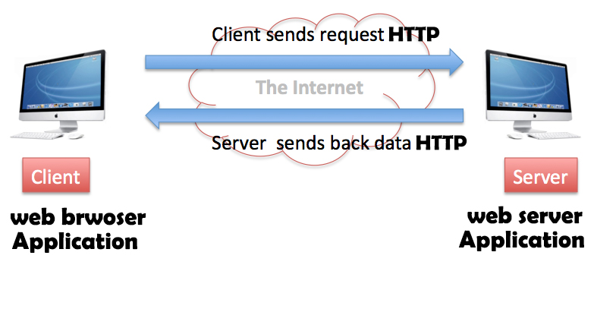
Web Service

Slide 49

Writing a Simple Web Server in Python
You need to create a simple Python web server, but don’t want to have to run a full web server stack.
Use the bottle Python library to run a pure Python web server that will respond to HTTP requests.
To install bottle, use the following command:
sudo apt-get install python-bottle
Following Figure shows the page you see if you connect to the Raspberry Pi from a browser anywhere on your network:

Slide 50
Simple_Webserver project
from bottle import route,run,template
from datetime import datetime
@route('/')
def index():
dt = datetime.now()
time = "{:%Y-%m-%d %H:%M:%S}".format(dt)
return template('<b>Pi thinks the date/time is: {{t}}</b>',t=time)
run(host='192.168.43.189', port=90)
To start the program, you need to run it with superuser privileges:
$ sudo python bottle_test.py

Slide 51
Writing a Simple Web Server in Python
After the import commands, the @route command links the URL path / with the handler function that follows it.
That handler function formats the date and time and then returns a string of the HTML to be rendered by the browser. In this case, it uses a template into which values can be substituted.
The final run line actually starts the web serving process. Note that you need to specify the hostname and port. Port 80 is the default port for web serving, so if you wish to use a different port, then you need to add the port number with a : after the server address.
You can define as many routes and handlers as you like within the program.

Slide 52


Contact us
www.e-system.ir
Info@e-system.ir

