Slide 1

Python Containers
Lecturer: Reza Arjmandi
Summer 2018
Preface:
In this chapter, we look at two key Python containers, list , tuple, set and dictionarie.

Slide 2
Python DataType
Python has many native datatypes. Here are the important ones:
Booleans are either True or False.
Numbers can be integers (1 and 2), floats (1.1 and 1.2), fractions (1/2 and 2/3), or even complex numbers.
Strings are sequences of Unicode characters, e.g. an HTML document.
Bytes and byte arrays, e.g. a JPEG image file.
Lists are ordered sequences of values.
Tuples are ordered, immutable sequences of values.
Sets are unordered bags of values.
Dictionaries are unordered bags of key-value pairs.

Slide 3
Creating a List
In Python, a list is a collection of values stored in order so that you can access them by position.
You create a list using [ and ] to contain its initial contents:
>>> a = [34, 'Fred', 12, False, 72.3]
>>>
Unlike more rigid arrays in languages like C, you don’t need to specify the size of a list in Python when you declare it. You can also change the number of elements in the list any time you like.
As this example illustrates, the items in a list do not have to be all of the same type, although they often are.
If you want to create an empty list that you can add items to later, you can write:
>>> a = []
>>>

Slide 4
Accessing Elements of a List
Use the [] notation to access elements of a list by their position in the list.For example:
>>> a = [34, 'Fred', 12, False, 72.3]
>>> a[1]
'Fred'
As well as using the [] notation to read values out of a list, you can also use it to change values at a certain position. For example:
>>> a = [34, 'Fred', 12, False, 72.3]
>>> a[1] = 777
>>> a
[34, 777, 12, False, 72.3]

Slide 5
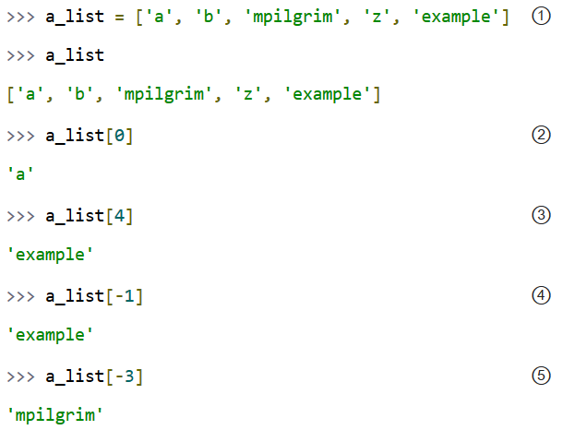
Accessing Elements of a List

Slide 6
Accessing Elements of a List
① First, you define a list of five items. Note that they retain their original order. This is not an accident. A list is an ordered set of items.
② A list can be used like a zero-based array. The first item of any non-empty list is always a_list[0].
③ The last item of this five-item list is a_list[4], because lists are always zero-based.
④ A negative index accesses items from the end of the list counting backwards. The last item of any non-empty list is always a_list[-1].
⑤ If the negative index is confusing to you, think of it this way:
a_list[-n] == a_list[len(a_list) - n].
So in this list, a_list[-3] == a_list[5 - 3] == a_list[2].

Slide 7
Find the Length of a List
Use the len Python function. For example:
>>> a = [34, 'Fred', 12, False, 72.3]
>>> len(a)
5
The len command also works on strings

Slide 8
Adding Elements to a List
Use the append, insert, or extend Python functions.
To add a single item to the end of a list, use append:
>>> a = [34, 'Fred', 12, False, 72.3]
>>> a.append("new")
>>> a
[34, 'Fred', 12, False, 72.3, 'new']
Sometimes you don’t want to add the new elements to the end of a list, but rather you want to insert them at a certain position in the list. For this, use the insert command. The first argument is the index where the item should be inserted, and the second argument is the item to be inserted:
>>> a.insert(2, "new2")
>>> a
[34, 'Fred', 'new2', 12, False, 72.3]

Slide 9
Adding Elements to a List
Both append and insert add only one element to a list. The extend function adds all the elements of one list to the end of another:
>>> a = [34, 'Fred', 12, False, 72.3]
>>> b = [74, 75]
>>> a.extend(b)
>>> a
[34, 'Fred', 12, False, 72.3, 74, 75]

Slide 10
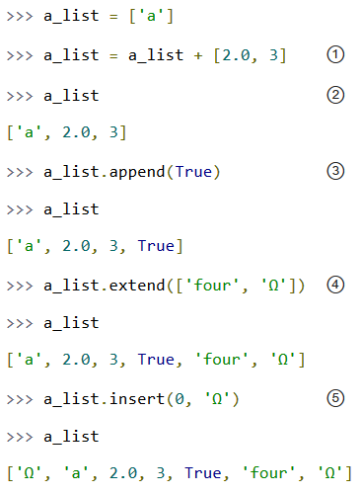
Adding Elements to a List

Slide 11
Adding Elements to a List
① The + operator concatenates lists to create a new list. A list can contain any number of items; there is no size limit (other than available memory). However, if memory is a concern, you should be aware that list concatenation creates a second list in memory. In this case, that new list is immediately assigned to the existing variable a_list. So this line of code is really a two-step process — concatenation then assignment — which can (temporarily) consume a lot of memory when you’re dealing with large lists.
② A list can contain items of any datatype, and the items in a single list don’t all need to be the same type. Here we have a list containing a string, a floating point number, and an integer.
③ The append() method adds a single item to the end of the list. (Now we have four different datatypes in the list!)
④ Lists are implemented as classes. “Creating” a list is really instantiating a class. As such, a list has methods that operate on it. The extend() method takes one argument, a list, and appends each of the items of the argument to the original list.
⑤ The insert() method inserts a single item into a list. The first argument is the index of the first item in the list that will get bumped out of position. List items do not need to be unique; for example, there are now two separate items with the value 'Ω': the first item, a_list[0], and the last item, a_list[6].

Slide 12
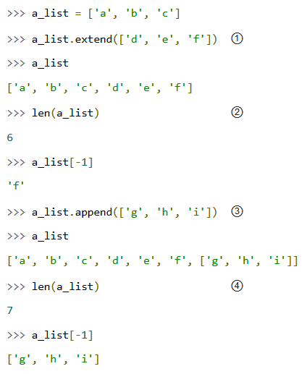
Adding Elements to a List
Let’s look closer at the difference between append() and extend().

Slide 13
Adding Elements to a List
① The extend() method takes a single argument, which is always a list, and adds each of the items of that list to a_list.
② If you start with a list of three items and extend it with a list of another three items, you end up with a list of six items.
③ On the other hand, the append() method takes a single argument, which can be any datatype. Here, you’re calling the append() method with a list of three items.
④ If you start with a list of six items and append a list onto it, you end up with... a list of seven items. Why seven? Because the last item (which you just appended) is itself a list. Lists can contain any type of data, including other lists. That may be what you want, or it may not. But it’s what you asked for, and it’s what you got.

Slide 14
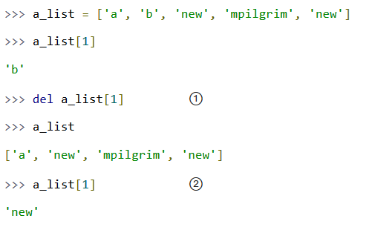
Removing Elements from a List
Lists can expand and contract automatically. You’ve seen the expansion part. There are several different ways to remove items from a list as well.

Slide 15
Removing Elements from a List
① You can use the del statement to delete a specific item from a list.
② Accessing index 1 after deleting index 1 does not result in an error. All items after the deleted item shift their positional index to “fill the gap” created by deleting the item.

Slide 16
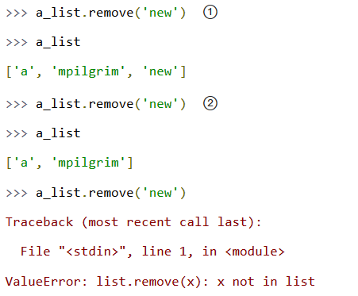
Removing Elements from a List
Don’t know the positional index? Not a problem; you can remove items by value instead.

Slide 17
Removing Elements from a List
① You can also remove an item from a list with the remove() method. The remove() method takes a value and removes the first occurrence of that value from the list. Again, all items after the deleted item will have their positional indices bumped down to “fill the gap.” Lists never have gaps.
② You can call the remove() method as often as you like, but it will raise an exception if you try to remove a value that isn’t in the list.

Slide 18
Removing Elements from a List
Use the pop Python function.
The command pop with no parameters removes the last element of a list:
>>> a = [34, 'Fred', 12, False, 72.3]
>>> a.pop()
72.3
>>> a
[34, 'Fred', 12, False]
Notice that pop returns the value removed from the list.
To remove an item in a position rather than the last element, use pop with a parameter of the position from which the item will be removed:
>>> a = [34, 'Fred', 12, False, 72.3]
>>> a.pop(0)
34

Slide 19
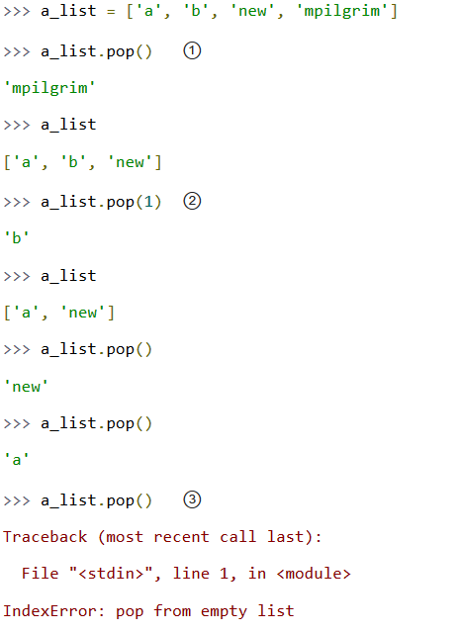
Removing Elements from a List

Slide 20
Removing Elements from a List
① When called without arguments, the pop() list method removes the last item in the list and returns the value it removed.
② You can pop arbitrary items from a list. Just pass a positional index to the pop() method. It will remove that item, shift all the items after it to “fill the gap,” and return the value it removed.
③ Calling pop() on an empty list raises an exception.

Slide 21
Creating a List by Parsing a String
You need to convert a string of words separated by some character into an array of strings with each string in the array being one of the words.
Use the split Python string function.
The command split with no parameters separates the words out of a string into individual elements of an array:
>>> "abc def ghi".split()
['abc', 'def', 'ghi']
If you supply split with a parameter, then it will split the string using the parameter as a separator. For example:
>>> "abc--de--ghi".split('--')
['abc', 'de', 'ghi']

Slide 22
Creating a List by Parsing a String
This command can be very useful when you are, say, importing data from a file. The split command can optionally take an argument that is the string to use as a delimiter when you are splitting the string. So, if you were to use commas as a separator, you could split the string as follows:
>>> "abc,def,ghi".split(',')
['abc', 'def', 'ghi']

Slide 23
Iterating over a List
You need to apply some lines of code to each item in a list in turn.
Use the for Python language command:
>>> a = [34, 'Fred', 12, False, 72.3]
>>> for x in a:
... print(x)
...
34
Fred
12
False
72.3
>>>

Slide 24
Enumerating a List
You need to run some lines of code to each item in a list in turn, but you also need to know the index position of each item.
Use the for Python language command along with the enumerate command.
>>> a = [34, 'Fred', 12, False, 72.3]
>>> for (i, x) in enumerate(a):
... print(i, x)
...
(0, 34)
(1, 'Fred')
(2, 12)
(3, False)
(4, 72.3)
>>>

Slide 25
Enumerating a List
It’s quite common to need to know the position of something in the list while enumerating each of the values. An alternative method is to simply count with an index variable and then access the value using the [] syntax:
>>> a = [34, 'Fred', 12, False, 72.3]
>>> for i in range(len(a)):
... print(i, a[i])
...
(0, 34)
(1, 'Fred')
(2, 12)
(3, False)
(4, 72.3)
>>>

Slide 26
Sorting a List
Use the sort Python language command:
>>> a = ["it", "was", "the", "best", "of", "times"]
>>> a.sort()
>>> a
['best', 'it', 'of', 'the', 'times', 'was']
When you sort a list, you’ll actually be modifying it rather than returning a sorted copy of the original list. This means that if you also need the original list, you need to use the copy command in the standard library to make a copy of the original list before sorting it:
>>> import copy
>>> a = ["it", "was", "the", "best", "of", "times"]
>>> b = copy.copy(a)
>>> b.sort()
>>> a
['it', 'was', 'the', 'best', 'of', 'times']
>>> b
['best', 'it', 'of', 'the', 'times', 'was']
>>>

Slide 27
Slicing A List
Use the [:] Python language construction. The following example returns a list containing the elements of the original list from index position 1 to index position 2 (the number after the : is exclusive):
>>> l = ["a", "b", "c", "d"]
>>> l[1:3]
['b', 'c']
The [:] notation is actually quite powerful. You can omit either argument, in which case the start or end of the list is assumed as appropriate. For example:
>>> l = ["a", "b", "c", "d"]
>>> l[:3]
['a', 'b', 'c']
>>> l[3:]
['d']
>>>

Slide 28
Slicing A List
You can also use negative indices to count back from the end of the list. The following example returns the last two elements in the list:
>>> l[-2:]
['c', 'd']
Incidentally, l[:-2] returns ['a', 'b'] in the preceding example.

Slide 29
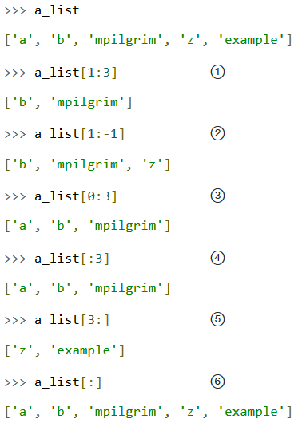
Slicing A List

Slide 30
Slicing A List
① You can get a part of a list, called a “slice”, by specifying two indices. The return value is a new list containing all the items of the list, in order, starting with the first slice index (in this case a_list[1]), up to but not including the second slice index (in this case a_list[3]).
② Slicing works if one or both of the slice indices is negative. If it helps, you can think of it this way: reading the list from left to right, the first slice index specifies the first item you want, and the second slice index specifies the first item you don’t want. The return value is everything in between.
③ Lists are zero-based, so a_list[0:3] returns the first three items of the list, starting at a_list[0], up to but not including a_list[3].
④ If the left slice index is 0, you can leave it out, and 0 is implied. So a_list[:3] is the same as a_list[0:3], because the starting 0 is implied.
⑤ Similarly, if the right slice index is the length of the list, you can leave it out. So a_list[3:] is the same as a_list[3:5], because this list has five items. There is a pleasing symmetry here. In this five-item list, a_list[:3] returns the first 3 items, and a_list[3:] returns the last two items. In fact, a_list[:n] will always return the first n items, and a_list[n:] will return the rest, regardless of the length of the list.
⑥ If both slice indices are left out, all items of the list are included. But this is not the same as the original a_list variable. It is a new list that happens to have all the same items. a_list[:] is shorthand for making a complete copy of a list.

Slide 31
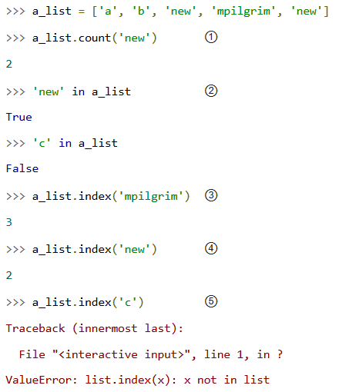
Searching For Values In A List

Slide 32
Searching For Values In A List
① As you might expect, the count() method returns the number of occurrences of a specific value in a list.
② If all you want to know is whether a value is in the list or not, the in operator is slightly faster than using the count() method. The in operator always returns True or False; it will not tell you how many times the value appears in the list.
③ Neither the in operator nor the count() method will tell you where in the list a value appears. If you need to know where in the list a value is, call the index() method. By default it will search the entire list, although you can specify an optional second argument of the (0-based) index to start from, and even an optional third argument of the (0-based) index to stop searching.
④ The index() method finds the first occurrence of a value in the list. In this case, 'new' occurs twice in the list, in a_list[2] and a_list[4], but the index() method will return only the index of the first occurrence.
⑤ As you might not expect, if the value is not found in the list, the index() method will raise an exception.
Wait, what? That’s right: the index() method raises an exception if it doesn’t find the value in the list. This is notably different from most languages, which will return some invalid index (like -1). While this may seem annoying at first, I think you will come to appreciate it. It means your program will crash at the source of the problem instead of failing strangely and silently later. Remember, -1 is a valid list index. If the index() method returned -1, that could lead to some not-so-fun debugging sessions!

Slide 33
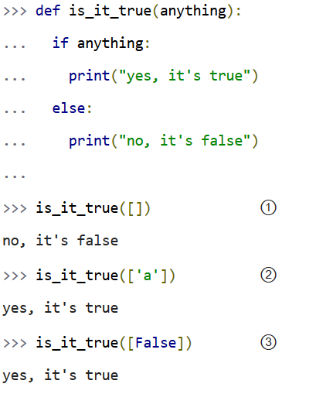
Lists In A Boolean Context
You can also use a list in a boolean context, such as an if statement.

Slide 34
Lists In A Boolean Context
① In a boolean context, an empty list is false.
② Any list with at least one item is true.
③ Any list with at least one item is true. The value of the items is irrelevant.

Slide 35
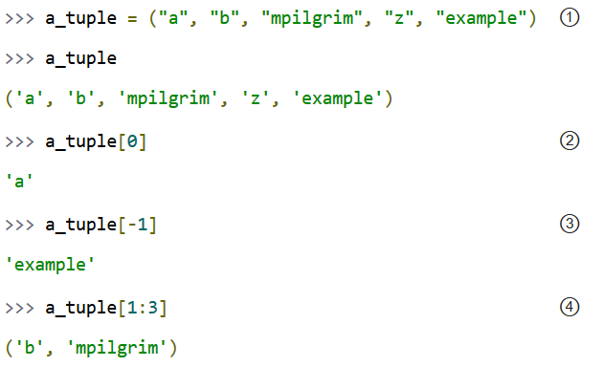
Tuples
A tuple is an immutable list. A tuple can not be changed in any way once it is created.

Slide 36
Tuples
① A tuple is defined in the same way as a list, except that the whole set of elements is enclosed in parentheses instead of square brackets.
② The elements of a tuple have a defined order, just like a list. Tuple indices are zero-based, just like a list, so the first element of a non-empty tuple is always a_tuple[0].
③ Negative indices count from the end of the tuple, just like a list.
④ Slicing works too, just like a list. When you slice a list, you get a new list; when you slice a tuple, you get a new tuple.
The major difference between tuples and lists is that tuples can not be changed. In technical terms, tuples are immutable. In practical terms, they have no methods that would allow you to change them. Lists have methods like append(), extend(), insert(), remove(), and pop(). Tuples have none of these methods.
You can slice a tuple (because that creates a new tuple), and you can check whether a tuple contains a particular value (because that doesn’t change the tuple), and… that’s about it.

Slide 37
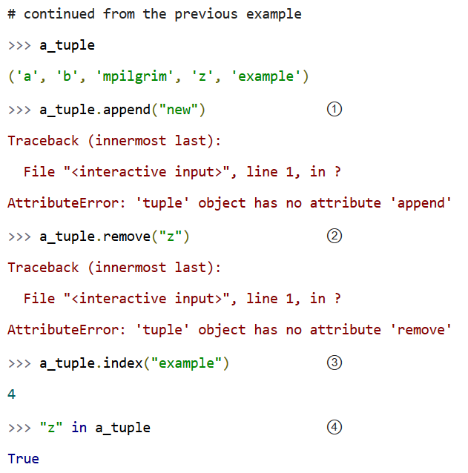
Tuples

Slide 38
Tuples
① You can’t add elements to a tuple. Tuples have no append() or extend() method.
② You can’t remove elements from a tuple. Tuples have no remove() or pop() method.
③ You can find elements in a tuple, since this doesn’t change the tuple.
④ You can also use the in operator to check if an element exists in the tuple.

Slide 39
So what are tuples good for?
Tuples are faster than lists. If you’re defining a constant set of values and all you’re ever going to do with it is iterate through it, use a tuple instead of a list.
It makes your code safer if you “write-protect” data that doesn’t need to be changed. Using a tuple instead of a list is like having an implied assert statement that shows this data is constant, and that special thought (and a specific function) is required to override that.
Some tuples can be used as dictionary keys (specifically, tuples that contain immutable values like strings, numbers, and other tuples).
Lists can never be used as dictionary keys, because lists are not immutable.
Tuples can be converted into lists, and vice-versa. The built-in tuple() function takes a list and returns a tuple with the same elements, and the list() function takes a tuple and returns a list.
In effect, tuple() freezes a list, and list() thaws a tuple.

Slide 40
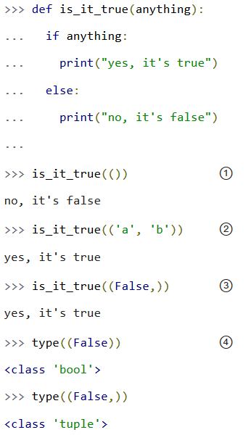
Tuples In A Boolean Context
You can use tuples in a boolean context, such as an if statement.

Slide 41
Tuples In A Boolean Context
① In a boolean context, an empty tuple is false.
② Any tuple with at least one item is true.
③ Any tuple with at least one item is true. The value of the items is irrelevant. But what’s that comma doing there?
④ To create a tuple of one item, you need a comma after the value. Without the comma, Python just assumes you have an extra pair of parentheses, which is harmless, but it doesn’t create a tuple.

Slide 42
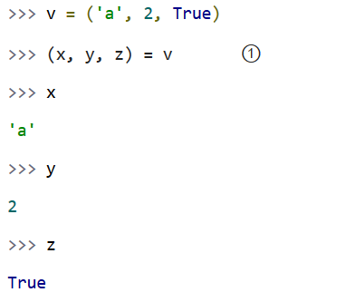
Assigning Multiple Values At Once
Here’s a cool programming shortcut: in Python, you can use a tuple to assign multiple values at once.
① v is a tuple of three elements, and (x, y, z) is a tuple of three variables. Assigning one to the other assigns each of the values of v to each of the variables, in order.

Slide 43
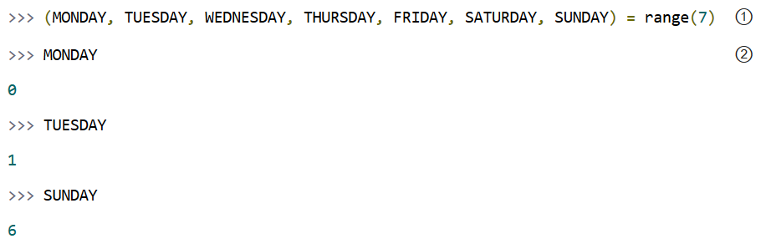
Assigning Multiple Values At Once
This has all kinds of uses. Suppose you want to assign names to a range of values. You can use the built-in range() function with multi-variable assignment to quickly assign consecutive values.

Slide 44
Assigning Multiple Values At Once
① The built-in range() function constructs a sequence of integers. (Technically, the range() function returns an iterator, not a list or a tuple, but you’ll learn about that distinction later.)
MONDAY, TUESDAY, WEDNESDAY, THURSDAY, FRIDAY, SATURDAY, and SUNDAY are the variables you’re defining. (This example came from the calendar module, a fun little module that prints calendars, like the UNIX program cal. The calendar module defines integer constants for days of the week.)
② Now each variable has its value: MONDAY is 0, TUESDAY is 1, and so forth.

Slide 45
Returning More Than One Value
Return a Python tuple and use the multiple variable assignment syntax.
Example:
>>> def calculate_temperatures(kelvin):
... celsius = kelvin - 273
... fahrenheit = celsius * 9 / 5 + 32
... return celsius, fahrenheit
...
>>> c, f = calculate_temperatures(340)
>>>
>>> print(c)
67
>>> print(f)
152.6

Slide 46
Returning More Than One Value
You can also use multi-variable assignment to build functions that return multiple values, simply by returning a tuple of all the values.
The caller can treat it as a single tuple, or it can assign the values to individual variables. Many standard Python libraries do this, including the os module, which you'll learn about in the next chapter.

Slide 47
Sets
A set is an unordered “bag” of unique values.
A single set can contain values of any immutable datatype.
Once you have two sets, you can do standard set operations like union, intersection, and set difference.

Slide 48
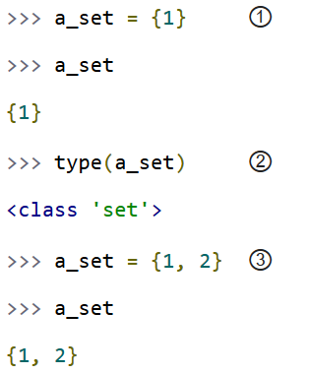
Creating A Set
① To create a set with one value, put the value in curly brackets ({}).
② Sets are actually implemented as classes, but don’t worry about that for now.
③ To create a set with multiple values, separate the values with commas and wrap it all up with curly brackets.

Slide 49
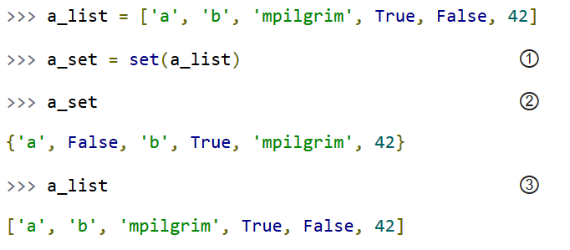
Creating A Set
You can also create a set out of a list.

Slide 50
Creating A Set
① To create a set from a list, use the set() function. (Pedants who know about how sets are implemented will point out that this is not really calling a function, but instantiating a class)
② As I mentioned earlier, a single set can contain values of any datatype. And, as I mentioned earlier, sets are unordered. This set does not remember the original order of the list that was used to create it. If you were to add items to this set, it would not remember the order in which you added them.
③ The original list is unchanged.

Slide 51
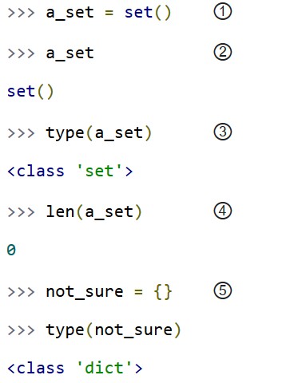
Creating A Set
Don’t have any values yet? Not a problem. You can create an empty set.

Slide 52
Creating A Set
① To create an empty set, call set() with no arguments.
② The printed representation of an empty set looks a bit strange. Were you expecting {}, perhaps? That would denote an empty dictionary, not an empty set. You’ll learn about dictionaries later in this chapter.
③ Despite the strange printed representation, this is a set…
④ …and this set has no members.
⑤ Due to historical quirks carried over from Python 2, you can not create an empty set with two curly brackets. This actually creates an empty dictionary, not an empty set.

Slide 53
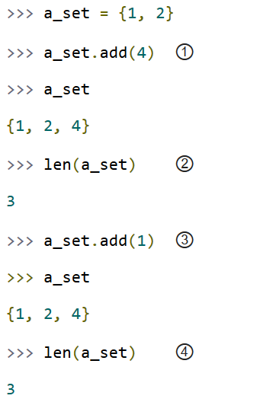
Modifying A Set
There are two different ways to add values to an existing set: the add() method, and the update() method.

Slide 54
Modifying A Set
① The add() method takes a single argument, which can be any datatype, and adds the given value to the set.
② This set now has 3 members.
③ Sets are bags of unique values. If you try to add a value that already exists in the set, it will do nothing. It won’t raise an error; it’s just a no-op.
④ This set still has 3 members.

Slide 55
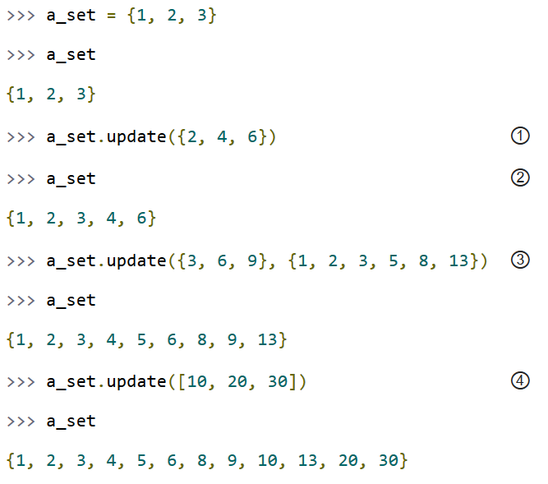
Modifying A Set

Slide 56
Modifying A Set
① The update() method takes one argument, a set, and adds all its members to the original set.
It’s as if you called the add() method with each member of the set.
② Duplicate values are ignored, since sets can not contain duplicates.
③ You can actually call the update() method with any number of arguments. When called with two sets, the update() method adds all the members of each set to the original set (dropping duplicates).
④ The update() method can take objects of a number of different datatypes, including lists. When called with a list, the update() method adds all the items of the list to the original set.

Slide 57
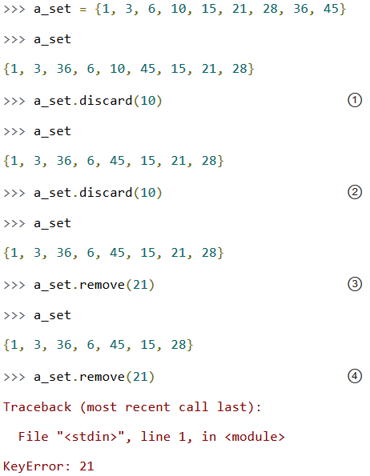
Removing Items From A Set
There are three ways to remove individual values from a set. The first two, discard() and remove(), have one subtle difference.

Slide 58
Removing Items From A Set
① The discard() method takes a single value as an argument and removes that value from the set.
② If you call the discard() method with a value that doesn’t exist in the set, it does nothing. No error; it’s just a no-op.
③ The remove() method also takes a single value as an argument, and it also removes that value from the set.
④ Here’s the difference: if the value doesn’t exist in the set, the remove() method raises a KeyError exception.

Slide 59
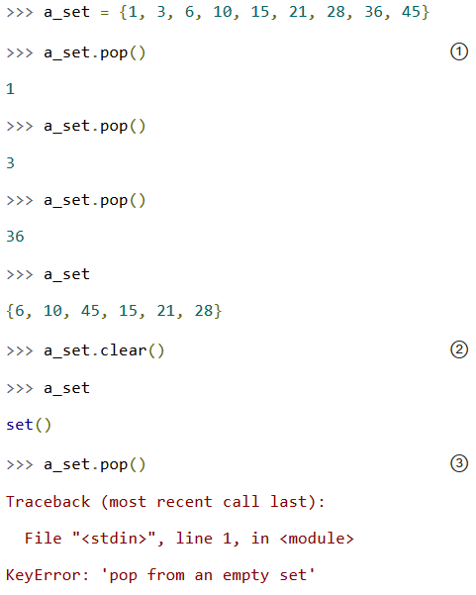
Removing Items From A Set

Slide 60
Removing Items From A Set
① The pop() method removes a single value from a set and returns the value. However, since sets are unordered, there is no “last” value in a set, so there is no way to control which value gets removed. It is completely arbitrary.
② The clear() method removes all values from a set, leaving you with an empty set. This is equivalent to a_set = set(), which would create a new empty set and overwrite the previous value of the a_set variable.
③ Attempting to pop a value from an empty set will raise a KeyError exception.

Slide 61
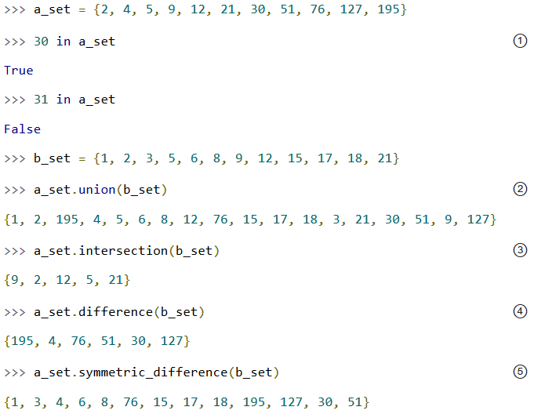
Common Set Operations
Python’s set type supports several common set operations.

Slide 62
Common Set Operations
① To test whether a value is a member of a set, use the in operator. This works the same as lists.
② The union() method returns a new set containing all the elements that are in either set.
③ The intersection() method returns a new set containing all the elements that are in both sets.
④ The difference() method returns a new set containing all the elements that are in a_set but not b_set.
⑤ The symmetric_difference() method returns a new set containing all the elements that are in exactly one of the sets.

Slide 63
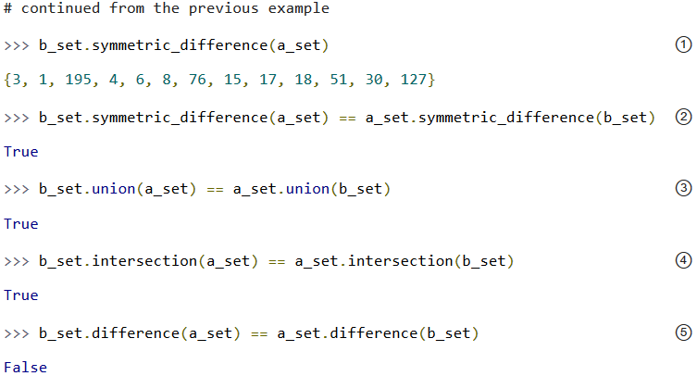
Common Set Operations
Three of these methods are symmetric.

Slide 64
Common Set Operations
① The symmetric difference of a_set from b_set looks different than the symmetric difference of b_set from a_set, but remember, sets are unordered. Any two sets that contain all the same values (with none left over) are considered equal.
② And that’s exactly what happens here. Don’t be fooled by the Python Shell’s printed representation of these sets. They contain the same values, so they are equal.
③ The union of two sets is also symmetric.
④ The intersection of two sets is also symmetric.
⑤ The difference of two sets is not symmetric. That makes sense; it’s analogous to subtracting one number from another. The order of the operands matters.

Slide 65
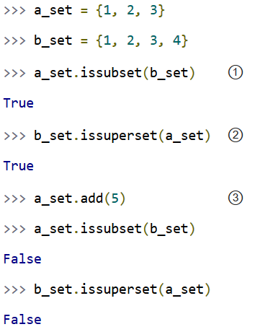
Common Set Operations
Finally, there are a few questions you can ask of sets.

Slide 66
Common Set Operations
① a_set is a subset of b_set — all the members of a_set are also members of b_set.
② Asking the same question in reverse, b_set is a superset of a_set, because all the members of a_set are also members of b_set.
③ As soon as you add a value to a_set that is not in b_set, both tests return False.

Slide 67
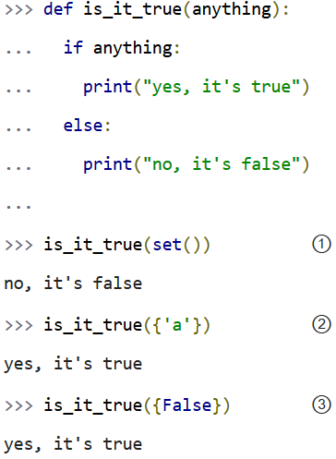
Sets In A Boolean Context
You can use sets in a boolean context, such as an if statement.

Slide 68
Common Set Operations
① In a boolean context, an empty set is false.
② Any set with at least one item is true.
③ Any set with at least one item is true. The value of the items is irrelevant.

Slide 69
Dictionary
A dictionary is an unordered set of key-value pairs.
When you add a key to a dictionary, you must also add a value for that key. (You can always change the value later.)
Python dictionaries are optimized for retrieving the value when you know the key, but not the other way around.

Slide 70

Creating a Dictionary
You need to create a lookup table where you associate values with keys.
Use a Python dictionary.
A dictionary stores key/value pairs in such a way that you can use the key to retrieve that value very efficiently and without having to search the whole dictionary.
To create a dictionary, you use the {} notation:
>>> phone_numbers = {'Simon':'01234 567899', 'Jane':'01234 666666'}

Slide 71
Creating a Dictionary
In this example, the keys of the dictionary are strings, but they do not have to be; they could be numbers or in fact any data type, although strings are most commonly used.
The values can also be of any data type, including other dictionaries or lists. The following example creates one dictionary (a) and then uses it as a value in a second dictionary (b):
>>> a = {'key1':'value1', 'key2':2}
>>> a
{'key2': 2, 'key1': 'value1'}
>>> b = {'b_key1':a}
>>> b
{'b_key1': {'key2': 2, 'key1': 'value1'}}
When you display the contents of a dictionary, you will notice that the order of the items in the dictionary may not match the order in which they were specified when the dictionary was created and initialized with some contents
The reason the order appears to be random is that the underlying data structure that is a hash table. Hash tables use a hashing function to decide where to store the value; the hashing function calculates a numeric equivalent to any object.

Slide 72

Creating a Dictionary
Dictionaries aren’t just for strings. Dictionary values can be any datatype, including integers, booleans, arbitrary objects, or even other dictionaries.
And within a single dictionary, the values don’t all need to be the same type; you can mix and match as needed.
Dictionary keys are more restricted, but they can be strings, integers, and a few other types. You can also mix and match key datatypes within a dictionary.

Slide 73
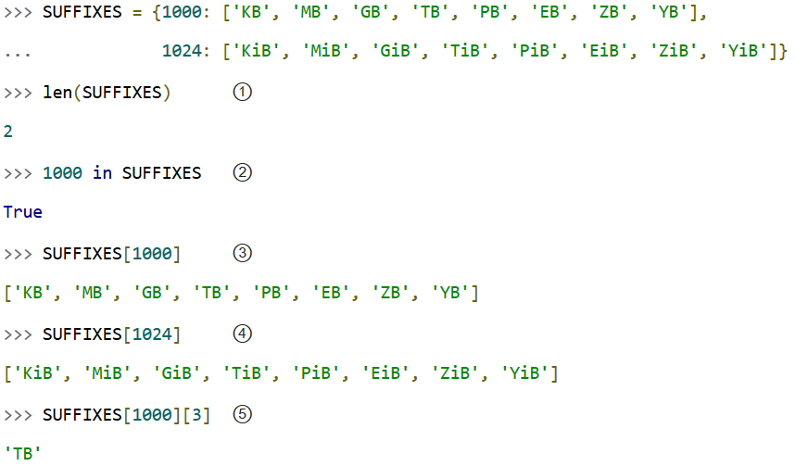
Creating a Dictionary

Slide 74
Creating a Dictionary
① Like lists and sets, the len() function gives you the number of keys in a dictionary.
② And like lists and sets, you can use the in operator to test whether a specific key is defined in a dictionary.
③ 1000 is a key in the SUFFIXES dictionary; its value is a list of eight items (eight strings, to be precise).
④ Similarly, 1024 is a key in the SUFFIXES dictionary; its value is also a list of eight items.
⑤ Since SUFFIXES[1000] is a list, you can address individual items in the list by their 0-based index.

Slide 75
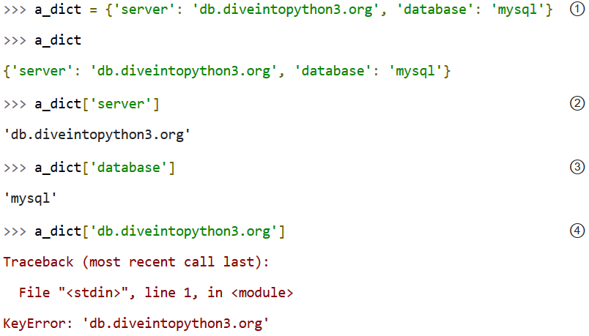
Creating a Dictionary

Slide 76
Creating a Dictionary
① First, you create a new dictionary with two items and assign it to the variable a_dict. Each item is a key-value pair, and the whole set of items is enclosed in curly braces.
② 'server' is a key, and its associated value, referenced by a_dict['server'], is 'db.diveintopython3.org'.
③ 'database' is a key, and its associated value, referenced by a_dict['database'], is 'mysql'.
④ You can get values by key, but you can’t get keys by value. So a_dict['server'] is 'db.diveintopython3.org', but a_dict['db.diveintopython3.org'] raises an exception, because 'db.diveintopython3.org' is not a key.

Slide 77
Accessing a Dictionary
Use the Python [] notation. Use the key of the entry to which you need access inside the brackets:
>>> phone_numbers = {'Simon':'01234 567899', 'Jane':'01234 666666'} >>> phone_numbers['Simon']
'01234 567899'
>>> phone_numbers['Jane']
'01234 666666‘
As well as using the [] notation to read values from a dictionary, you can also use it to add new values or overwrite existing ones.
>>> phone_numbers['Pete'] = '01234 777555'
>>> phone_numbers['Pete']
'01234 777555'
If the key is not in use in the dictionary, a new entry is automatically added. If the key is already present, then whatever value was there before will be overwritten by the new value.

Slide 78
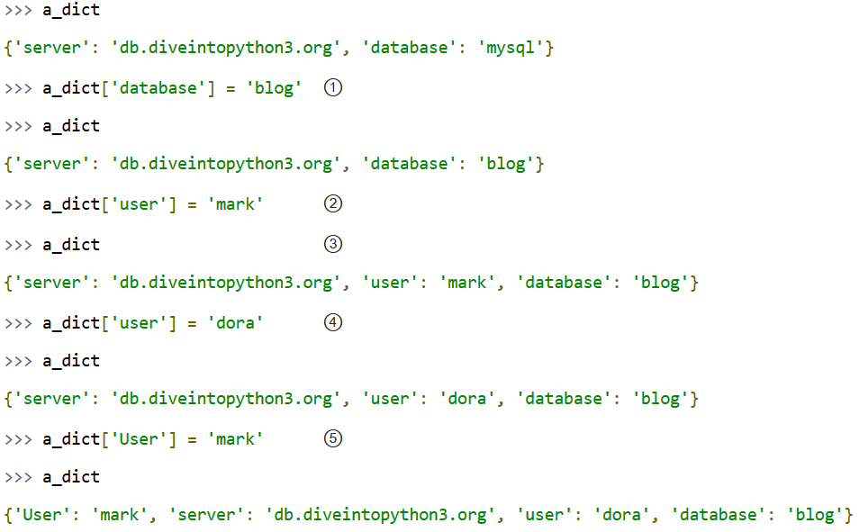
Accessing a Dictionary
Dictionaries do not have any predefined size limit. You can add new key-value pairs to a dictionary at any time, or you can modify the value of an existing key. Continuing from the previous example:

Slide 79
Accessing a Dictionary
① You can not have duplicate keys in a dictionary. Assigning a value to an existing key will wipe out the old value.
② You can add new key-value pairs at any time. This syntax is identical to modifying existing values.
③ The new dictionary item (key 'user', value 'mark') appears to be in the middle. In fact, it was just a coincidence that the items appeared to be in order in the first example; it is just as much a coincidence that they appear to be out of order now.
④ Assigning a value to an existing dictionary key simply replaces the old value with the new one.
⑤ Will this change the value of the user key back to "mark"? No! Look at the key closely — that’s a capital U in "User". Dictionary keys are case-sensitive, so this statement is creating a new key-value pair, not overwriting an existing one. It may look similar to you, but as far as Python is concerned, it’s completely different.

Slide 80
Removing Things from a Dictionary
Use the pop command, specifying the key for the item that you want to remove:
>>> phone_numbers = {'Simon':'01234 567899', 'Jane':'01234 666666'}
>>> phone_numbers.pop('Jane')
'01234 666666'
>>> phone_numbers
{'Simon': '01234 567899'}
The pop command returns the value of the item removed from the dictionary.

Slide 81
Iterating over Dictionaries
You need to do something to each of the items in the dictionary in turn.
Use the for command to iterate over the keys of the dictionary:
>>> phone_numbers = {'Simon':'01234 567899', 'Jane':'01234 666666'}
>>> for name in phone_numbers:
... print(name)
...
Jane
Simon
There are a couple of other techniques that you can use to iterate over a dictionary. The following form can be useful if you need access to the values as well as the keys:
>>> phone_numbers = {'Simon':'01234 567899', 'Jane':'01234 666666'}
>>> for name, num in phone_numbers.items():
... print(name + " " + num)
...
Jane 01234 666666
Simon 01234 567899

Slide 82
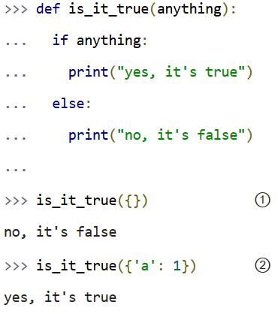
Dictionaries In A Boolean Context
You can also use a dictionary in a boolean context, such as an if statement.
① In a boolean context, an empty dictionary is false.
② Any dictionary with at least one key-value pair is true.

Slide 83
None
None is a special constant in Python. It is a null value.
None is not the same as False.
None is not 0.
None is not an empty string.
Comparing None to anything other than None will always return False.
None is the only null value.
It has its own datatype (NoneType).
You can assign None to any variable, but you can not create other NoneType objects.
All variables whose value is None are equal to each other.

Slide 84
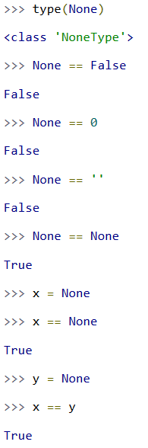
None

Slide 85
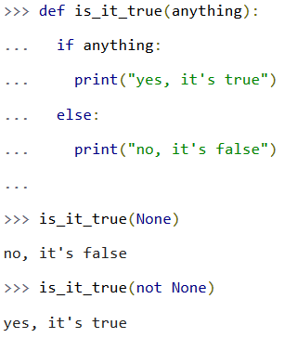
None In A Boolean Context
In a boolean context, None is false and not None is true.

Slide 86


Contact us
www.e-system.ir
Info@e-system.ir

