Slide 1

Closures And Generators
Lecturer: Reza Arjmandi
Summer 2018
Preface:
In this chapter, you’re going to learn about functions that return other functions, advanced regular expressions, and generators.

Slide 2
Introduction
In this chapter, you’re going to learn about plural nouns. Also, functions that return other functions, advanced regular expressions, and generators. But first, let’s talk about how to make plural nouns.
If you grew up in an English-speaking country or learned English in a formal school setting, you’re probably familiar with the basic rules:
If a word ends in S, X, or Z, add ES. Bass becomes basses, fax becomes faxes, and waltz becomes waltzes.
If a word ends in a noisy H, add ES; if it ends in a silent H, just add S. What’s a noisy H? One that gets combined with other letters to make a sound that you can hear. So coach becomes coaches and rash becomes rashes, because you can hear the CH and SH sounds when you say them. But cheetah becomes cheetahs, because the H is silent.
If a word ends in Y that sounds like I, change the Y to IES; if the Y is combined with a vowel to sound like something else, just add S. So vacancy becomes vacancies, but day becomes days.
If all else fails, just add S and hope for the best

Slide 3
Introduction
I know, there are a lot of exceptions. Man becomes men and woman becomes women, but human becomes humans. Mouse becomes mice and louse becomes lice, but house becomes houses. Knife becomes knives and wife becomes wives, but lowlife becomes lowlifes. And don’t even get me started on words that are their own plural, like sheep, deer, and haiku.
Let’s design a Python library that automatically pluralizes English nouns. We’ll start with just these four rules, but keep in mind that you’ll inevitably need to add more.

Slide 4
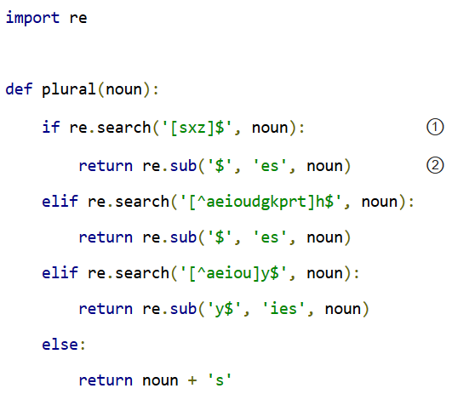
Plural nouns
① This is a regular expression, but it uses a syntax you didn’t see in Regular Expressions. The square brackets mean “match exactly one of these characters.” So [sxz] means “s, or x, or z”, but only one of them. The $ should be familiar; it matches the end of string. Combined, this regular expression tests whether noun ends with s, x, or z.
② This re.sub() function performs regular expression-based string substitutions.

Slide 5
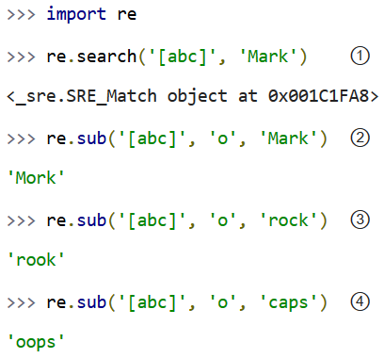
Plural nouns
Let’s look at regular expression substitutions in more detail.

Slide 6
Plural nouns
① Does the string Mark contain a, b, or c? Yes, it contains a.
② OK, now find a, b, or c, and replace it with o. Mark becomes Mork.
③ The same function turns rock into rook.
④ You might think this would turn caps into oaps, but it doesn’t. re.sub replaces all of the matches, not just the first one. So this regular expression turns caps into oops, because both the c and the a get turned into o.

Slide 7
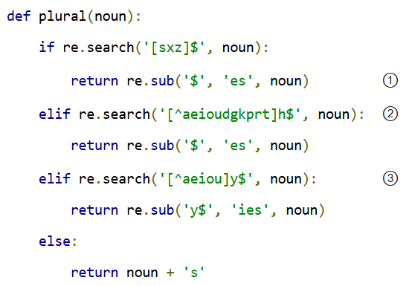
Plural nouns

Slide 8
Plural nouns
① Here, you’re replacing the end of the string (matched by $) with the string es. In other words, adding es to the string. You could accomplish the same thing with string concatenation, for example noun + 'es', but I chose to use regular expressions for each rule, for reasons that will become clear later in the chapter.
② Look closely, this is another new variation. The ^ as the first character inside the square brackets means something special: negation. [^abc] means “any single character except a, b, or c”. So [^aeioudgkprt] means any character except a, e, i, o, u, d, g, k, p, r, or t. Then that character needs to be followed by h, followed by end of string. You’re looking for words that end in H where the H can be heard.
③ Same pattern here: match words that end in Y, where the character before the Y is not a, e, i, o, or u. You’re looking for words that end in Y that sounds like I.

Slide 9
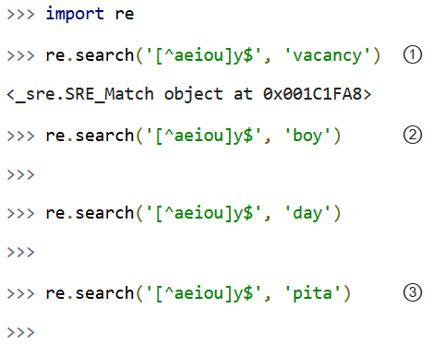
Plural nouns
Let’s look at negation regular expressions in more detail.
① vacancy matches this regular expression, because it ends in cy, and c is not a, e, i, o, or u.
② boy does not match, because it ends in oy, and you specifically said that the character before the y could not be o. day does not match, because it ends in ay.
③ pita does not match, because it does not end in y.

Slide 10
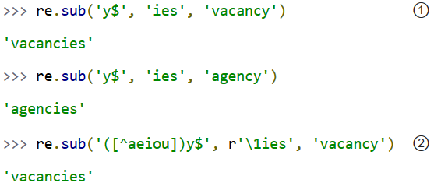
Plural nouns
① This regular expression turns vacancy into vacancies and agency into agencies, which is what you wanted. Note that it would also turn boy into boies, but that will never happen in the function because you did that re.search first to find out whether you should do this re.sub.
② Just in passing, I want to point out that it is possible to combine these two regular expressions (one to find out if the rule applies, and another to actually apply it) into a single regular expression. Here’s what that would look like. Most of it should look familiar: you’re using a remembered group, which you learned in Case study: Parsing Phone Numbers. The group is used to remember the character before the letter y. Then in the substitution string, you use a new syntax, \1, which means “hey, that first group you remembered? put it right here.” In this case, you remember the c before the y; when you do the substitution, you substitute c in place of c, and ies in place of y. (If you have more than one remembered group, you can use \2 and \3 and so on.)

Slide 11
Plural nouns
Regular expression substitutions are extremely powerful, and the \1 syntax makes them even more powerful.
But combining the entire operation into one regular expression is also much harder to read, and it doesn’t directly map to the way you first described the pluralizing rules. You originally laid out rules like “if the word ends in S, X, or Z, then add ES”. If you look at this function, you have two lines of code that say “if the word ends in S, X, or Z, then add ES”. It doesn’t get much more direct than that.

Slide 12
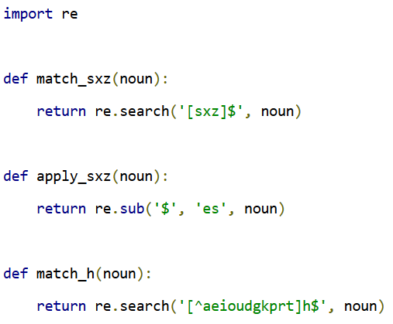

A List Of Functions
Now you’re going to add a level of abstraction. You started by defining a list of rules: if this, do that, otherwise go to the next rule. Let’s temporarily complicate part of the program so you can simplify another part.

Slide 13
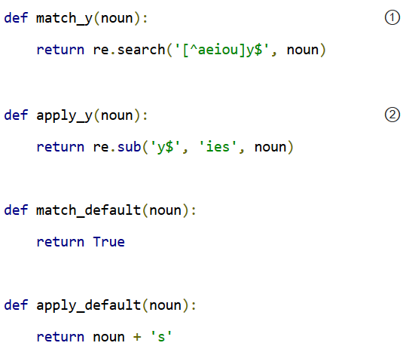
A List Of Functions

Slide 14
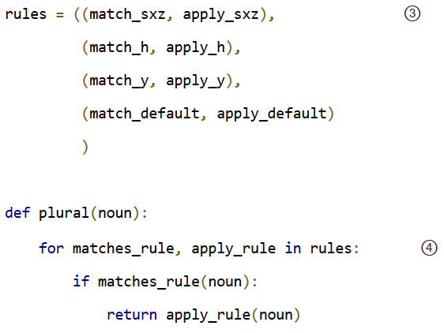
A List Of Functions

Slide 15
A List Of Functions
① Now, each match rule is its own function which returns the results of calling the re.search() function.
② Each apply rule is also its own function which calls the re.sub() function to apply the appropriate pluralization rule.
③ Instead of having one function (plural()) with multiple rules, you have the rules data structure, which is a sequence of pairs of functions.
④ Since the rules have been broken out into a separate data structure, the new plural() function can be reduced to a few lines of code. Using a for loop, you can pull out the match and apply rules two at a time (one match, one apply) from the rules structure. On the first iteration of the for loop, matches_rule will get match_sxz, and apply_rule will get apply_sxz. On the second iteration (assuming you get that far), matches_rule will be assigned match_h, and apply_rule will be assigned apply_h. The function is guaranteed to return something eventually, because the final match rule (match_default) simply returns True, meaning the corresponding apply rule (apply_default) will always be applied.

Slide 16
A List Of Functions
The reason this technique works is that everything in Python is an object, including functions. The rules data structure contains functions — not names of functions, but actual function objects.
When they get assigned in the for loop, then matches_rule and apply_rule are actual functions that you can call. On the first iteration of the for loop, this is equivalent to calling matches_sxz(noun), and if it returns a match, calling apply_sxz(noun).

Slide 17
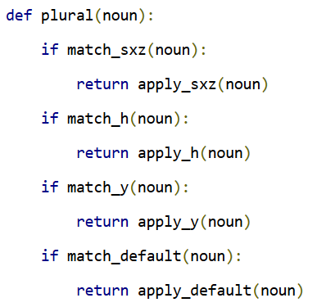
A List Of Functions
If this additional level of abstraction is confusing, try unrolling the function to see the equivalence. The entire for loop is equivalent to the following:

Slide 18
A List Of Functions
The benefit here is that the plural() function is now simplified. It takes a sequence of rules, defined elsewhere, and iterates through them in a generic fashion.
Get a match rule
Does it match? Then call the apply rule and return the result.
No match? Go to step 1.
The rules could be defined anywhere, in any way. The plural() function doesn’t care.
Now, was adding this level of abstraction worth it? Well, not yet. Let’s consider what it would take to add a new rule to the function. In the first example, it would require adding an if statement to the plural() function. In this second example, it would require adding two functions, match_foo() and apply_foo(), and then updating the rules sequence to specify where in the order the new match and apply functions should be called relative to the other rules.
But this is really just a stepping stone to the next section. Let’s move on…

Slide 19
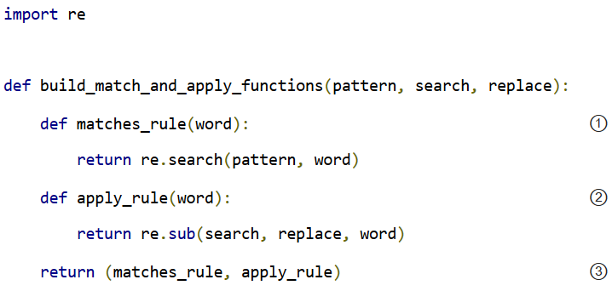
A List Of Patterns
Defining separate named functions for each match and apply rule isn’t really necessary. You never call them directly; you add them to the rules sequence and call them through there. Furthermore, each function follows one of two patterns. All the match functions call re.search(), and all the apply functions call re.sub(). Let’s factor out the patterns so that defining new rules can be easier.

Slide 20
A List Of Patterns
① build_match_and_apply_functions() is a function that builds other functions dynamically. It takes pattern, search and replace, then defines a matches_rule() function which calls re.search() with the pattern that was passed to the build_match_and_apply_functions() function, and the word that was passed to the matches_rule() function you’re building. Whoa.
② Building the apply function works the same way. The apply function is a function that takes one parameter, and calls re.sub() with the search and replace parameters that were passed to the build_match_and_apply_functions() function, and the word that was passed to the apply_rule() function you’re building. This technique of using the values of outside parameters within a dynamic function is called closures. You’re essentially defining constants within the apply function you’re building: it takes one parameter (word), but it then acts on that plus two other values (search and replace) which were set when you defined the apply function.
③ Finally, the build_match_and_apply_functions() function returns a tuple of two values: the two functions you just created. The constants you defined within those functions (pattern within the matches_rule() function, and search and replace within the apply_rule() function) stay with those functions, even after you return from build_match_and_apply_functions(). That’s insanely cool.

Slide 21
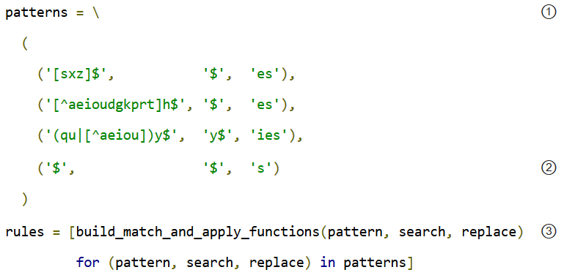
A List Of Patterns
If this is incredibly confusing (and it should be, this is weird stuff), it may become clearer when you see how to use it.

Slide 22
A List Of Patterns
① Our pluralization “rules” are now defined as a tuple of tuples of strings (not functions). The first string in each group is the regular expression pattern that you would use in re.search() to see if this rule matches. The second and third strings in each group are the search and replace expressions you would use in re.sub() to actually apply the rule to turn a noun into its plural.
② There’s a slight change here, in the fallback rule. In the previous example, the match_default() function simply returned True, meaning that if none of the more specific rules matched, the code would simply add an s to the end of the given word. This example does something functionally equivalent. The final regular expression asks whether the word has an end ($ matches the end of a string). Of course, every string has an end, even an empty string, so this expression always matches. Thus, it serves the same purpose as the match_default() function that always returned True: it ensures that if no more specific rule matches, the code adds an s to the end of the given word.

Slide 23
A List Of Patterns
③ This line is magic. It takes the sequence of strings in patterns and turns them into a sequence of functions. How? By “mapping” the strings to the build_match_and_apply_functions() function. That is, it takes each triplet of strings and calls the build_match_and_apply_functions() function with those three strings as arguments. The build_match_and_apply_functions() function returns a tuple of two functions. This means that rules ends up being functionally equivalent to the previous example: a list of tuples, where each tuple is a pair of functions. The first function is the match function that calls re.search(), and the second function is the apply function that calls re.sub().

Slide 24
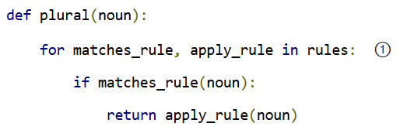
A List Of Patterns
Rounding out this version of the script is the main entry point, the plural() function.
① Since the rules list is the same as the previous example (really, it is), it should come as no surprise that the plural() function hasn’t changed at all. It’s completely generic; it takes a list of rule functions and calls them in order. It doesn’t care how the rules are defined. In the previous example, they were defined as separate named functions. Now they are built dynamically by mapping the output of the build_match_and_apply_functions() function onto a list of raw strings. It doesn’t matter; the plural() function still works the same way.

Slide 25
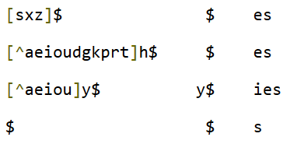
A File Of Patterns
You’ve factored out all the duplicate code and added enough abstractions so that the pluralization rules are defined in a list of strings. The next logical step is to take these strings and put them in a separate file, where they can be maintained separately from the code that uses them.
First, let’s create a text file that contains the rules you want. No fancy data structures, just whitespace-delimited strings in three columns. Let’s call it plural4-rules.txt.

Slide 26
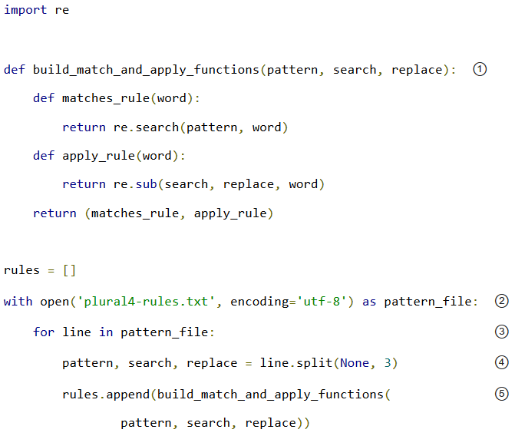
A File Of Patterns
Now let’s see how you can use this rules file.

Slide 27
A File Of Patterns
① The build_match_and_apply_functions() function has not changed. You’re still using closures to build two functions dynamically that use variables defined in the outer function.
② The global open() function opens a file and returns a file object. In this case, the file we’re opening contains the pattern strings for pluralizing nouns. The with statement creates what’s called a context: when the with block ends, Python will automatically close the file, even if an exception is raised inside the with block.
③ The for line in <fileobject> idiom reads data from the open file, one line at a time, and assigns the text to the line variable.

Slide 28
A File Of Patterns
④ Each line in the file really has three values, but they’re separated by whitespace (tabs or spaces, it makes no difference). To split it out, use the split() string method. The first argument to the split() method is None, which means “split on any whitespace (tabs or spaces, it makes no difference).”
The second argument is 3, which means “split on whitespace 3 times, then leave the rest of the line alone.” A line like [sxz]$ $ es will be broken up into the list ['[sxz]$', '$', 'es'], which means that pattern will get '[sxz]$', search will get '$', and replace will get 'es'. That’s a lot of power in one little line of code.
⑤ Finally, you pass pattern, search, and replace to the build_match_and_apply_functions() function, which returns a tuple of functions. You append this tuple to the rules list, and rules ends up storing the list of match and apply functions that the plural() function expects.
The improvement here is that you’ve completely separated the pluralization rules into an external file, so it can be maintained separately from the code that uses it. Code is code, data is data, and life is good.

Slide 29
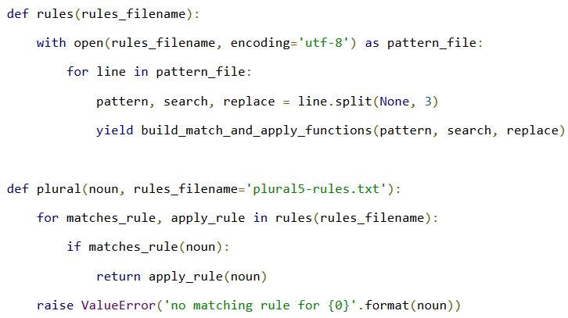
Generators
Wouldn’t it be grand to have a generic plural() function that parses the rules file? Get rules, check for a match, apply appropriate transformation, go to next rule. That’s all the plural() function has to do, and that’s all the plural() function should do.

Slide 30
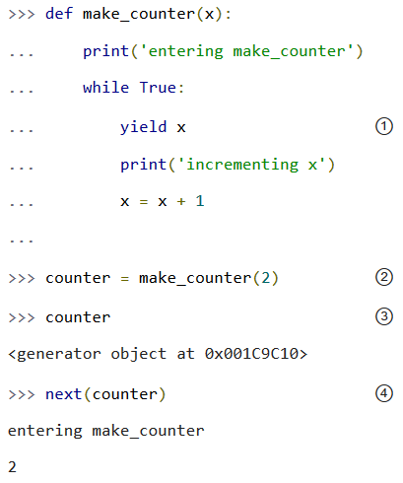
Generators
How the heck does that work? Let’s look at an interactive example first.

Slide 31
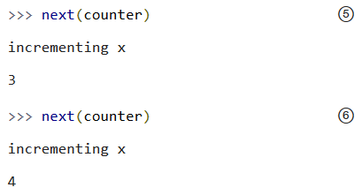
Generators
① The presence of the yield keyword in make_counter means that this is not a normal function. It is a special kind of function which generates values one at a time. You can think of it as a resumable function. Calling it will return a generator that can be used to generate successive values of x.
② To create an instance of the make_counter generator, just call it like any other function. Note that this does not actually execute the function code. You can tell this because the first line of the make_counter() function calls print(), but nothing has been printed yet.

Slide 32
Generators
③ The make_counter() function returns a generator object.
④ The next() function takes a generator object and returns its next value. The first time you call next() with the counter generator, it executes the code in make_counter() up to the first yield statement, then returns the value that was yielded. In this case, that will be 2, because you originally created the generator by calling make_counter(2).
⑤ Repeatedly calling next() with the same generator object resumes exactly where it left off and continues until it hits the next yield statement. All variables, local state, &c. are saved on yield and restored on next(). The next line of code waiting to be executed calls print(), which prints incrementing x. After that, the statement x = x + 1. Then it loops through the while loop again, and the first thing it hits is the statement yield x, which saves the state of everything and returns the current value of x (now 3).
The second time you call next(counter), you do all the same things again, but this time x is now 4.
Since make_counter sets up an infinite loop, you could theoretically do this forever, and it would just keep incrementing x and spitting out values. But let’s look at more productive uses of generators instead.

Slide 33
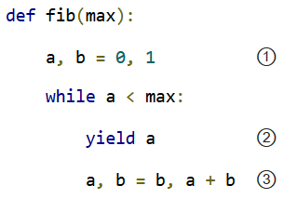
A Fibonacci Generator
① The Fibonacci sequence is a sequence of numbers where each number is the sum of the two numbers before it. It starts with 0 and 1, goes up slowly at first, then more and more rapidly. To start the sequence, you need two variables: a starts at 0, and b starts at 1.
② a is the current number in the sequence, so yield it.
③ b is the next number in the sequence, so assign that to a, but also calculate the next value (a + b) and assign that to b for later use. Note that this happens in parallel; if a is 3 and b is 5, then a, b = b, a + b will set a to 5 (the previous value of b) and b to 8 (the sum of the previous values of a and b).

Slide 34
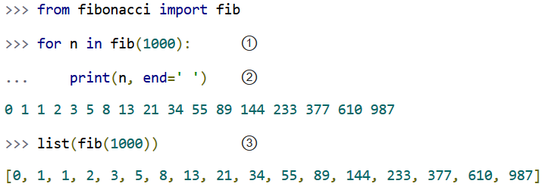
A Fibonacci Generator
So you have a function that spits out successive Fibonacci numbers. Sure, you could do that with recursion, but this way is easier to read. Also, it works well with for loops.

Slide 35
A Fibonacci Generator
① You can use a generator like fib() in a for loop directly. The for loop will automatically call the next() function to get values from the fib() generator and assign them to the for loop index variable (n).
② Each time through the for loop, n gets a new value from the yield statement in fib(), and all you have to do is print it out. Once fib() runs out of numbers (a becomes bigger than max, which in this case is 1000), then the for loop exits gracefully.
③ This is a useful idiom: pass a generator to the list() function, and it will iterate through the entire generator (just like the for loop in the previous example) and return a list of all the values.

Slide 36
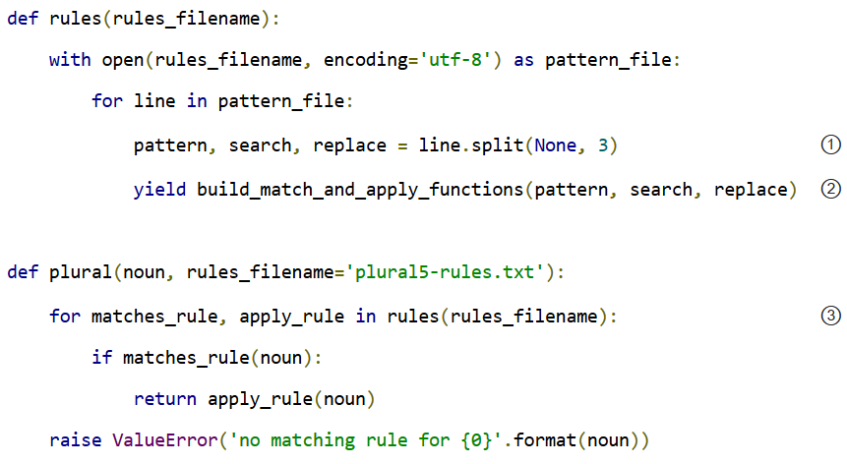
A Plural Rule Generator
Let’s go back to plural problem and see how this version of the plural() function works.

Slide 37
A Plural Rule Generator
① No magic here. Remember that the lines of the rules file have three values separated by whitespace, so you use line.split(None, 3) to get the three “columns” and assign them to three local variables.
② And then you yield. What do you yield? Two functions, built dynamically with your old friend, build_match_and_apply_functions(), which is identical to the previous examples. In other words, rules() is a generator that spits out match and apply functions on demand.
③ Since rules() is a generator, you can use it directly in a for loop. The first time through the for loop, you will call the rules() function, which will open the pattern file, read the first line, dynamically build a match function and an apply function from the patterns on that line, and yield the dynamically built functions. The second time through the for loop, you will pick up exactly where you left off in rules() (which was in the middle of the for line in pattern_file loop). The first thing it will do is read the next line of the file (which is still open), dynamically build another match and apply function based on the patterns on that line in the file, and yield the two functions.

Slide 38
A Plural Rule Generator
What have you gained over stage 4? Startup time. In stage 4, when you imported the plural4 module, it read the entire patterns file and built a list of all the possible rules, before you could even think about calling the plural() function.
With generators, you can do everything lazily: you read the first rule and create functions and try them, and if that works you don’t ever read the rest of the file or create any other functions.
What have you lost? Performance! Every time you call the plural() function, the rules() generator starts over from the beginning — which means re-opening the patterns file and reading from the beginning, one line at a time.
What if you could have the best of both worlds: minimal startup cost (don’t execute any code on import), and maximum performance (don’t build the same functions over and over again). Oh, and you still want to keep the rules in a separate file (because code is code and data is data), just as long as you never have to read the same line twice.
To do that, you’ll need to build your own iterator. But before you do that, you need to learn about Python classes.

Slide 39


Contact us
www.e-system.ir
Info@e-system.ir

