Slide 1
Foundation Training for Teachers’ under DTE
Module-6.05
TVET & SOCIAL MEDIA
DR. Sheikh Abu Reza
Director (Rtd) DTE &
CBT&A Trainer

Slide 2
1. The concept of TVET 2. TVET scenario of Bangladesh 3. The concept of social media 4. Social Media, Social networking and E-learning 5. Channels of performing activities in social media 6. Advantages and disadvantages of social network in education 7. Some Examples
Outlines

Slide 3
TVET

Slide 4
TE = Technical Education (All type of Diploma Courses )
VE = Vocational Education ( SSC Voc & HSC Voc under BTEB)
T = Training( All Ministry)

Slide 5
Quality issues in TVET
TVET may varied in country to country and institute to institute for different factors, context and environments- traditional TVET-
Not consistent about QA
Not Standards alien with demanded occupations
Curriculum not based on needs
TVET teachers and trainers are not properly trained
Lack of strong and appropriate TVET governance
Skills training is problematics
Recruitment rules are defective and time consuming
P-60

Slide 6
QAM (Quality Assurance Manuals)
CAD ( Course Accreditation Documents)

Slide 7
P-31

Slide 8
P-34

Slide 9
Two pre-vocational levels to allow easier access to formal TVET for poor or under privileged groups who might not have sufficient formal schooling and lack of literacy and numeracy but having skills either working in different economic sector or have no works at all.
P-34

Slide 10
P-37

Slide 11
P-53

Slide 12
Social media, Social networking and E-learning
Social media is the interaction among people in which they create, share or exchange information and ideas in virtual communities and networks.
Social media can also be said to be a group of internet-based applications that build on the ideological and technological foundations of internet that allows the creation and exchange of user generated contents.

Slide 13
Types of Social Media
1. Social Networks - Connect with people (Facebook, Twitter, LinkedIn ) 2. Messaging Apps - Message privately (WhatsApp, Messenger, WeChat ) 3. Photo/Media Sharing - Share photos, videos and more (Instagram, YouTube) 4. Blogging & Publishing Networks - Long format content 5. Interactive Apps - Connect, create and share content (Snapchat, TikTok ) 6. Discussion Forums - Share knowledge, news and ideas (Quora, Reddit) 7. Bookmarking & Content Curation - Discover, save and share content 8. Review Network - View and publish reviews 9. Social Shopping Networks - Shop online 10. Interest Based Networks - Explore hobbies and interests 11. Sharing economy networks - Trade goods and services 12. Audio only apps - Join discussions, share ideas and knowledge on audio 13. Anonymous Social Networks - Post anonymously

Slide 14
Social Networking
A social networking service is a platform to build social networks or social relations among people who, for example share interests, activities, backgrounds or real life connection. Social networking is the hottest online. Not only do social media sites provide to keep in contact with friends, but they can also offer opportunities for professional online networking.

Slide 15
Advantages of Social Networking
Connect to Other People All Over the World.
Easy and Instant Communication.
Real-Time News and Information Discovery.
Great Opportunities for Business Owners.
General Fun and Enjoyment.
Information Overload and Overwhelm.
Privacy Issues.
Social Peer Pressure and Cyber Bullying.

Slide 16
Disadvantages of Social Networking
Lacks Emotional Connection. ...
Gives People a License to be Hurtful. ...
Decreases Face-to-Face Communication Skills. ...
Conveys Inauthentic Expression of Feelings. ...
Diminishes Understanding and Thoughtfulness. ...
Causes Face-to-Face Interactions to Feel Disconnected. ...
Facilitates Laziness.

Slide 17
E-learning
A learning system based on formalised teaching but with the help of electronic resources is known as E-learning. While teaching can be based in or out of the classrooms, the use of computers and the Internet forms the major component of E-learning. E-learning can also be termed as a network enabled transfer of skills and knowledge, and the delivery of education is made to a large number of recipients at the same or different times. Earlier, it was not accepted wholeheartedly as it was assumed that this system lacked the human element required in learning.

Slide 18
E-learning management system
E-learning courses are typically managed and administered via a learning management system (LMS). Learning management system is "a multiuser software application, usually accessed through a web browser. It helps organizations manage training events, self-paced courses, and blended learning programs. It provides automation that replaces rigorous and expensive manual work, saves time, and enables you to organize your content, data, and learners. It tracks and reports on training activity and results.“
According to ATD’s 2020 State of the Industry report, technology-based learning methods, including e-learning accounted for 56 percent of learning hours used in 2019.(Association for talent development)

Slide 19


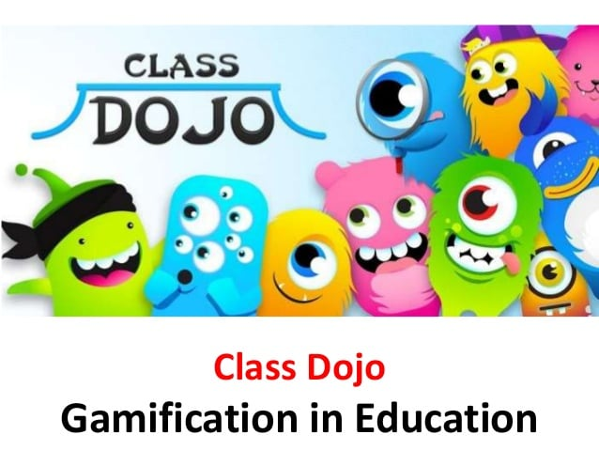




Teaching platforms for teachers

Slide 20
Google Classroom
YouTube Link

Slide 21
Education Management Website
Ideal Institute of Science & Technology ( IIST )
E- Campus: Blended Learning Platform of DTE through LMS

Slide 22
6 Bangladeshi platforms
1. E-Campus: Blended Learning Activities of DTE through LMS
2. 10-Minute School: A modern platform for the contemporary learners
3. Shikkok Batayon: A Teaching platform for the Teachers!
4. StudyPress: 'Automating' learning to combat the curse of unemployment
5. Repto Education Centre: A destination for Bangladeshi online content creators and freelance-aspirants
6. Amar Pathshala: Free education for all from any corner of the world

Slide 23

Review

Slide 24


