Slide 1

BY
Name:
Des
Inst

Slide 2
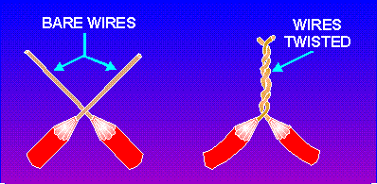
Review Previous Session :
Perform pigtail joint
These question does not appear in the slide
What is bare wire
Why it is called pigtail joint
What amount of insulation should be removed

Slide 3
To-Day’s Learning Outcome
At the end of this session you will be able to perform western union joint perfectly within ten (10) minutes as per industry standard.

Slide 4
Structure
(Introduction, Discussion, Demonstration, Practice Session, Review & Feedback, Next Session )
&
Stimulation

Slide 5
Structure & Stimulation

Slide 6
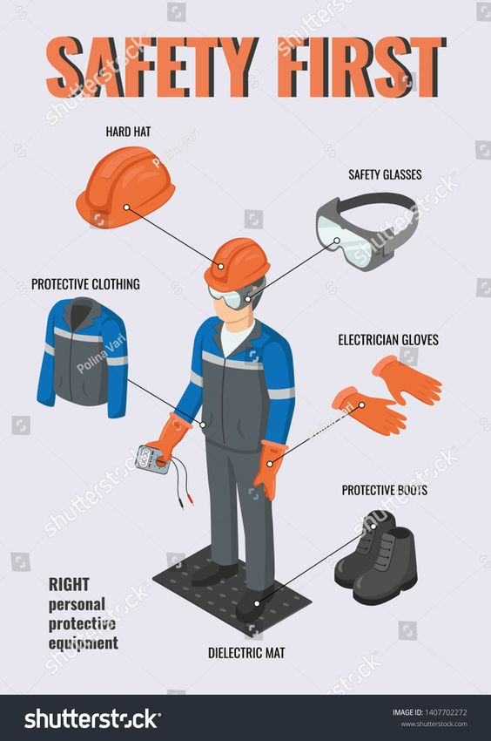

Slide 7
Required Equipment
Sl. No. | Tools and Equipment | Quantity
1 | Wire stripper | 1 unit
2 | Needle nose pliers | 1 unit
3 | Cutting pliers | 1 unit
4 | Insulating tape | 1 unit
Sl. No. | Raw Materials | Quantity
1 | Cable (1.0 Re) | 1 coil

Slide 8
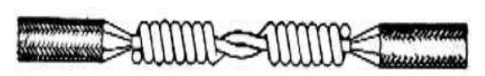
Western Union Joint
The Western Union splice or joint is a method of joining electrical cable.
It is developed in the nineteenth century by the telegraph company named Western Union telegraph company.
This method can be used where the cable may be subject to loading stress.
The wrapping pattern design causes the join to tighten as the conductors pull against each other.
Fig: Western Union Joint

Slide 9
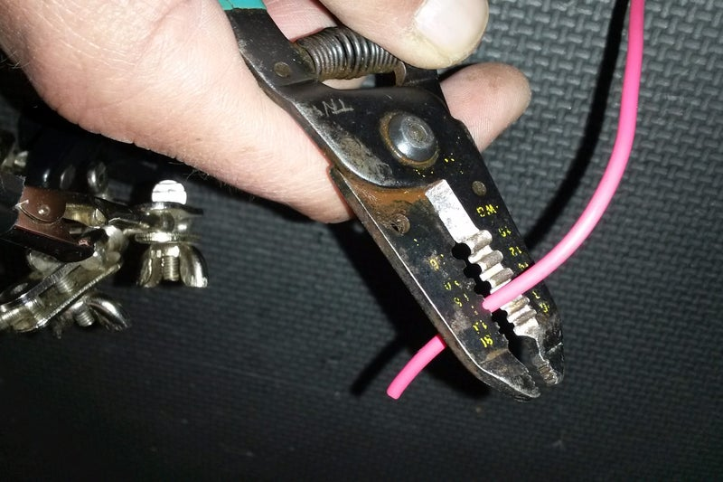
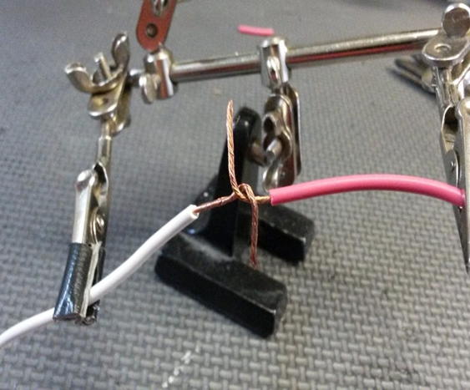
Procedure
Collect the cables which have to make joint.
First remove 2 to 3 inches insulation from each cable by using wire stripper.
The Western union splice is made by twisting two ends of a wire together counterclockwise 2 or 3 of a turn each, finger tight.
Fig: Remove insulation
Fig: Twisting wire

Slide 10
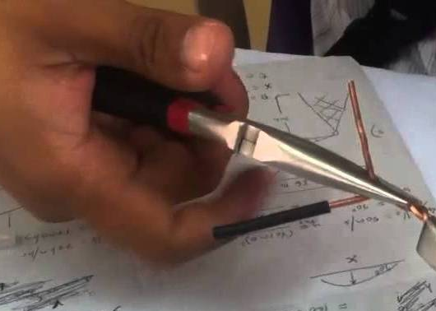
Procedure (Contd.)
Then, using needle-nose pliers, the ends are twisted at least four (4) more turns, tightly.
After tighten, the joint area must covered with insulation tape.
Fig: Tighten the twisted wire
Fig: Taping the Twisted area

Slide 11
Demonstration
Step-1. Do it normal
Step-2. Do it slow
Step-3. Do it Together
Practice Session
Wear PPE
Take job sheet and specification sheet
Take tools and equipment

Slide 12

Review and Feed Back
What we learned from this session:

Slide 13
If You Can Perform This Joint Then-
You can apply in your practical life
You can make a joint of overhead transmission line as it is a very strong joint.
You can extent wire, conductor or cable.

Slide 14
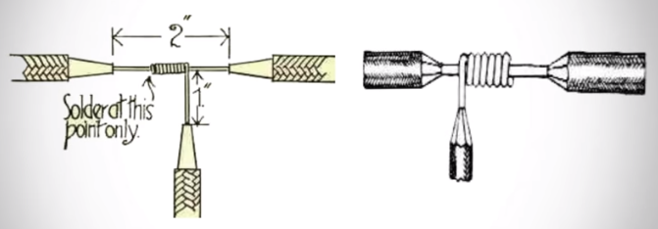
Next Session
Perform T-joint
T-joint
CBLM-9, Page-27

Slide 15

Thank You

