Slide 1
Competency Based Training (CBT&A Methodology) Trainer & Assessor(Level 4)
Day-5 Session-3
5. Maintain Training Equipment and Facility
DR. Sheikh Abu Reza
Director (Rtd) DTE &
CBT&A Trainer

Slide 2
5. Maintain Training Equipment and Facility
1. Perform housekeeping activities
2. Maintain training equipment and Tools following the
manufacturers manual and organization policies.
Document and report maintenance activities according to organizational policies & procedures.
P- 09

Slide 3
5.1 Perform housekeeping activities
Maintaining a house on a daily or long term basis
Housekeeping is a process of keeping a place clean, beautiful and well maintained so that it looks and feels pleasant and inviting to all, either - living, visiting or working there.
P-13

Slide 4
Characteristics of well-organized workshops
The workshop must be safe to work in, and in the event of an accident
People should know the procedures for the treatment of first aid
Aisles of travel and safety zones designated by painted lines.
There should be sufficient space for each person to perform the tasks
The working area must be clean and maintained to ensure ease of access
Poisonous and flammable substances are labeled and stored correctly
Tools and other small equipment are stored correctly
Clear information is available regarding procedures
Appropriate fire extinguishers and hoses are evident and regularly checked
Electrical leads and connections are labeled, in good condition
Rules and notices regarding smoking
Safety rules and signs posted in hazardous areas
P-13

Slide 5
5's Approach in Workshop Keeping
Japanese words | English translation
Seiri | Sort
Seiton | Set in order (systematize)
Seiso | Sweep
Seiket | Standardize (sanitize)
Shitsuke | Sustain (Self-discipline)
P-15

Slide 6
Safety factors
The following procedures assist in providing a safe working environment:
regular checks of equipment
personal protective clothing/equipment is stored accordingly
safety signs/symbols are identified and followed as per instructions
equipment, machinery and materials are used with agreed policy
first aid kits are stocked
workshop housekeeping is undertaken
mandatory protective clothing is worn
hazardous chemicals and solid wastes are disposed of safely
P-15

Slide 7

Basic first aid kit
P-16

Slide 8
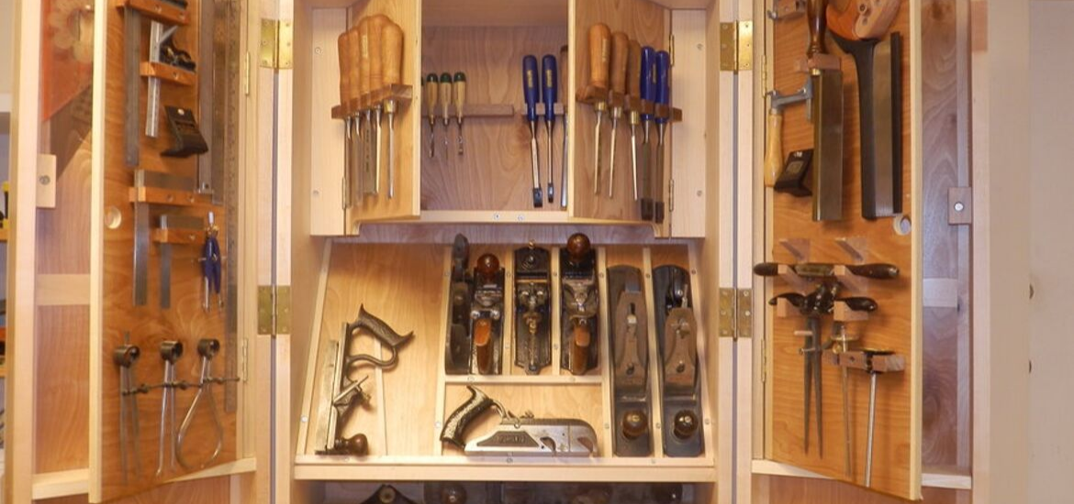
Proper Arrangement and storage of tools and equipment
P-17

Slide 9
Well-organized open workshop area
Security is necessary for two main reasons:
• Protection against personal risk.
• Prevention of loss.
Access:
Cleanliness :
Requirement for system of Instruction:
1-1, 10, 30 or More
Teacher-centered learning
Student-centered, Self-paced learning
P-19 & 20

Slide 10
Training areas for this purpose will have:
• an adequately-equipped workshop where the work tasks are
performed
• a separate resource area where the student has access to learning
materials in the form of written information, audio-visual programs,
computer programs and demonstration, and explanatory discussions
with subject teacher(s)
P-20

Slide 11
Requirement for system of Instruction
layout of a traditional classroom
layout of a CBT classroom
P-22

Slide 12
Factors to consider in laying out a shop
Floor plan of the building or shop (available space)
• Amount and source of light (natural and artificial)
• Ventilation
• Electrical outlet and power supply
• Machine placement (space allowed and accessibility)
• Production work organization sequence
• Wash rack and restroom facilities
• Shop departments (space for each)
• Location of chalkboard, bulletin boards
• Instructor's desk, filing cabinets
P-22

Slide 13
5.2 Maintain training equipment and Tools
Tools & equipment
A tool is a device that can be used to produce an item or accomplish a task, but that is not consumed in the process. It can be considered as extension of the human hand thus increasing speed, power, and accuracy and on the other hands equipment includes any machine powered by electricity
P-48

Slide 14
Classification of Tools and Equipment.
Tools & equipment can be classifying as follows-
1. Hand tools- are tools manipulated by hands without using electrical
2. Machine/Power tools -are tools manipulated by our hands and
with the use of electrical energy
3. Pneumatic tools are -tools or instruments activated by air pressure.
Pneumatic tools are designed around three basic devices: the air
cylinder, the vane motor, and the sprayer.
P-48

Slide 15
Types of maintenance
Preventive Maintenance- is conducted to keep equipment working or extend the life of the equipment.
Corrective Maintenance- is sometimes called "repair", is conducted to get equipment working.
P-52

Slide 16
Quality Management Cycle (QMC)
Plan: Design or revise business process components to improve results.
Do: Implement the plan and measure its performance.
Check: Assess the measurements and report the results to decision makers.
Act: Decide on changes needed to improve the process.
P-52

Slide 17
5.3 Document and report maintenance activities
Reporting process:
You act based on the inspection report by;
Analyzing the report.
Investigate condition of Facilities based on the inspection report and in conformance with standards.
Prepare repair improvement schedule to correct malfunctions and damages.
Install continuous maintenance of facilities.
P - 78

Slide 18
Documentation process
Assessment
1. Verify quality characteristics standards.
2. Create and set standard value for inspection.
3. Prepare inspection check list based on standards.
4. Assess condition of facilities based on inspection and check list and
maintenance program.
5. Prepare and submit inspection report

Slide 19
Review
1. Perform housekeeping activities
2. Maintain training equipment and Tools following the
manufacturers manual and organization policies.
Document and report maintenance activities according to organizational policies & procedures.

