Slide 1
Competency Based Training (CBT&A Methodology) Trainer & Assessor(Level 4)
Day-10
10. Design Competency Based Assessment
DR. Sheikh Abu Reza
Director (Rtd) DTE &
CBT&A Trainer

Slide 2
Design Competency Based Assessment
Determine the focus of the assessment tools/instruments
Plan and organize assessment processes
Document the assessment plan
P-7

Slide 3
10.1 Determine the focus of the assessment tools
Purpose and context of assessment are identified and confirmed according to legal, organizational and ethical requirements.
Assessment Strategy and Different types of assessment methods are interpreted.
Focus on various type of assessment tools and instruments are identified and clarified
Trainee’s assessment needs are identified and clarified.
P-13

Slide 4
Purpose, Context and Principles of Competency Based Assessment
Assessment is a central element in curriculum development: it is the critical link between learning outcomes, content and learning & teaching activities. Assessment not only gauges what students have learned; it shapes how students approach learning. Often assessment is the first thing to be considered by many students in planning their engagement with a topic.
Assessment is crucial in vocational education as it is the process of making judgements about whether competency has been achieved by learners before sending them out into the workplace.
P-13

Slide 5
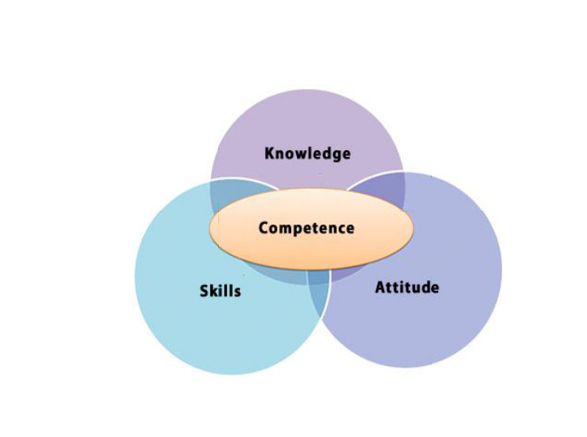
The critical aspects of competency include
Capacity to perform task according to the required standard consistently
Ability to respond to different needs in the workplace
Proficiency to plan and integrate a variety of tasks to attain an outcome
Capability to deal with responsibilities within the workplace
P-13

Slide 6
Definition of Assessment
Assessment is the process of collecting evidence and making judgments on whether competency has been achieved.
Assessment involves the collection of evidence to demonstrate that a learner can perform or behave according to specific standards.
The benchmark for basis of assessment are the competency standards.
The assessment outcome that will allow the assessor to make judgment with respect to the achievement or non-achievement of these outcomes (i.e. competent / not yet competent).
P-14

Slide 7
Competency Based Assessment
It is evidence based.
It is criterion referenced.
Decisions about whether a person is competent are based upon evidence provided by trainee/or candidate for assessment.
It focuses on the capacity to perform workplace activities to industry standards.
Evidence of competency may be collected over a period of time.
It ensures that the assessors judgment of attainment of competencies are reliable.
P-14

Slide 8
Purpose of the assessment
recognizing current & existing competence of candidates
to recognize prior learning
to identify training needs or progress
determining if competence has been achieved following learning
establishing candidate progress towards achievement of competence
determining language, literacy and numeracy needs of candidates
certifying competence through a national qualification or Statement of Attainment
licensing or regulatory requirements.
a component of a training or vocational pathway
to establish progress towards a qualification
to determine training gaps & measure work performance of candidate/s
to meet organizational requirements for work – operate equipment/ develop new skills
to gain a particular qualification or a license.
P-14

Slide 9
Context of the assessment
Environment in which the assessment will be carried out, including real or simulated work and (OHS) issues
Opportunities for gathering evidence in a number of situations
Purpose of assessment
Who carries out the assessment
Relationship between units of competency and the work activities in the candidate’s workplace
Relationships between competency standards and learning activities
Period of time during which the assessment takes place
Apportioned costs or fees (if applicable)
Quality assurance mechanisms
Individual unit or integrated approaches to competency assessment.
P-15

Slide 10
Who MUST we involve
The candidate/s
The assessors who will be conducting the assessment (it could be us, or our colleagues)
P-16

Slide 11
Who MAY we involve
The assessment regulatory authority (in this case, BTEB)
the client, company or organization
team leaders, managers, supervisors
delivery personnel
technical/subject experts
training and assessment coordinators
industry regulators
employee and employer representatives
members of professional associations
P-16

Slide 12
What do we need to ask
assessment system policies and procedures
assessment strategy requirement
reporting, recording and retrieval systems for assessment
quality assurance systems
business and performance plans
access and equity policies and procedures
collaborative/partnership arrangements
defined resource parameters
mutual recognition arrangements
industrial relations systems and processes,
awards/enterprise agreements
P-16

Slide 13
OHS considerations include
ensuring OHS requirements are adhered to during the assessment process
identifying and reporting OHS hazards and concerns to relevant personnel.
Of course, as with all other things we do, it is important that we document these requirements in our assessment plan, and confirm our intentions with the relevant people before going any further.
P-17

Slide 14
To find out the purpose of assessment
Information | Purpose
Candidate’s Name
Assessment Designer’s Name
Qualification
Unit of Competency (task)
What is the purpose of assessment? | recognizing current & existing competence of candidates to recognize prior learning to identify training needs or progress determining if competence has been achieved following learning establishing candidate progress towards achievement of competence determining language, literacy and numeracy needs of candidates certifying competence through a national qualification or Statement of Attainment licensing or regulatory requirements. a component of a training or vocational pathway to establish progress towards a qualification to determine training gaps & measure work performance of candidate/s to meet organizational requirements for work – operate equipment/ develop new skills to gain a particular qualification or a license.
P-17

Slide 15
To find out the purpose of assessment
Information | Purpose
Who do you need to consult to establish the purpose of assessment? | Principal Trainer Technical Expert Training and Assessment coordinator Trainees
Signature of the Assessment Designer
P-18

Slide 16
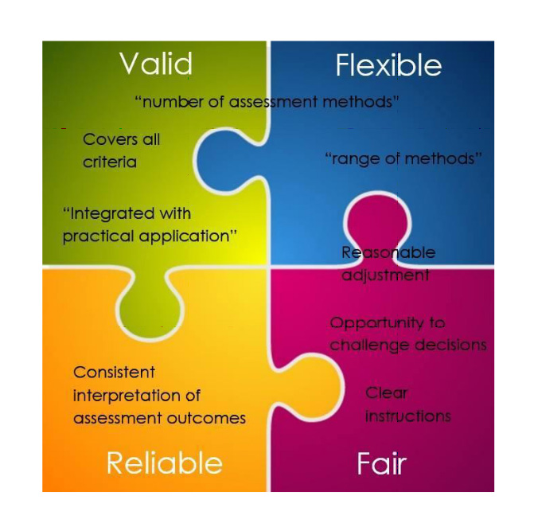
Principles of Competency Based Assessment
P-18

Slide 17
Principles of the assessment
Principle | How It Guides the Assessment Process
Valid (Assessments are valid when they assess what they claim to assess) | Validity is the degree to which the assessment A valid assessment is one that addresses and gathers sufficient evidence to cover the required aspects of the unit of competency.
Reliable (Assessments are reliable when the methods and procedures used are consistently interpreted and applied over time with different candidates, assessors and in various situations.) | Reliability is the level of consistency and accuracy of the assessment process. A reliable assessment process is one that may be used in different contexts, at different times, and still returns the same outcome regardless of the assessor making the decision.
Flexible (Assessments are flexible when they are appropriate to the range of knowledge skills and attitudes encompassed by competency standards, the range of delivery modes and locations as well as the needs of a wide range of candidates.) | Flexibility in the assessment process is one that allows for reasonable adjustment to be made to the assessment tools in order to cater for individual candidates. This may include timing, whether written or verbal questions are provided, and at what location the assessment takes place.
Fair (Assessments are fair when they are accessible to all eligible candidates regardless of age, gender, disability, ethnic or social background, language barriers or geographic location, and when no one is disadvantaged by the procedures or methods used.) | Fairness is ensuring that the assessment process does not discriminate against particular candidates or groups. This means when planning an assessment, ensuring that the methods and tools used are flexible enough to cater for people from different backgrounds, or different abilities, or certain limitations.
P-19

Slide 18
Valid
Any assessment decision of the RTO is justified, based on the evidence of performance of the individual learner. Validity requires:
Assessment against the unit(s) of competency and the associated assessment requirements covers the broad range of skills and knowledge that are essential to competent performance;
Assessment of knowledge and skills is integrated with their practical application;
Assessment to be based on evidence that demonstrates that a learner could demonstrate these skills and knowledge in other similar situations; and
Judgement of competence is based on evidence of learner performance that is aligned to the unit/s of competency and associated assessment requirements.
P-20

Slide 19
Reliable
Evidence presented for assessment is consistently interpreted and assessment results are comparable irrespective of the assessor conducting the assessment. Assessment practices should be monitored and reviewed to ensure that there is consistency in the interpretation of evidence. Assessors must be competent in terms of the national competency standards for assessment.
P-20

Slide 20
Flexible
Assessment is flexible to the individual learner by:
reflecting the learner’s needs;
assessing competencies held by the learner no matter how or where they have been acquired; and
drawing from a range of assessment methods and using those that are appropriate to the context, the unit of competency and associated assessment requirements, and the individual.
P-20

Slide 21
Fair
The individual learner’s needs are considered in the assessment process. Where appropriate, reasonable adjustments are applied by the RTO to take into account the individual learner’s needs. The RTO informs the learner about the assessment process, and provides the learner with the opportunity to challenge the result of the assessment and be reassessed if necessary.
P-20

Slide 22
Reasonable adjustments include the following
consideration on the candidate’s language, literacy and numeracy ability
provision of personal support services like reader/interpreter, attendant career
considerations relating to age and gender
considerations relating to cultural beliefs, traditional practices, religious observance
use of adaptive technology or special equipment
adjustment to the physical environment or venue
flexible assessment sessions to allow for fatigue or other physical demands
format of assessment materials (first language or use of audio-visual aids)
revising proposed assessment methods and tools
P-21

Slide 23
Possible strategies for adjusting the assessment
Concern | Strategy
Cultural background Language Literacy Numeracy Confidence | allow enough time to learn about the community and how this may impact on the assessment process; for example, whether the age and gender of the assessor is an issue assessment strategies are inclusive and culturally sensitive, in some cases, it may be more appropriate to demonstrate knowledge rather than to talk about one’s knowledge identify events that may affect the assessment activity; for example, time of prayer use methods that do not require a higher level of language and literacy (may depend on the level of qualification) than is needed be direct and to the point clarify information by rephrasing, if asked offer to write down, or have someone else write the oral responses given by the candidate
Disability | discuss with the candidate and authorised person whether the disability is likely to impact on assessment use a support person and support strategies, as required offer to write down, or have someone else write the oral responses given by the candidate
P-22

Slide 24
Groups for whom adjustments
indigenous candidates
candidates with low language, literacy or numeracy skills
older candidates
women
candidates from rural or remote areas
candidates with a disability
migrant workers
recent returnees to the workforce
P-22

Slide 25
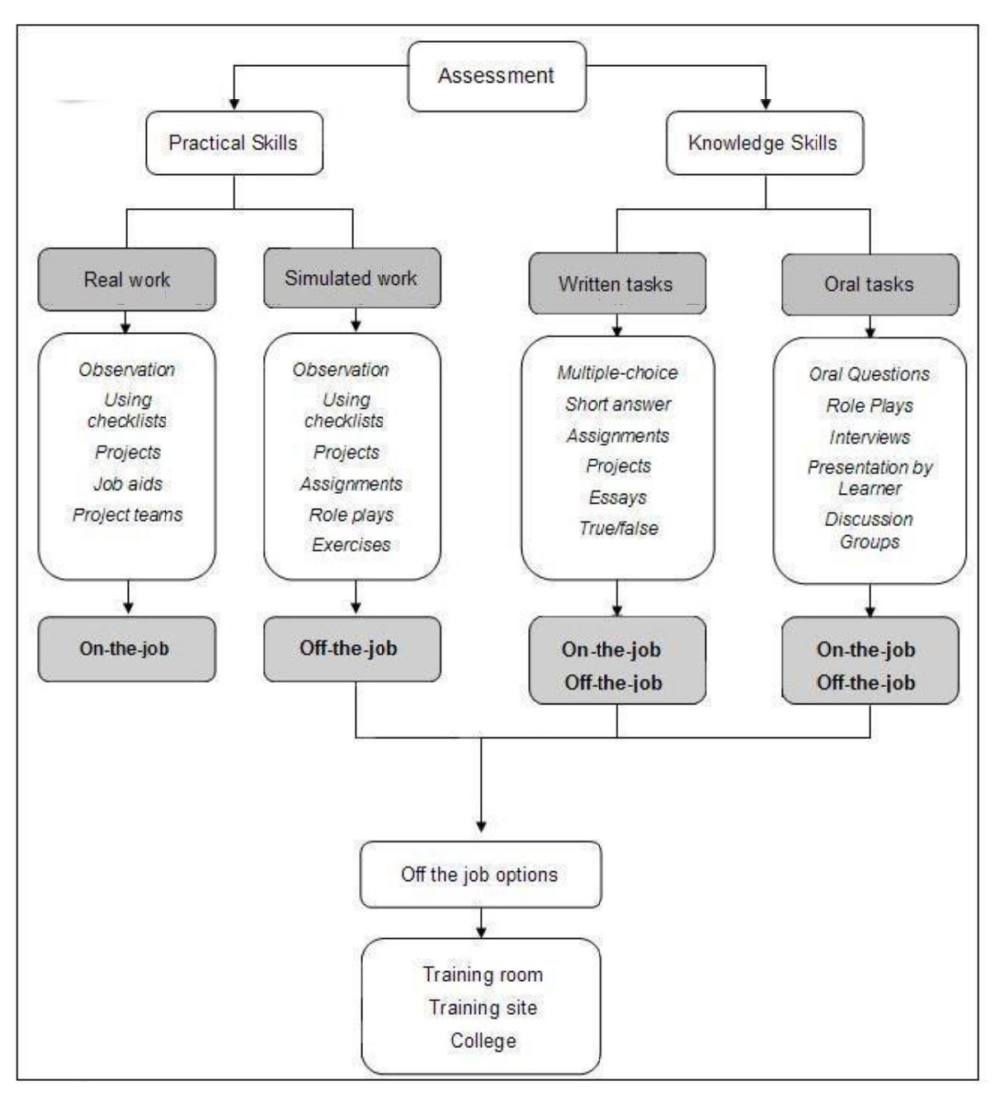
The critical aspects of competency include
P-13

Slide 26
Other principles of CB Assessment
Authenticity:
When designing assessment tools that use indirect evidence, e.g. work samples you need to ensure that the assessors check on authenticity. You should establish that indirect evidence is the work of the candidate and not someone else's. You should collect more direct evidence if in doubt.
Currency:
When assessment tools also rely on evidence such as samples, references and qualifications, ensure you check on their currency. If currency is in doubt, look for more direct evidence.
Cost-effectiveness:
It is your responsibility to ensure that the assessment methods and activities are cost-effective in terms of both time and financial costs.
Reasonable adjustment:
Reasonable adjustments may involve reconfiguring a simulated workplace so that a candidate’s disability does not impede the assessment process; or for example, finding someone who can understand a regional dialect and assist the assessor with essential communication skills.
P-21

Slide 27
Rules of evidence
Principle | How It Guides the Assessment Process
Valid | Address the elements and performance criteria Reflect the skills, knowledge and context described in the competency standard Demonstrate the skills and knowledge are applied in real or simulated workplace situations
Current | Demonstrate the candidate's current skills and knowledge Comply with current standards returns the same outcome regardless of the assessor making the decision.
Sufficient | Demonstrate competence over a period of time Demonstrate competence that is able to be repeated Comply with language, literacy and numeracy levels which match those required by the work task (not beyond)
Consistent | Does the evidence show that the candidate consistently meets the standards under workplace conditions? Does the evidence incorporate multiple items of evidence?
Authentic | Be the work of the candidate Be able to be verified as genuine
Recent | Is the evidence less than five years old?
P-54

Slide 28
Validity
The assessor is assured that the learner has the skills, knowledge and attributes as described in the module or unit of competency and associated assessment requirements. For example, the evidence will not be valid if you instruct a candidate to solve printer problems by simply asking: Type a standard office memo on a word processor. Validity is assured when the performance required matches the performance described in a competency standard.
P-54

Slide 29
Currency
The assessor is assured that the assessment evidence demonstrates current competency. This requires the assessment evidence to be from the present or the very recent past.
Currency means evidence needs to be checked to ensure it shows recent performance.
P-54

Slide 30
Sufficiency
The assessor is assured that the quality, quantity and relevance of the assessment evidence enables a judgement to be made of a learner’s competency.
A judgement has to be made concerning how much evidence to call for. How much is required for the assessor to accept the performance as competent? Too little evidence risks the assessment not being reliable; too much leads to waste of time and effort.
Tell your candidates that the evidence they present for RPL should be organised and presented in a format that makes it easy for the assessor to make a judgement of competence.
P-55

Slide 31
Consistency
Does the evidence show that the candidate consistently meets the standards under workplace conditions? Does the evidence incorporate multiple items of evidence?
P-55

Slide 32
Authenticity
The assessor is assured that the evidence presented for assessment is the learner’s own work.
Authenticity means evidence needs to be checked to ensure it actually relates to the performance of the person being assessed, and not that of another person. Checking for authenticity is important when some supplementary sources of evidence are used in assessment.
P-55

Slide 33
Recent
Is the evidence less than five years old?
P-55

Slide 34
Purpose of evidence gathering tools
help candidates understand what is expected of them
provide a focus for the assessment
identify what is needed to judge competency
assist the assessor to make judgement on whether the candidate is competent or not yet competent
allow the BTEB to have guidance on the evidence to be collected from candidates by assessors
aid an organisation in preparation of the tools, equipment and materials required for assessment
P-55

Slide 35
Steps for Design of Evidence Gathering Tools
Step 1: Identify interrelated unit(s) of competency to be assessed
Step 2: Interpret the unit(s) of competency
Step 3: Identify the type and amount of evidence to be collected
Step 4: Prepare the evidence-gathering tool
Step 5: Validate the evidence-gathering tool
Step 6: Prepare the final version of the evidence-gathering tool
P-55

Slide 36
Assessment Plan
An assessment plan is the overall planning document for the assessment process and includes a range of information to guide assessors which may include purpose, context, personnel, competency standards/assessment benchmarks, assessment methods and tools, the evidence plan, organizational arrangements including physical and material resources and equipment and other relevant information. An assessment plan is developed by an assessment designer.
Assessment plan includes:
purpose and aims of assessment
context of assessment
relevant benchmarks for assessment
other assessment information and documentation identified as relevant
- what is to be assessed & how assessment is to take place
- where assessment is to take place
- when assessment is to take place
P-61

Slide 37
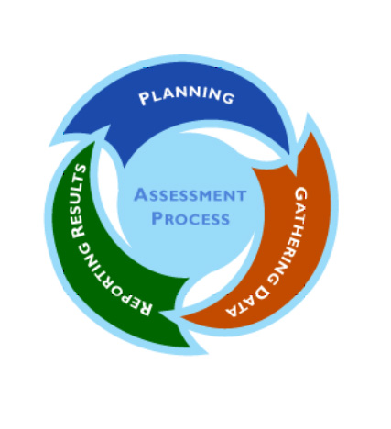
Assessment Planning Process
The assessment process is an agreed series of steps that the candidate undertakes to be judged as competent - planning, gathering and reporting cycle. The process must best suit the needs of all key stakeholders and be both effective and efficient.
P-61

Slide 38
To help us recognize competency
4 questions that we can ask
Can this person transfer these skills to new situations?
How does this person respond when things go wrong?
How does this person cope with changes to the conditions under which the task is being performed?
How does this person manage the task as part of the other demands of the job?
P-61

Slide 39
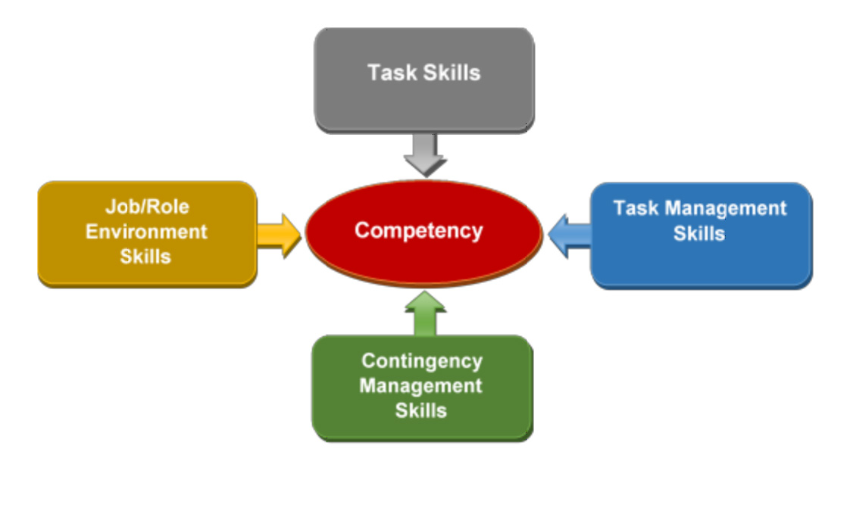
Dimensions of competency
P-63

Slide 40
Dimensions of competency
Dimension of Competency | Analysis
Task skills | Those skills actually needed to perform the task at an acceptable level Include knowledge and physical skills Usually described in the performance criteria of competency standards
Task management skills | Organizing and coordinating skills needed to manage a number of tasks or activities within the job
Contingency skills | Skills needed to respond and react appropriately to unexpected problems, changes in routine and breakdown
Job role/environment skills | Particular skills needed to perform as expected in a particular job position and location May be described in the range of variables and underpinning skills and knowledge sections of a competency standard
P-54

Slide 41
Key Features of the Assessment Plan
fair, valid, reliable and flexible.
links to the units and competency elements and the performance criteria set out in the Competency Unit.
covering the assessment of underpinning knowledge.
including assessment instruments and events which are ‘performance based’. This means the assessor is able to make a direct assessment of whether the trainee can perform the competency to the required skill level as set out in the performance criteria – through workplace demonstrations, simulated workplace demonstrations and practical tasks or other performance-based processes.
be practical and ‘doable’. This means there is a reasonable balance of course time taken up with training and assessment (the demands of assessment should not overwhelm the trainers’ time dedicated to course instruction). Assessment should not impose unreasonable burdens on the participant nor should the criteria be set so high that trainees find it unreasonably difficult to succeed.

Slide 42
Key Features of the Assessment Plan
where possible, assessment should be fun. Clever and authentic assessment should tap upon the natural enthusiasm of the learner to learn and the satisfaction which comes with demonstrating a skill or ability.
be holistic and avoid being ‘atomistic’ – multiple small, unconnected assessment events which are time consuming and may mean little on their own. Often the key to
‘competence’ is to be able to combine a set of discrete skills into a meaningful job related process.
have coherency and, where possible, clustered around a few more comprehensive assessment events which can collectively assess several specific elements and performance criteria in a connected way.
the weightings of the assessment events and processes should be documented – and whether they are essential for an assessment of competence or not essential should be made clear to participants.

Slide 43
Key Features of the Assessment Plan
detail and justify how an assessment of ‘Competent’ is reached, for example how the knowledge assessment is integrated into the overall assessment, whether there is a threshold requirement on this assessment, how ‘failed’ attempts may be repeated and what are the essential elements of competence in the assessment. It should be stressed that there is no such thing as 80% ‘Competent’ - a candidate is either ‘Competent’ or ‘Not Yet Competent’.
avoidance of multiple choice and true/ false objective testing unless for the most basic cognitive recall elements of underpinning knowledge.
for the knowledge component short written or oral answers to authentic work related questions or situations are a more suitable approach; other techniques can include longer written reports, presentations and longer written tests.
it is useful and recommended that the assessment plan be set out in descriptive tabular form showing how the assessment covers the various elements of competence.

Slide 44
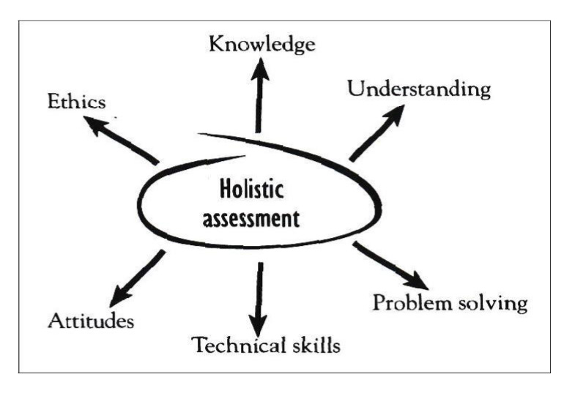
Holistic Assessment Design
An approach to assessment that covers the clustering of multiple units of competency from relevant competency standard. This approach focuses on the assessment of a ‘whole of job’ role or function that draws on a number of units of competency. The assessment approach also integrates the assessment of the application of knowledge, understanding, problem solving, technical skills, attitudes and ethics.
P-66

