Slide 1
Competency Based Training (CBT&A Methodology) Trainer & Assessor(Level 4)
Day-7
7. Design and Modify CBT Learning Materials and
Resources
DR. Sheikh Abu Reza
Director (Rtd) DTE &
CBT&A Trainer

Slide 2
Previous Class Outcome
Maintain and Enhance Professional & Technical Competency
Personal Professional Skill Development Plan
Enhancing qualification
Industry attachment, Industry visit, Conference, Seminar etc.
Technical Competency Development Plan
Required Skills Development
Visit Industry for updated skills

Slide 3
Today’s Learning outcome
1. Analyze existing learning materials and relevant resources
2. Adapt existing resources
3. Develop new resources
4. Review learning materials
5. Evaluate the design and development process.
P- 7

Slide 4
7.1 Analyze existing learning materials and relevant resources
Competency Standards(CS)
Industry competency standards, often referred to as 'competency standards’ are industry-determined specifications of performance, which set out the skills, knowledge and attitudes required to operate effectively in employment. Competency standards are made up of units of competency, which are themselves made up of elements of competency, together with performance criteria, a range of variables, and an evidence guide.
Curriculum Documents (CD)
A curriculum is a documented representation of a set of competencies. Under the National Technical and Vocational Qualification Framework (NTVQF), these competencies are usually written as Units of Competency (UoC) in the competency standards document. These standards are endorsed by the relevant Industry Skills Council (ISC).
P- 13

Slide 5
Provided information of a curriculum document
Name and Number of the module and/unit of competency
Nominal delivery hours
General description of the purpose of the module
Prerequisite knowledge and skills
Relationship to the industry competency standards
Summary of the assessment
Detailed description of the learning outcomes
Description of how the module and /or unit of competency might be delivered
P- 14

Slide 6
Learning Materials
Learning materials is a generic term used to describe the resources Trainer and trainees use to deliver instruction. Ideally, the teaching materials will be tailored to the content in which they're being used, to the students in whose class they are being used, and the trainees.
The importance of learning Materials is to improve students' knowledge, abilities, and skills, to monitor their assimilation of information, and to contribute to their overall development and upbringing.
A trainer should always think about his/her learners before providing Learning Materials. A trainer should identify the need of developing new teaching and training materials. Trainer can classify their materials according to the need and requirement of learners. A lesson plan can be one of the effective materials.
P- 14

Slide 7
Learning Resources
Learning resources are added tools that
helps teachers teach and students learn.
Examples
Textbooks (print and digital),
Workbooks,
Worksheets,
Manipulative (blocks, beads, etc.),
Educator workshops,
Non-fiction books,
Posters,
Power point , etc.
P- 14

Slide 8
Why use Learning Resources?
Learning materials are an aid to the learning process. They should not be for the benefit of the instructor or something that must be used all the time. They must facilitate the students' learning. They should:
Arouse and Maintain interest.
Efficient and Effectiveness of CBT
Simplify instruction.
Aid retention.
Stimulate active thinking.
Accelerate learning as more senses are involved
P- 16

Slide 9
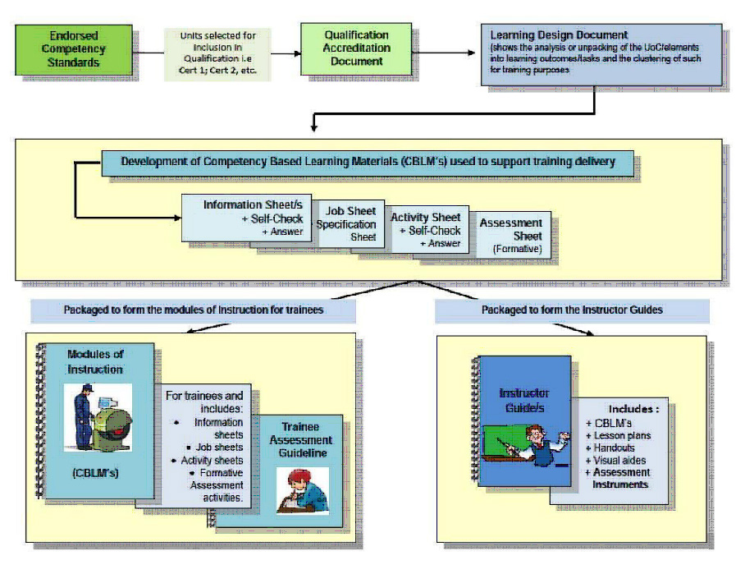
Some Linkages between CS ad CD
P- 16

Slide 10
Relationship between learning outcomes and elements
A learning outcome ·
Is a curriculum term ·
States what a learner should be able to do towards achieving the purpose
of the module/unit of competency ·
Relates to standards of competency identified by industry ·
Is written as an action statement from the learner's point of view.
An element of competency ·
Is a industry competency standards term ·
Is the basic building block of a unit of competence ·
Describes the tasks that make up the broader function or job.
P- 16

Slide 11
Validating Training Requirements by the following persons/officers
Experts in the trainees trade areas.
Supervisors/ or trainees employers.
Training providers, employers and human resources departments.
Trainers, Teachers and Assessors.
Participant Trainee/Learner who is advanced in skill.
Government regulatory bodies.
Consultative Committees.
BTEB registered Assessors/Assessment Centers.
P- 17

Slide 12
Learning outcomes and assessment criteria
Learning outcomes and assessment criteria are an essential part of curriculum design and need to be written in the planning stages. Well written outcomes and criteria enable higher level skills and a learner-led curriculum to be developed.
Learning outcomes
define what students are expected to learn and what they need to do to pass.
provide clarity for an external audience (other colleagues, examiners, parents, employers etc.) of the standards required of learners
Assessment criteria are based on the intended learning outcomes for the work being assessed and make explicit the knowledge, understanding and skills markers expect a student to display in the assessment task and which are taken into account in marking the work.
P- 18

Slide 13
Learning outcomes and assessment criteria
Learning outcomes are the focus of the curriculum design. Teaching activities should flow from them and allow students to engage with the knowledge and/or practice the applications and skills designated within them. Learning outcomes may be assessed by individual assignments or in a larger task, such as a project, which encompasses several. Whether individually or grouped, every learning outcome must be assessed.
Assessment criteria specify how an assessment task will be judged. They may also include recognition of formative assessment, for example by requiring completion of a formative task as a pre-requisite for a summative assignment. Both formative and summative assessment tasks should enable learning by emphasizing progress and achievement and hence fostering motivation.
Assessment feedback should relate specifically to the learning outcomes and assessment criteria and indicate to learners how to improve.
P- 19

Slide 14
Adult learning
Adult learning is defined as ‘the entire range of formal, non-formal and informal learning activities which are undertaken by adults after a break since leaving initial education and training, and which results in the acquisition of new knowledge and skills.
Seven core principles have been identified in the practice of adult learning; these are:
Learner’s need to know.
Adults bring life experience and knowledge to the learning environment. This experience and knowledge includes work-related, family, and community events and circumstances
Self-concept of the learner.
Adults tend to prefer self-directed, autonomous learning? But this is often not an expectation of learning institutions and society.
Prior experience of the learner.
Adults have self-pride and desire respect. They need their experience, beliefs, knowledge, questions, and ideas acknowledged as important.
P- 22

Slide 15
Adult learning
Readiness to learn.
Adults want practical, goal-oriented, and problem-centered learning that can immediately help them deal with life's challenges.
Orientation to learning.
Adults have preferences for the way in which they learn. Some prefer learning by doing (kinesthetic), others prefer learning by observing (visual), while still others prefer learning by listening (auditory).
Motivation to learn.
Adults are motivated to learn by a wide variety of factors. These are the most common: personal aspirations, externally imposed expectations, internal desire or interest, escape from a situation (boredom or fear), growth and advancement, and service to others.
Desire feedback on the progress
Adults desire feedback on the progress they are making at learning something new.
Provide opportunities for learners to get immediate feedback to their own learning through case examples, role-playing, quizzes, and responses to trainer questions.
P- 22

Slide 16
7.2 Adapt existing resources
Below are some tips and resources to consider for evaluating and adapting materials.
Assess needs and resources
Evaluate the material
Find out whether you need permission to use or adapt the existing material
Pilot test (field test) new or adapted materials
Make changes based on pilot test
Finalize and implement
Evaluate your adapted material
P- 29

Slide 17
The learning operational resources
Overhead projector and transparencies
Internet / web based resources
multimedia / data projector
slides – power point presentation
Video / CD / DVD
Film
Computer training packages
Blackboard / whiteboard
Magnetic boards and cards
Charts and posters
Notice boards
Handouts
Competency Based Training and Assessment resources / guides
Tape recorders / Video recorders
Text books and references
Workbooks and manuals
P- 32

Slide 18
Consumable resources
Marking pens
Overhead transparencies
CDs and DVDs
Paper for the printer
Butcher's paper or flip charts
Whiteboard markers
Chalks (yes, there are still some blackboards out there).
P- 35

Slide 19
7.3 Develop new resources
Nine steps that can assist you in your writing:
Gain Attention – to orientate and motivate the learner
Inform Learners of Objectives – to guide learners and to assist them to organize their thoughts around what they are about to learn
Stimulate Recall of Prior Knowledge – because adults learn by establishing relationships with what they know and a new knowledge or skill
Present the material – in a way that appeals to the different learning references and is easy to digest
Provide guidance for learning – by providing opportunities to integrate new information into their existing knowledge base
Provide feedback – to reinforce or correct learning
Assess performance – learners should be given the opportunity for assessment to gain recognition of their success in learning
Enhance retention and transfer – by encouraging learner to plan the application of what they have learnt
P- 39

Slide 20
Choosing Learning Activities and Methods
Analogies
Assist learners to make connections with the materials and what they already know.
Many well-known concepts have been effectively explained using this technique.
Case Studies
Case studies are an excellent way of providing opportunities for analysis of ‘real world’ situations which pose problems for the learner to solve as well as a chance to apply or consolidate their learnings.
Charts and Diagrams
Checklists
Instructional Games and Simulations
Mind Maps
Mnemonic Aids
Are used to assist learners in remembering key concepts or principles. An example is RATER, which reminds us of the five factors that clients use to rate the quality of service they receive.
Reliability
Assurance
Tangibles
Empathy
Responsiveness
P- 42

Slide 21
Things consider for writing CBLM
To enjoy writing
Knowledge of your subject area and be able to put time into research
Relevant personal experience that you can draw upon
Appropriate knowledge of instructional design, adult learning and training.
To focus for periods of time without interruption
P- 46

Slide 22
Improving your Writing
1. Using overviews instead of introductions.
2. Make the dialogue sound real, not artificial.
3. Create interesting case studies and role plays.
4. Position ideas for highlighting.
P- 48

Slide 23
7.4 Review learning materials
Competency Based Learning Material (CBLM):
CBLM is a learning guide which will lead a learner through a series of activities. These activities may be completed as part of structured classroom activities or you to work at your on pace. These activities will ask you to complete associated learning and practices activities in order to gain knowledge, skills you need to achieve the learning outcome.
P- 51

Slide 24
Reasons for Using CBLM
Learning is self-paced;
Learning is student-centered;
Develop learning mastery;
Immediate feedback on the achievement of learning; and Training is well-planned
P- 51

Slide 25
The major parts of CBLM’s contain which are
:
Information sheet
Self Check sheet
Answer sheet
Job Sheet
Specification sheet.
P- 51

Slide 26
The major parts of CBLM’s contain which are
: Job Sheet:
Job sheet is a set of instruction to perform a specific job. This is used when a basic task, operation or process needs to be mastered before doing the job. List all the steps a worker will need to complete the job.
Specification sheet:
In a specification there is a set of condition, Specifications, Diagram of exiting job which is required to perform the job.
. Information sheet:
The information supports the job sheet; i,e to perform the job required underpinning knowledge are included in the information sheet.
P- 51

Slide 27
Characteristics of a Good Information Sheet
Free from violation of copyright law;
Contains information essential to the attainment of the learning outcomes; Has a title that gives some idea of the coverage of the sheet;
Approach in terms of content and presentation is appropriate to the interest and reading level of the learner;
The layout, text and drawings are attractive in appearance and legible; and Has uncommon terms marked for further defining Has acknowledgement per copied part of the sheet.
P- 51

Slide 28
7.5 Evaluate the design and development process
ghfghcf
P- 110

Slide 29
Review
Please mention some current trends (at least 5)
What are the steps to help you manage your emotions?
Say at least 5 Innovative Learning Strategies for Modem Pedagogy?
What is Context based Learning?
What is main reason for keeping a record of your achievements ?

