Slide 1
The History of Linux
From a Hobby Project to Powering the World
Reza Jaliani

Slide 2
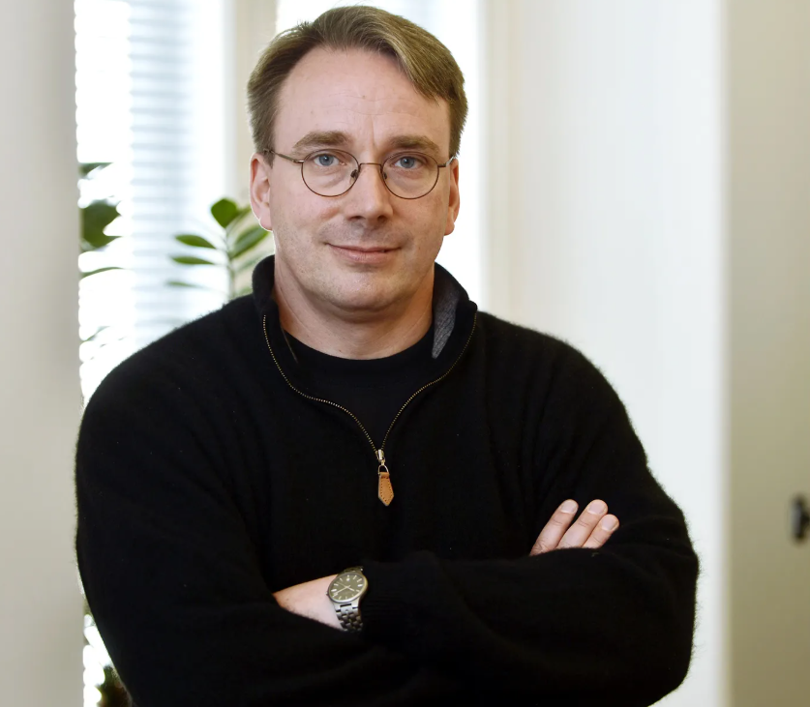
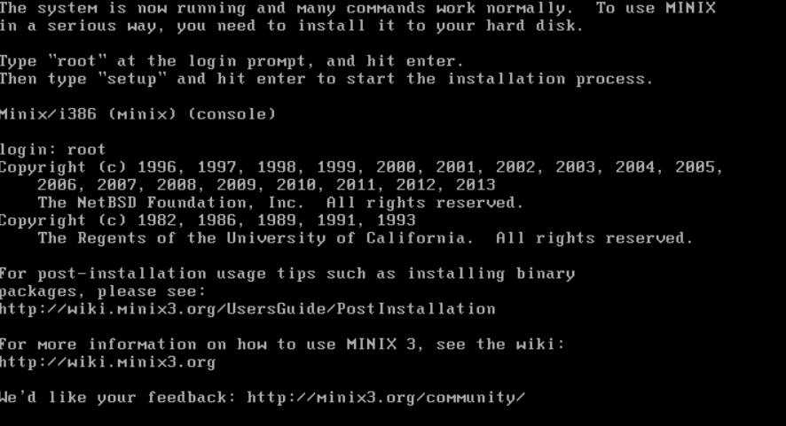
Early Days (1991)
Created by Linus Torvalds
Started as a personal hobby
Inspired by Minix, a teaching OS
Goal: a free, Unix-like kernel

Slide 3
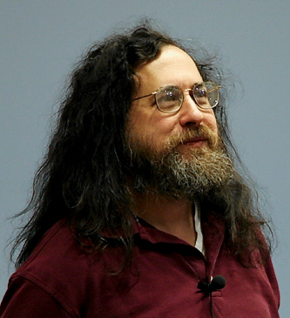

Open-Source Revolution
GNU Project provided tools and utilities
Free Software Foundation (Richard Stallman)
Combination of Linux kernel + GNU utilities
Marked the birth of a complete OS

Slide 4



Growth in the 1990s
First Linux distributions appeared
Popular examples: Slackware, Debian, Red Hat
Gained attraction among developers
Community-driven improvements

Slide 5

Expansion in the 2000s
Linux became popular for servers
Enterprises and governments adopted it
Rise of Ubuntu for user-friendly desktop use
Strong ecosystem of contributors

Slide 6



Linux Today
Powers Android smartphones
Dominates cloud computing
Runs on supercomputers
Integral part of IoT devices

Slide 7

Summary
From a hobby project in 1991
To a global open-source phenomenon
Linux now powers much of the modern world

