Slide 1
Updating ρ and σ in cov

Slide 2
 | 𝛒 |  | 𝛔
Synthetic estimated | Mean | Std | Mean | Std
ρ=0 | 0.087 | 0.076 | 1.142 | 0.062
ρ=0.05 | 0.034 | 0.081 | 1.127 | 0.059
ρ=0.1 | 0.033 | 0.082 | 1.125 | 0.062
ρ=0.15 | 0.031 | .084 | 1.124 | 0.061

Slide 3
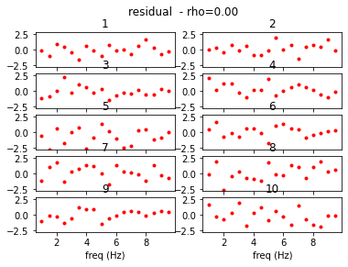
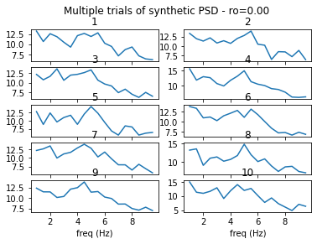
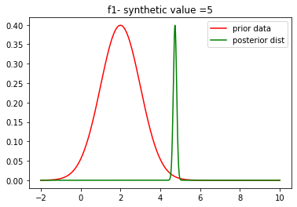
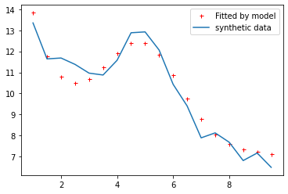
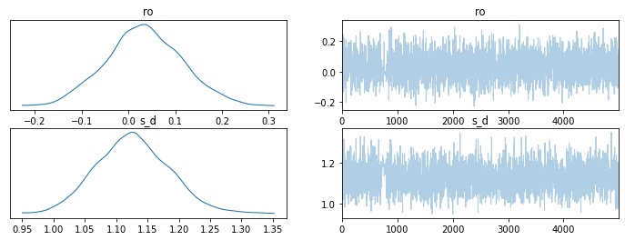
ρ=0.0

Slide 4
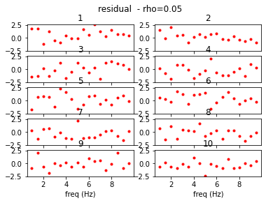
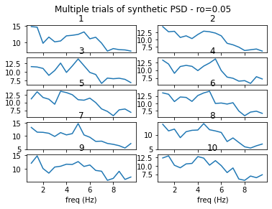
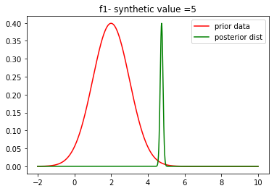
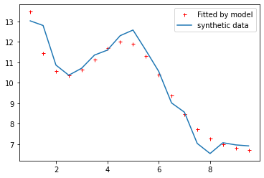
ρ=0.05

Slide 5
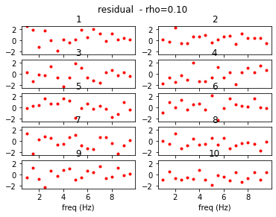
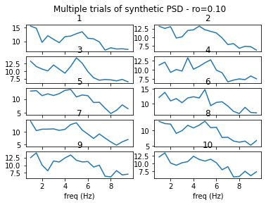

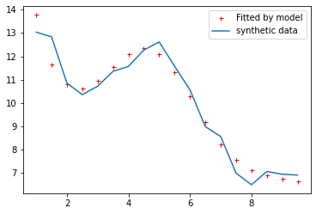
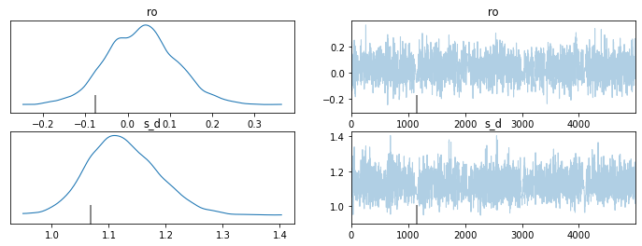
ρ=0.1

Slide 6
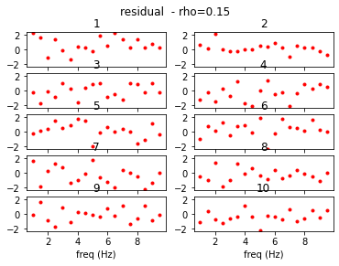
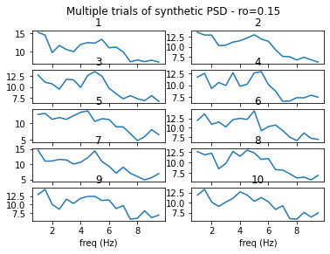

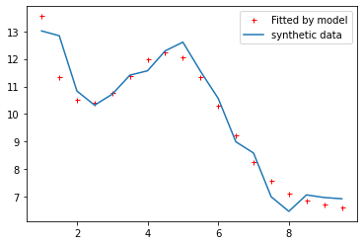
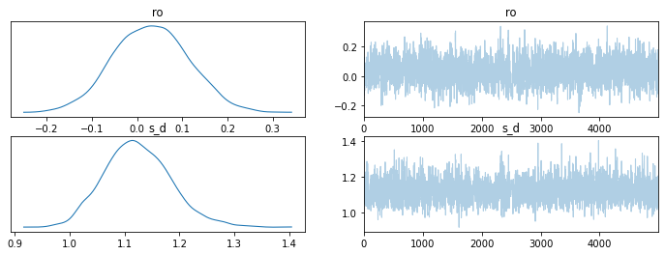
ρ=0.15

Slide 7
Only Updating ρ (not σ in cov)

Slide 8
 | 𝛒
Synthetic estimated | Mean | Std
ρ=0.01 | 0.03 | 0.03
ρ=0.05 | 0.02 | 0.02
ρ=0.08 | 0.03 | 0.03
ρ=0.1 | 0.06 | 0.06
ρ=0.3 | 0.02 | 0.02
ρ=0.5 | 0.01 | 0.01

Slide 9


ρ =0.01

Slide 10
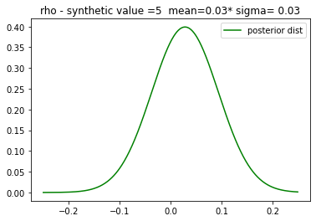
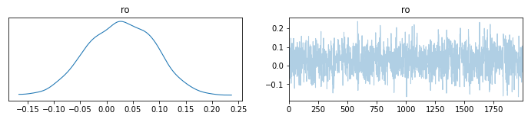

Slide 11


ρ =0.05

Slide 12
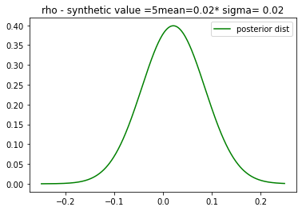
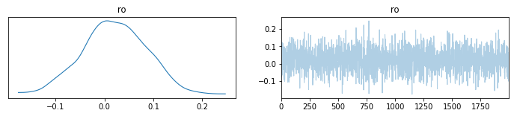

Slide 13


ρ =0.08

Slide 14
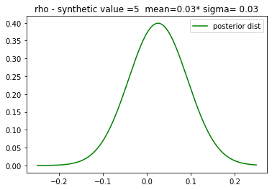
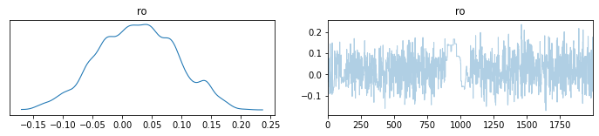

Slide 15


ρ =0.1

Slide 16
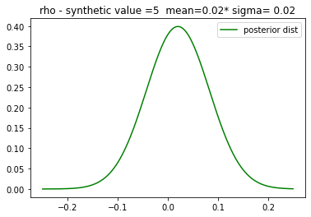
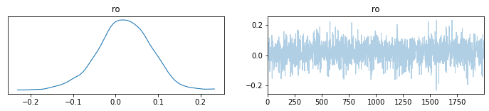

Slide 17
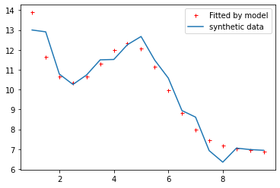

ρ = 0.3

Slide 18
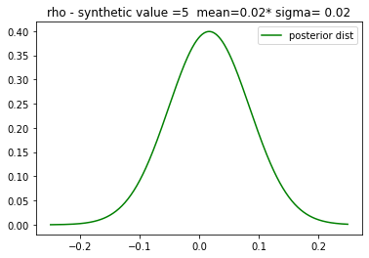
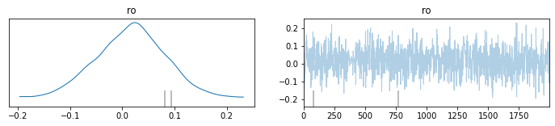

Slide 19
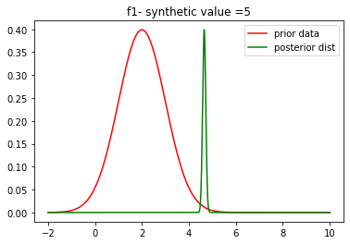
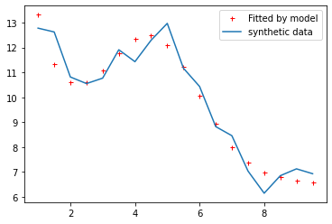
ρ = 0.5

Slide 20
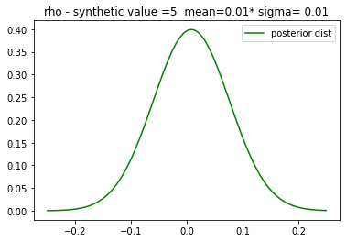
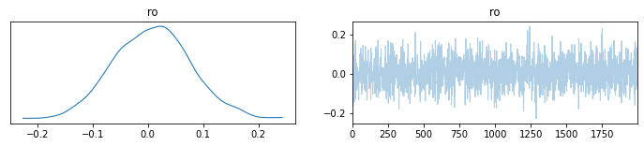

Slide 21
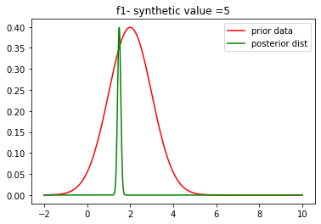
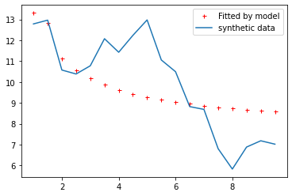
ρ = 0.7

Slide 22
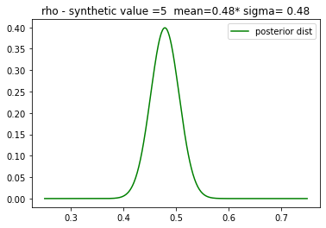
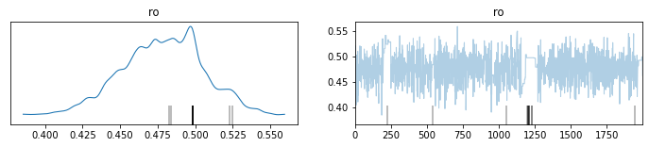

Slide 24
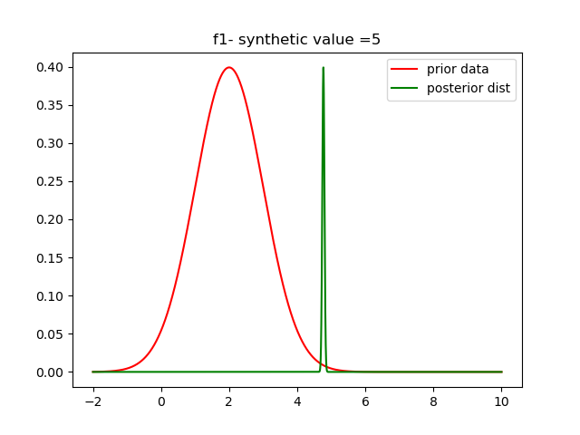
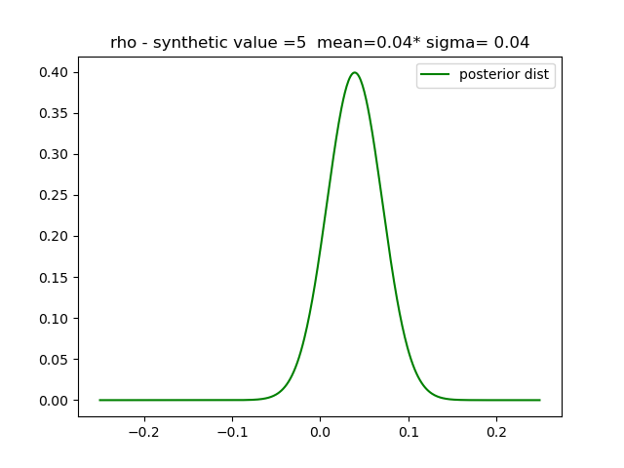
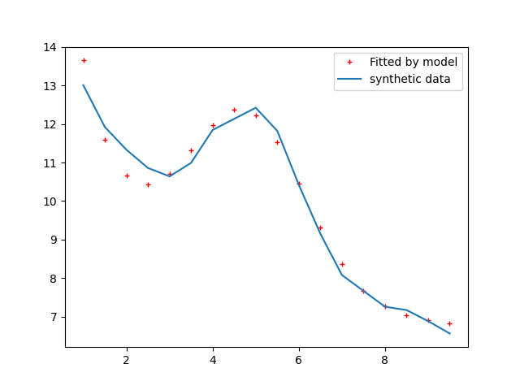
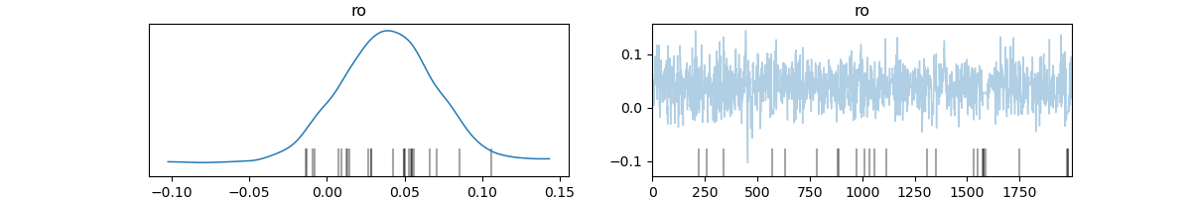
Num taper 50 – rho=0.2

Slide 25
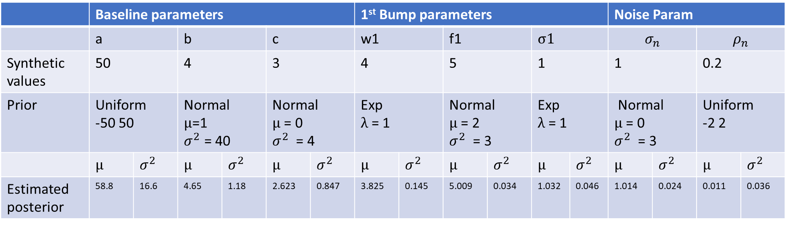
Rho=0.4
 | Baseline parameters |  |  |  |  |  | 1st Bump parameters |  |  |  |  |  | Noise Param
 | a |  | b |  | c |  | w1 |  | f1 |  | σ1 |  | $$σ_{n}$$ |  | $$ρ_{n}$$
Synthetic values | 50 |  | 4 |  | 3 |  | 4 |  | 5 |  | 1 |  | 1 |  | 0.2
Prior | Uniform -50 50 |  | Normal μ=1 $σ^{2}$ = 40 |  | Normal μ = 0 $σ^{2}$ = 4 |  | Exp λ = 1 |  | Normal μ = 2 $σ^{2}$ = 3 |  | Exp λ = 1 |  | Normal μ = 0 $σ^{2}$ = 3 |  | Uniform -2 2
 | μ | $σ^{2}$ | μ | $σ^{2}$ | μ | $σ^{2}$ | μ | $σ^{2}$ | μ | $σ^{2}$ | μ | $σ^{2}$ | μ | $σ^{2}$ | μ | $σ^{2}$
Estimated posterior | 58.8 | 16.6 | 4.65 | 1.18 | 2.623 | 0.847 | 3.825 | 0.145 | 5.009 | 0.034 | 1.032 | 0.046 | 1.014 | 0.024 | 0.011 | 0.036

Slide 26
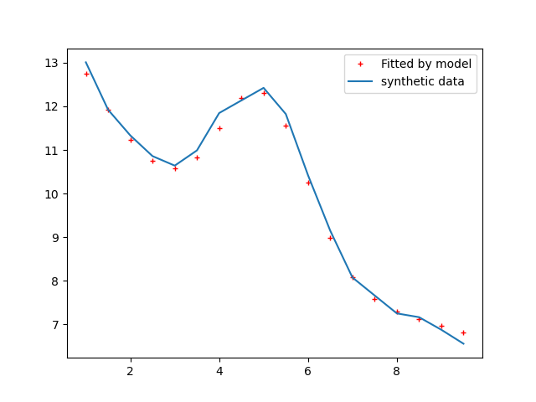
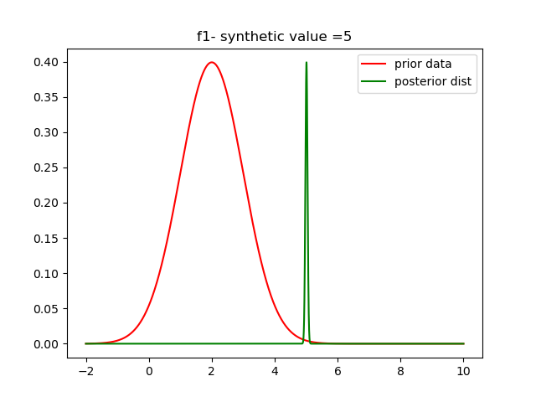

Slide 27
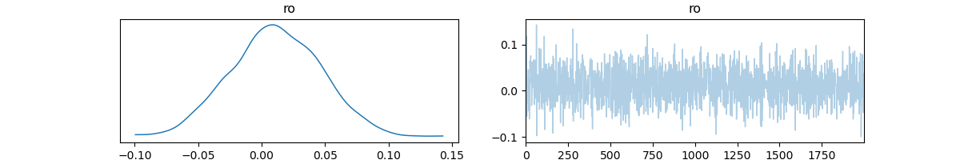
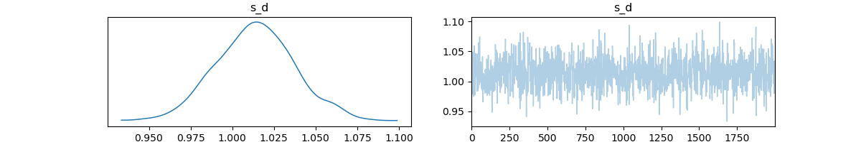

Slide 28
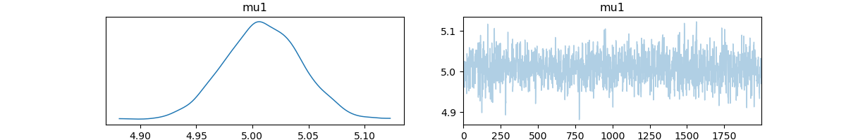
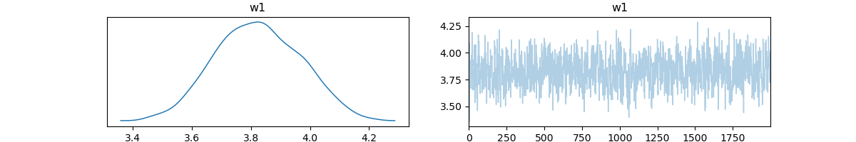
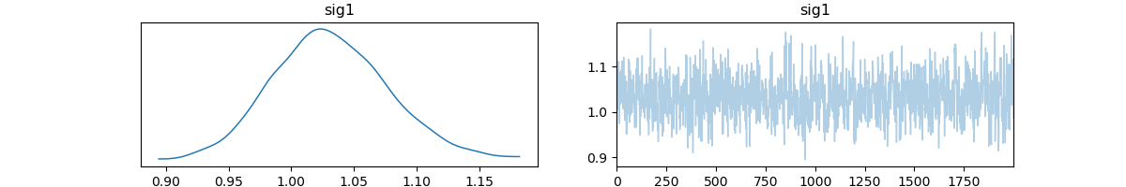

Slide 29
