Slide 1
FOOOF – ρ distribution

Slide 2
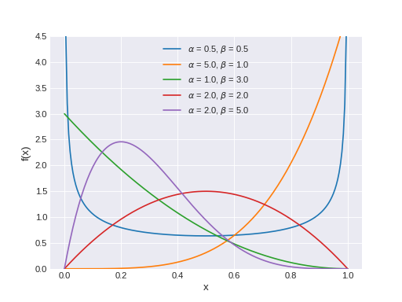
Using Beta Distribution as Prior of ρ

Slide 3
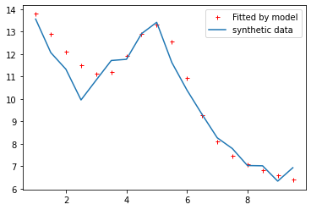
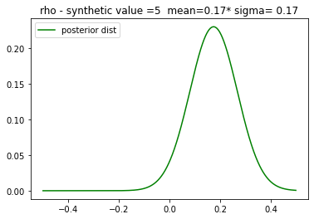
α=2, β=2 – like a normal in positive part
Synthetic ρ = 0.0

Slide 4
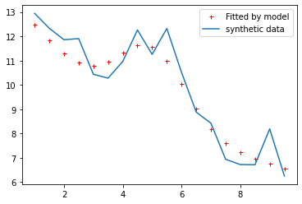
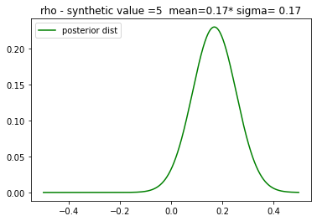
α=2, β=2
Synthetic ρ = 0.1

Slide 5
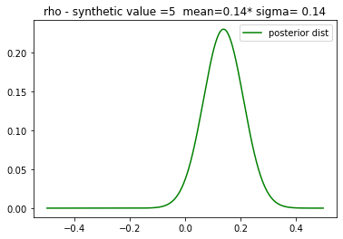
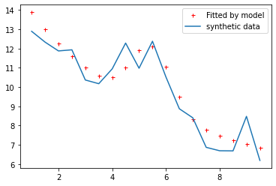
α=2, β=2
Synthetic ρ = 0.3

Slide 6
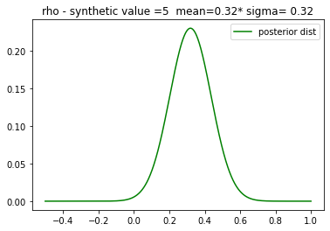
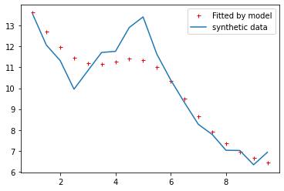
α=5, β=1 – like an exponential
Synthetic ρ = 0.0

Slide 7
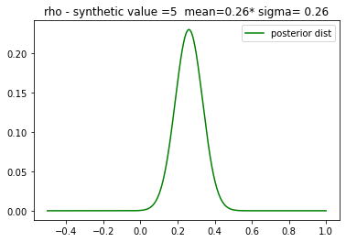
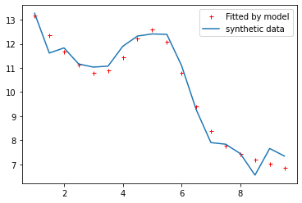
α=5, β=1
Synthetic ρ = 0.0

Slide 8
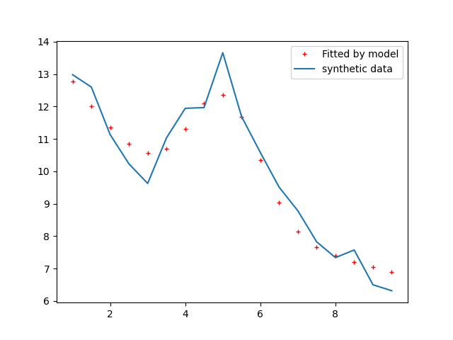
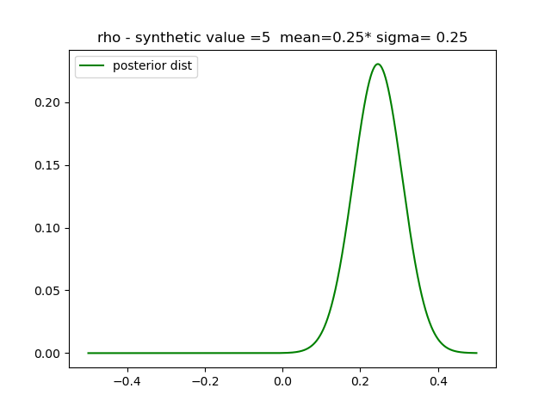
α=5, β=1
Synthetic ρ = 0.3

Slide 9
Question
The exact value might not be estimated> but the optimal goal is to have a good fit on the observation

Slide 10
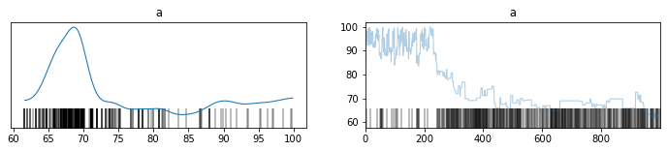
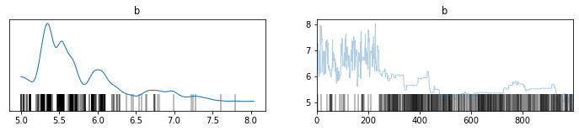
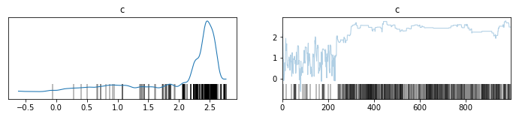
'a': 50,
'b': 4,
'c': 3

