Slide 1
FOOOF – Prior examination

Slide 2
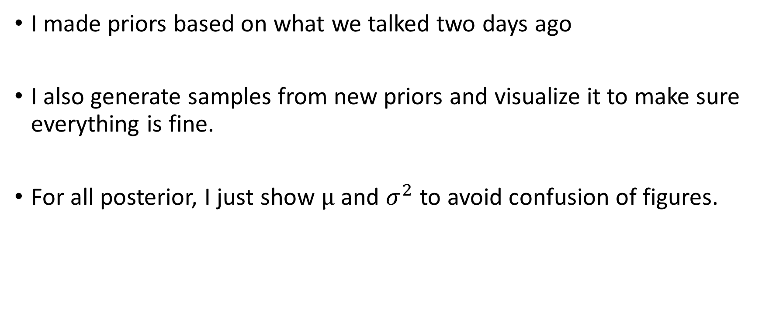
General Points
I made priors based on what we talked two days ago
I also generate samples from new priors and visualize it to make sure everything is fine.
For all posterior, I just show μ and $σ^{2}$ to avoid confusion of figures.

Slide 3
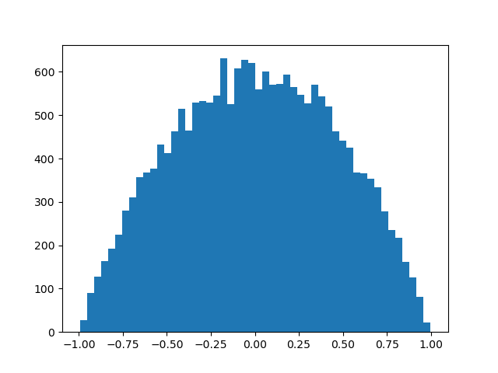

ρ prior
Using scaled beta distribution with below info
Bounded distribution
ρ≃$\left(β\left(α=2, β=2\right)−0.5\right)×2$

Slide 4
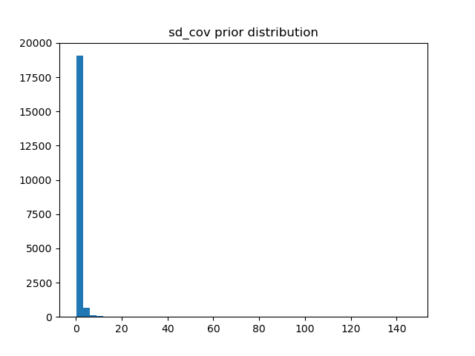

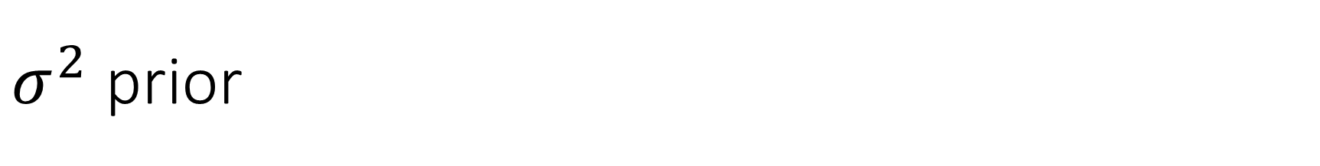
$σ^{2}$ prior
Using $σ^{2}$ rather than σ
InversedGamma is not bounded
$σ^{2}$ ≃$\left(γ^{−1}\left(α=2, β=1\right)\right)$

Slide 5
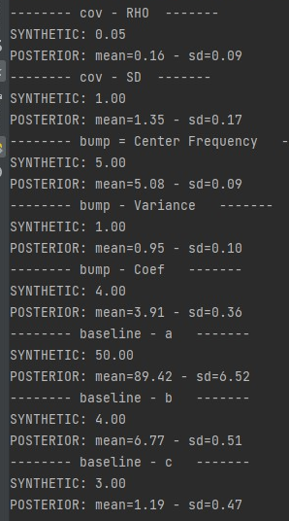
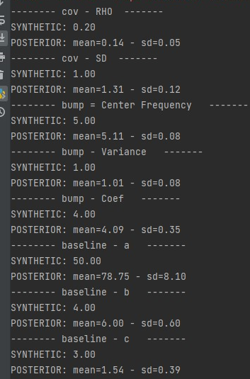

Posteior results (ρ priors is β- $σ^{2}$ is $γ^{−1}$)
Here I used two different configuration to compare results
Synthetic ρ = 0.05
Synthetic ρ = 0.2
All other params are fixed

Slide 6
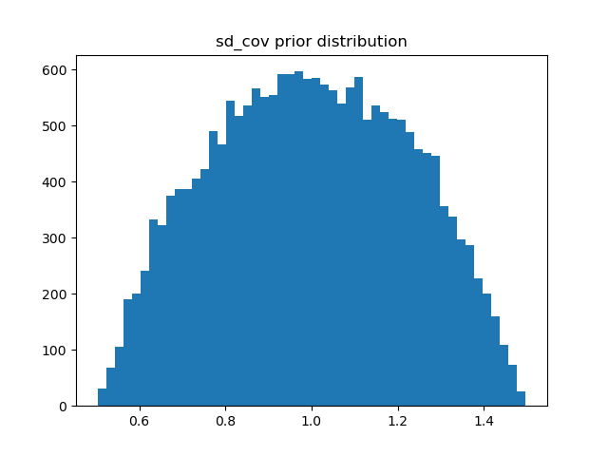

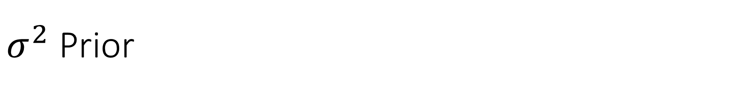
$σ^{2}$ Prior
as the Inversed Gamma is not bounded, I cheked scaled β around 1 for $σ^{2}$
$σ^{2}$ ≃$\left(β\left(α=2, β=2\right)+0.5\right)$

Slide 7
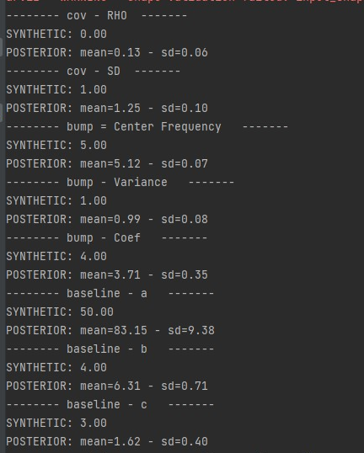
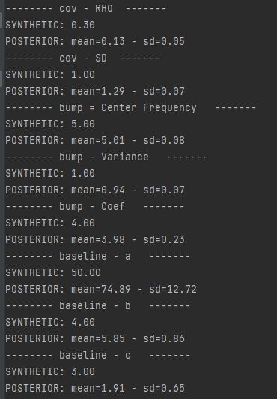

Posterior Results (ρ and $σ^{2}$ priors are β)

Slide 8


Why $a$ value is so different
Baseline = $\frac{a}{b+f}+c$
In this simulation, I assume $b, c$fixed.

Slide 9
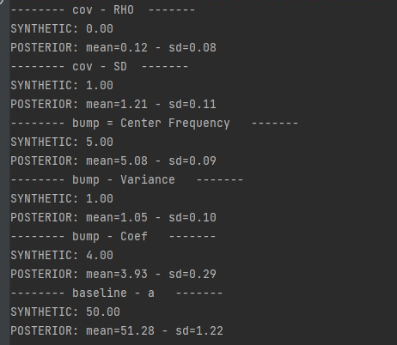
Keeping fixed b, c update a

Slide 10
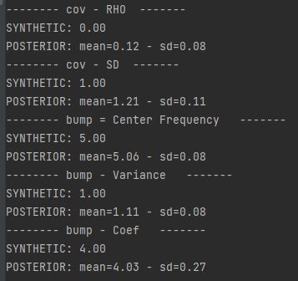
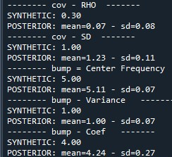
Fixing a, b, c
Here, I assume a, b, c fixed (with their real synthetic values)
Again estimations for ρ is not correct

Slide 11
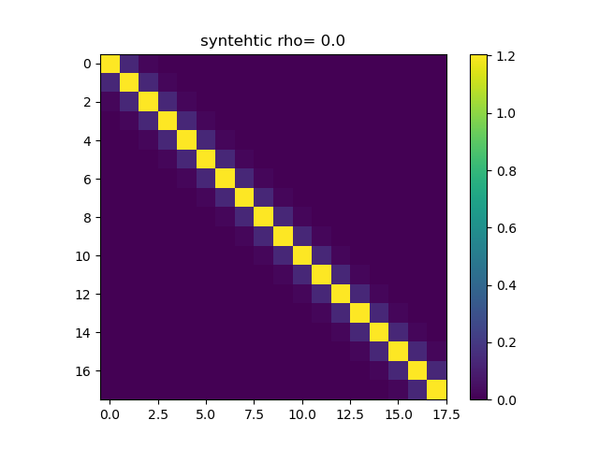

Posterior of Covariance Matrix (mean value)

Slide 12
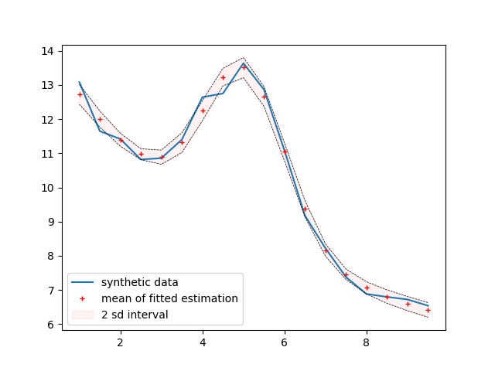

Slide 13
Suggestion
For cosyne, we don’t consider covariance structure (ρ=0)> introduce Bayesian FOOOF
We can investigate it later

