Slide 1
FOOOF – Rho update

Slide 2
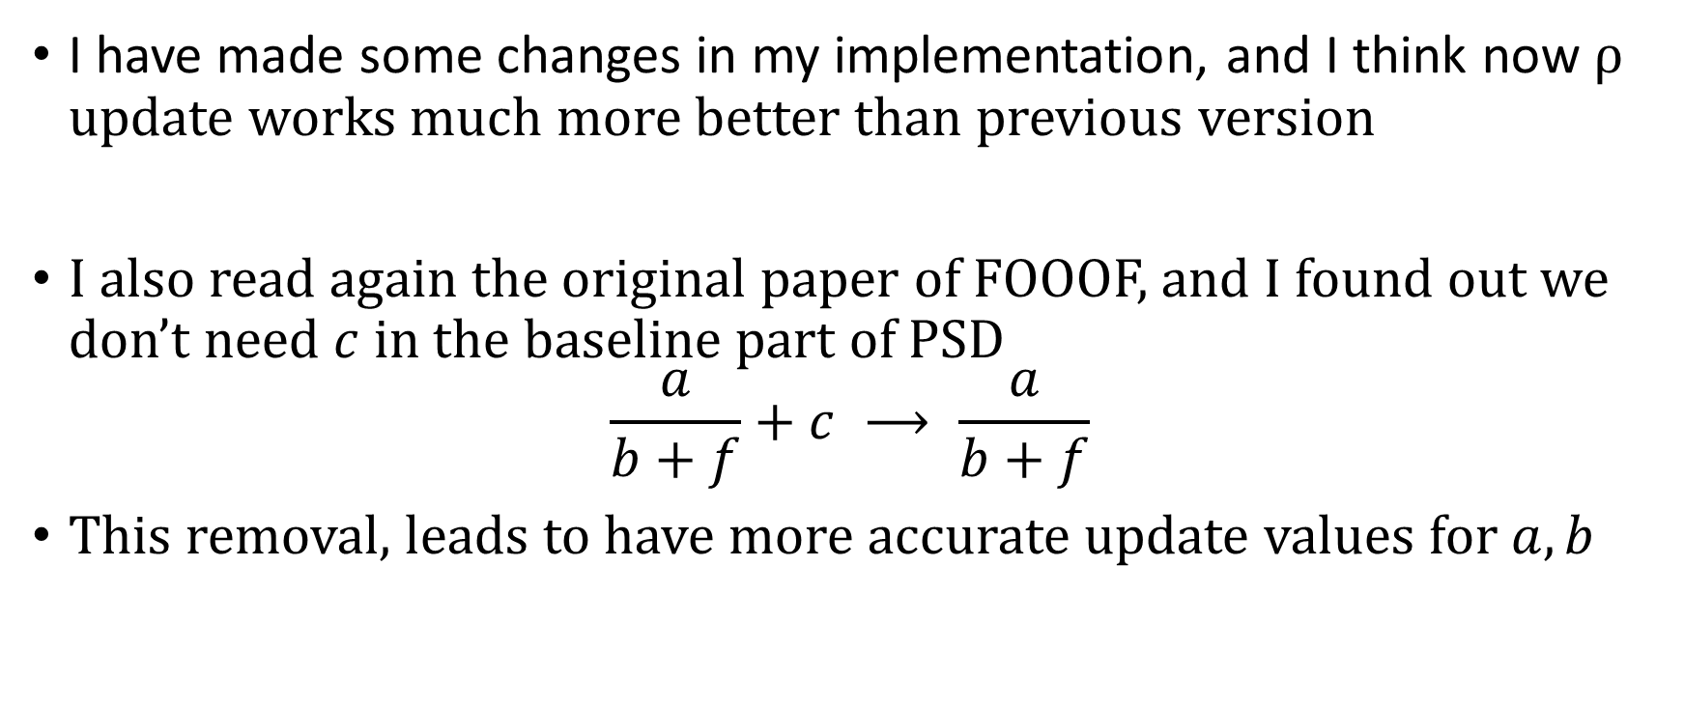
I have made some changes in my implementation, and I think now ρ update works much more better than previous version
I also read again the original paper of FOOOF, and I found out we don’t need $c$ in the baseline part of PSD
$$\frac{a}{b+f}+c ⟶ \frac{a}{b+f}$$
This removal, leads to have more accurate update values for $a, b$

Slide 3
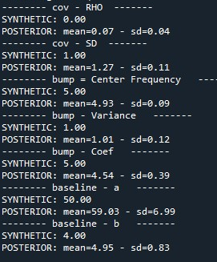
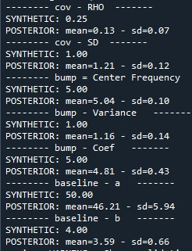
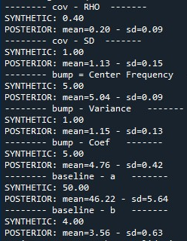
Update parameters

Slide 4
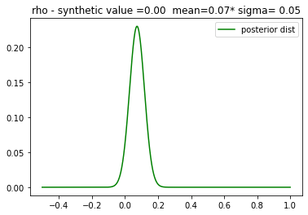
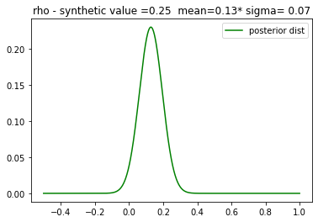
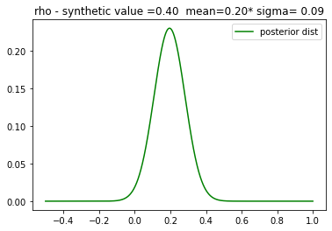
Posterior of ρ

Slide 5
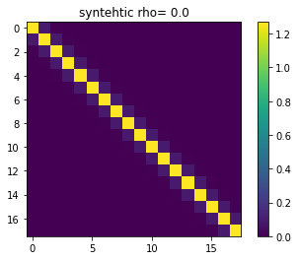
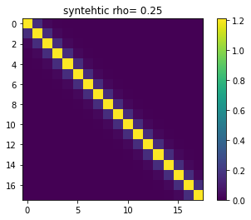


Covariance Matrix (has been made by mean of ρ and $σ^{2}$)
One can see reconstructed covariance matrix can capture ρ value somewhat.

