Slide 1
FOOOF – ρ distribution

Slide 2
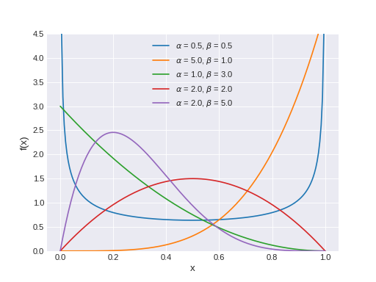
Using Beta Distribution as Prior of ρ

Slide 3
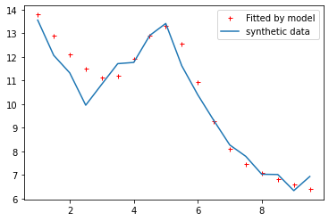
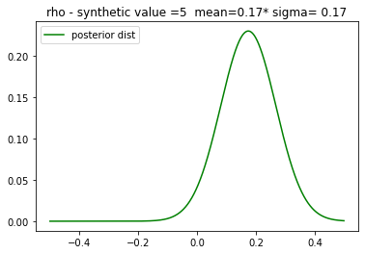
α=2, β=2 – like a normal in positive part
Synthetic ρ = 0.0

Slide 4
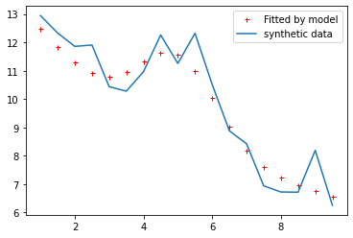
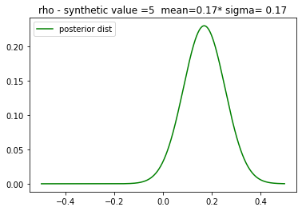
α=2, β=2
Synthetic ρ = 0.1

Slide 5
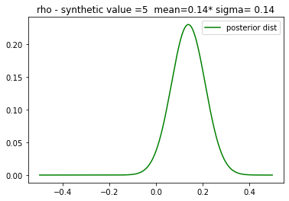
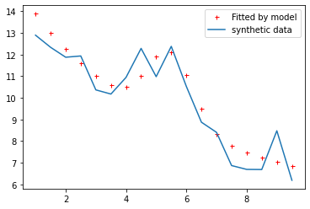
α=2, β=2
Synthetic ρ = 0.3

Slide 6
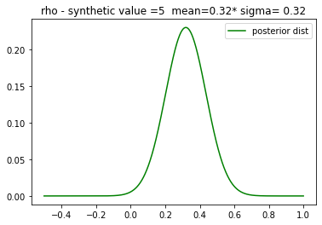
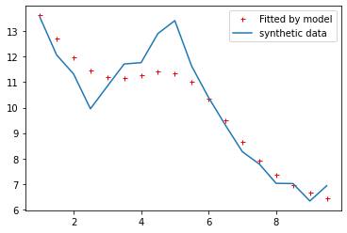
α=5, β=1 – like an exponential
Synthetic ρ = 0.0

Slide 7
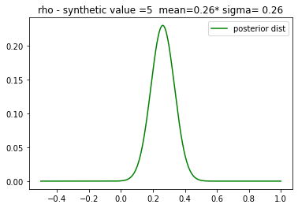
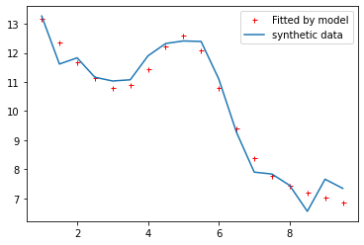
α=5, β=1
Synthetic ρ = 0.0

Slide 8
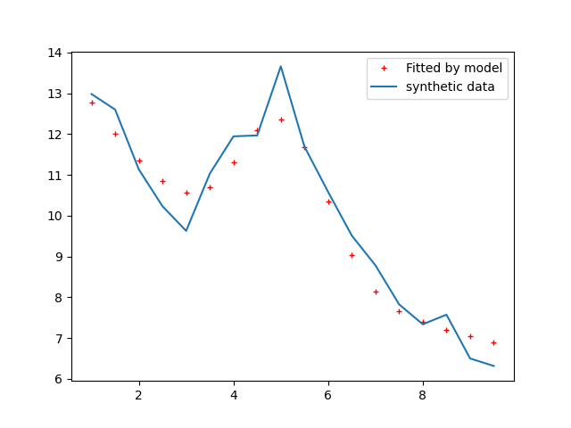
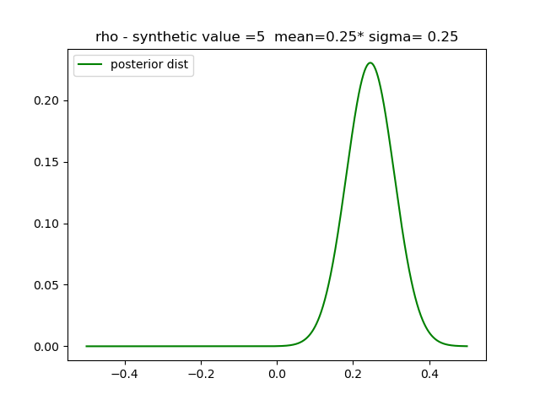
α=5, β=1
Synthetic ρ = 0.3

Slide 9
Question
The exact value might not be estimated> but the optimal goal is to have a good fit on the observation

Slide 10
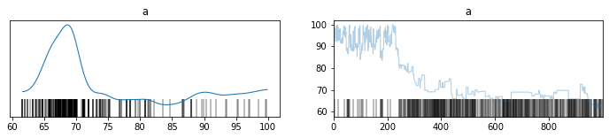
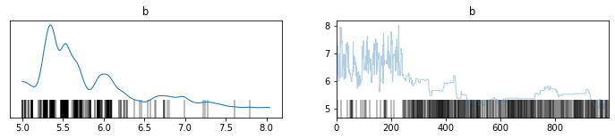
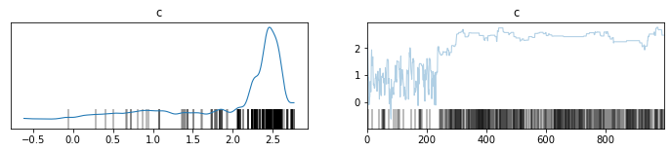
'a': 50,
'b': 4,
'c': 3

Slide 11
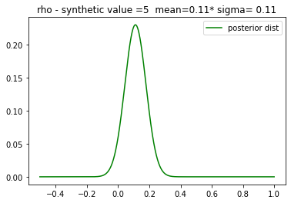

Synthetic ρ=0.0
ρ= beta ( α=1, β=5)
Mean = $\frac{\text{α}}{\text{α}+\text{β}}=\frac{1}{6}$
Estimation
RHO cov info: mean=0.11 - sd=0.07
SD cov info: mean=1.14 - sd=0.07

Slide 12
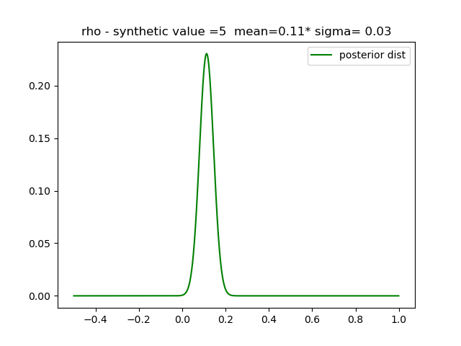

Synthetic ρ=0.2
ρ= beta ( α=1, β=5)
Mean = $\frac{\text{α}}{\text{α}+\text{β}}=\frac{1}{6}$
Estimation
RHO cov info: mean=0.11 - sd=0.03
SD cov info: mean=1.21 - sd=0.05

Slide 13
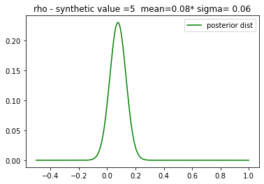

Synthetic 0.0
ρ= beta ( α=1, β=10) → Mean = $\frac{\text{α}}{\text{α}+\text{β}}=\frac{1}{11}$
σ= beta ( α=2, β=1) → Mean = $\frac{\text{β}}{\text{α}−1}=\frac{1}{1}=1$
RHO cov info: mean=0.08 - sd=0.06
SD cov info: mean=1.09 - sd=0.07

Slide 14
Synthetic 0.2
ρ= beta ( α=1, β=10) → Mean = $\frac{\text{α}}{\text{α}+\text{β}}=\frac{1}{11}$
σ= beta ( α=2, β=1) → Mean = $\frac{\text{β}}{\text{α}−1}=\frac{1}{1}=1$
RHO cov info: mean=0.08 - sd=0.06
SD cov info: mean=1.14 - sd=0.07

Slide 15
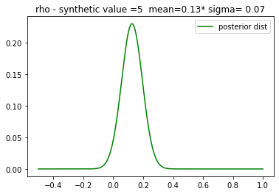
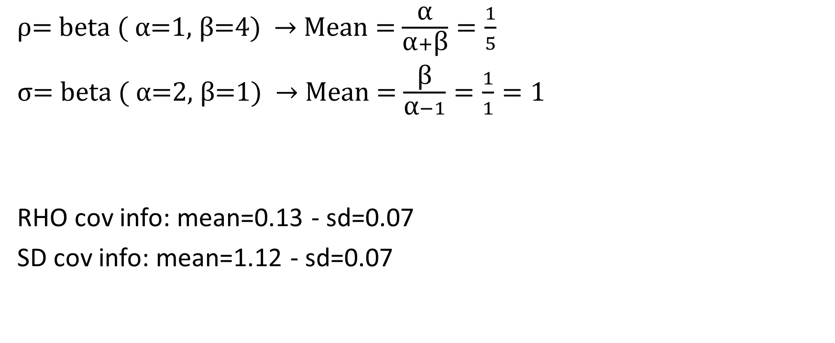
Synthetic 0.0
ρ= beta ( α=1, β=4) → Mean = $\frac{\text{α}}{\text{α}+\text{β}}=\frac{1}{5}$
σ= beta ( α=2, β=1) → Mean = $\frac{\text{β}}{\text{α}−1}=\frac{1}{1}=1$
RHO cov info: mean=0.13 - sd=0.07
SD cov info: mean=1.12 - sd=0.07

Slide 16
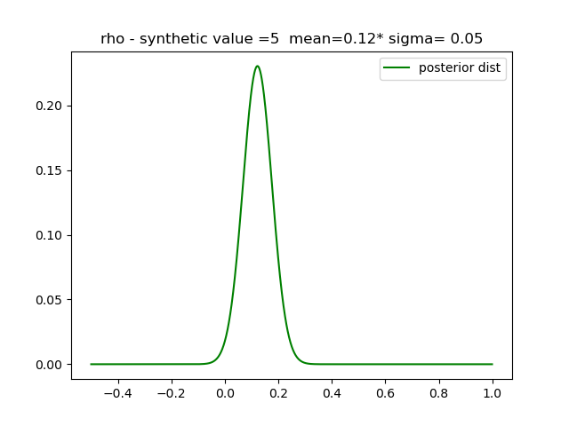
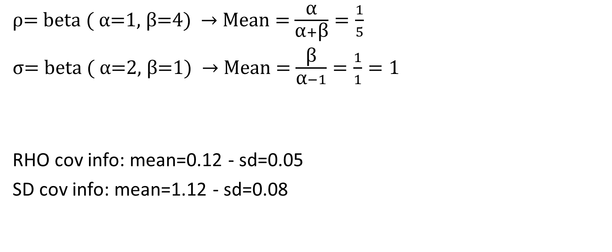
Synthetic 0.2
ρ= beta ( α=1, β=4) → Mean = $\frac{\text{α}}{\text{α}+\text{β}}=\frac{1}{5}$
σ= beta ( α=2, β=1) → Mean = $\frac{\text{β}}{\text{α}−1}=\frac{1}{1}=1$
RHO cov info: mean=0.12 - sd=0.05
SD cov info: mean=1.12 - sd=0.08

