Slide 1
Spyder Challenge

Slide 2
Data
Spyder > large-scale complex and cross-domain semantic parsing and text-to-SQL
Sematic Parsing: Converting Natural Language to a Logical Form
a machine understandable representation of its meaning
Extract meaning of an utterance
Application: Question Answering

Slide 3
Data
10,181 question
5693 unique SQL queries on 200 databases
138 different domain
Previous challenges > use single data sets
Spyder challenge> various kind of data sets

Slide 4
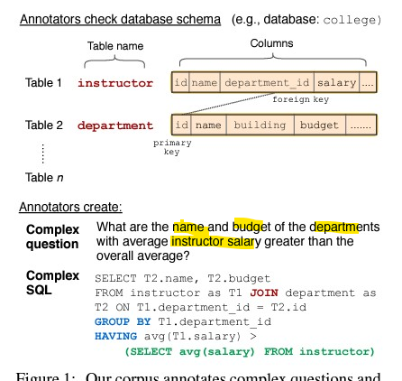
Challenge
Need to understand the meaning of Natural Language
Mapping to meaningful executable queries such as SQL queries
To generate the SQL query for given question model needs to understand both: 1. natural language question 2- relations between tables and columns in the DB

Slide 5
Challenge
Model Should take
the Task required the model > to generalize well to both
New SQL queries
New Dataset schemas
Input |  | Output
Questions |  | Predict unseen queries on new databse
Database Schemas

Slide 6
Challenge
This challenge aims to ensure that the proposed model can only make correct prediction when they truly understand the semantic meaning of question rather than memorization

Slide 7
Evaluation
Component Matching measuring average exact match between the prediction and the ground truth
Exact Matching assessing whether the predicted query as a whole is equivalent to the Gold query?
Execution Accuracy instead of a Gold query> a set of gold values for each question is given> Model need to select them and fill them into right slots in the predicted query

Slide 8
Method
It has been started recently!

