Slide 1
Updating ρ and σ in cov

Slide 2
 | 𝛒 |  | 𝛔
Synthetic estimated | Mean | Std | Mean | Std
ρ=0 | 0.087 | 0.076 | 1.142 | 0.062
ρ=0.05 | 0.034 | 0.081 | 1.127 | 0.059
ρ=0.1 | 0.033 | 0.082 | 1.125 | 0.062
ρ=0.15 | 0.031 | .084 | 1.124 | 0.061

Slide 3
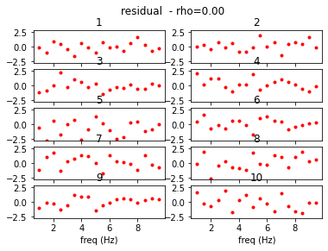
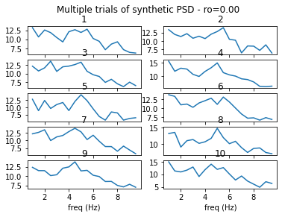
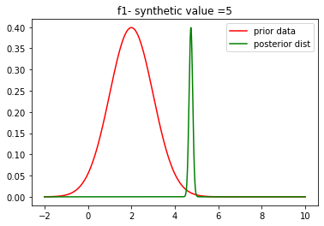
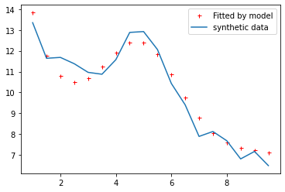
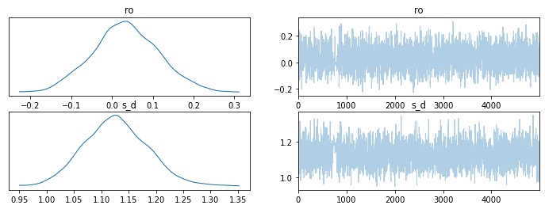
ρ=0.0

Slide 4
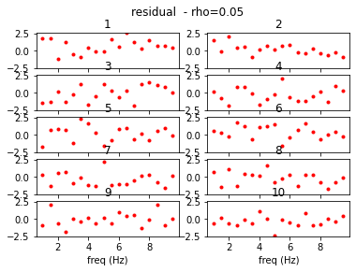
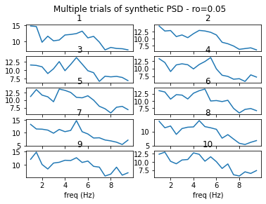
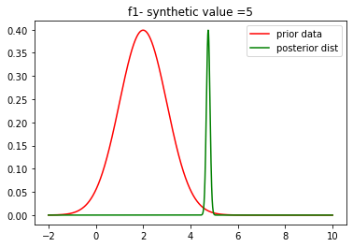
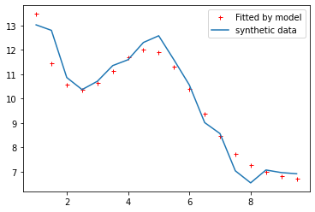
ρ=0.05

Slide 5
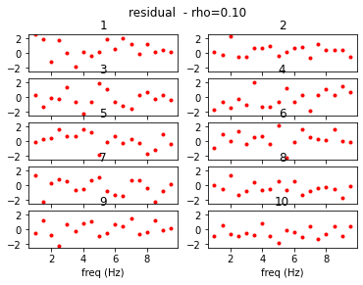
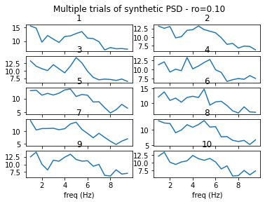

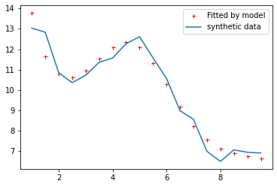
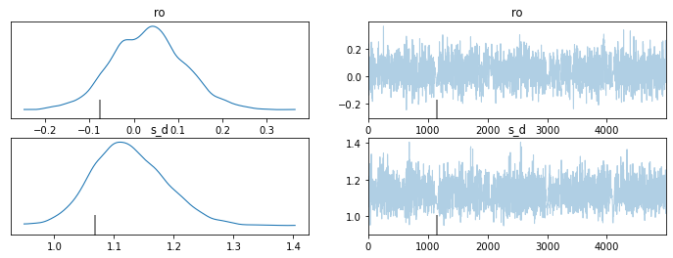
ρ=0.1

Slide 6
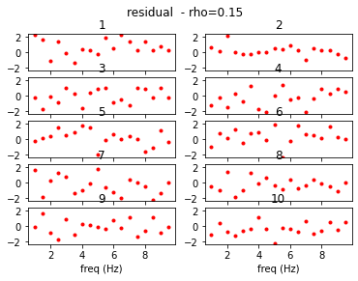
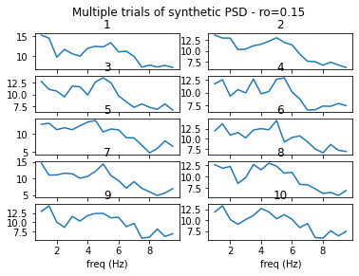

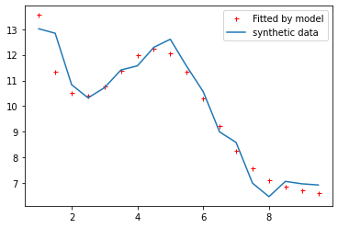
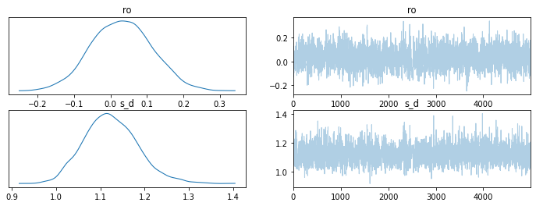
ρ=0.15

Slide 7
Only Updating ρ (not σ in cov)

Slide 8
 | 𝛒
Synthetic estimated | Mean | Std
ρ=0.01 | 0.03 | 0.03
ρ=0.05 | 0.02 | 0.02
ρ=0.08 | 0.03 | 0.03
ρ=0.1 | 0.06 | 0.06
ρ=0.3 | 0.02 | 0.02
ρ=0.5 | 0.01 | 0.01

Slide 9


ρ =0.01

Slide 10
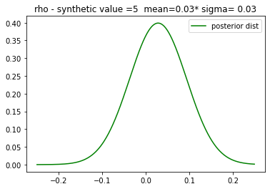


Slide 11


ρ =0.05

Slide 12
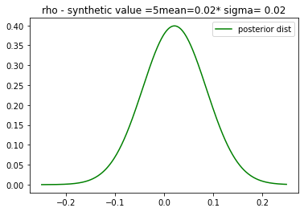


Slide 13


ρ =0.08

Slide 14
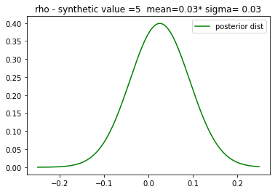


Slide 15


ρ =0.1

Slide 16
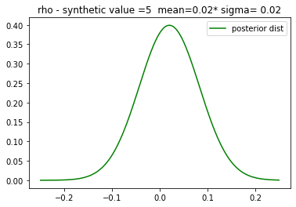


Slide 17
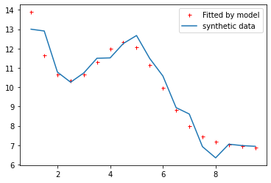

ρ = 0.3

Slide 18
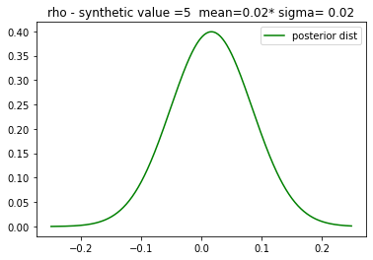


Slide 19
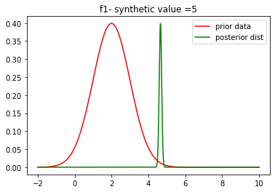
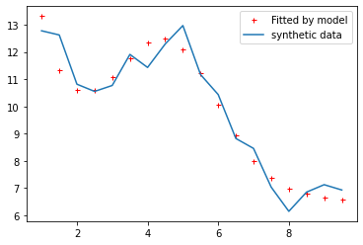
ρ = 0.5

Slide 20
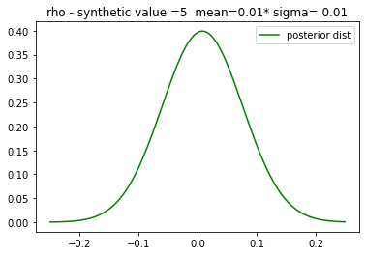


Slide 21
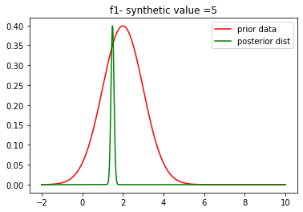
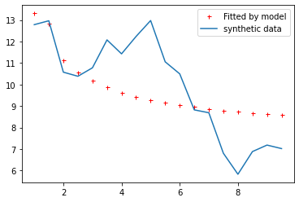
ρ = 0.7

Slide 22
