Slide 1
SSA Logistics Planner App
team assignments based on delivery priorities and member nearest

Slide 2
Smart Store Selection:
Selection is based on delivery value.
Number of stores selected corresponds to the number of available leaders.
Members are assigned based on proximity to stores.
App Link: https://reza76.streamlit.app/

Slide 3
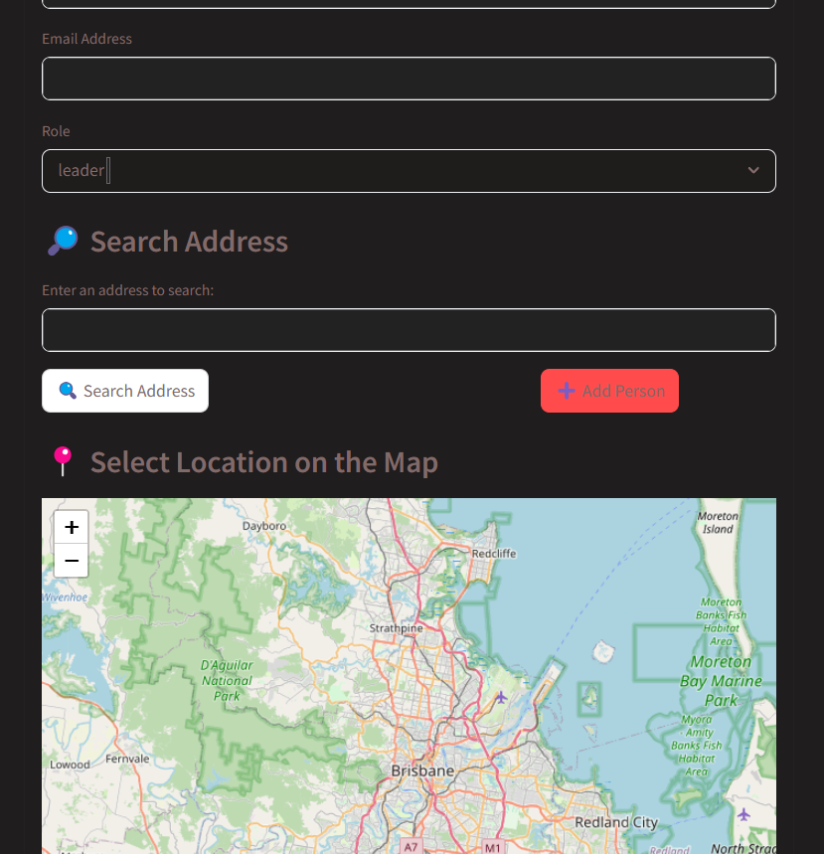
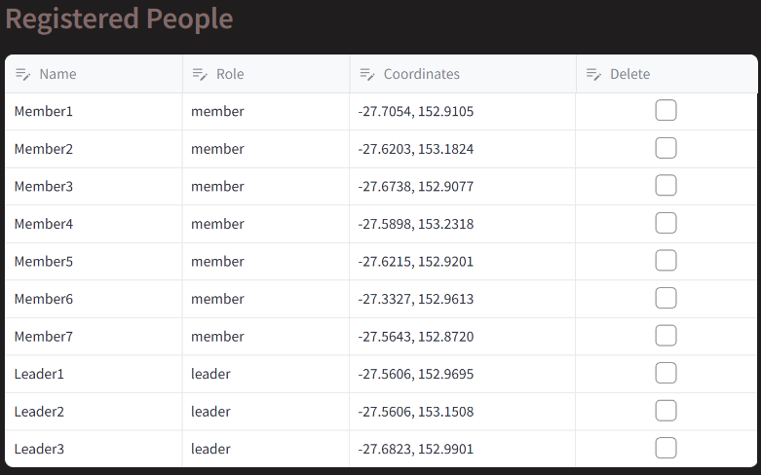
Planner Inputs
Member details: name, email, address.

Slide 4
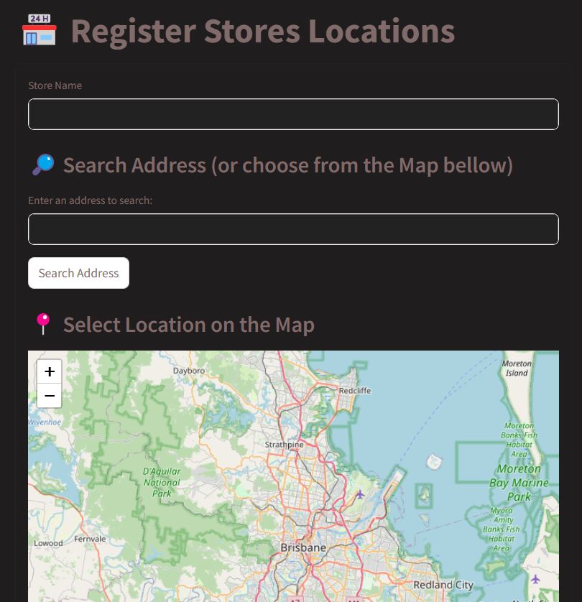
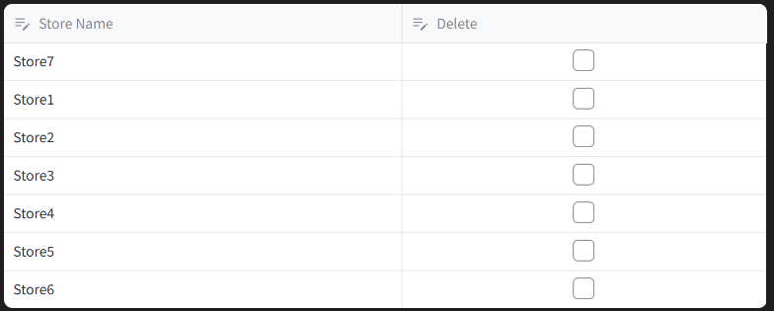
Planner Inputs
Store information: name, address.

Slide 5
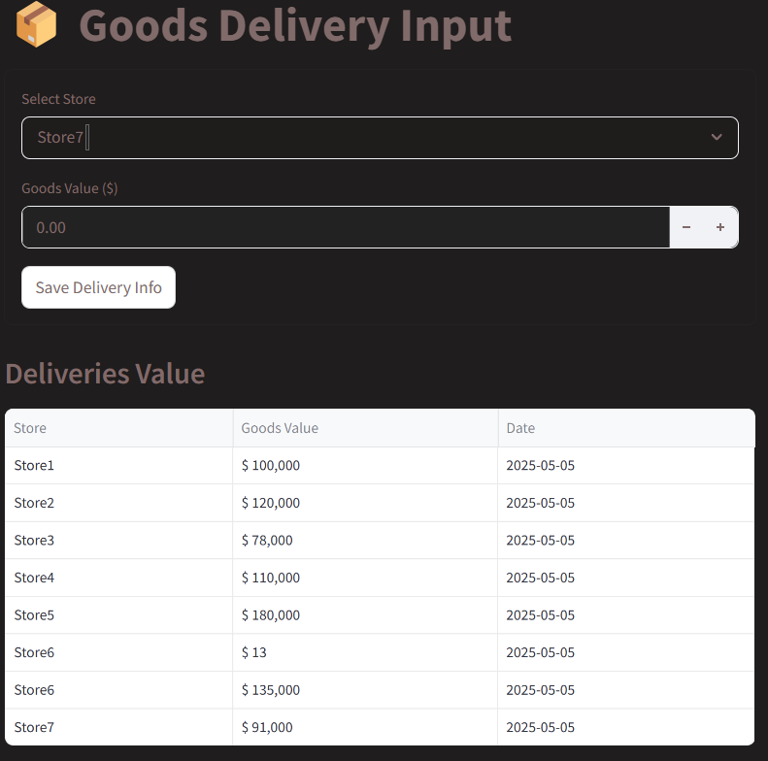
Planner Inputs
Delivery values per store.

Slide 6
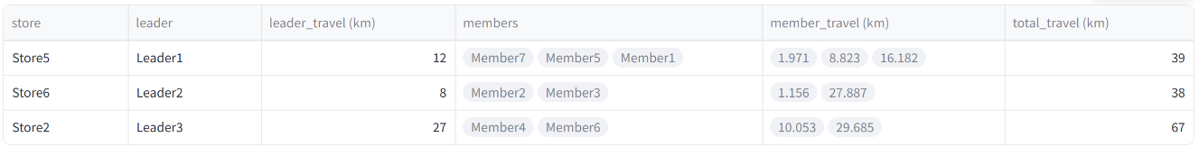
Plan Output & Insights
Assignment plans detailing who visits which store.

Slide 7
Plan Output & Insights
Calculated distances from members' homes to assigned stores.

Slide 8
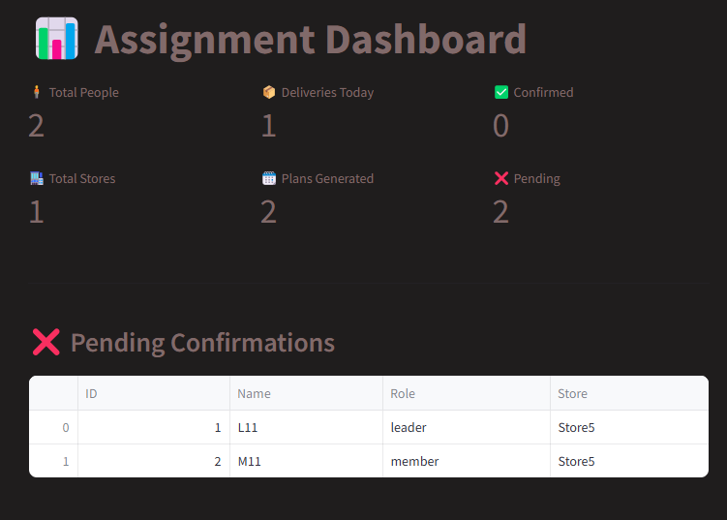
Plan Output & Insights
Email confirmation statuses.

Slide 9
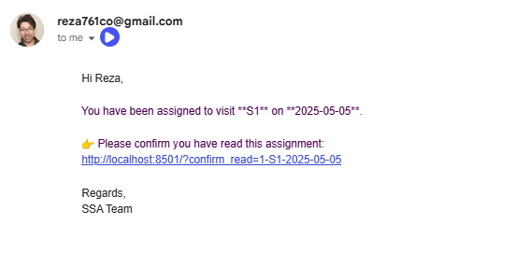
Automated email notifications with read tracking

Slide 10
Future developing
📈 Future: Supplier trust analysis (based on repeated visit patterns)

