Slide 1

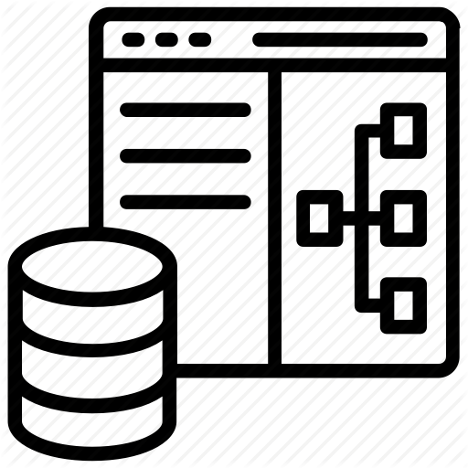

























Dataverse: What’s in the box
Integration
Storage
Event to Event Hub
Relational
databases
Data
Catalog
and discovery
Files and
blobs
Event to Service Bus
Logic
Log files
Jobs
Event to webhook
Modelling
Reporting
Semi-structured
data
Security
Calculated &
Rollup fields
Business
Rules
API
Mobile
Offline
Export to
Azure SQL
Data
validation
Authentication
Export to
ADLS Gen2
Search and
Find data
Plugins
Duplicate
Detection
Authorization
Auditing
Common Data
Model
TDS Endpoint
Dataflow
Workflows

