Slide 1
ACS 3909 Project
University of Winnipeg Campus Food Ordering System
Reza Saker Hossain
Gagandeep Singh
Niranjan Bikram Shah

Slide 2
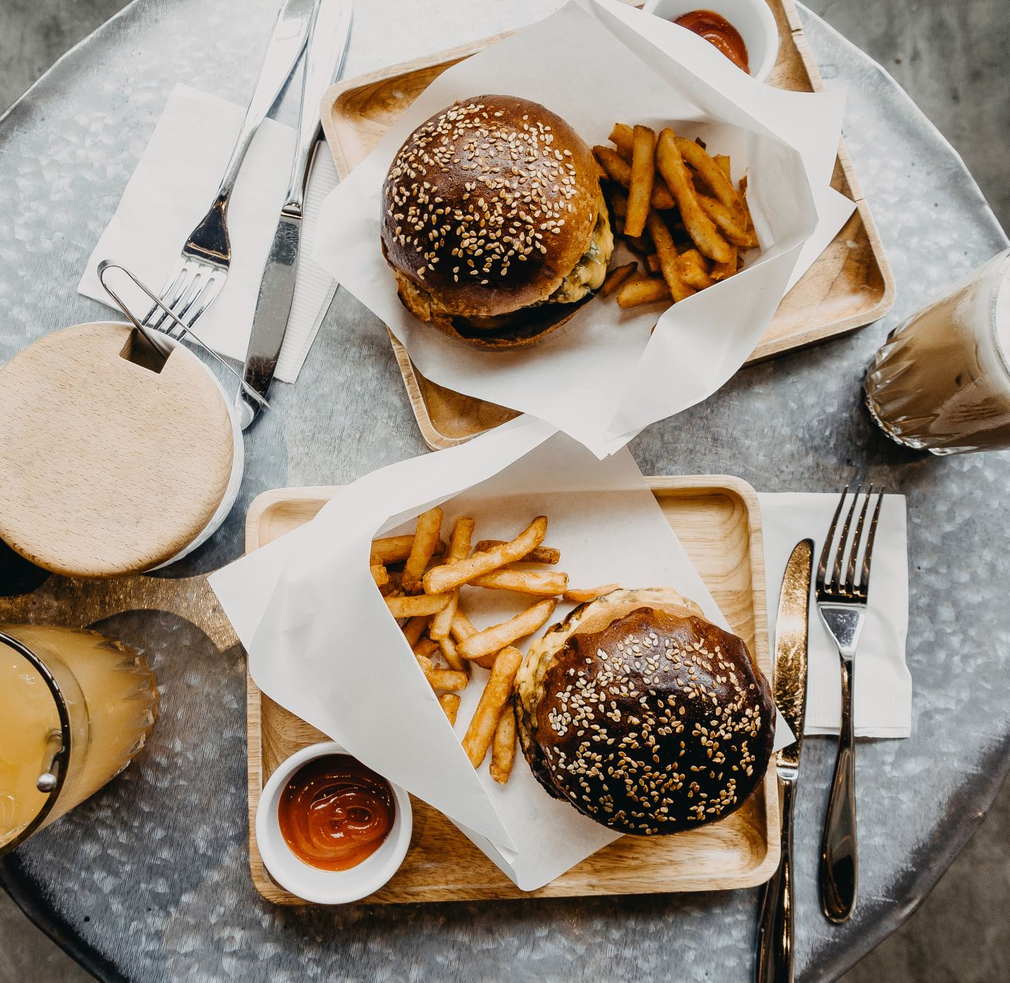
What is it?
It is a Food ordering system for University of Winnipeg, which include all the Cafe’s in U of W campus.

Slide 3
What does it Do?
Customers/Student’s can login using their credentials and can place order, give reviews/feedback etc..
When order placed, customer will get order number and approx.. Time for food preparation.
Worker in Café can accept the order and when done notify customer that it’s ready to pickup.
Admin can add new cafes and menu items if needed.
Worker/Employess in café will have their own login page where they interact with orders.

Slide 4
Authentication page
Email
Password
Log in

Slide 5
Student/Customer index page with list of restaurants
LOGO
Account
Log out
Malecon
Pangea’s
Dash
Malecon 2
Pangea’s 2
Dash 2

Slide 6
Student/Customer (A particular restaurant menu)
LOGO
Account
Log out
Malecon Restaurant menu
Cart:
Food item 1 – $10.20
Food item 1 – $10.20
Food item 1 – $10.20
Food item 1 – $10.20
Food item 1 – $10.20
Subtotal – 100
Tax - 10
Total - 110
Food item 1 ($10.20)
Img
Food item 1 ($10.20)
Img
Food item 1 ($10.20)
Img
Food item 1 ($10.20)
Img
Special instruction
Add to Cart
Go Back
Place order

Slide 7
Customer Order Tracker
Your order will be ready in:
00:40:36
Notification Box: Your order is being prepared

Slide 8
Employee index page with list of restaurants
LOGO
Account
Log out
Malecon
Pangea’s
Dash
Malecon 2
Pangea’s 2
Dash 2

Slide 9
Employee (Order loading page)
LOGO
Account
Log out
Malecon Restaurant (Orders)
Food item 1
Food item 1
Food item 1
Food item 1
Special instruction:
Alskf
Laksdfh
Klasdfhj
Klasdhfj
lksadhfj
Order 5 (New)
Order 4 (New)
Order 3 (Pending)
Order 2 (Pending)
Order 1 (Pending)
Cancel order
Accept order

Slide 10
Employee (Order loading page)
LOGO
Account
Log out
Malecon Restaurant (Orders)
Food item 1
Food item 1
Food item 1
Food item 1
Special instruction:
Alskf
Laksdfh
Klasdfhj
Klasdhfj
lksadhfj
Order 5 (New)
Order 4 (New)
Order 3 (Pending)
Order 2 (Pending)
Order 1 (Pending)
Mark Done

Slide 11
Admin index page with list of restaurants
LOGO
Account
Log out
Malecon
Pangea’s
Dash
Malecon 2
Pangea’s 2
Dash 2
Add New Restaurant

Slide 12
Admin create new restaurant
Create new restaurant
Form with different fields to create new restaurant
Create

Slide 13
Admin (A particular restaurant menu)
LOGO
Account
Log out
Malecon Restaurant menu
Food item 1 ($10.20)
Edit
Delete
Food item 1 ($10.20)
Edit
Delete
Food item 1 ($10.20)
Edit
Delete
Food item 1 ($10.20)
Edit
Delete
Add new item

Slide 14
Other Features:
1. Option for customers to upload images of their order which can then be served as static files from a folder.
2. Admins can add/edit/delete employees;
3. See orders/sales for different time periods (will have filter, sort, and search options);

Slide 15
Mid-term milestone requirements:
Implementing the admin part with ability to display and create restaurants and menu items.
Custom 404 and 500 pages.
Upload food images and serve as static files from a folder.
When a particular restaurant is opened, or edited, or menu item is edited, restaurant or menu id is passed as route or query string parameter.
HTML Forms will be served for creating restaurants and menu items.
Http-bodies will be processed when a form is submitted for creating restaurant or menu.
Accept food image files uploaded by the customers and store it.
Deleting menu items will be done through Ajax calls.
All view files will use Nunjucks templates and include advanced features such as loops, conditions, and include/extends.

