Slide 1

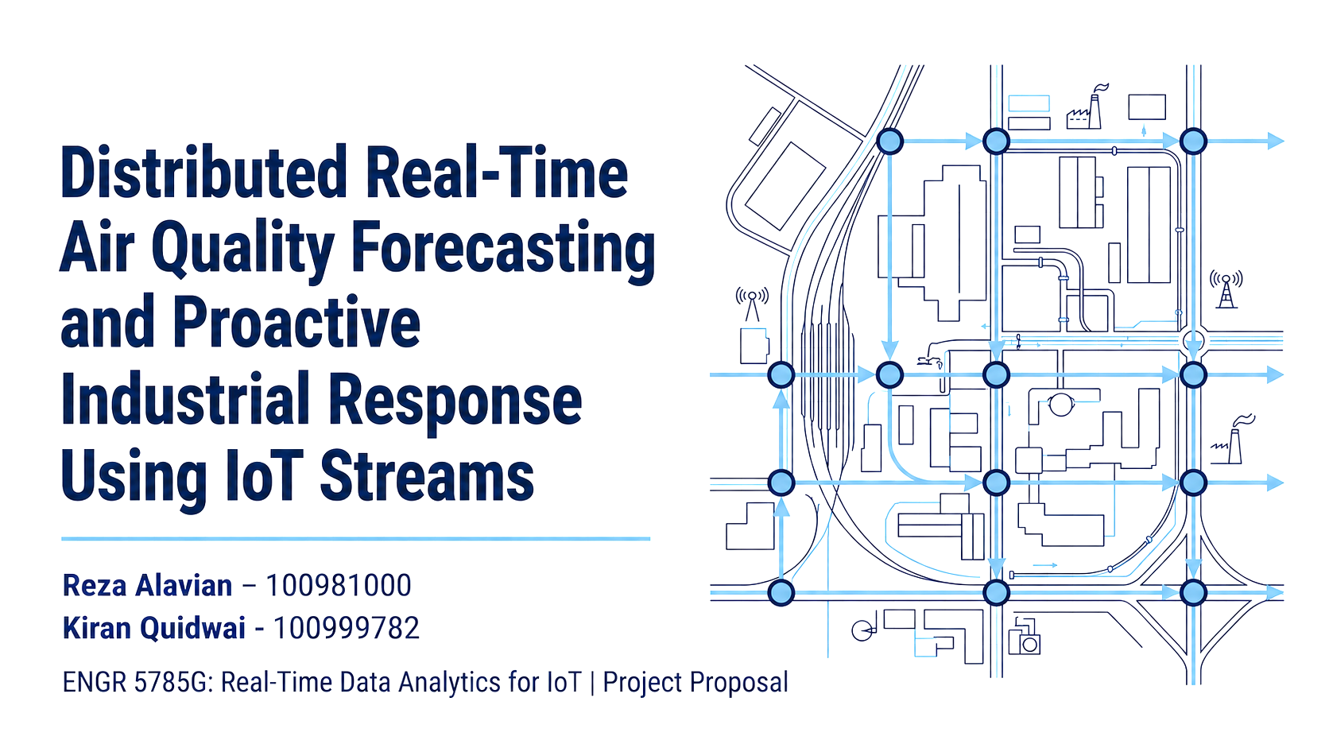
Real-Time Air Quality Forecasting Using Wind-Aware Diffusion Features from IoT Streams
Presenters:
Reza Alavian – 100981000
Kiran Ahmed Quidwai – 100999782
Emmanuel Omole – 101004432

Slide 2
Problem Statement & Motivation
7M
premature deaths/yr from air pollution (WHO)
The Problem
1
PM2.5 depends on weather, emissions, wind transport, and station location.
Traditional models may miss wind-driven movement between monitoring stations.
Advanced GNN/Transformer models can model spatial transport, but they are complex and computationally heavy.
It is unclear whether accuracy gains come from model complexity or from the physical transport information.
This study tests lightweight wind-aware diffusion features as an interpretable alternative.
3
2
Toronto monitoring
stations used in this study
3
3
forecast horizons:
1h, 2h, and 3h ahead
4
5
2

Slide 3
Objectives
OBJ 1
Test Feature Transfer
OBJ 2
Isolate Architecture Value
OBJ 3
Deploy in Real-Time IoT
Apply wind-aware diffusion features (wind alignment, transport potential, distance, upwind PM₂.₅) identically across all five models.
Evaluate 1-, 2-, and 3-hour forecasts to see whether diffusion features let simple models rival complex graph-based ones.
Operationalize the framework in a Kafka streaming pipeline and evaluate latency, throughput, ablation, and reliability under load.
3

Slide 4
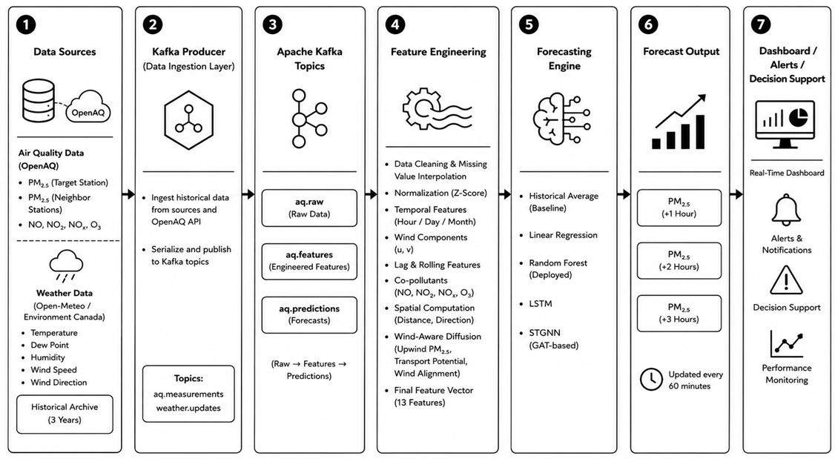



Real-Time System Architecture
A Kafka-based streaming pipeline carries each observation from sensor to forecast in a single 60-minute polling cycle.
4

Slide 5
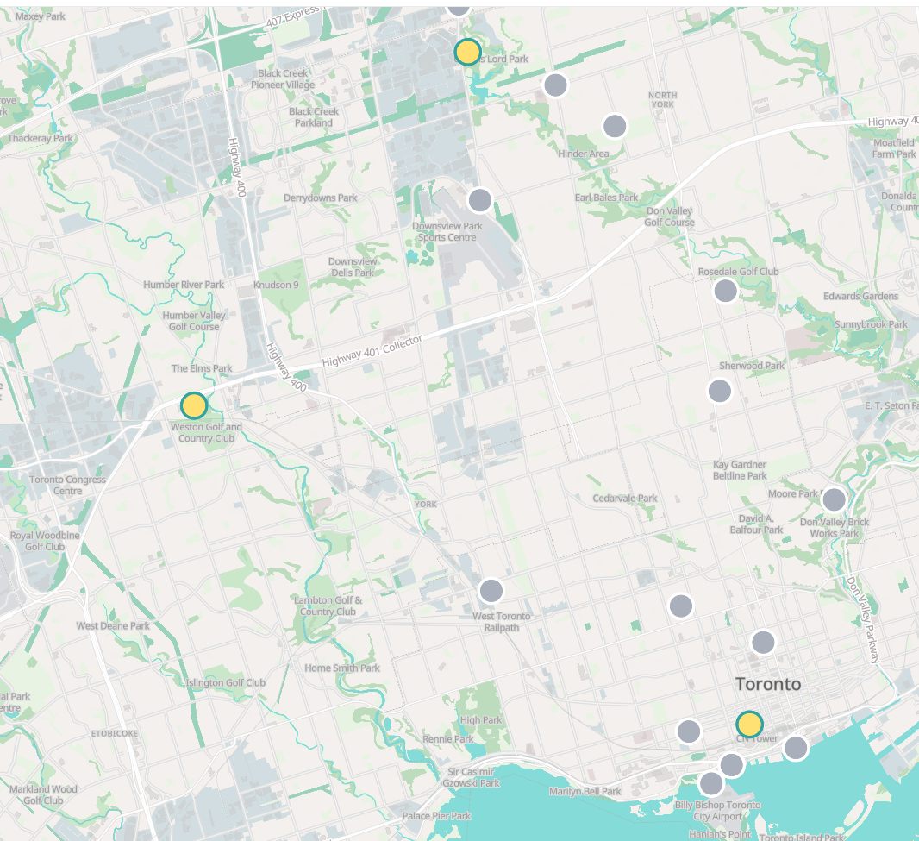
Dataset
C
Downtown Toronto
A
Station North
B
Station West
Neighbour (A)
Neighbour (B)
Target station
25,535
Jul 2023
Hourly
observations
Dataset
start
3
Jun 2026
Toronto
stations
Dataset
end
5

Slide 6
The Dynamic Graph
Station NORTH
Target node
Downtown Toronto
Node
1
Station North
Node
2
Station West
Noe 1
Node 2
Neighbour (A)
Neighbour (B)
Target station
Station WEST
Stations as nodes, wind-conditioned edges that change every timestep
G = (V, E, A(t))
V = monitoring stations E = possible links
A(t) = dynamic adjacency matrix at time t
DOWNTOWN
Why is it dynamic? The influence of a station depends on current wind, not fixed geography.
Case 1 — Wind: West → Downtown
Case 2 — Wind: Downtown → West
West station strongly influences Downtown
West station weakly influences Downtown
Alignment ≈ +1 → high edge weight
Alignment ≈ −1 → near-zero edge weight
6

Slide 7
Step-by-Step Construction
1
Station coordinates
(lat, lon) per station
2
Haversine distance
d=2Rarcsin⁡(√(〖sin⁡〗^2 (Δϕ/2)+cos⁡(ϕ_1)cos⁡(ϕ_2)〖sin⁡〗^2 (Δλ/2) ))
3
Direction vector
East = R·Δφ, North = R·Δλ·cos(φ̄)
4
Wind vector
wind_u = V·cos(θ), wind_v = V·sin(θ)
Avoids 0°/360° discontinuity
5
Wind alignment (cosine similarity)
Align = (East·wind_u + North·wind_v)/ (|s|·|wind|)
+1 toward target,
0 perpendicular,
−1 away
7

Slide 8

Edge Weight: Distance Decay × Wind Alignment
Aᵢⱼ(t) = exp(−dᵢⱼ / k) × (0.5 + 0.5×Alignmentᵢⱼ)
Part A — Distance decay
Part B — Wind alignment factor
exp(−d / 10) [Cressie, 2015]
d = 2 km → e⁻⁰·² = 0.819 (strong)
d = 20 km → e⁻² = 0.135 (weak)
Alignment = +1 → 1.0 (max support)
Alignment = 0 → 0.5 (moderate)
Alignment = −1 → 0.0 (no influence)
Worked example — West → Downtown, distance = 5 km
Wind toward Downtown (Alignment = +1): A = e⁻⁰·⁵ × 1.0 = 0.606 — strong edge
Wind reverses (Alignment = −1): A = e⁻⁰·⁵ × 0.0 = 0 — no influence
8

Slide 9
Wind-Aware Diffusion Features
Raw Station Data
PM₂.₅ · wind · temp · humidity
Wind Alignment
+1 directly toward target; −1 away
▼
Align = cos(θwind − θstation)
Haversine Distance + Wind Alignment
cos similarity, station-pair vs wind vector
Transport Potential
Strength of pollutant movement
▼
Wind Speed × Alignment
Diffusion Weight & Transport Potential
Upwind PM₂.₅
Transported pollutant estimate
▼
Σ(Weightᵢ × PM₂.₅,ᵢ) / ΣWeightᵢ
Common Feature Set → All 5 Models
Identical inputs for fair comparison
9

Slide 10
Forecasting Models & Live Demo
5 models — identical features — 3 horizons
Historical
Average
Linear
Regression
Random
Forest
LSTM
STGNN
▶
LIVE DEMONSTRATION
1
Kafka topics live: air-quality-raw → air-quality-features → air-quality-predictions
Trigger a manual OpenAQ poll and show the JSON message land in air-quality-raw
Show the feature-enriched record (wind u/v, diffusion weight, transport potential) in air-quality-features
Display a live 1h/2h/3h PM₂.₅ prediction from the monitoring dashboard
2
3
1
4
3
10

Slide 11
Experimental Results - Models
Forecast Horizon | Model | R² | MAE | RMSE
+1 hour | Historical Average | 0.000 | 4.72 | 6.77
 | Linear Regression | 0.757 | 2.27 | 3.34
 | Gradient Boosting / RF | 0.908 | 1.28 | 2.05
 | LSTM Sequential | 0.686 | 2.29 | 3.81
 | Spatiotemporal Graph | 0.593 | 3.04 | 4.32
+2 hours | Historical Average | 0.000 | 4.72 | 6.77
 | Linear Regression | 0.685 | 2.59 | 3.80
 | Gradient Boosting / RF | 0.792 | 1.95 | 3.09
 | LSTM Sequential | 0.669 | 2.42 | 3.91
 | Spatiotemporal Graph | 0.720 | 2.45 | 3.59
+3 hours | Historical Average | 0.000 | 4.72 | 6.77
 | Linear Regression | 0.603 | 2.92 | 4.27
 | Gradient Boosting / RF | 0.663 | 2.60 | 3.93
 | LSTM Sequential | 0.578 | 2.82 | 4.41
 | Spatiotemporal Graph | 0.582 | 2.86 | 4.38
11

Slide 12
Feature Ablation Study
Five feature layers used for the ablation study
1
temp, dew point, humidity, wind_u, wind_v, pm25
Core base features (6)
Current meteorological conditions + raw target variable
2
hour_sin, hour_cos, dow_sin, dow_cos
Diurnal / weekly cyclic time (4)
Captures diurnal/weekly traffic and ambient temperature patterns
3
no, no2, nox, o3
Gases (4)
Multi-pollutant precursors/correlates to particulate matter
4
pm25_lag1–lag12, pm25_roll3_mean, pm25_roll6_mean
Autoregressive lags & rolling avg. (7)
Models persistence in PM₂.₅ concentration
5
upwind_pm25, transport_potential, wind_alignment
Spatiotemporal diffusion (3)
Physics-informed: how pollutants disperse based on wind velocity
Total: 24 engineered features — ablation recipes add layers cumulatively to isolate each layer's contribution
12
Notes:
Five feature layers from the codebase, used as the basis for the ablation study. Each ablation recipe (base6, diffusion9, with_pollutants, base+pollutants) adds layers cumulatively so we can isolate how much predictive value each layer contributes on its own. Be ready to clarify: layer 4 lists pm25_lag1 through lag12 plus two rolling means - if asked why that's labeled (7) rather than (14), clarify which specific lag subset and rolling windows are actually used in the deployed recipe.

Slide 13
System Performance Under Load
Kafka pipeline reliability and scalability
Users | Avg Latency | P95 Latency | Throughput | Success
1 | 2,086 ms | 2,121 ms | 0.48 req/s | 100%
5 | 2,132 ms | 2,349 ms | 2.34 req/s | 100%
10 | 2,489 ms | 2,833 ms | 3.85 req/s | 100%
20 | 3,196 ms | 3,631 ms | 5.96 req/s | 100%
50 | 5,298 ms | 5,943 ms | 8.91 req/s | 100%
Reliability
100%
request success rate
across 1–50 concurrent users
Throughput scaled 0.48 → 8.91 req/s as concurrency increased, confirming the architecture supports real-time operational deployment.
Takeaway: latency grows with concurrency (2.1s → 5.3s) but the system never fails a request — stable degradation, not collapse, under increasing load.
13
Notes:
This addresses 'real-time analytics features' from the demo rubric criterion even outside the live demo itself. Be ready to explain why latency grows with load - likely Kafka consumer group rebalancing and model inference queueing, not a fundamental architecture flaw.

Slide 14
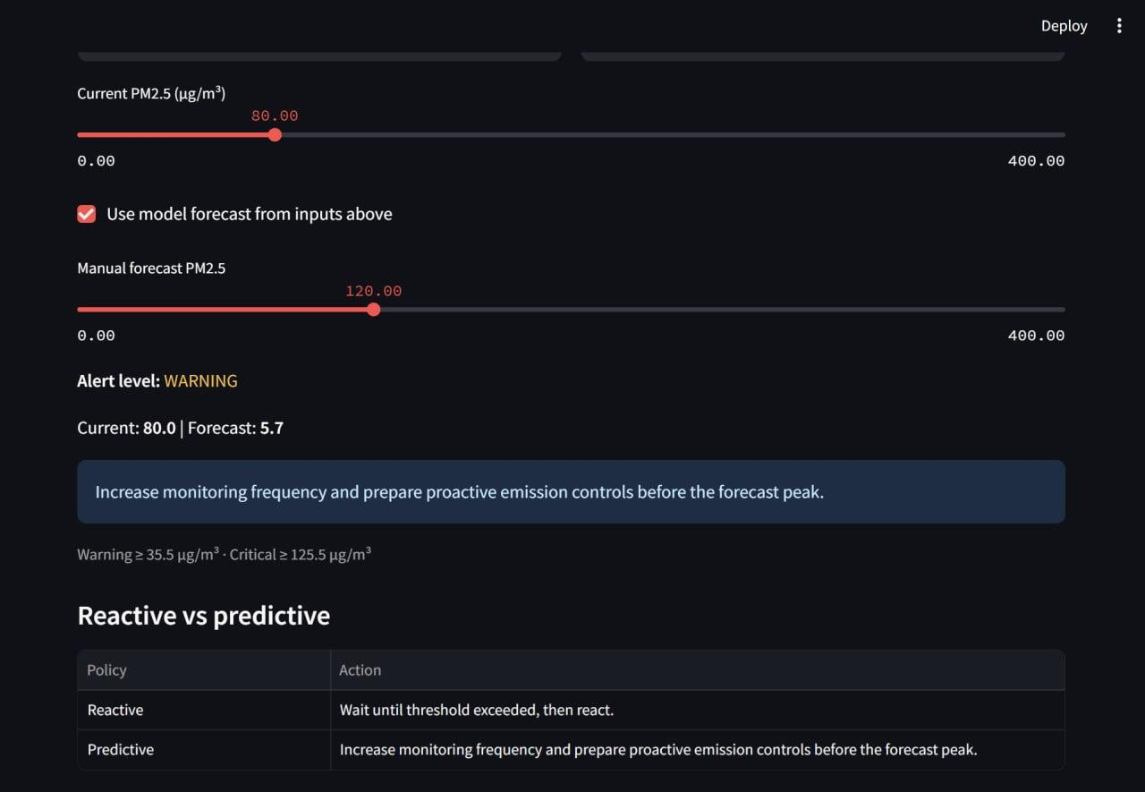
Alerts
Warning = 35.5 μ g/m³
Critical = 125.5 μ g/m³
14
Notes:
This addresses 'real-time analytics features' from the demo rubric criterion even outside the live demo itself. Be ready to explain why latency grows with load - likely Kafka consumer group rebalancing and model inference queueing, not a fundamental architecture flaw.

Slide 15
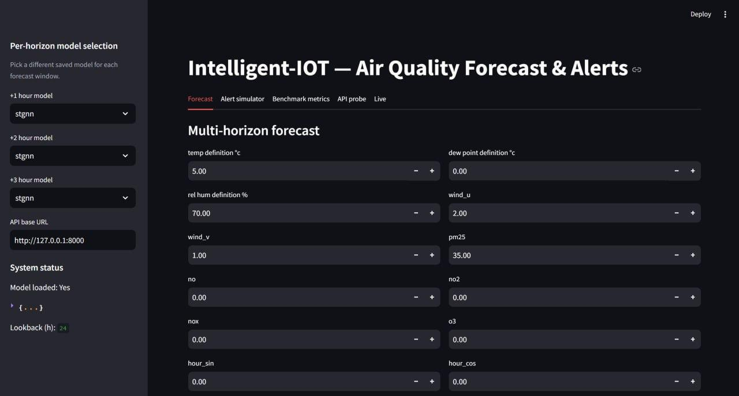
Dashboard
15

Slide 16
Analysis & Discussion
01
Features > Architecture
02
All Models Beat the Baseline
Given identical diffusion features, Random Forest performed best at every horizon: R²=0.908, 0.792, 0.663, with the lowest MAE and RMSE
Historical Average (R²≈ 0) is dramatically outperformed by every ML/DL model — confirming meteorological and diffusion features carry real predictive signal.
03
Simple Models Stay Competitive
04
Practical Implication
Linear Regression remains strong, especially at +1 and +3h, while STGNN only slightly exceeds LR at +2h – so higher complexity does not consistently dominate.
Because the tree-based model gives the best accuracy with lower deployment complexity than LSTM and STGNN, it is the preferred choice for real-time forecasting.
16
Notes:
Discussion point 3 (LSTM underperforming) is the most likely follow-up question. Be ready: with only a 12-hour lookback and explicit lag/rolling features already in the input, the LSTM's recurrence may be redundant with information already present in the engineered features.

Slide 17

Challenges Encountered
Missing Sensor Data
Circular Wind Direction
PM₂.₅ and meteorological gaps required forward-only interpolation and nearest-station matching to avoid leakage while maintaining continuity.
Raw wind direction (0–360°) has a discontinuity at the wrap-around point; resolved via u/v Cartesian decomposition before modelling.
Fair Multi-Model Comparison
Sequence Model Complexity
Ensuring Linear Regression, RF, LSTM, and STGNN all received an identical, leakage-free feature set required a decoupled feature-extraction design.
LSTM and STGNN required careful 12-hour lookback window construction and graph edge recomputation at every timestep
Real-Time Latency Constraints
Limited Station Network
Balancing the 60-minute OpenAQ polling interval against the goal of “near-real-time” forecasting required careful staging across Kafka topics.
Only 3 active Toronto stations restrict the density of the wind-aware graph, limiting how richly spatial transport can be modelled.
17
Notes:
This slide demonstrates critical self-awareness, which the rubric rewards under Technical Content. If asked directly about STGNN reliability or model limitations beyond what's shown here, acknowledge openly that further validation across more stations and longer time spans would strengthen confidence in the findings.

Slide 18
Future Work
Linear Regression with wind-aware diffusion features reaches R²=0.913 — virtually identical to STGNN's R²=0.912 at 1-hour horizon
01
02
The gap between LR and STGNN remains negligible at 2h and 3h horizons too, holding across all tested forecast windows
Terrain & Elevation
Forecasting for Smaller Horizon
The Kafka-based pipeline sustained 100% request success rate from 1 to 50 concurrent users, confirming real-time viability
Add topography-aware features inspired by TopoFlow
Forecast for the lower polling cycle, like 15 min, 30min
Physically informed feature engineering can substitute for architectural complexity in short-term PM₂.₅ forecasting
03
04
Larger Networks
Hybrid Architectures
More stations, broader geographic regions
Combine diffusion features with GNN/Transformer models
18
Notes:
Close with the single sentence takeaway: physically informed feature engineering is a practical, interpretable alternative to increasingly complex forecasting architectures. Then open the floor for Q&A.

Slide 19

Team Contributions
Streaming Process – Kafka and Flink
Reza Alavian
Kiran Ahmed Quidwai
Emmanuel Omole
Model Training and Deployment
Feature Engineering and Research work
17

Slide 20

Thank You
Questions & Discussion

Slide 21
References
Box, G. E. P., Jenkins, G. M., Reinsel, G. C., & Ljung, G. M. (2015). Time Series Analysis: Forecasting and Control. Wiley.
Hochreiter, S., & Schmidhuber, J. (1997). Long Short-Term Memory. Neural Computation, 9(8), 1735–1780.
Zhang, Y., Bocquet, M., Mallet, V., Seigneur, C., & Baklanov, A. (2018). Real-time air quality forecasting, part I: History, techniques, and current status. Atmospheric Environment, 60, 632–655.
Wu, Z., Pan, S., Chen, F., Long, G., Zhang, C., & Yu, P. S. (2021). A Comprehensive Survey on Graph Neural Networks. IEEE Transactions on Neural Networks and Learning Systems, 32(1), 4–24.
Nguyen, T., et al. (2023). ClimaX: A Foundation Model for Weather and Climate. ICML 2023.
Kheder, A., Toropainen, H., Peng, W., Antão, S., Chen, J., Boy, M., & Liu, Z. S. (2026). TopoFlow: Topography-aware Pollutant Flow Learning for High-Resolution Air Quality Prediction. npj Clean Air, 2, 12.
Inness, A., et al. (2019). The CAMS global reanalysis of atmospheric composition. Atmospheric Chemistry and Physics, 19, 3515–3556.
Dai, T., et al. (2019). CUACE: Operational Air Quality Forecasting System in China. Atmospheric Environment.
Dimri, R., Choi, Y., Singh, D., & Park, J. (2026). TransNet: A transport-informed graph neural network for forecasting PM2.5 concentrations across South Korea. npj Clean Air, 2(1). https://doi.org/10.1038/s44407-026-00052-x
J. Xu et al., “Dynamic Graph Neural Network with Adaptive Edge Attributes for Air Quality Predictions,” arXiv:2302.09977, 2023.
Around 400 000 premature deaths annually linked to air pollution in the Eastern Mediterranean Region. https://www.emro.who.int/ceha/ceha-news/air-pollution-deaths.html
Environmental Protection Agency AQI breakpoints. https://aqs.epa.gov/aqsweb/documents/codetables/aqi_breakpoints.html
21

