Slide 1

Study of SiO₂ based MOS by capacitance-voltage and thermally stimulated current techniques
R. Aliasgari Renani*, O.A. Soltanovich, M.A. Knyazev,
and S.V. Koveshnikov
Institute of Microelectronics Technology, RAS, Chernogolovka, Russia
* MIPT, Dolgoprudny, Russia
10/4/2023
ICMNE-2023

Slide 2
SiO₂ applications, requirements and issues Applications:
Major gate dielectric for Si, SiC, GaN MOSFETs
Passivation layer for bipolar transistor IC, Flash Memory, etc.
Active layer for resistive memory
etc.
Requirements:
Stability under bias stress
Radiation immunity under high and low energy irradiation
Low density of bulk traps and states at the interface with semiconductor
etc.
Issues:
Bulk traps for electrons and holes and interface states as revealed by C-V method
Quality of thin (less than 10 nm) oxide
Needs for good metrology
10/4/2023
ICMNE-2023

Slide 3
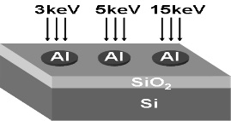
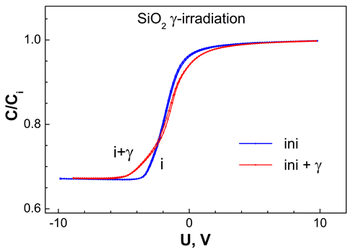
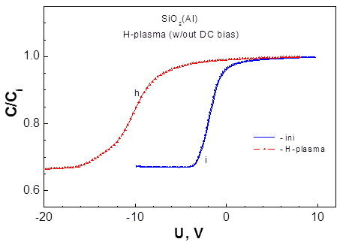
Defect generation in SiO₂: Motivation and Objective
Low energy e-beam irradiation:
Generation of positive charge mainly
at the SiO₂/Si interface revealed by C-V
High-energy gamma-irradiation:
Generation of interface states
Hydrogen passivation in ECR plasma:
Etching of SiO₂ and generation of
positive charge
Objective: investigate properties of defects generated in MOS by using both methods:
capacitance –voltage and thermally stimulated current
10/4/2023
ICMNE-2023

Slide 4
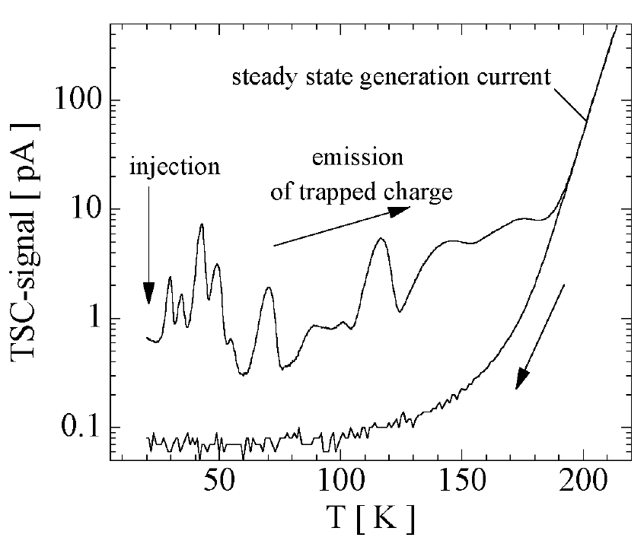
Method of Thermally Stimulated Current (TSC)
Cooling down under reverse bias → traps not filled with carriers
(2) Charge injection/ Filling: → traps filled by applying bias or via optical injection
(3) Measurement: temperature is raised with a constant rate under reverse bias
(4) Recording TSC-spectra: → monitoring the discharging current due to thermal emission from the defect levels
4
ICMNE-2023

Slide 5
Method of Thermally Stimulated Current:
Choosing measurement conditions based on C-V data
e
E_{c}
E_{c}
E_{c}
E_{c}
E_{F}
E_{F}
E_{F}
E_{F}
+
E_{V}
E_{V}
E_{V}
E_{V}
Reverse bias
during cooling
Forward bias
at LT w/o
e injection
Forward bias
at LT with
e injection
Reverse bias
during measurement
10/4/2023
ICMNE-2023

Slide 6
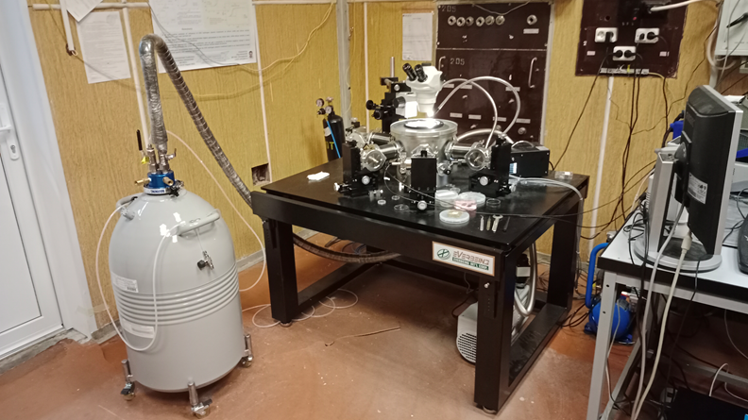
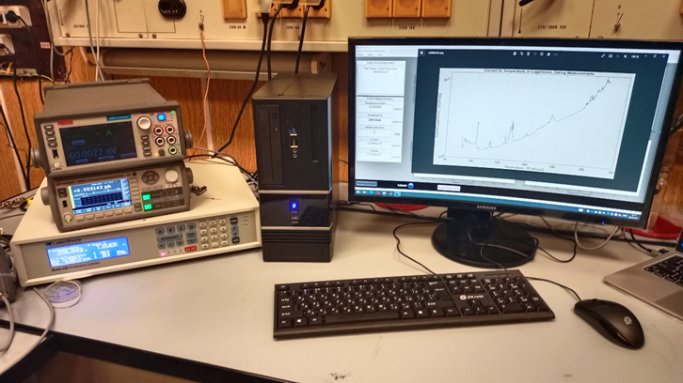
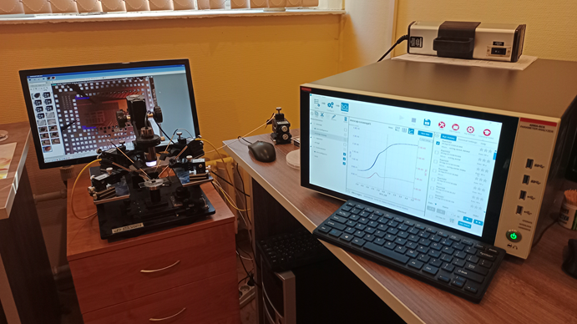
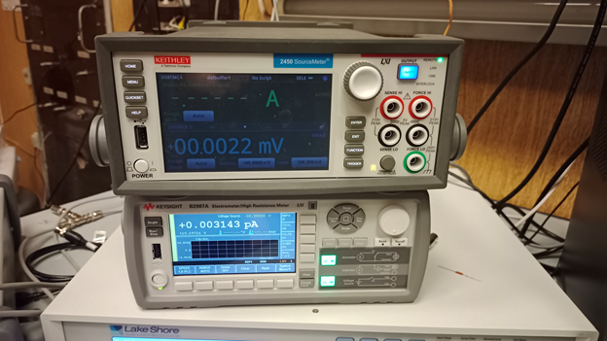
Method of Thermally Stimulated Current:
Everbeing Cryo station (80K – 450K)
with 4 micromanipulators and Lake Shore
Temperature controller
TSC experimental setup with originally
developed software
Parametric Analyzer Keithley 4200A-SCS
Source Meter Keithley 2450
Keysight 2987 Electrometer (sensitivity 10 fA)
10/4/2023
6
ICMNE-2023

Slide 7
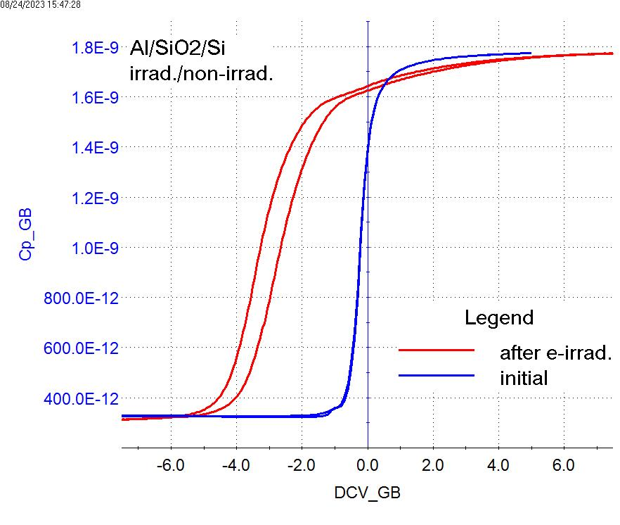
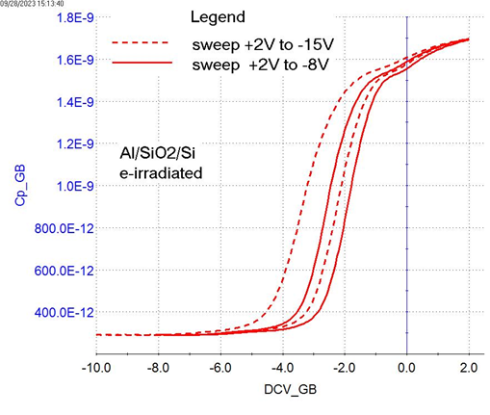
e-beam irradiated n-MOS: C-V
n-MOS structures irradiated in Jeol JSM 840A with 20 keV electrons, dose 500 μC
start
start
Notable changes observed after e-beam irradiation:
shift to negative voltage is due to positive charge in SiO₂ bulk
decreased C-V slope is caused by increased density of interface states
hysteresis indicates formation of “shallow” electron traps in the oxide bulk
increasing negative bias reveals deep and shallow traps for holes in the oxide
C-V slope indicates uniform increase of D_{it} over the band gap - is it so?
How shallow are the “shallow” traps? (up to ~0.7 eV traps emit electrons at RT)
10/4/2023
ICMNE-2023

Slide 8
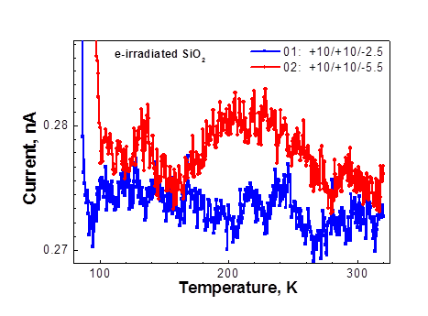
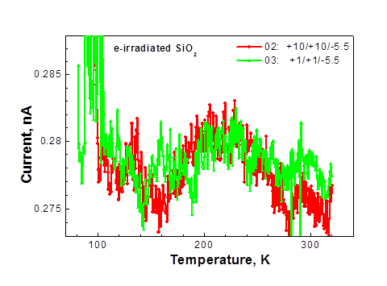
e-beam irradiated n-MOS: TSC
During pulse
During warming
During warming
E₁
E₂
E₅
E₃
E₄
E_{c}
E_{c}
E_{c}
E_{F}
E_{F}
E_{F}
E_{V}
+
E_{V}
E_{V}
Different portions of BG for interface states +
same shallow electron traps contribute to TSC
Same cooling and pulse
During pulse
During pulse
During warming
E₁
E₂
E₆
E₃
E_{c}
E_{c}
E_{F}
E_{F}
E_{c}
E_{F}
E_{V}
E_{V}
E_{V}
Lower pulse eliminates electron
injection and trapping
Same bias during warming
Preliminary trap identification:
E₁ – electron traps in Si within the space charge region; E₂ – int. states
10/4/2023
ICMNE-2023

Slide 9
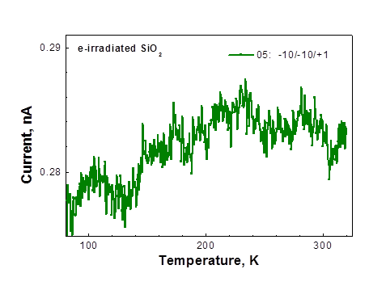
e-beam irradiated n-MOS: TSC
To identify traps, the measurements done
under conditions eliminating contribution of interface states and electron traps
E₁
E₂
E₅
E₃
E₄
During pulse
During measurement
Onle hole traps contribute to TSC
E_{c}
E_{c}
E₃
E_{F}
E_{F}
E₇
+
+
E_{V}
E_{V}
h
Thus, E3 and E7 are related to shallow hole traps in SiO₂
10/5/2023
ICMNE-2023

Slide 10
Identification of traps in TSC spectrum
Identification of traps is done based on knowledge of the part of MOS structure to be
tested and what carriers were injected and trapped
Pulse | Bias at Warming | Peaks in TCS spectra | Identification
+10V (accumulation, electron injection) | -5.5V (strong depletion; hole injection; int. states all over contribute to TSC) | E1, E2, E3 | E₁ – electron traps in Si; E₂ – int. states; E₃ - hole traps in SiO₂
+1V (accumulation, no electron injection) | -5.5V (strong depletion; hole injection; all int. states contribute to TSC) | E2, E3, E6 | E₂ – int. states; E₃ - hole traps in SiO₂ E₆ - electron trap in SiO₂
-10V (strong depletion, hole injection) | +1V (accumulation; int. states are filled and do not contribute to TSC) | E3, E7 | E₃ - hole traps in SiO₂ E₇ - hole traps in SiO₂
+10V (accumulation, electron injection) | -2.5V (weak depletion; only a portion of BG int. states contributes to TSC) | E4, E5 | E4, E5 – int. states and/or electron traps in SiO₂
E6 is a shallow electron trap as it is seen only at low E field;
At high E field the electrons are blown out from shallow traps and not detected
10/5/2023
ICMNE-2023

Slide 11
TSC spectra of gamma irradiated and hydrogen plasma treated MOS structures
Gamma irradiation
Hydrogen plasma treatment
Radiation defects in Si
Electron traps in ultra thin SiO₂
10/5/2023
ICMNE-2023

Slide 12
Summary
We have investigated traps generated in Si/SiO₂ structures by low energy electron irradiation, high energy gamma rays and hydrogen plasma
Based on the obtained data and gained experience we can conclude:
TSC is a highly sensitive method to detect traps in MOS devices
TSC can be applied to investigation of any dielectric/semiconductor structure and semi-insulating materials (e.g., GaAs)
With help of C-V, traps revealed by TSC can be identified :
by their location (within dielectric, semiconductor or at the interface)
by their nature (trap for electron or for hole)
Utilization of highly sensitive electrometer (e.g., Keysight B2987A) for current measurements will allow evaluation of trap activation energy
10/4/2023
ICMNE-2023

Slide 13
Current meters for TSC
10/4/2023
ICMNE-2023

Slide 14
Back Up

Slide 15
