Slide 1
Massive parallelization on GPU using PyCuda

Slide 2


CPU vs GPU
CPU: One complex task
GPU: Many simple tasks

Slide 3
Architecture

Slide 4
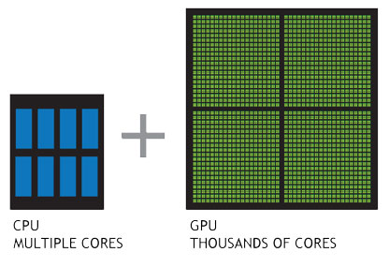
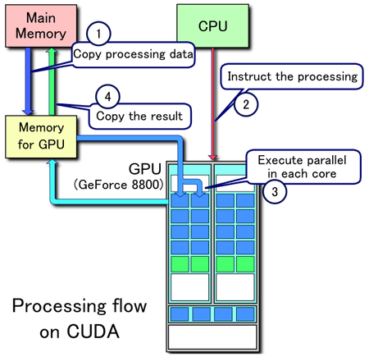
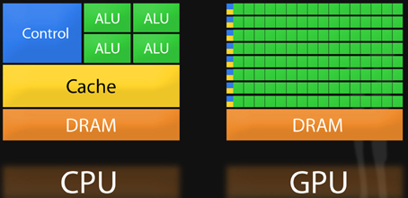
Overall view

Slide 5
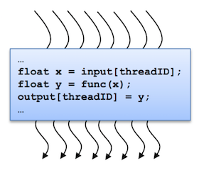
Kernel and threads
Simple tasks: Kernels
A Kernel is a function that we want to run many times with different inputs.
Each run of that function can generate its own output value.
Kernels are executed in parallel by an array of threads
All threads run the same code.
Each thread has an ID that it uses to compute memory addresses and make control decisions.

Slide 6
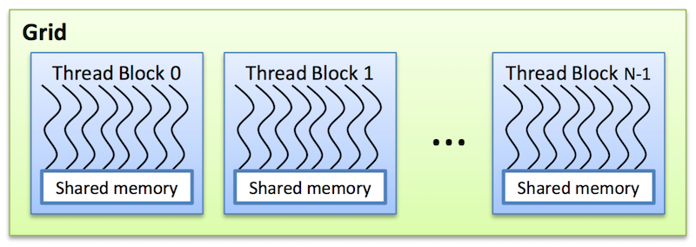
Blocks
Threads are arranged as a grid of thread blocks:
Different kernels can have different grid/block configuration
Threads from the same block have access to a shared memory and their execution can be synchronized
Threads within a block can cooperate through their shared memory
Blocks run independently

Slide 7
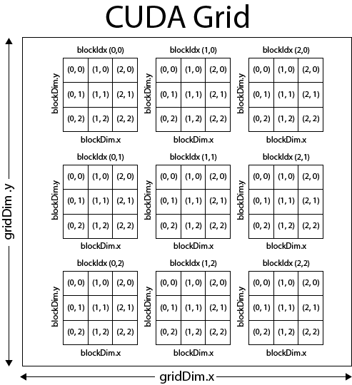
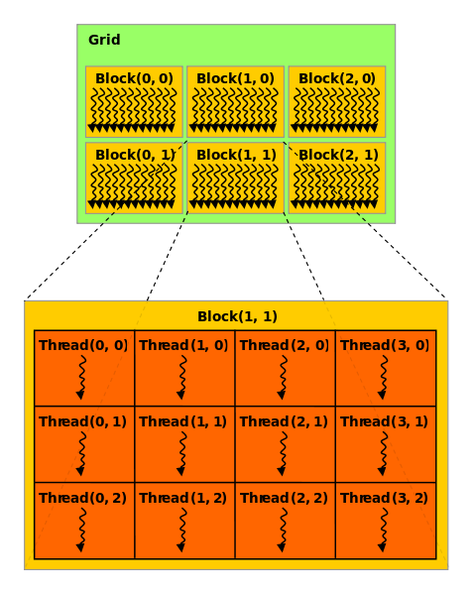
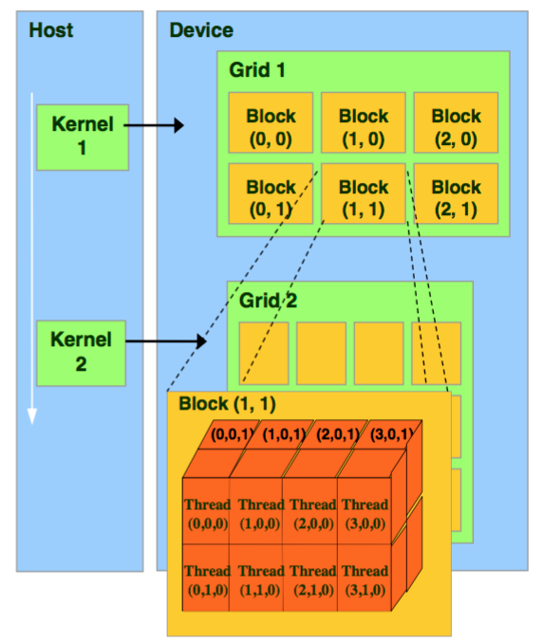
Grids

Slide 8
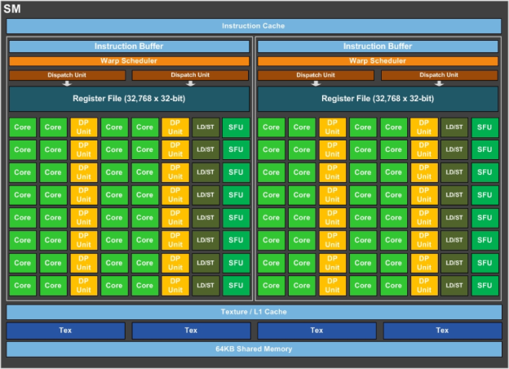
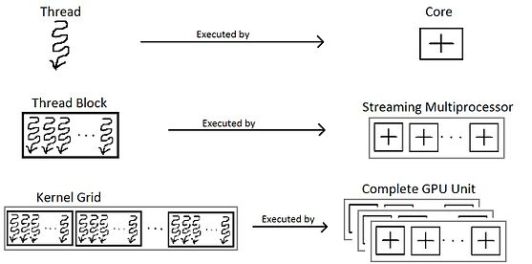
Hardware side

Slide 9
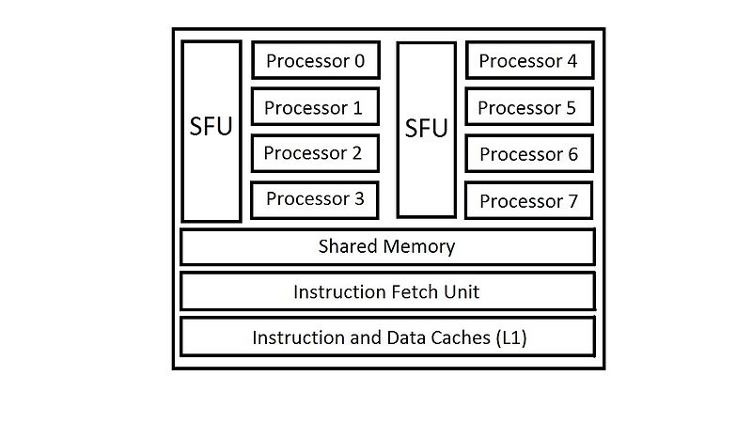
Hardware side
On the hardware side, a thread block is composed of ‘warps’. A warp is a set of 32 threads within a thread block such that all the threads in a warp execute the same instruction. These threads are selected serially by the SM.
32 threads are in one warp, the threads in one warp are executed in parallel
An SM can run multiple Warps at once (parallel)

Slide 10
Software

Slide 11
Numba installation in Python
dependencies:
- python=3.6
- numpy
- cudatoolkit=9.0
- cudnn
- numba
If using environments:
For some reasons, you would need to install THE SAME cudatoolkit (same version) on the main conda environment! I could not figure out why. Otherwise you would get an error on “libNVVM error”
Also make sure your machine CUDA version, if using, is the same version as the cudatoolkit (9.0).

Slide 12
GPU spec

Slide 13
Kernel
Characteristics
kernels cannot explicitly return a value; all result data must be written to an array passed to the function (if computing a scalar, you will probably pass a one-element array);
kernels explicitly declare their thread hierarchy when called: i.e. the number of thread blocks and the number of threads per block (note that while a kernel is compiled once, it can be called multiple times with different block sizes or grid sizes).

Slide 14
Calculation of thread ID

Slide 15
Hands-on
Example 1
Simple kernel for adding two numbers
Using CPU vs jit vs GPU
Example 2
Mandelbrot fractal kernel
Using CPU vs jit vs GPU

Slide 16
A good CUDA code
NVIDIA recommends that programmers focus on following those recommendations to achieve the best performance:
Find ways to parallelize sequential code
Minimize data transfers between the host and the device
Adjust kernel launch configuration to maximize device utilization
Ensure global memory accesses are coalesced
Minimize redundant accesses to global memory whenever possible
Avoid different execution paths within the same warp

Slide 17
Useful links
Pretty good website: https://people.duke.edu/~ccc14/sta-663/CUDAPython.html
To know about GPU: https://nyu-cds.github.io/python-gpu/01-introduction/
To know about Numba: https://nyu-cds.github.io/python-numba/01-jit/

Slide 18

Analytics events

