Slide 1
STOCK MARKET ANALYSIS SAEID REZAEI , 2021 (stu:205812010)
Instructor ELHAM HARIRPOUSH Course CP-640-ML

Slide 2
INTRODUTION
A Stock market, equity market or share market is the aggregation of buyers and sellers of stocks, which represents ownership claims of business, Stock market and share price changes based on economy, international reputation, war, and so on. Therefore, Investors are willing to know the future and predict stock market
In this project I’m going to Analyse
INDEX market such as GSPC or IBEX
Equity stock market with same industry such as GOOG, AMAZN

Slide 3
Source of Data
OFF-LINE source: I have downloaded price history from Yahoo Finance, and Google. Price history exist per symbol or Index
ON-LINE source: I used “quantmod” package in R
with this function I was able to get up-to-date price
## Date GSPC.Open GSPC.High GSPC.Low GSPC.Close GSPC.Volume ## 2007-01-03 1418.03 1429.42 1407.86 1416.60 3429160000 ## 2007-01-04 1416.60 1421.84 1408.43 1418.34 3004460000

Slide 4
Data Structure
Data structure for off-line and on-line are very similar and as below:
Date: Represents the date of the market price, format is DATE, YYYYMMDD.
Symbol: each company or stock in the market is known with symbol. This is a unique value that identifies equity in the market, its CHAR variable that could be a combination of alphabet and number.
Open price: this is a numeric entity that shows price of each unit of stock when market opens, this price is usually is closed to previous day closing price.
Low price: this item shows lowest price of each unit in a day, this items changes frequency while market is open, however my data set record the lowest one. This is a numeric attribute with 3 decimal.
High price: this item is opposite of low price, hence shows highest unit price in one day. This is also numeric attribute with 3 decimal.
Close price: this item records the latest share price during a day and do not use in financial calculation such as rate of returns (ROR). Same as above, this is a numeric with 3 decimal.
Volume: This attribute shows the number of shares in total that has been traded within a day; Volume is an important element for investor to analyze the stock market

Slide 5
Approach
Load / Merge an d cleanup data
Analyse the price to get the most valuable one
Analyse Index based on Time Series and technical analysis
Conduct basket analysis and Moving Average model for same stock category
Analyse stock price and volume in different chart
Export and draw graphs in Tableau

Slide 6
Business Questions
Below are the questions that will be addressed by this project:
Find out when the index market or Stock price is dropped and what are the important parameters
How is possible to compare several stock market that has same characteristic in same basket, and find out the common impact analyses
How long investor should keep their Index, essentially is that possible to find the Stock Movement Average (SMA) and Rate of Capital (ROC)
How investor or trade Analyst could find stock is oversold, or find the fraud in trade

Slide 7
Users or stakeholders
Trading experts, business analysts , Investors and Auditors
New Investor how wants to watch the trade trends and make a decision

Slide 8
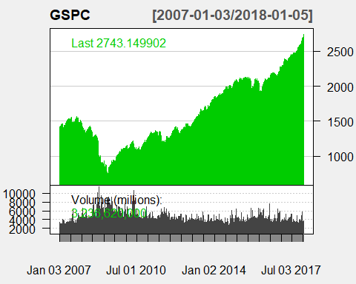
Exploring data and Analysis
Below chart shows SP&500 trend for almost 10 years, I found that Index price was dropped for the period of 2008 – 2010 when there was financial crisis in NOA

Slide 9
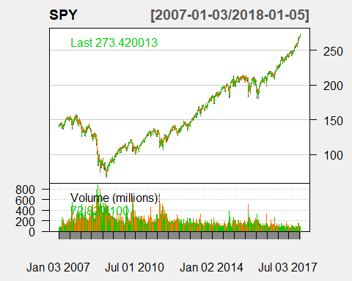
Time Series Model Analysis
Share Market Trend Analysis is an aspect of time series analysis that tries to predict the future movements of a stock based on past data. A Share market trend is based on the concept that the past movements are windows to the future trends. There are three main types of share market trends, short-term, intermediate-term, and long-term

Slide 10
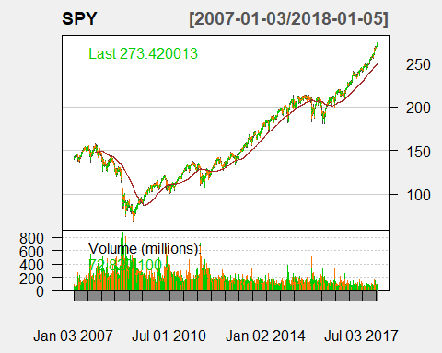
Simple Moving Average Modeling (SMA)
A simple moving average (SMA) is an arithmetic moving average calculated by adding the closing price of the security for a number of time periods and then dividing this total by the number of time periods

Slide 11
Two types of indicators
ROC Indicator: The Rate-of-Change (ROC) indicator, which is also referred to as simply Momentum, is a pure momentum oscillator that measures the percent change in price from one period to the next. The ROC calculation compares the current price with the price “n” periods ago. The plot forms an oscillator that fluctuates above and below the zero line as the Rate-of-Change moves from positive to negative
ROC = [(Close - Close n periods ago) / (Close n periods ago)] * 100
ADX Indicator: ADX is plotted as a single line with values ranging from a low of zero to a high of 100. ADX is non-directional; it registers trend strength whether price is trending up or down. The indicator is usually plotted in the same window as the two directional movement indicator (DMI) lines, from which ADX is derived

Slide 12
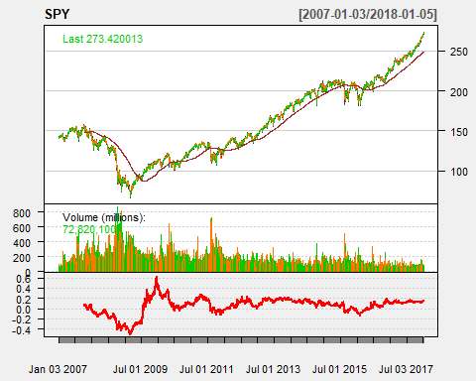
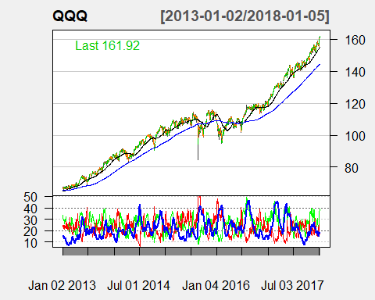
Continued …
ROC
ADX

Slide 13
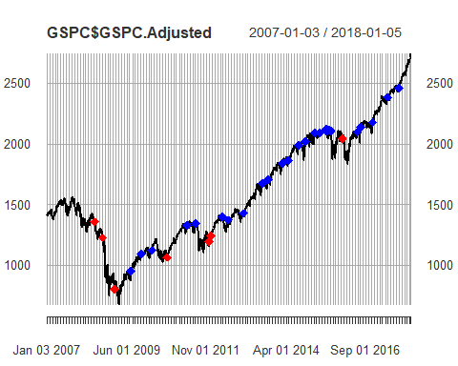
Trending with Trades
Below graph is showing trade analyst and experts to do short trading for the period that shows with RED sing and long trade for the position that shows with BLUE. In below example trade is recommended to keep investment for short period in 2008-2010, and keep long term their investment after 2011. In this way traders will be able to set stop loss on their trading system based on below chart. They also will be able to predict future trend based on long term movement

Slide 14
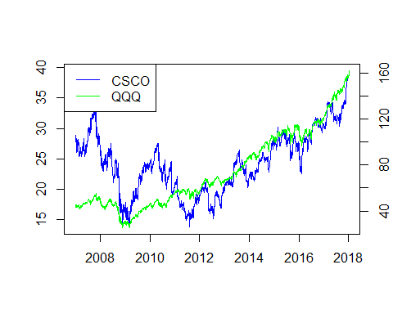
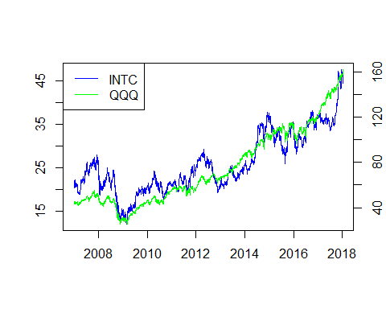
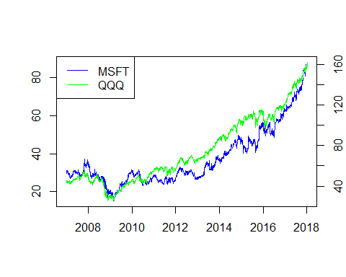
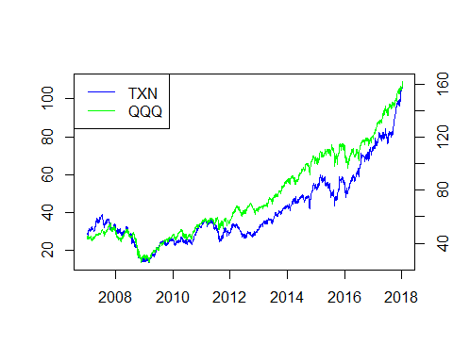
Basket Analysis
Market Basket Analysis is a modeling technique based upon the theory that if you buy a certain group of items, you are more (or less) likely to buy another group of items. For example, if you are in an English pub and you buy a pint of beer and don't buy a bar meal, you are more likely to buy crisps (US. chips) at the same time than somebody who didn't buy beer

Slide 15
Visualization using Tableau
Install “Rserver” Package in R
Set the connection in Tableau
Write calculation formula var. using below functions
SCRIPT_REAL
SCRIPT_STR
SCRIPT_INT
SCRIPT_BOOL

Slide 16
Long Short-Term Memory (LSTM)
LSTMs are very powerful in sequence prediction problems because they’re able to store past information. This is important in our case because the previous price of a stock is crucial in predicting its future price.
We’ll kick of by importing NumPy for scientific computation, Matplotlib for plotting graphs, and Pandas to aide in loading and manipulating our datasets.

Slide 17
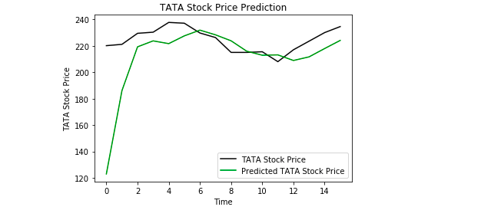

Slide 18
Conclusion
I attempted to show a large swath of tools, functions, and methodologies in the technical and quantitative analysis field using the R programming language, In addition I tried to address all of questions which was important for my users and stakeholders, there are many factors that could change the stock market trends and it’s almost not possible to come up with the product that consider everything and provide prediction, However most of the indicators that I have mentioned on this report could help analysts to manage their future investment must wiser and have efficient decision for their holding.

