Slide 1
Effect of Features Generated from Adjacent and Overlapped Segments in Protein Sequence Classification
Student ID No.: 1524042012
Name: Mohammad Reza Faisal
Chief Advisor: Professor Kenji Satou
Notes:
Today I will present my dissertation report.
The title is …

Slide 2
Outline
Introduction
Methods
Experiments and results
Summary and future works
Notes:
This presentation will be divided into 4 section
(Go to next slide w/o read)

Slide 3
Introduction
Notes:
The 1st section is …

Slide 4
Protein Sequence Classification in Bioinformatics
This format cannot be understood by classification algorithm.
MCMDVRCPSICTAPG
Feature Extraction
Each sample must have same feature length
feature1 | feature2 | feature3
value1 | value2 | value3
value4 | value5 | value6
Protein Descriptor: convert protein sequence into feature representation.
Numeric or nominal
features
Classification Algorithm
Feature representation
Require specific format of data.
Prediction Result
Notes:
This is sample of protein sequence.
But this format cannot directly be processed by classification algorithm.
Click – click
(Click) this is format that can be understood by classification algorithm.
Click – click – click – click
We need additional process to convert protein sequence into this format. The name of the process is feature extraction.
Click – feature extraction tool in protein sequence classification is protein descriptor.
Click – the output of this process is also known as feature representation.
This is basic flowchart of protein sequence classification.

Slide 5
Protein Descriptor
There are 22 protein descriptors that are commonly used in active researches (Xiao et al., 2014)
Amino Acid Composition
Autocorrelation
Profile-Based
Composition/Translation/ Distribution
Conjoint Triad
Quasi Sequence Order
Pseudo Amino Acid Composition
Proteochemometric
Alignment free descriptor
Alignment-based descriptor
Notes:
Until now, there are hundreds of protein feature extraction and protein descriptor researches were reported.
So we can say: this topic is important in classification protein sequence research.
In report by Xiao, he mentions there are 22 protein descriptors that are commonly used in active research.
These 22 protein descriptors are grouped into 8.
(click)
These 8 groups can be divided into 2 (click):
Alignment free descriptor.
Alignment-based descriptor.

Slide 6
Strength & Limitation: Alignment-based Descriptor
It also known as position specific descriptor
LASACMER
f₁ | f₂ | f₃ | f₄ | f₅ | f₆ | f₇ | f₈
MCMDVR
Alignment-based Descriptor
f₁ | f₂ | f₃ | f₄ | f₅ | f₆
DVRC
f₁ | f₂ | f₃ | f₄
length of feature representation
will be vary
Classification Algorithm
it can generate feature representation with position information
Need data with same feature length.
Notes:
Now I will explain about Alignment-based descriptor or also known as position specific descriptor.
The strength of this descriptor is (click)
it can generate feature representation with position information.
(click) But length of feature representation will be vary, it depend on the length of sequence.
(click) as we know, classification algorithm need data with same feature length
We have to make all feature representation have same length of features.
(click) For example, we can make all feature representation have same length as the shortest one.

Slide 7
Strength & Limitation: Alignment Free Descriptor 1/2
It also know as position independent descriptor
may lose position information
LASACMER
f₁ | f₂ | f₃ | f₄ | ... | f₂₀
MCMDVR
Alignment Free Descriptor
f₁ | f₂ | f₃ | f₄ | ... | f₂₀
DVRC
f₁ | f₂ | f₃ | f₄ | ... | f₂₀
fixed length features representation
A variable length sequence
Classification Algorithm
Notes:
Alignment Free descriptor is also known as position independent descriptor.
This descriptor can convert (click) a variable length sequence of protein
into (click) fixed length features representation.
(point to output) This form/format can be processed directly by classification algorithm.
(click)
But the feature representation may lose position information of amino acid.

Slide 8
Strength & Weakness: Alignment Free Descriptor 2/2
MCMDVR
A | R | N | D | C | E | Q | G | H | I | L | K | M | F | P | S | T | W | Y | V
0 | 0.17 | 0 | 0.17 | 0.17 | 0 | 0 | 0 | 0 | 0 | 0 | 0 | 0.33 | 0 | 0 | 0 | 0 | 0 | 0 | 0.17
Alignment Free Descriptor
Different order of amino acids
Same feature representation values
A | R | N | D | C | E | Q | G | H | I | L | K | M | F | P | S | T | W | Y | V
0 | 0.17 | 0 | 0.17 | 0.17 | 0 | 0 | 0 | 0 | 0 | 0 | 0 | 0.33 | 0 | 0 | 0 | 0 | 0 | 0 | 0.17
RVDMCM
Amino Acid Composition Descriptor
Notes:
For example, there are two different protein sequences. (click)
If the sequences are converted by using alignment free descriptor, for example (click) Amino Acid Composition
(click) We can see the feature representation have same values. (this feature A has same value with this feature A and so on)
It proves that alignment free descriptor (AAC descriptor) may discards position information of amino acid.

Slide 9
What has been done? 1/2
There are two methods to generate new feature representation in active researches.
A combination of various alignment free descriptors.
Concatenation of all feature representations
Still may lose position information
Alignment Free Descriptor 1
Feature representation 1
Alignment Free Descriptor 2
Feature representation 2
Feature representation 1
Feature representation 2
…
Feature representation n
Protein sequence
…
…
Alignment Free Descriptor n
Feature representation n
Have more information
Generated noises (Ong et al., 2007)
Notes:
What has been done in protein feature extraction or protein descriptor research?
(read) (read)
(click) … (click)

Slide 10
What has been done? 2/2
Combination of alignment free and alignment-based descriptor
Add position information in the new feature representation
Alignment free Descriptor
Feature representation 1
Feature representation 1
Feature representation 2
Protein sequence
Alignment based Descriptor
Feature representation 2
Position information
Notes:
2nd, researchers add position information in their new feature representation by using combination of alignment free and alignment-based descriptor.
(click)

Slide 11
What has not been done?
In existing reports, researchers only used an original sequence as the input to protein descriptor.
We generate new feature representation by using additional segments.
Local information of this position
Local information of this position
Global information of the original sequence.
Dividing an original sequence
MCMDVRCPSICTAPGSRGLA
Feature representation
Alignment Free Descriptor
MCMDVRCPSI
CTAPGSRGLA
Feature representation
new feature representation
with position information
Feature representation
Concatenate all feature representations
Notes:
In previous slide, we can see researchers only used an original sequence as the input to protein descriptor.
(click)
In our experiment, we try to generate new feature representation by using additional segments as the input.
Click … click BACA KOTAK MERAH SAMPAI HABIS
We expect, this approach can add position information to new feature representation.

Slide 12
Number of Segment
Relation between number of segment and information.
few
poor
rich
How many segment which is appropriate?
…
sequence information
number of segment
position information
Is it possible to get rich position and also sequence information?
…
…
many
rich
poor
Notes:
The purpose of generating additional segments is to get more information.
This illustration shows the relation between number of additional segment and information.
There are 2 type of information.
Click … click.
Many segments will give rich position information.
Few segment will give rich sequence information.
(click) (click)

Slide 13
Motivation
What is the optimal way to create additional segments?
How many segment which is appropriate?
Is it possible to get rich position and also sequence information?
Can feature generated from additional inputs help to improve the accuracy prediction of the model?
Does this approach work on all protein classification problems?
Notes:
And these are our motivations.

Slide 14
Method
Notes:
The 2nd section is method.

Slide 15
Flowchart
Protein sequence
Generated feature representation
train data
test data
Sanity check of the amino acid types
Feature ranking
Feature Extraction
Classification
Generate additional segments
Feature selection
z = 2, 3, 4, …
Construct feature representation
Learning & Prediction
Generated feature representation
Prediction Accuracy Calculation
Notes:
---BACA SAJA, JANGAN IMPROVISASI--
This is flowchart of our research.
There are 2 main steps:
1st step is feature extraction: we convert protein sequence into feature representation.
In feature extraction, there are 3 processes: ….
2nd step is classification: we process generated feature representation by using classification algorithm.
And in classification there are 3 processes: …

Slide 16
Experimental Design
Feature extraction:
Protr (R package) provides 22 protein descriptor functions.
Feature ranking & selection:
Random Forest (R package)
Classification:
Support Vector Machine (SVM) function from Kernlab (R package)
Evaluation method
Leave-one-out cross-validation.
k-fold cross-validation (k = 5, 10)
Notes:
These are tools & methods that are used in our research.
Don’t read note below
The more the accuracy of the random forest decreases due to the exclusion (or permutation) of a single variable, the more important that variable is deemed, and therefore variables with a large mean decrease in accuracy are more important for classification of the data.
In either case, is the Mean Decrease in Accuracy the number or proportion of observations that are incorrectly classified by removing the feature (or values from the feature) in question from the model?
The column called MeanDecreaseAccuracy contains a measure of the extent to which a variable improves the accuracy of the forest in predicting the classification
Importance (MeanDecreaseGini) provides a more nuanced measure of importance, which factors in both the contribution that variable makes to accuracy

Slide 17
Sanity check of the amino acid types
Glycine/G
Alanine/A
Valine/V
Cysteine/C
Proline/P
Leucine/L
Isoleucine/I
Methionine/M
Tryptophan/W
Phenylalanine/F
Lysine/K
Arginine/R
Histidine/H
Serine/S
Threonine/T
Tyrosine/Y
Asparagine/N
Glutamine/Q
Aspartic Acid/D
Glutamic Acid/E
SQMTRQARRLYBGC
SQMTRQARRLYGC
Sanity check of the amino acid types
GRKKRRERRRPPERKCX
GRKKRRERRRPPERKC
Feature Extraction
Protein descriptor functions in PROTR only recognize 20 amino acid codes.
Unrecognize code by protein descriptor function in PROTR:
X: undetermined amino acid
B: asparagine/N or aspartic acid/D
Z: glutamic acid/E or glutamine/Q
J: leucine/L or isoleucine/I
O: Pyrrolysine (UAG)
U: Selenocysteine (UGA)
Notes:
---BACA SAJA, JANGAN IMPROVISASI--
Now, I will explained each process in feature extraction.
The 1st process is …
For the information, Protein descriptor functions in protr package only recognize 20 amino acids.
For that reason, we have to eliminate amino acid that are not in these 20 amino acids
--- jangan di baca ---
The genetic code contains 20 amino acids, but many other amino acids are made by modifying these 20 amino acids after proteins have been made. Selenocysteine and pyrrolysine are rare genetically encoded amino acids. Selenocysteine is encoded by one of the stop codons, UGA.

Slide 18
Generate additional segments
Adjacent segments
Original sequence
2 segments (k=2)
3 segments (k=3)
4 segments (k=4)
Overlapped segments
It is generated by using 2 adjacent segments
Overlapped segment for k=2
Overlapped segments for k=3
Overlapped segments for k=4
MCMDVRCPSICTAPGSRGLA
20 amino acids
MCMDVRCPSI
CTAPGSRGLA
MCMDVRCPSI
CTAPGSRGLA
Feature Extraction
10 amino acids
10 amino acids
Divide into 2 segments
RCPSICTAPG
RCPSI
CTAPG
MCMDVRC
PSICTAP
GSRGLA
MCMDVRC
PSICTAP
GSRGLA
7 amino acids
7 amino acids
6 amino acids
VRCPSIC
TAPGSR
MCMDV
RCPSI
CTAPG
SRGLA
MCMDV
RCPSI
CTAPG
SRGLA
5
amino acids
5
amino acids
5
amino acids
5
amino acids
DVRCP
SICTA
PGSRG
Notes:
The 2nd process is ... additional segment generation
We generate 2 types of additional segment in this process.
The 1st type is adjacent segment.
(click) if we want to have 2 segment … we just divide an original sequence into 2 segment with same length.
2nd, an overlapped segment are generated by using 2 adjacent segments.
(click) 1st, we divide each adjacent segment into 2 segment.
(click) We use a half of 1st and 2nd adjacent segment, and (click) we get this overlapped segment.
In two next slide:
orange color represents adjacent segment,
green color represents overlapped segment,
blue color represents original sequence.

Slide 19
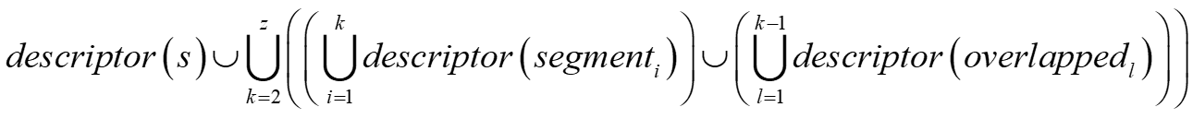


Construct feature representation 1/2
$$z=2$$
i.e. combine k=2 & k=3
Function from PROTR
$$z=3$$
Single descriptor
concatenate
original
MCMDVRCPSICTAPGSRGLA
Feature representation
k=2
MCMDVRCPSI
Feature representation
Feature Extraction
CTAPGSRGLA
Feature representation
Feature representation
RCPSICTAPG
Feature representation
Alignment Free Descriptor
Feature representation
k=3
MCMDVRC
Feature representation
PSICTAP
Feature representation
GSRGLA
Feature representation
VRCPSIC
Feature representation
TAPGSR
Feature representation
Notes:
The next process is feature representation construction.
This process convert original sequence (blue), adjacent segments (orange) and overlapped segments (green) into feature representation.
(click) as alignment free descriptor, we use existing protein descriptor function in protr package.
This is formula if we use only one alignment free descriptor.
If z = 2, we will use generated segments with k=2
(click) If z=3, we will use generated segment with (click) k=2 and k=3
If z=4, we will use generated segments with k=2 UNTIL k=4.
The new feature representation is generated by merging all of feature representation from original sequence and all segments.

Slide 20

Construct feature representation 2/2
$$z=2$$
type={AAC, DC}
concatenate
A combination of various descriptors
original
MCMDVRCPSICTAPGSRGLA
Feature representation
k=2
AAC
AAC’s Feature representation
MCMDVRCPSI
Feature representation
Feature Extraction
CTAPGSRGLA
Feature representation
RCPSICTAPG
Feature representation
Feature representation
original
MCMDVRCPSICTAPGSRGLA
Feature representation
k=2
MCMDVRCPSI
DC
Feature representation
DC’s Feature representation
CTAPGSRGLA
Feature representation
RCPSICTAPG
Feature representation
Notes:
This is formula if we use a combination of various alignment free descriptors.
(click) Beside variable z,
(click) we also have variable type.
For example, z=2 and we use 2 descriptors: AAC & DC.
---JANGAN LAMA---

Slide 21
How to retrieve rich position & sequence information?
z is a variable to manage how poor or rich the information that we will generate.
few
poor
rich
small
k=2
z=2
z=3
k=3
z=4
z=5
Which z value should we use?
k=4
z=6
z=7
k=5
number of segment
position information
sequence information
z value
Problem:
The poor information may include in the feature representation
k=6
k=7
More rich position
& sequence information
k=n
many
rich
poor
big
Notes:
JANGAN LAMA
Baca
(click) (click)
We have more rich position & rich sequence information if we use bigger z value. (click)
But (click) (baca kotak)
We have to find which z value can give more rich information and less poor information.

Slide 22
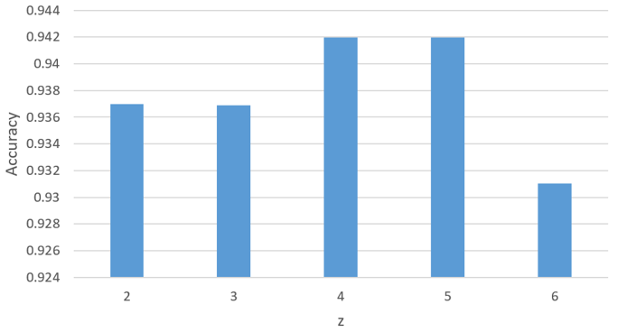

Classification
more useful information, also may have more noises
data with Z=3
…
data with Z=n
data with Z=2
data with Z=6
data with Z=2
data with Z=3
…
train data
test data
Classification
Accuracy
Learning
Classification
model
Prediction
accuracyZ=2
accuracyZ=3
…
accuracyZ=6
Z
Notes:
Now I will explain about The 2nd main step, classification.
Because we don’t know which z value can give more rich information and less poor information.
We prepare data of generated feature representation with various z values.
We use each data as an input of classification process.
1st we use data with z=2 …. (click) … (click)
As we can in this performance chart
(click) By increasing z value, the performance also increase.
(click) But in this point, the performance decrease.
So we can say data with z=4 have good number of rich position and sequence information.
And less number of poor information.

Slide 23
Classification: Feature Selection Implementation
data with Z=4
Feature were sorted based on the importance
355 features
train data
test data
Feature Ranking
Classification
Generate Feature Subset
Classification
Learning
model
Prediction
Accuracy for all feature subsets
Number feature in feature subset:
5, 10, 15, …, all features
Notes:
The next process is feature ranking and feature selection ON SELECTED DATA IN PREVIOUS PROCESS.
(click) 5x
SETELAH ITU BACA AJA.
By using this process, the performance was improved and features were reduced.
The purpose is the purpose is to improve the performance and reduce the feature.
The more the accuracy of the random forest decreases due to the exclusion (or permutation) of a single variable, the more important that variable is deemed, and therefore variables with a large mean decrease in accuracy are more important for classification of the data.

Slide 24
Experiments & Results
Notes:
The 3rd section is experiments & results.

Slide 25
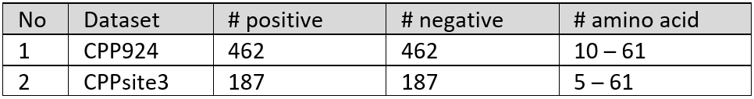
Datasets 1/2
Imbalanced data problem
Classification of Nuclear Receptors (P. Wang et al., 2011)
Cell-Penetrating Peptides Prediction (L. Wei et al., 2017)
Imbalanced data problem
Notes:
In this research, we use dataset from 3 protein sequence classification cases.
The 1st case is …
We conduct 2 type experiments with this dataset.
1st experiment is to identify NR & Non-NR. This experiment is 2 class classification with imbalance data problem. (click)
2nd experiment is to identify subfamilies. This experiment is multiclass classification with imbalance data problem. (click)
The 2nd case is …. There is no imbalanced data problem in this dataset.
LANGSUNG KE SLIDE BERIKUTNYA.

Slide 26
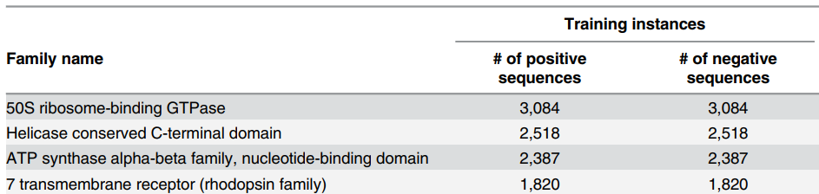

Datasets 2/2
Protein Family Classification (E. Asgari & M. R. K. Mofrad, 2015)
7,027 protein families
…
…
324.000 protein sequences
Notes:
The 3rd case is …
This data are from Swiss-Prot.
There are around 324.000 protein sequences in around 7000 families.
Positive and negative sequences have same number.
So we don’t have imbalanced data in this classification case.
JANGAN IMPROVISASI – SLIDE BERIKUTNYA

Slide 27
Result: Classification of Nuclear Receptors 1/2
Experiment I
M. P. S. R. Bhasin and Gajendra, “Classification of nuclear receptors based on amino acid composition and dipeptide composition,” J. Biol. Chem., vol. 279, no. 22, 2004
Result of Bhasin & Gajendra’s experiment
Feature selection were implemented, features=790
Feature selection were implemented, features=355
Generated feature representation by using DC with z=4, features=6400
Generated feature representation by using AAC with z=7, features=980
Notes:
Now I will show the result of our experiments.
In this experiment, We compare our result to Bhasin & Gajendra experiment.
Click … click sampai habis
Our approach improved the performance.
---JANGAN LAMA---

Slide 28
Result: Classification of Nuclear Receptors 2/2
Experiment II
P. Wang, X. Xiao, and K.-C. Chou, “NR-2L: A Two-Level Predictor for Identifying Nuclear Receptor Subfamilies Based on Sequence-Derived Features,” PLoS One, vol. 6, no. 8, p. e23505, Aug. 2011
Our approach give better performance than NR-2L if it implemented with DC descriptor
After implemented feature selection. Features reduced from 1600 to 120 features.
After implemented feature selection. Features reduced from 180 to 100 features.
Using only 1 descriptor. Our approach obtained better performance
Feature representation were generated by using combination of 5 descriptors
Notes:
In this experiment, we compare our approach to method by Wang and friends.
(click) They generated feature representation by using a combination of 5 protein descriptors.
There were 2 classification experiments.
1st experiment was conducted to identify NR & non-NR. CLICK … CLICK
2nd experiment was conducted to identify NR subfamilies. 1 CLICK SAJA
---LANGSUNG PINDAH SLIDE---

Slide 29
Result: Protein Family Classification
Feature selection were implemented.
Average number of features: 866 features
Provec was claimed can compete with previous research (used 3 descriptors: CTDC, CTDT & CTDD).
Features=100.
Performance improved.
Feature selection → feature reduced to 250.
Using 4 protein descriptors: AAC, CTDT, CTDD & CTDC with z=5
Features=4175
Weighted average accuracy for 1000 families.
Weighted based on the number of instances/samples
E. Asgari and M. R. K. Mofrad, “Continuous distributed representation of biological sequences for deep proteomics and genomics,” PLoS One, vol. 10, no. 11, pp. 1–11, 2015.
Notes:
This is the result of protein family classification case.
We compare our result to Asgari & Mofrad experiment. (click) BACA
(click) We generated feature representation by using a combination of 4 protein descriptors. (click) … (click)
--
This chart is the result of classification experiment on a protein family.
In this case, we did 1000 protein family classification experiments.
--
And this is the result (click) … (click)
This experiment prove that our approach also can work on a combination of various descriptor.

Slide 30
Result: Cell-Penetrating Peptides Prediction 1/2
Feature representation: combination of 4 descriptors, 636 features
Feature selection: 340 features.
Better performance than other performance of our experiments.
But lower than CPPred-RF.
Performance comparison
L. Wei, P. Xing, R. Su, G. Shi, Z. S. Ma, and Q. Zou, “CPPred-RF: A Sequence-based Predictor for Identifying Cell-Penetrating Peptides and Their Uptake Efficiency,” J. Proteome Res., vol. 16, no. 5, pp. 2044–2053, May 2017
Notes:
The last case is cell-penetrating peptides prediction.
---JANGAN LAMA---
BACA KOTAK … Cuma 2 click
Our approach cannot obtain better performance than previous research.

Slide 31
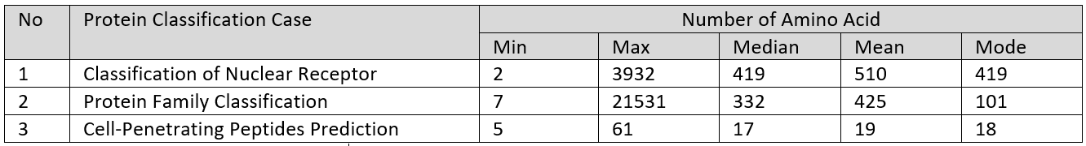
Result: Cell-Penetrating Peptides Prediction 2/2
Additional segments from our approach made the classifier’s performance decreasing in most of all our experiments.
Our approach cannot work if sequences don’t have sufficient amino acids
Notes:
Additional segments from our approach made the classifier’s performance decreasing in most of all our experiments IN THIS CASE.
JELASKAN SEDIKIT TENTANG HASIL DARI ORIGINAL SEQUENCE DAN Z=2 … Z=3 (untuk chart pertama saja)
BACA YANG DI BAWAH SETELAH TEKS MERAH MUNCUL
This table shows the statistic information of sequences in 3 cases.
Sequences in 3rd case have shorter length if compare with 1st and 2nd case.

Slide 32
Summary & Future Works
Notes:
The last section is …

Slide 33
Summary
We developed simple but powerful approach to generate feature representation of protein sequence.
Feature representation are generated by merging numerical feature of a original sequence, adjacent and overlapped segments.
Adjacent and overlapped segments give position information.
Evaluation on datasets from three protein classification cases.
Our approach achieved significant improvement in all cases which have a dataset with sufficient amino acid in each sequence.
Our approach can be applied on single descriptor or a combination of various descriptor.
But it cannot work well on cell-penetrating peptide prediction because sequences don’t have sufficient amino acids.
Notes:
Here, let me summarize my dissertation.

Slide 34
Future Work
Plan 1: applying our model to other alignment free protein descriptors.
We had used 6 protein descriptors:
Amino Acid Composition
CTD Composition
CTD Translation
CTD Distribution
Dipeptide Composition
Pseudo Amino Acid Composition (PseAAC)
We can apply our approach to others alignment free protein descriptors (15 protein descriptors).
Plan 2: applying our model to other areas of sequence classification like DNA sequence.
Notes:
We have 2 plans for our future research.

Slide 35
Thank You

