Slide 1
Predictive Analysis On World Happiness dataset
By : Reza Karbasi
Course : Data Analysis
Dr. Mohammad Amin Sadeghi
23-feb-2021

Slide 2
Table of content
Data structure
Get a sense from data
Find the most important parameters
Regression
What to do in Iran ?

Slide 3
Data Structure

Slide 4
Data¹ Structure
We Used only 2020 data
Parameters of data :
Ladder score
Logged GDP per capita
Social support
Healthy life expectancy
Freedom to make life choices
Generosity
Perceptions of corruption
Dystopia + residual
1 : https://www.kaggle.com/mathurinache/world-happiness-report

Slide 5
Get a sense from data

Slide 6
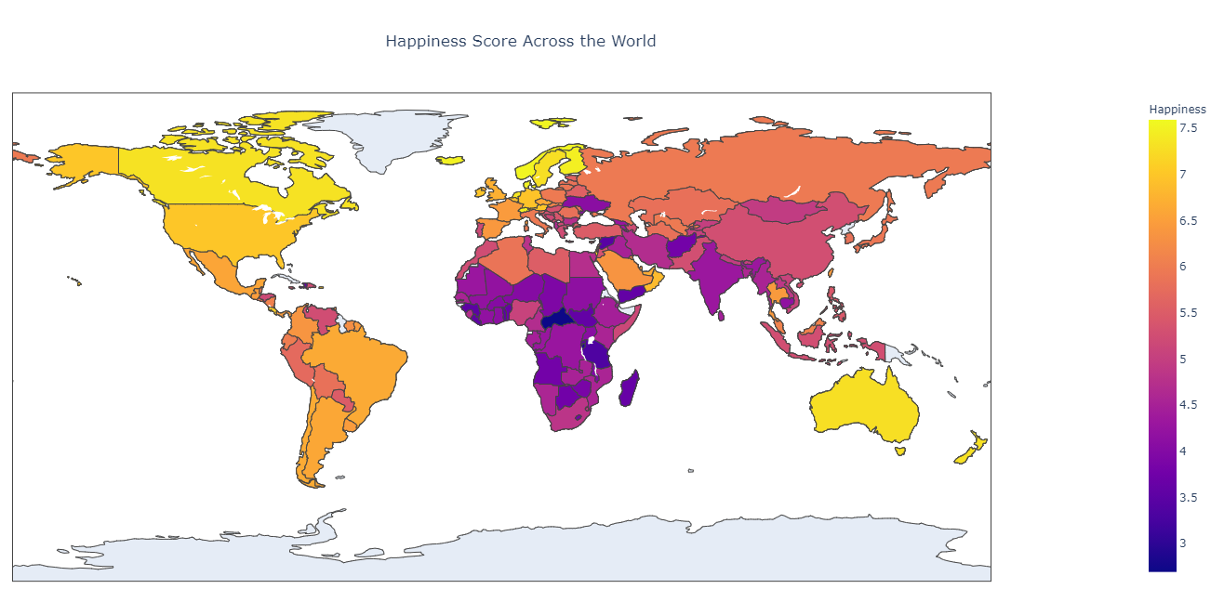

Slide 7
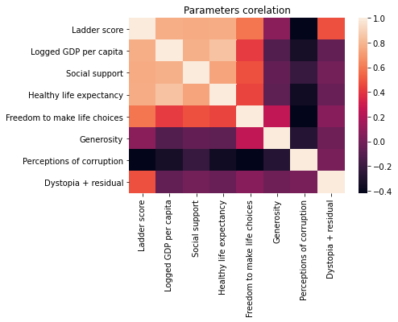

Slide 8
Find the most important parameters

Slide 9
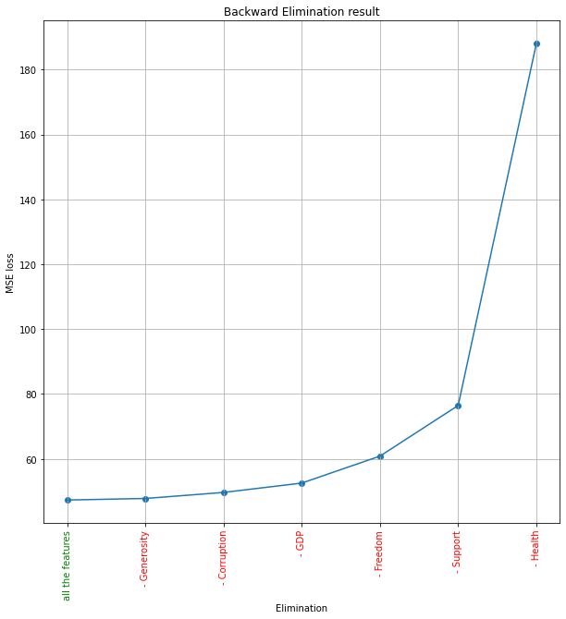

Slide 10
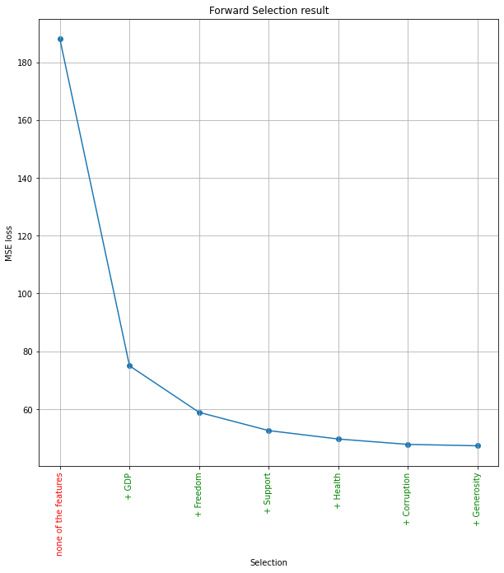

Slide 11
Regression

Slide 12
Happiness score =
0.23 * Logged GDP per capita
+ 2.72 * Social support
+ 0.03 * Healthy life expectancy
+ 1.78 * Freedom to make life choices
+ 0.41 * Generosity
- 0.62 * Perceptions of corruption

Slide 13
What to do in Iran ?

Slide 14
Changing the parameter | Effect in happiness score
10% GDP | 0.02
10% Social support | 0.19
4 year Health life expectancy (66 -> 70) | 0.14
20% Freedom | 0.23
20% Generosity | 0.01
15% Corruption | 0.06

Slide 15

Thanks for your attention
github.com/rezakarbasi/Project2_DataAnalytics/tree/master

