Slide 1


Types of Memories for a Contextual Awareness Autonomous Navigation Agent
Reza Amini
r.aminibaghbaderani2323@student.leedsbeckett.ac.uk

Slide 2
01
Background
02
Cognitive Architecture
03
Memories
04
Knowledge Utilisation
Table of Contents
contextual awareness and memories
Overall structure, comprehension and usage
Short-term, semantic and episodic memory
Knowledge retrieval and usage from memories

Slide 3
Background
contextual awareness and memories

Slide 4
Contextual Awarness and Memories
Real-time Perception and understanding of the current environment, through variety of sources such as sensors.
Data sourced from diverse channels that are multimodal nature, often dynamic and requires handling and storage.
Memories in the form of short-term (working memory) or long-term memories.

Slide 5
Characteristics of Memories
Memory Encoding
Context Integration
storing relevant details about the environment
integrating memories to create a coherent representation of context
Context-Based Decision Making
Memory Retrieval
ability to retrieve and access information from memory when needed
using the information evaluate options, assess potential outcomes and make informed decisions

Slide 6
Cognitive Architecture
Overall structure, comprehension and usage

Slide 7
Soar Cognitive Architecture
General Cognitive Architecture
Intelligent Systems & Agents
for a variety of task simulate human-like cognitive processes
provides a flexible and extensible framework to develop agents
Goal-Directed Behaviour
Knowledge Processing
similar to how humans pursue and achieve goals
represent & use forms of knowledge while interacting with the outside world
Problem-Solving & Decision Support
Learning and Adaptation
solve a range of problem-solving tasks in domains such as robotics
to learn from experiences and adapt its behaviour over time
Notes:
Goal-Directed Behavior: Soar is designed to exhibit goal-directed behavior, similar to how humans pursue and achieve goals. It can set and prioritize goals, make decisions based on those goals, and take actions to accomplish them.
Problem-Solving and Decision Support: Soar can be applied to solve a range of problem-solving tasks and provide decision support. It has been used in domains such as robotics, game playing, natural language processing, and planning, showcasing its versatility in different applications.
Application in AI Research: Soar has been widely used as a platform for AI research, particularly in cognitive science, psychology, and artificial intelligence. It provides a flexible and extensible framework for studying and developing intelligent systems and cognitive architectures.
Computational Simulations of Human Cognition: Soar aims to model and simulate human cognitive processes and behavior. It is inspired by psychological theories and findings, with the goal of understanding and replicating aspects of human intelligence.
Many tools to aid development • Visual-Soar, Debugger, …
Integrated learning • Adding reinforcement learning, episodic & semantic

Slide 8
Soar Basics: Decision Cycle Through Knowledge Rules & Operators
1. Input
Input from environment
5. Output
Output to environment, make an action
2. Elaborate,
Propose & Evaluate Operators
Elaborate current situation: parallel rules
4. Apply Operator
Modify internal data structures: parallel rules
3. Select Operator
Propose and evaluate operators via preferences: parallel rules

Slide 9
Soar Knowledge Rules Structure & Syntax
sp {propose*hello-world
(state <s> ^type state)
-->
(<s> ^operator <o> +)
(<o> ^name hello-world) }
Rule name
Condition(s)
or
Left Hand Side (LHS) of the rule
Starts with SP
Separate Actions or LHS from conditions or RHS.
Action(s)
or
Right Hand Side (RHS) of the rule
Notes:
For the rule to fire, each condition must be satisfied.

Slide 10
Soar Operator Proposal
Rule
Meaning
sp {propose*hello-world
(state <s> ^type state)
-->
(<s> ^operator <o> +)
(<o> ^name hello-world)}
If I exist,
propose the hello-world operator.

Slide 11
Soar Apply Operator
Rule
Meaning
sp {apply*hello-world
(state <s> ^operator <o>)
(<o> ^name hello-world)
-->
(write |Hello World|)
(halt)}
If the hello-world operator is selected, write “Hello World”
and halt.

Slide 12
Memories
Short-term, semantic and episodic memory

Slide 13
Types of Memories
Conceptual knowledge storage
Declarative Knowledge
Persistent information that do not change
Query and integration with Working Memory
Exact query match
Long-term memory
Storing past experiences
Contains snapshots of working memory
Inclusion/exclusion of snapshots
Query and integration with working memory
Partial query match
Long-term memory
Implicit and internal learning
Procedural learning
Reinforcement learning
Long-term memory
Integrate with Working memory
Current enviroment data
Temporary Storage
Immediate Access
Dynamic Updating
Symbolic, knowledge graph
Integration with Long-Term Memories
Cognitive Control
Short-term memory
Working Memory
Semantic Memory
Episodic Memory
Procedural Memory
Notes:
Short-term memory:
Cognitive Control: Working memory plays a crucial role in cognitive control processes within the Soar architecture. It helps in maintaining task goals, inhibiting irrelevant information, and coordinating different cognitive processes for effective decision-making and problem-solving.
-Conceptual Knowledge Storage: Semantic memory in Soar is responsible for storing conceptual knowledge about facts, meanings, and relationships between various entities or concepts. It represents general knowledge about the world.
-Declarative Knowledge: Semantic memory in Soar focuses on declarative knowledge, which includes factual information, concepts, categories, and the relationships between them. It captures the general understanding of the world and its entities.

Slide 14
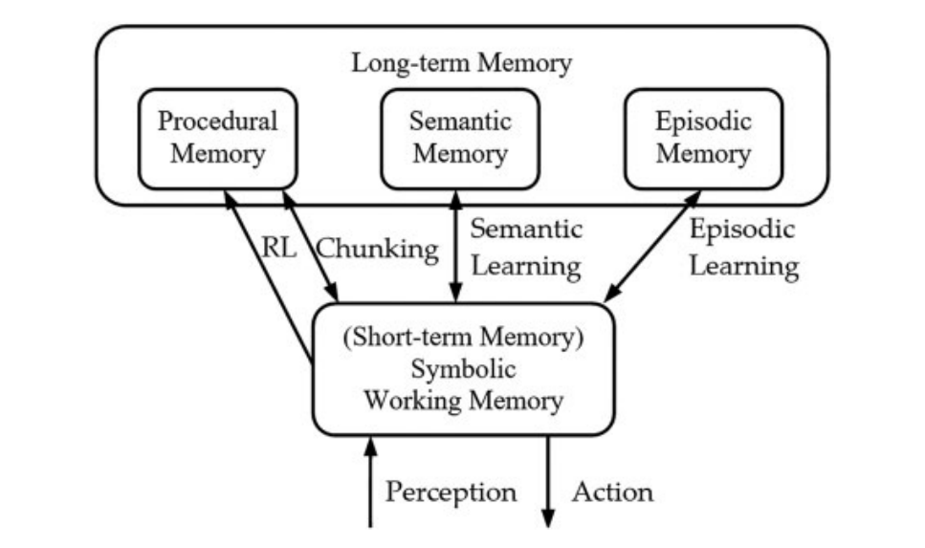
Memories Overall Structure & Integrations
Notes:
Van Dang, C., Jun, M., Shin, Y.-B., Choi, J.-W. & Kim, J.-W. (2018) Application of Modified Asimov’s Laws to the Agent of Home Service Robot Using State, Operator, and Result (Soar). International Journal of Advanced Robotic Systems, 15 (3), p. 172988141878082.

Slide 15

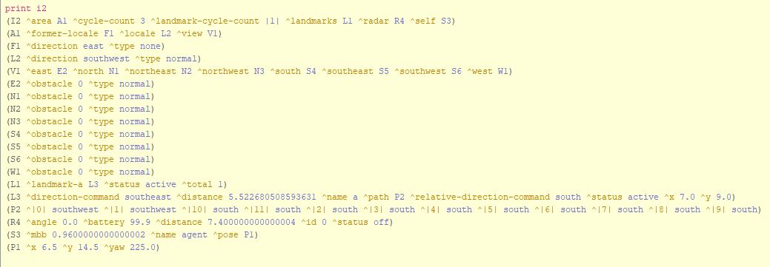
Working Memory ( Short-Term Memory )

Slide 16
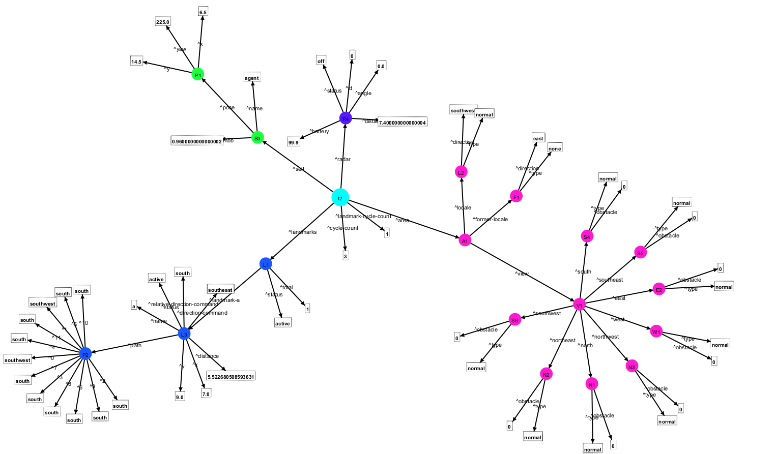
Working Memory Knowledge Graph

Slide 17
Working Memory Knowledge Graph

Slide 18
Knowledge Utilisation
Knowledge retrieval and usage from memories

Slide 19
Retrieving Working Memory Knowledge
sp {propose*move-forward
(state <s>
^io.input-link.area.view <area-view>
^io.input-link.area.locale.direction <current-direction>
^io.input-link.self.pose <e> )
(<area-view> ^<current-direction>.type <> block )
(<e> ^x <x> ^y <y>)
-->
(<s> ^operator <o> + =)
(<o> ^name move-forward
^actions <a>)
(<a> ^move.direction <current-direction> )}

Slide 20
Episodic Memory Knowledge Snapshots

Slide 21

Episodic Memory Knowledge Overall Structure
epmem --set learning on
epmem --set trigger dc
epmem --set append-database on
epmem --set exclusions turn-directions

Slide 22

Episodic Memory Knowledge Query & Retrieval
sp {epmem*query-current-position
(state <s> ^epmem.command <cmd>
^io.input-link.self.pose <e> )
(<e> ^x <x> ^y <y>)
-->
(<cmd> ^query <q>)
(<q> ^self.pose <position> )
(<position> ^x <x> ^y <y> )}

Slide 23

Semantic Memory Overall Structure
smem --set learning on
smem --set append-database on
smem --set path /resources/smem-db.sqlite

Slide 24
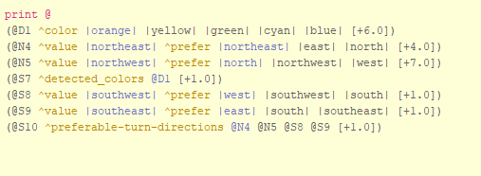
Semantic Memory Knowledge Store
sp {smem*store*preferable-turn-directions
(state <s> ^superstate nil)
-->
( cmd smem --add
|
(<ss> ^preferable-turn-directions <ne> <nw> <sw> <se> )
(<ne> ^value northeast ^prefer northeast)
(<ne> ^value northeast ^prefer east)
(<ne> ^value northeast ^prefer north)
(<nw> ^value northwest ^prefer northwest)
(<nw> ^value northwest ^prefer west)
(<nw> ^value northwest ^prefer north)
(<sw> ^value southwest ^prefer southwest)
(<sw> ^value southwest ^prefer south)
(<sw> ^value southwest ^prefer west)
(<se> ^value southeast ^prefer southeast)
(<se> ^value southeast ^prefer south)
(<se> ^value southeast ^prefer east)
|
)
}

Slide 25


Semantic Memory Knowledge Query & Retrieval
sp {smem*query
(state <s> ^smem.command <smem>
^io.input-link.area.locale.direction <current-direction>
)
-->
(<smem> ^query <q>)
(<q> ^value <current-direction> )}

Slide 26
THANK YOU For Your Attention

