Slide 1
Data analysis report on bike-share trip data
By: reza Farshchi

Slide 2
Introduction
Our analysis goal is to discover differences between behaviors of casual users and members of our service to find a way to encourage users to buy annual subscription.
For this purpose we have analyzed data related to trips that have taken place with our bikes by our users(casual and member) in the last 12 months (2022-04 -> 2023-03) and we are about to reveal our findings.

Slide 3
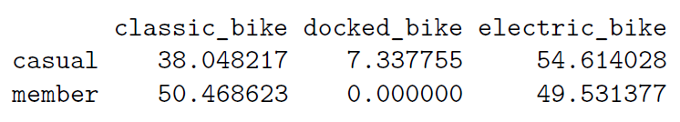
Key findings
There are some insights that might help the executive team come up with good ideas to try.
The most popular station in the last 12 months for our casual users is “Streeter Dr & Grand Ave “ and the most popular station for our members is “Kingsbury St & Kinzie St”
The most popular bike for our casual users is electric bikes and our members favor classic and electric bike almost the same. The exact percentage of used bikes for each user type in the last 12 months is shown here.

Slide 4
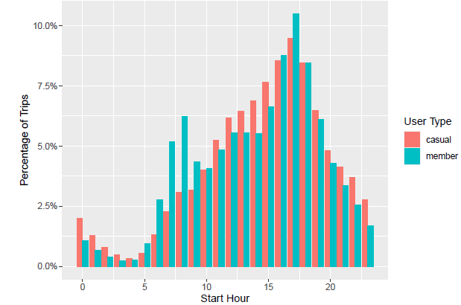
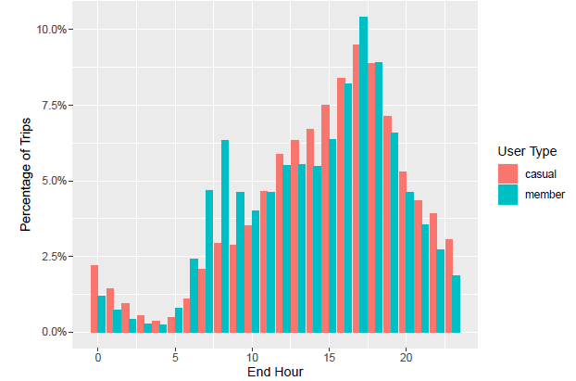
The most popular hour of the day in the last 12 months for members and casual users is shown here. Note that one chart is for start time of the trips and one is for the end of trip.

Slide 5
The most popular day of the week for casual users is Saturday with 20.2% of all trips happened in Saturdays. On the other hand our members favor Tuesdays, Wednesdays, and Thursdays all at around 15.8% of all trips in the last year.

Slide 6
Recommendations:
Since we are focusing on encouraging casual members to become members it is a good idea to hold an event near one of our stations and give discounts to them if possible.
We rather hold this event when our stations are as crowded as possible. Based on our analysis the best time and location for our event is:
Saturday 4PM-7PM or 5PM-6PM (based on how long we wish the event to take time) at “Streeter Dr & Grand Ave “ station
We can promote our popular bike for casual users which is electric bike to draw their attention.

