Slide 1
Lecture 19: NN Regularization

Slide 2
Outline
Regularization of NN
Norm Penalties
Early Stopping
Data Augmentation
Sparse Representation
Bagging
Dropout

Slide 3
Outline
Regularization of NN
Norm Penalties
Early Stopping
Data Augmentation
Sparse Representation
Bagging
Dropout

Slide 4
Regularization
Regularization is any modification we make to a learning algorithm that is intended to reduce its generalization error but not its training error.

Slide 5
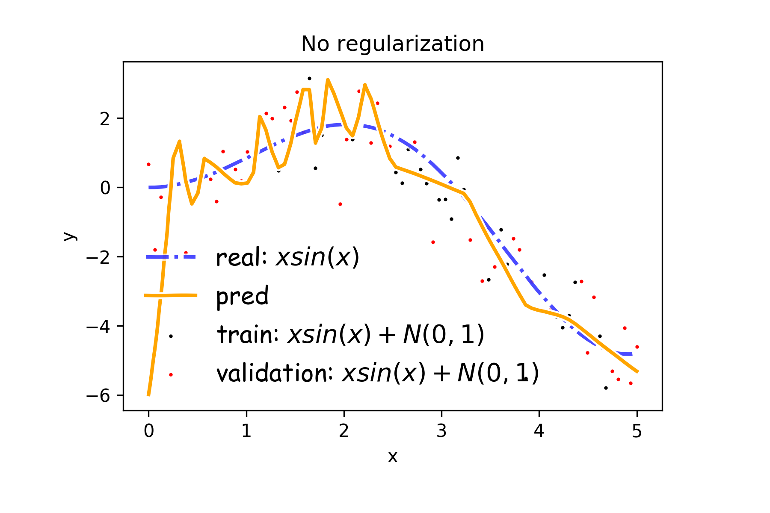
Overfitting
Fitting a deep neural network with 5 layers and 100 neurons per layer can lead to a very good prediction on the training set but poor prediction on validations set.

Slide 6

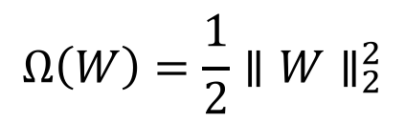
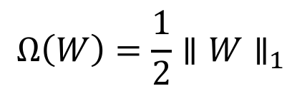
Norm Penalties
We used to optimize:
$$J\left(W;X, y\right)$$
Change to …
$$J_{R}\left(W;X,y\right)= J\left(W;X, y\right)+αΩ(W)$$
L₂ regularization:
Weights decay
MAP estimation with Gaussian prior
L₁ regularization:
encourages sparsity
MAP estimation with Laplacian prior
Biases not penalized
$$Ω\left(W\right)=\frac{1}{2}∥W∥_{2}^{2}$$
$$Ω\left(W\right)=\frac{1}{2}∥W∥_{1}$$

Slide 7


Norm Penalties
weights decay in proportion to its size.
We used to optimize:
$$J\left(W;X, y\right)$$
Change to …
$$J_{R}\left(W;X,y\right)= J\left(W;X, y\right)+αΩ(W)$$
L₂ regularization:
Decay of weights
MAP estimation with Gaussian prior
L₁ regularization:
encourages sparsity
MAP estimation with Laplacian prior
$$W^{(i+1)}=W^{(i)}−λ\frac{∂J}{∂W} \\ J_{R}\left(W;X,y\right)= J\left(W;X, y\right)+\frac{1}{2}αW^{2} \\ W^{(i+1)}=W^{(i)}−λ\frac{∂J}{∂W}−λα W$$
Biases not penalized
$$Ω\left(W\right)=\frac{1}{2}∥W∥_{2}^{2}$$
$$Ω\left(W\right)=\frac{1}{2}∥W∥_{1}$$

Slide 8
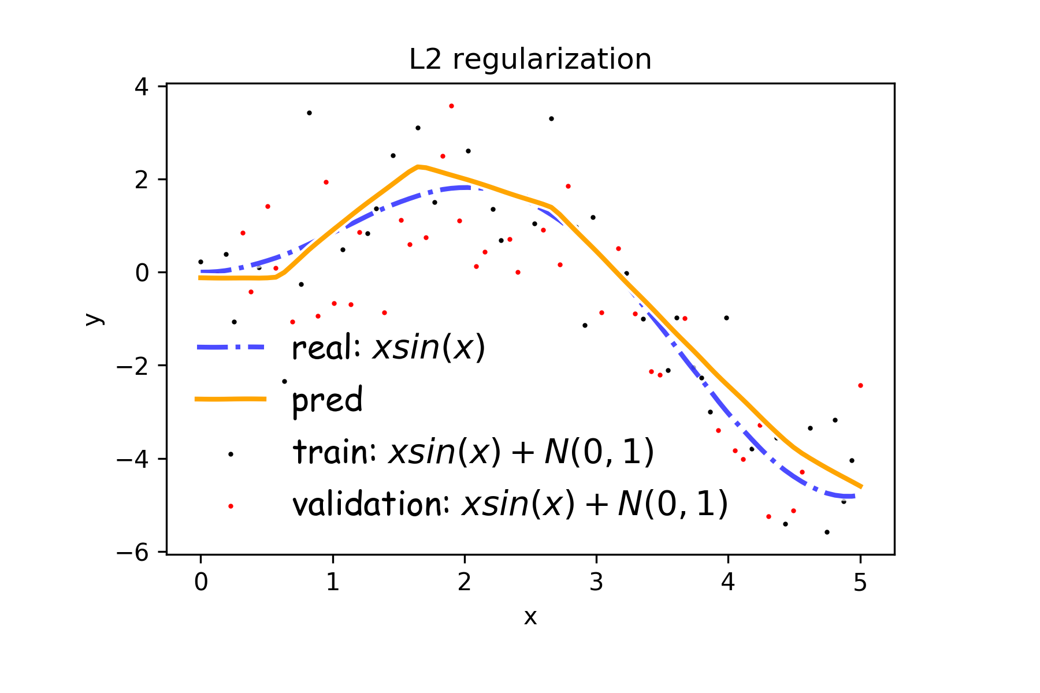
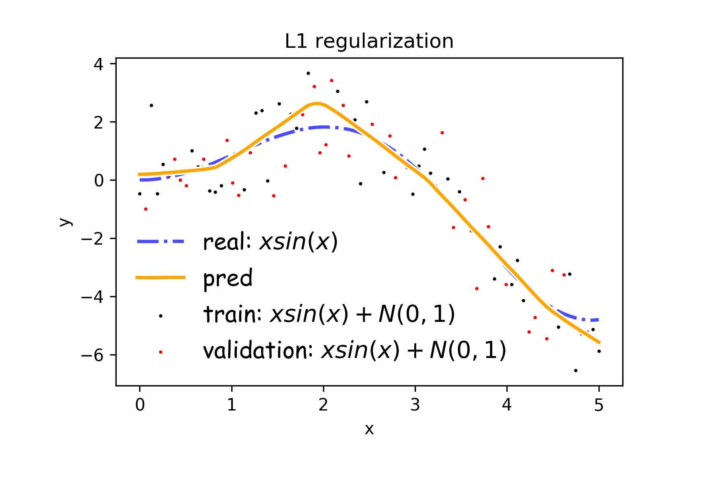
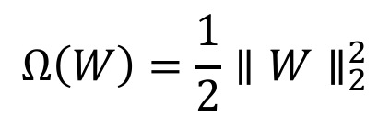
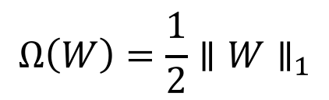
Norm Penalties
$$Ω\left(W\right)=\frac{1}{2}∥W∥_{2}^{2}$$
$$Ω\left(W\right)=\frac{1}{2}∥W∥_{1}$$

Slide 9

Norm Penalties as Constraints
$$\min_{Ω\left(W\right)≤K}{J(W;X,y)}$$
Useful if K is known in advance
Optimization:
Construct Lagrangian and apply gradient descent
Projected gradient descent

Slide 10
Outline
Regularization of NN
Norm Penalties
Early Stopping
Data Augmentation
Sparse Representation
Bagging
Dropout

Slide 11
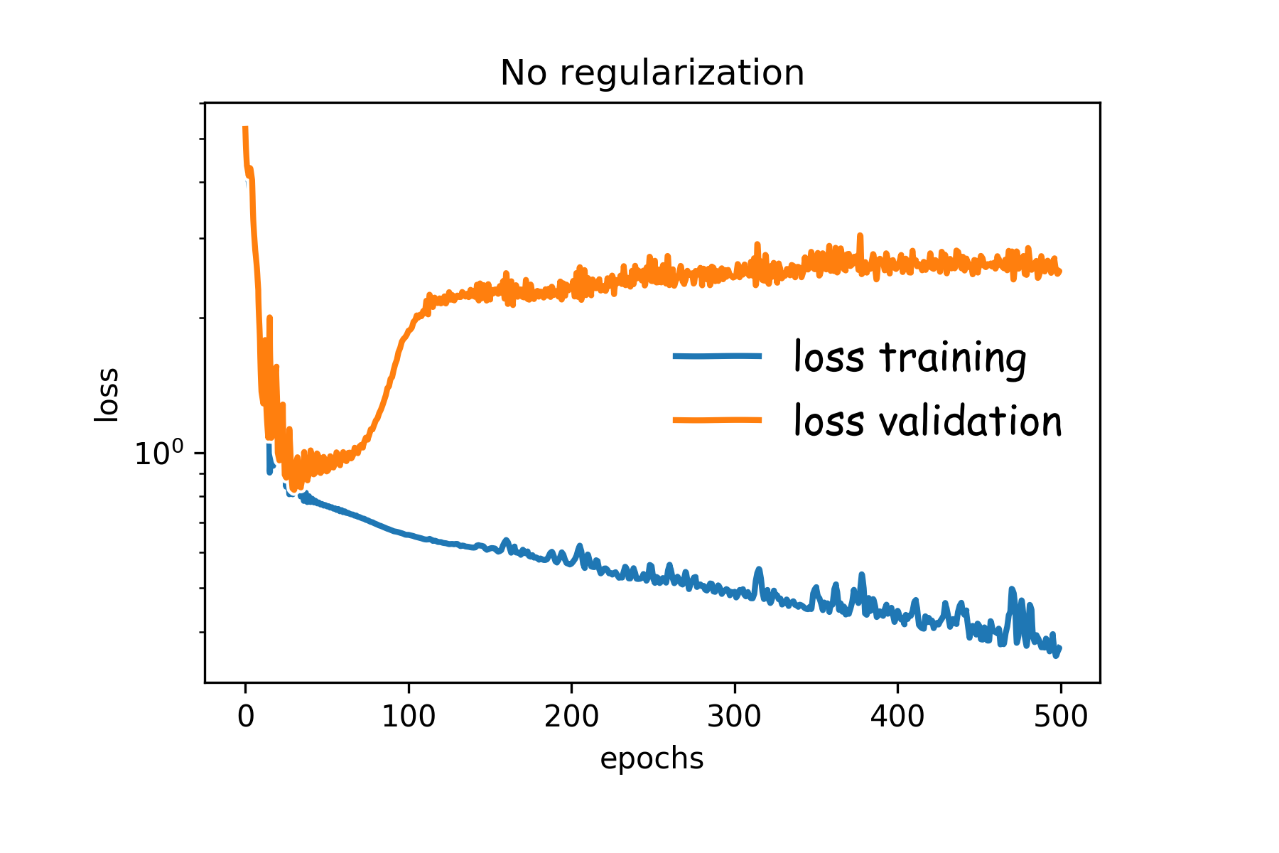
Early Stopping
Early stopping: terminate while validation set performance is better
Training time can be treated as a hyperparameter

Slide 12
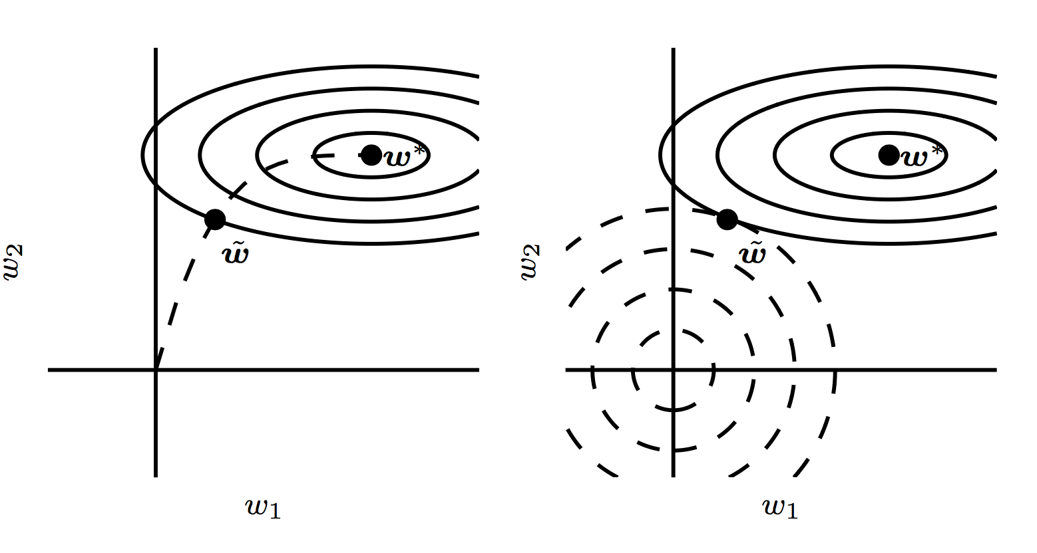
Early Stopping

Slide 13
Outline
Regularization of NN
Norm Penalties
Early Stopping
Data Augmentation
Sparse Representation
Bagging
Dropout

Slide 14
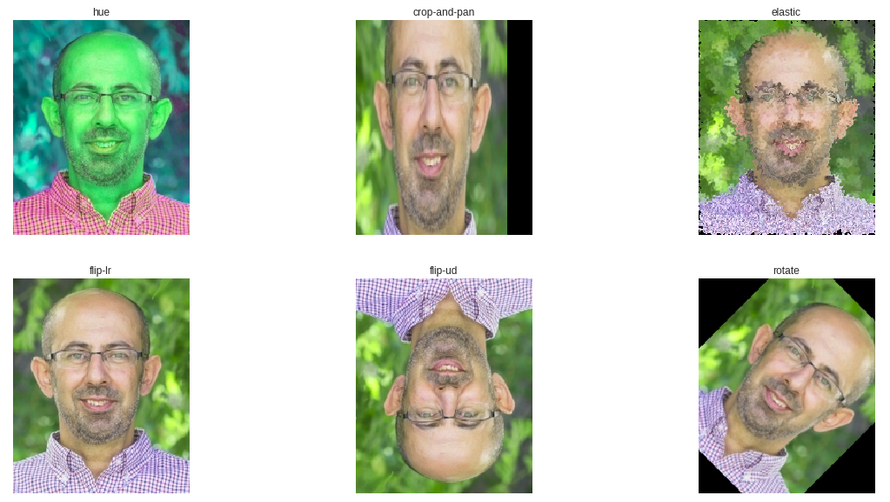
Data Augmentation

Slide 15
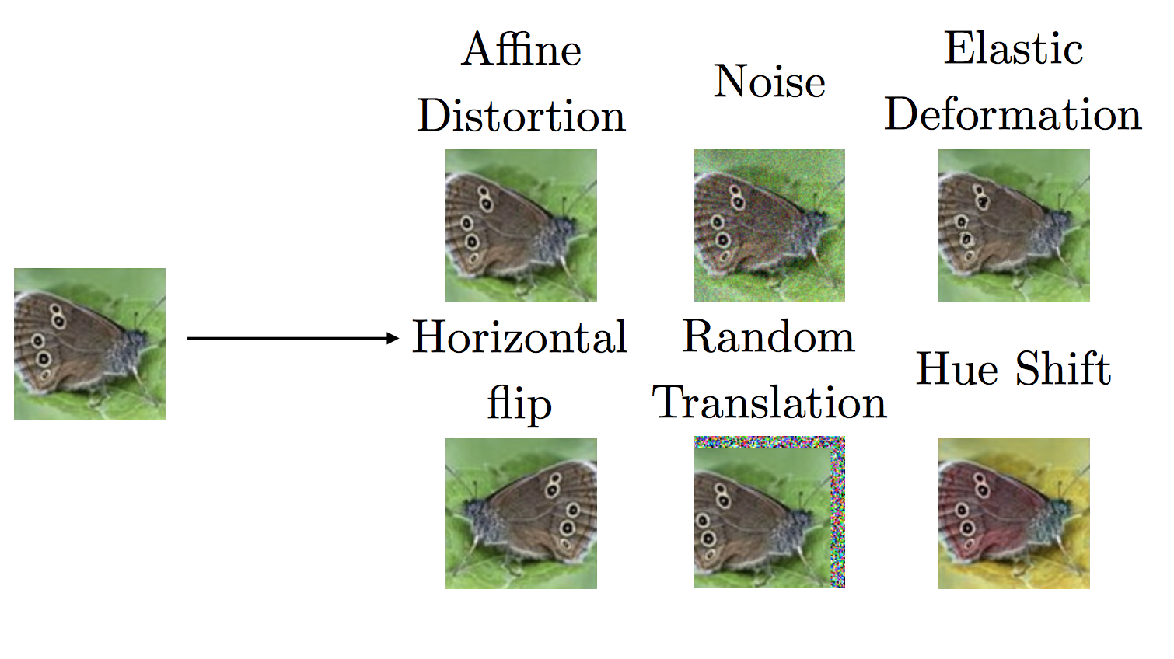
Data Augmentation

Slide 16
Outline
Regularization of NN
Norm Penalties
Early Stopping
Data Augmentation
Sparse Representation
Bagging
Dropout

Slide 17
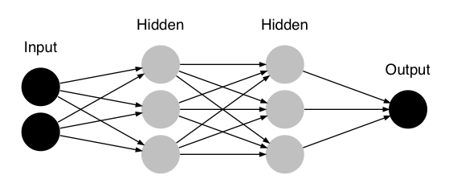









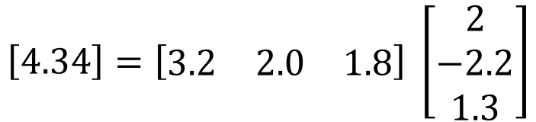
Sparse Representation
$$W_{1}$$
$$W_{4}$$
$$W_{2}$$
$$W_{5}$$
$$W_{7}$$
$$Y$$
$$W_{3}$$
$$W_{6}$$
$$J\left(θ;X, y\right)$$
$$\left[4.34\right]=\left[\begin{matrix}3.2 & 2.0 & 1.8\end{matrix}\right] \left[\begin{aligned}2 \\ −2.2 \\ 1.3\end{aligned}\right]$$
$$W_{7}$$

Slide 18


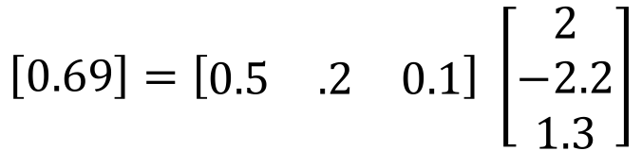
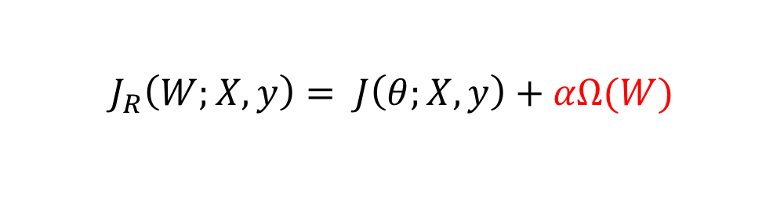






Sparse Representation
$$W_{1}$$
$$W_{4}$$
$$W_{2}$$
$$W_{5}$$
$$W_{7}$$
$$Y$$
$$W_{3}$$
$$W_{6}$$
$$J_{R}\left(W;X,y\right)= J\left(θ;X, y\right)+αΩ(W)$$
$$\left[0.69\right]=\left[\begin{matrix}0.5 & .2 & 0.1\end{matrix}\right] \left[\begin{aligned}2 \\ −2.2 \\ 1.3\end{aligned}\right]$$
$$W_{7}$$
Weights in output layer

Slide 19



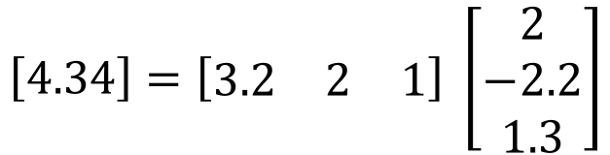

Sparse Representation
$$h_{31}$$
$$h_{32}$$
$$W_{7}$$
$$Y$$
$$h_{33}$$
$$J\left(θ;X, y\right)$$
$$\left[4.34\right]=\left[\begin{matrix}3.2 & 2 & 1\end{matrix}\right] \left[\begin{aligned}2 \\ −2.2 \\ 1.3\end{aligned}\right]$$
$$h_{31},h_{32},h_{33}$$

Slide 20
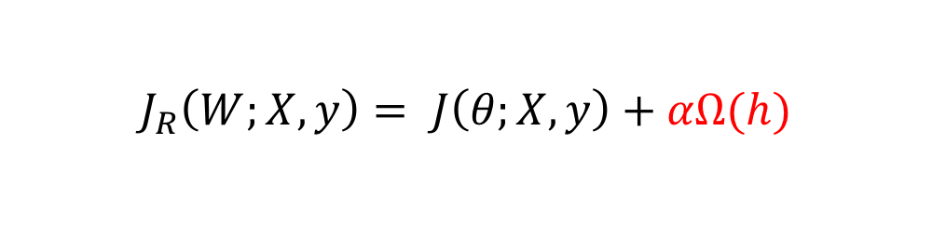



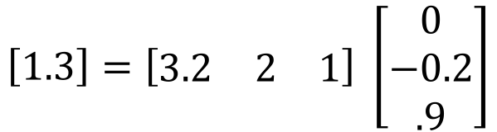
Sparse Representation
$$h_{31}$$
$$h_{32}$$
$$h_{33}$$
$$J_{R}\left(W;X,y\right)= J\left(θ;X, y\right)+αΩ(h)$$
$$\left[1.3\right]=\left[\begin{matrix}3.2 & 2 & 1\end{matrix}\right] \left[\begin{aligned}0 \\ −0.2 \\ .9\end{aligned}\right]$$
$$h_{31},h_{32},h_{33}$$
Output of hidden layer

Slide 21
Outline
Regularization of NN
Norm Penalties
Early Stopping
Data Augmentation
Sparse Representation
Bagging
Dropout

Slide 22
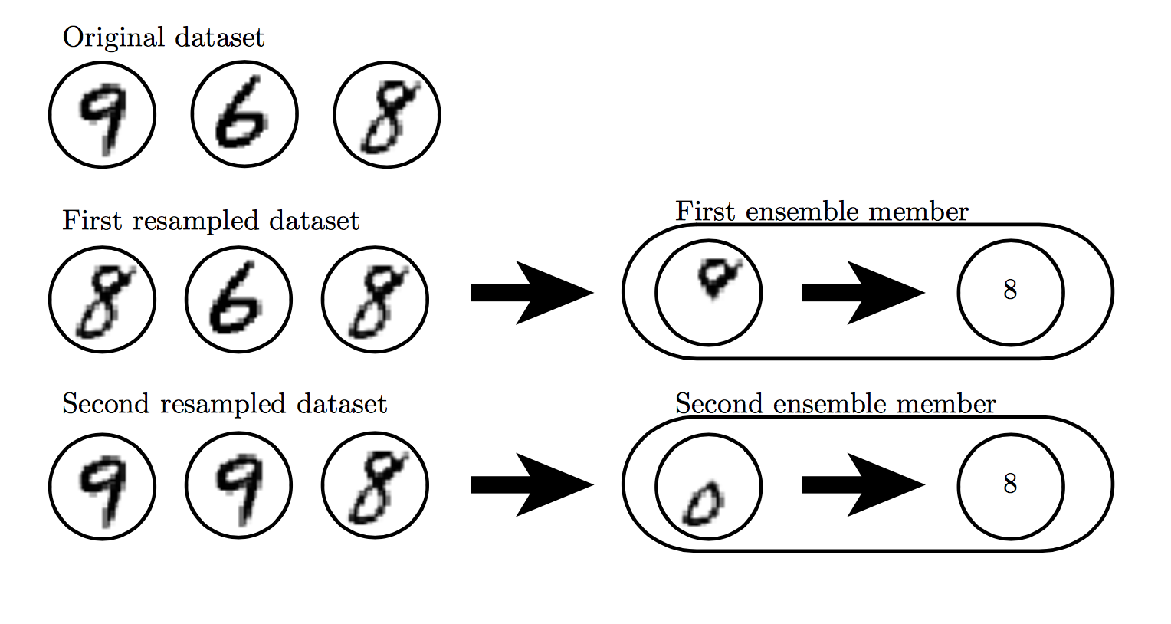

Slide 23
Outline
Regularization of NN
Norm Penalties
Early Stopping
Data Augmentation
Sparse Representation
Bagging
Dropout

Slide 24
Noise Robustness
Random perturbation of network weights
Gaussian noise: Equivalent to minimizing loss with regularization term
Encourages smooth function: small perturbation in weights leads to small changes in output
Injecting noise in output labels
Better convergence: prevents pursuit of hard probabilities

Slide 25
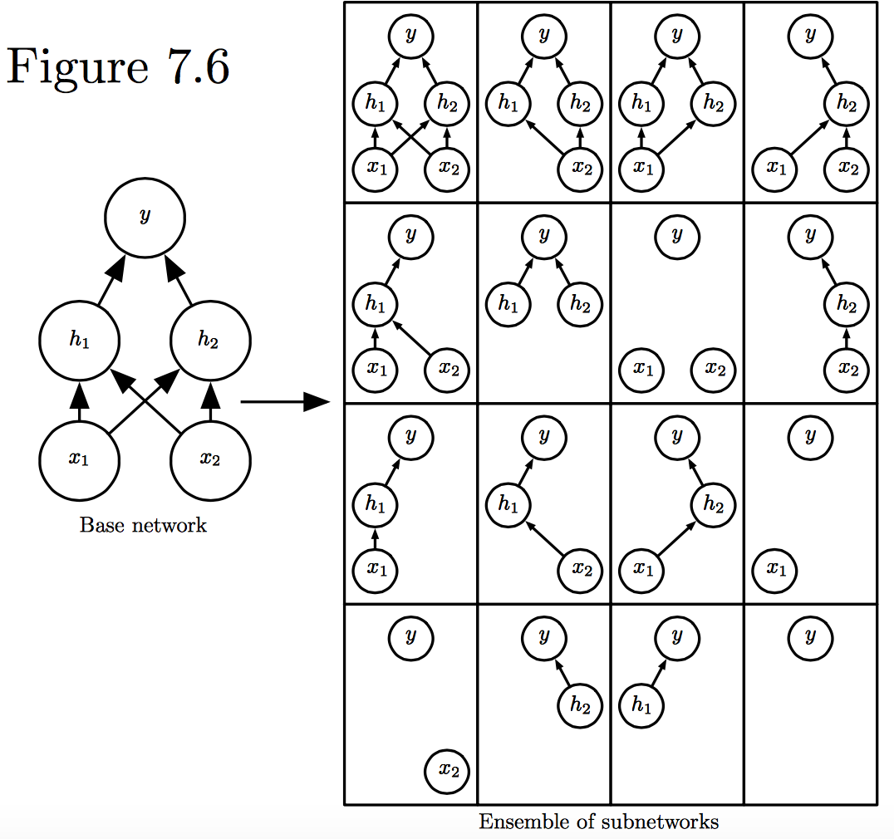
Dropout
Train all sub-networks obtained by removing non-output units from base network

Slide 26
Dropout: Stochastic GD
For each new example/mini-batch:
Randomly sample a binary mask μ independently, where μ_{i} indicates if input/hidden node i is included
Multiply output of node i with μ_{i}, and perform gradient update
Typically, an input node is included with prob=0.8, hidden node with prob=0.5.

Slide 27
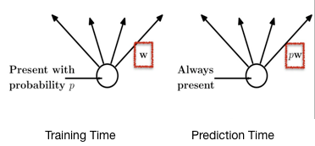
Dropout: Weight Scaling
During prediction time use all units, but scale weights with probability of inclusion
Notes:
https://chatbotslife.com/regularization-in-deep-learning-f649a45d6e0

Slide 28
Adversarial Examples

Slide 29




Adversarial Examples
$$+$$
$$=$$
Panda 57% confidence
noise
Gibbon 99.3% confidence
Training on adversarial examples is mostly intended to improve security, but can sometimes provide generic regularization.

Slide 30
Recap
Regularization of NN
Norm Penalties
Early Stopping
Data Augmentation
Sparse Representation
Bagging
Dropout

