Slide 1
Lecture 19 Additional Material: Optimization

Slide 2
Outline
Optimization
Challenges in Optimization
Momentum
Adaptive Learning Rate
Parameter Initialization
Batch Normalization

Slide 3
Learning vs. Optimization
Goal of learning: minimize generalization error
In practice, empirical risk minimization:
Quantity optimized different from the quantity we care about

Slide 4
Batch vs. Stochastic Algorithms
Batch algorithms
Optimize empirical risk using exact gradients
Stochastic algorithms
Estimates gradient from a small random sample
Large mini-batch: gradient computation expensive
Small mini-batch: greater variance in estimate, longer steps for convergence

Slide 5
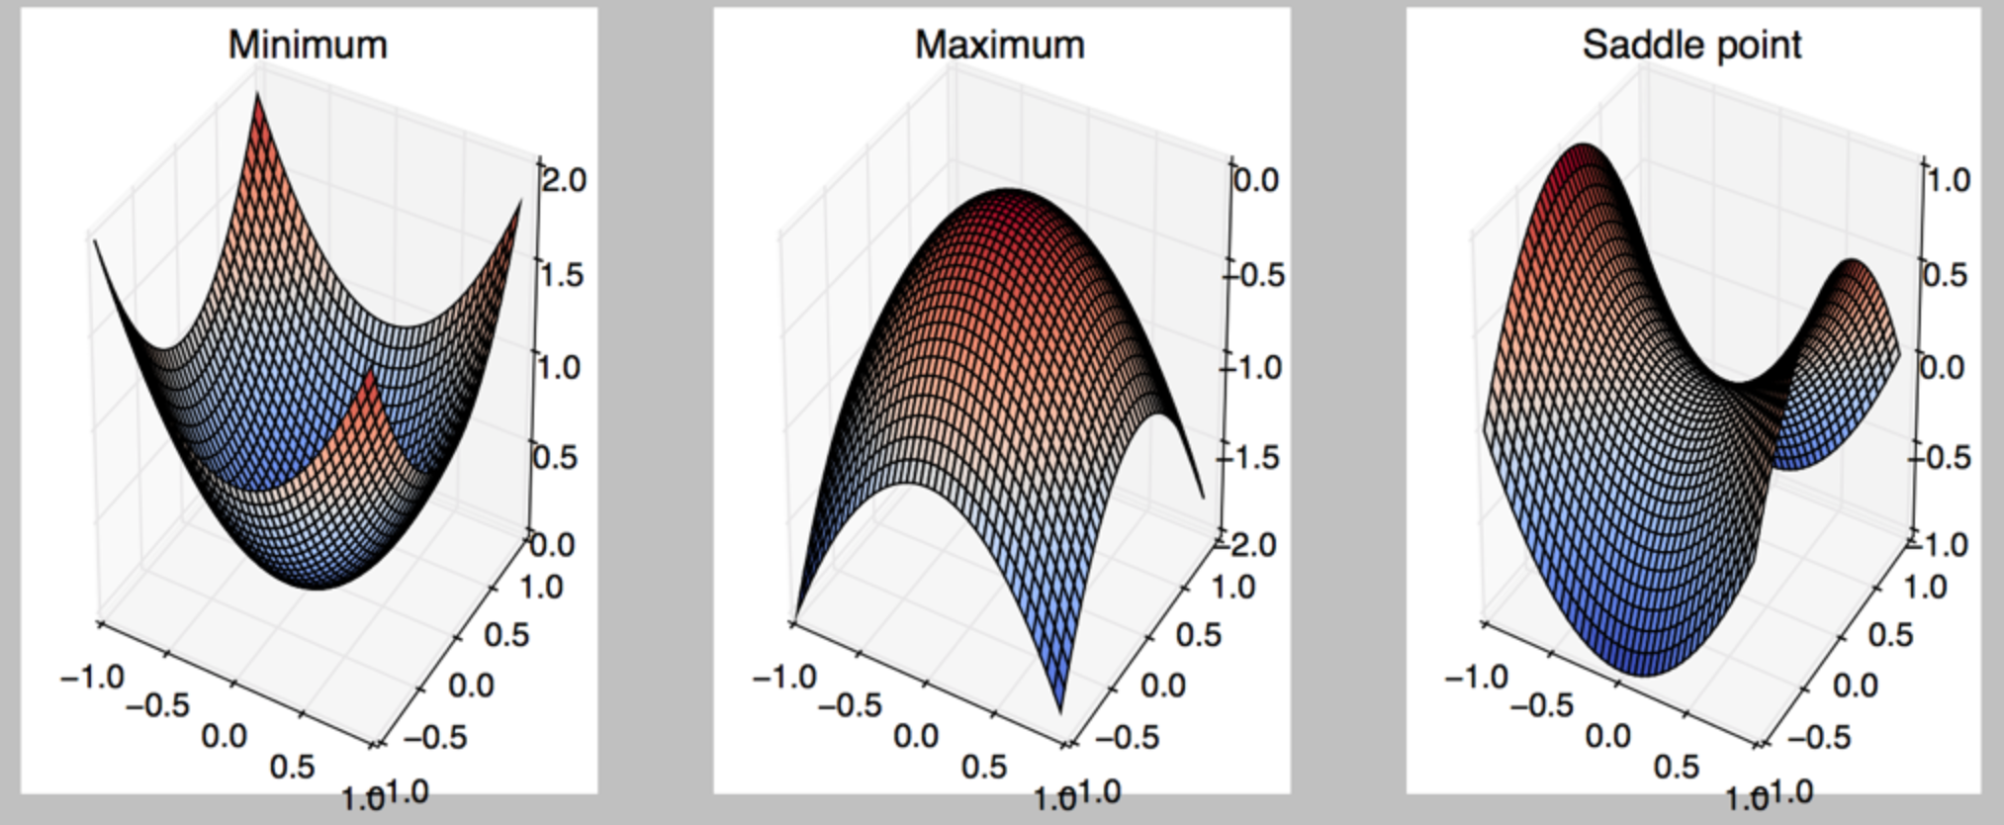
Critical Points
Points with zero gradient
2nd-derivate (Hessian) determines curvature
Goodfellow et al. (2016)

Slide 6
Stochastic Gradient Descent
Take small steps in direction of negative gradient
Sample m examples from training set and compute:
Update parameters:
In practice: shuffle training set once and pass through multiple times

Slide 7
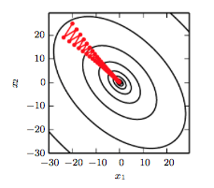
Stochastic Gradient Descent
Oscillations because updates do not exploit curvature information
Goodfellow et al. (2016)

Slide 8
Outline
Optimization
Challenges in Optimization
Momentum
Adaptive Learning Rate
Parameter Initialization
Batch Normalization

Slide 9
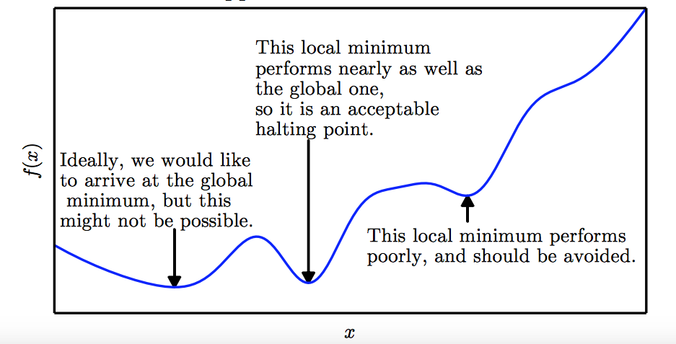
Local Minima
Goodfellow et al. (2016)

Slide 10
Local Minima
Old view: local minima is major problem in neural network training
Recent view:
For sufficiently large neural networks, most local minima incur low cost
Not important to find true global minimum

Slide 11
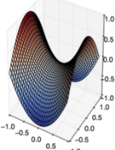
Saddle Points
Both local min and max
Recent studies indicate that in high dim, saddle points are more likely than local min
Gradient can be very small near saddle points
Goodfellow et al. (2016)

Slide 12
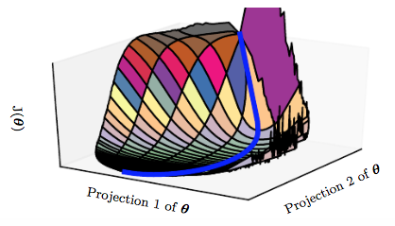
Saddle Points
SGD is seen to escape saddle points
Moves down-hill, uses noisy gradients
Second-order methods get stuck
solves for a point with zero gradient
Goodfellow et al. (2016)

Slide 13
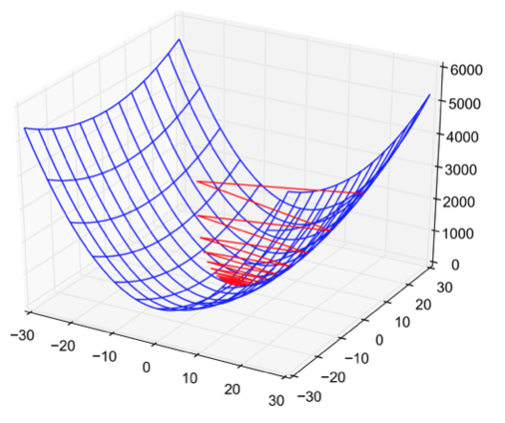
Poor Conditioning
Poorly conditioned Hessian matrix
High curvature: small steps leads to huge increase
Learning is slow despite strong gradients
Oscillations slow down progress

Slide 14
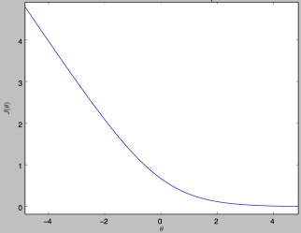
No Critical Points
Some cost functions do not have critical points. In particular classification.

Slide 15
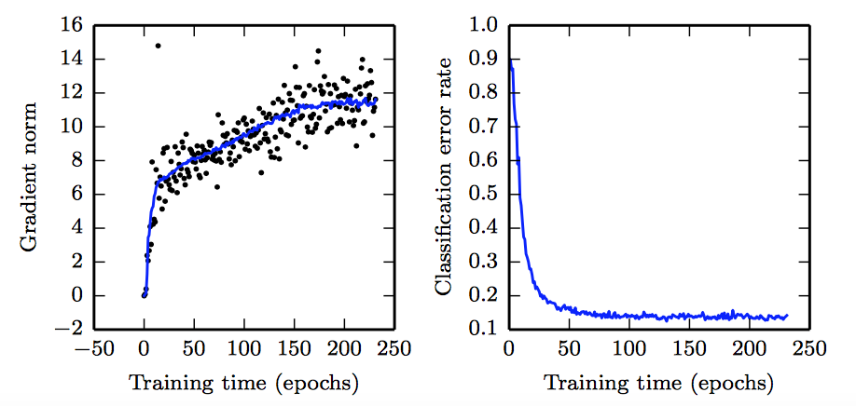
No Critical Points
Gradient norm increases, but validation error decreases
Convolution Nets for Object Detection
Goodfellow et al. (2016)

Slide 16
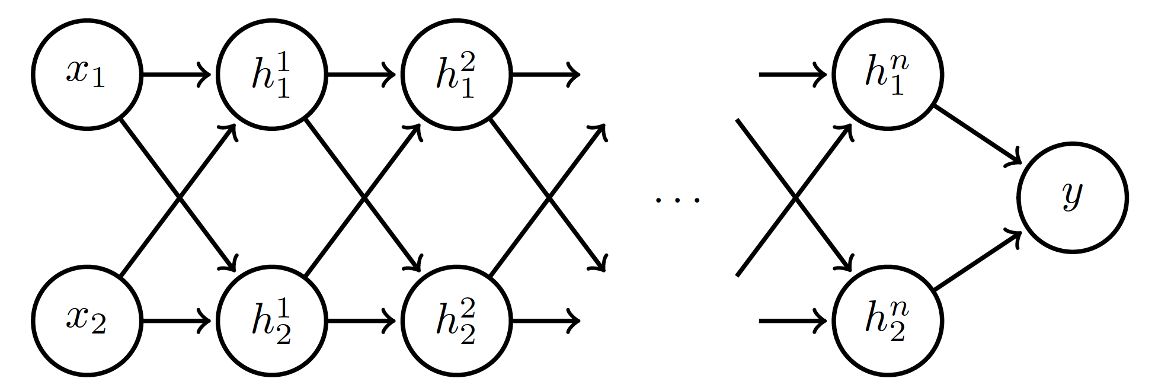
Exploding and Vanishing Gradients
Linear activation
deeplearning.ai

Slide 17
Exploding and Vanishing Gradients

Slide 18
Exploding and Vanishing Gradients
Explodes!
Vanishes!

Slide 19
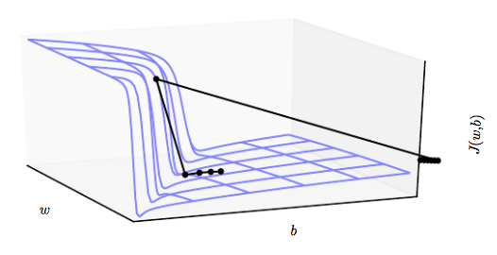
Exploding and Vanishing Gradients
Exploding gradients lead to cliffs
Can be mitigated using gradient clipping
Goodfellow et al. (2016)

Slide 20
Outline
Optimization
Challenges in Optimization
Momentum
Adaptive Learning Rate
Parameter Initialization
Batch Normalization

Slide 21
Momentum
SGD is slow when there is high curvature
Average gradient presents faster path to opt:
vertical components cancel out
Notes:
https://distill.pub/2017/momentum/

Slide 22
Momentum
Uses past gradients for update
Maintains a new quantity: ‘velocity’
Exponentially decaying average of gradients:
Current gradient update
controls how quickly effect of past gradients decay

Slide 23
Momentum
Compute gradient estimate:
Update velocity:
Update parameters:

Slide 24
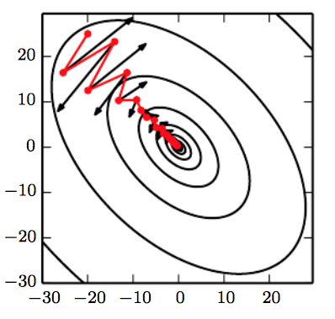
Momentum
Damped oscillations:
gradients in opposite directions get cancelled out
Goodfellow et al. (2016)

Slide 25
Nesterov Momentum
Apply an interim update:
Perform a correction based on gradient at the interim point:
Momentum based on look-ahead slope

Slide 26
Outline
Optimization
Challenges in Optimization
Momentum
Adaptive Learning Rate
Parameter Initialization
Batch Normalization

Slide 27
Adaptive Learning Rates
Slow
Fast
Oscillations along vertical direction
Learning must be slower along parameter 2
Use a different learning rate for each parameter?

Slide 28
AdaGrad
Accumulate squared gradients:
Update each parameter:
Greater progress along gently sloped directions
Inversely proportional to cumulative squared gradient

Slide 29
RMSProp
For non-convex problems, AdaGrad can prematurely decrease learning rate
Use exponentially weighted average for gradient accumulation

Slide 30
Adam
RMSProp + Momentum
Estimate first moment:
Estimate second moment:
Update parameters:
Also applies bias correction to v and r
Works well in practice, is fairly robust to hyper-parameters

Slide 31
Outline
Optimization
Challenges in Optimization
Momentum
Adaptive Learning Rate
Parameter Initialization
Batch Normalization

Slide 32
Parameter Initialization
Goal: break symmetry between units
so that each unit computes a different function
Initialize all weights (not biases) randomly
Gaussian or uniform distribution
Scale of initialization?
Large -> grad explosion, Small -> grad vanishing

Slide 33
Xavier Initialization
Heuristic for all outputs to have unit variance
For a fully-connected layer with m inputs:
For ReLU units, it is recommended:

Slide 34
Normalized Initialization
Fully-connected layer with m inputs, n outputs:
Heuristic trades off between initialize all layers have same activation and gradient variance
Sparse variant when m is large
Initialize k nonzero weights in each unit

Slide 35
Bias Initialization
Output unit bias
Marginal statistics of the output in the training set
Hidden unit bias
Avoid saturation at initialization
E.g. in ReLU, initialize bias to 0.1 instead of 0
Units controlling participation of other units
Set bias to allow participation at initialization

Slide 36
Outline
Challenges in Optimization
Momentum
Adaptive Learning Rate
Parameter Initialization
Batch Normalization

Slide 37
Feature Normalization
Good practice to normalize features before applying learning algorithm:
Features in same scale: mean 0 and variance 1
Speeds up learning
Feature vector
Vector of mean feature values
Vector of SD of feature values

Slide 38
Feature Normalization
Before normalization
After normalization

Slide 39
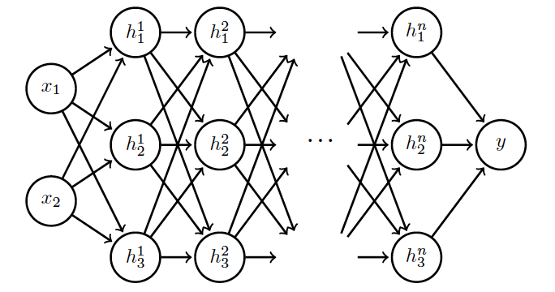
Internal Covariance Shift
Each hidden layer changes distribution of inputs to next layer: slows down learning
…
Normalize inputs to layer 2
Normalize inputs to layer n

Slide 40
Batch Normalization
Training time:
Mini-batch of activations for layer to normalize
K hidden layer activations
N data points in mini-batch

Slide 41
Batch Normalization
Training time:
Mini-batch of activations for layer to normalize
where
Vector of mean activations across mini-batch
Vector of SD of each unit across mini-batch

Slide 42
Batch Normalization
Training time:
Normalization can reduce expressive power
Instead use:
Allows network to control range of normalization
Learnable parameters

Slide 43
Batch Normalization
Batch 1
…..
Add normalization operations for layer 1
Batch N

Slide 44
Batch Normalization
Batch 1
…..
Add normalization operations for layer 2 and so on …
Batch N

Slide 45
Batch Normalization
Differentiate the joint loss for N mini-batches
Back-propagate through the norm operations
Test time:
Model needs to be evaluated on a single example
Replace μ and σ with running averages collected during training

