Slide 1
Advanced Section #2 Model Selection & Information Criteria Akaike Information Criterion
Marios Mattheakis and Pavlos Protopapas

Slide 2
Outline
Maximum Likelihood Estimation (MLE). Fit a distribution
Exponential distribution
Normal (Linear Regression Model)
Model Selection & Information Criteria
KL divergence
MLE justification through KL divergence
Model Comparison
Akaike Information Criterion (AIC)

Slide 3
Maximum Likelihood Estimation (MLE) & Parametric Models

Slide 4
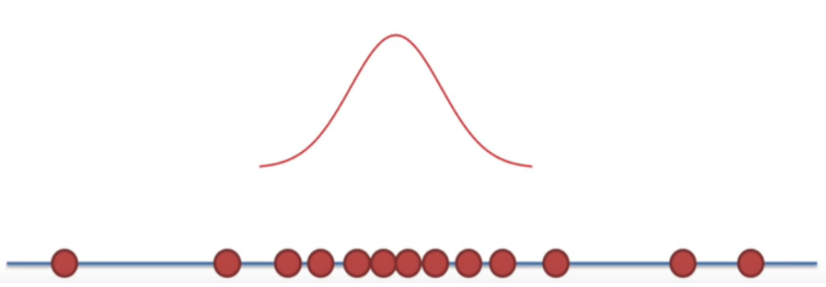
Maximum Likelihood Estimation (MLE)
Fit your data with a parametric distribution q(y|θ).
θ=(θ₁, … , θ_{k}) is a parameter set to be estimated.
y

Slide 5
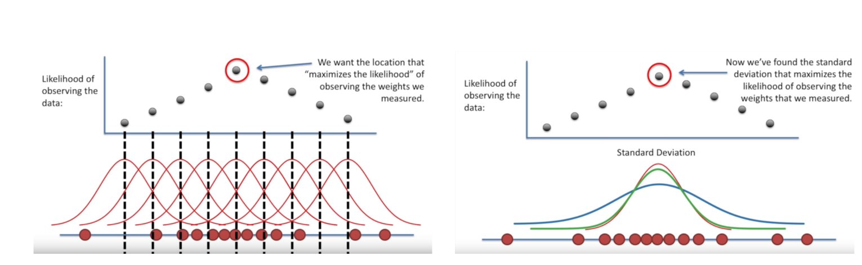
Maximize the Likelihood L
Scanning over all the parameters until find the maximum L
...but this is a too time-consuming approach.

Slide 6
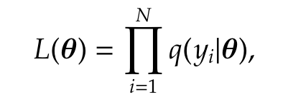
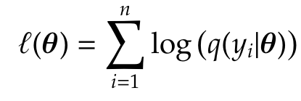
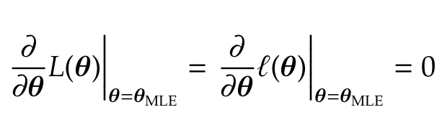
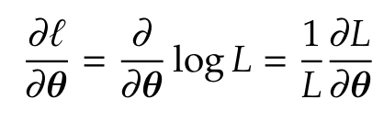
Maximum Likelihood Estimation (MLE)
A formal and efficient method is given by MLE
Observations: y=(y₁, …, y_{n})
Easier and numerically more stable to work with log-likelihood
So,

Slide 7
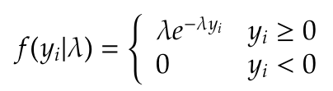
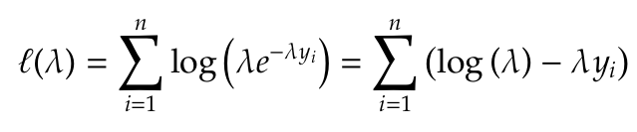
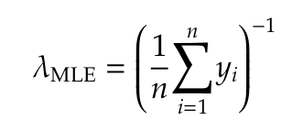
Exponential distribution: A simple and useful example
A one parameter distribution: rate parameter λ

Slide 8
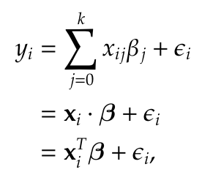
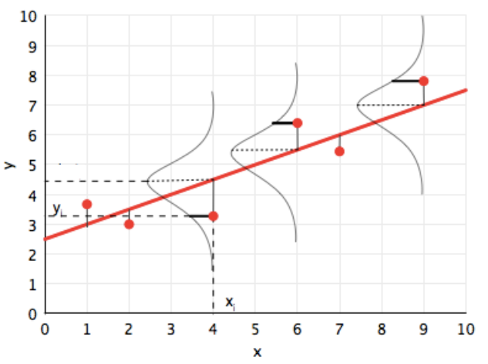
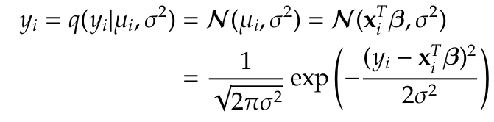
Linear Regression Model with gaussian error

Slide 9
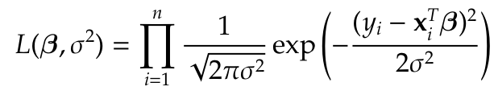
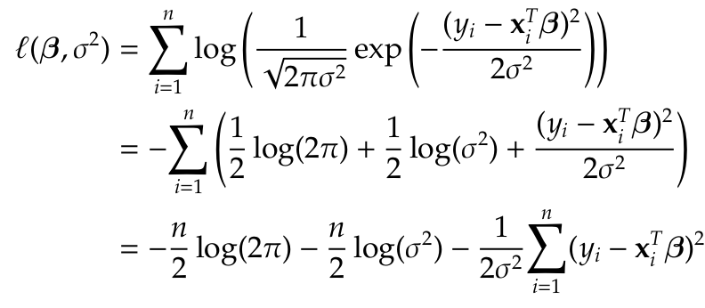
Linear Regression Model through MLE
Loss Function

Slide 10
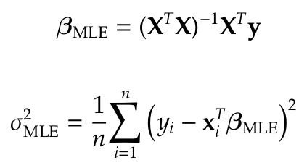
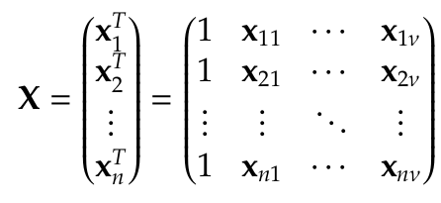

Linear Regression Model: Standard Formulas
Minimize the loss essentially maximize the likelihood, and we get

Slide 11
Model Selection & Information Theory: Akaike Information Criterion

Slide 12
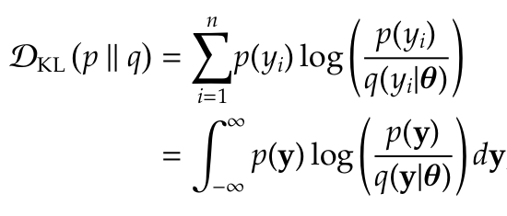
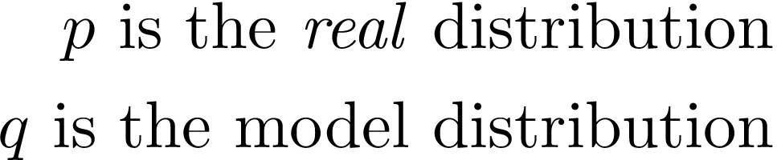
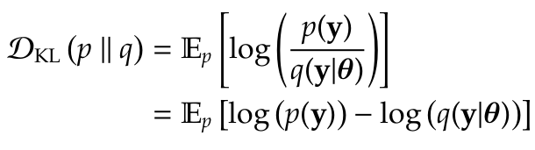
Kullback-Leibler (KL) divergence (or relative entropy)
How good do we fit the data?
What additional uncertainty have we introduced?

Slide 13

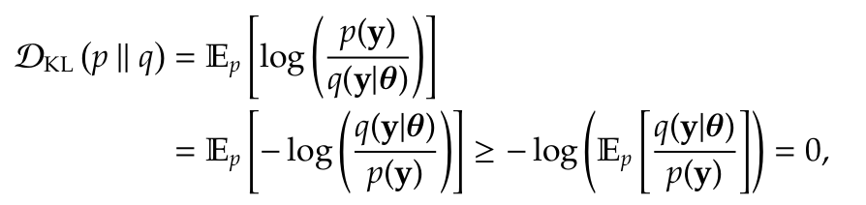

KL divergence
The KL divergence shows the “distance” between two distributions, hence it is a non-negative quantity.
With Jensen’s inequality for convex functions f(y):
KL divergence is a non-symmetric quantity

Slide 14
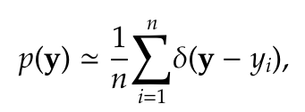
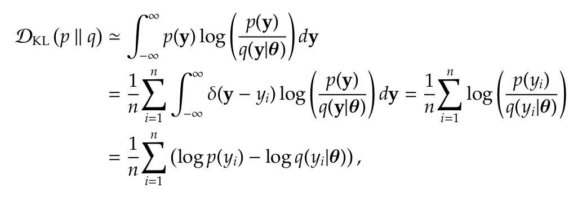
MLE justification through KL divergence
Empirical distribution
Minimize KL divergence is the same with maximize likelihood
log-likelihood

Slide 15

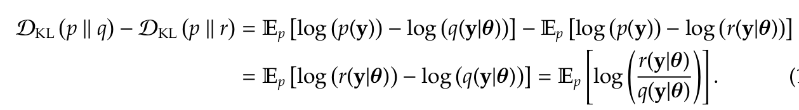
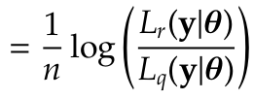

Model Comparison
Consider to model distributions
By using the empirical distribution:
p is eliminated.

Slide 16

Akaike Information Criterion (AIC)
AIC is a trade off between the number of parameters k and the error that is introduced (overfitting).
AIC is an asymptotic approximation of the KL-divergence
The data are being used twice: first for MLE and second for the KL-divergence estimation.
AIC estimates which is the optimal number of parameters k

Slide 17
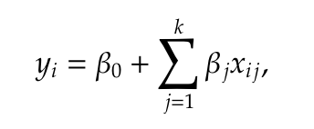
Polynomial Regression Model Example
Suppose a polynomial regression model
Which is the optimal k?
For k smaller than the optimal: Underfitting
For k larger than the optimal: Overfitting

Slide 18
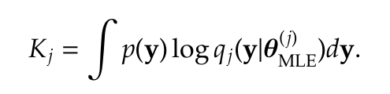
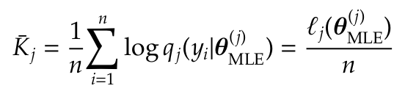
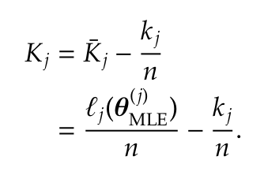
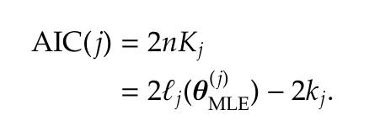
Minimizing real and empirical KL-divergence
Suppose many models indicated by index j Work with the j-th model which has k_{j} parameters

Slide 19
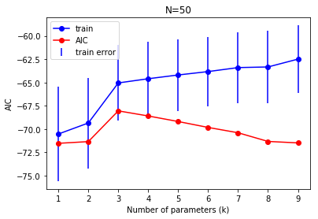
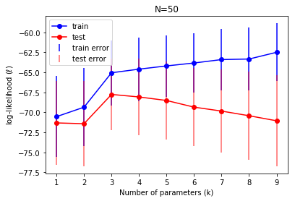
Numerical verification of AIC

Slide 20
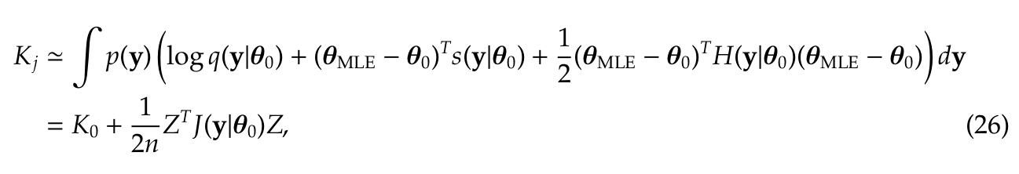
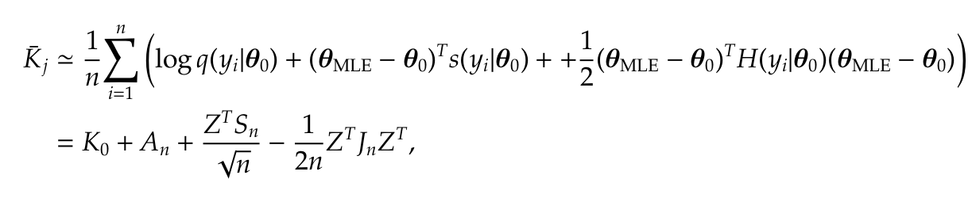
Akaike Information Criterion (AIC): Proof
Asymptotic Expansion around true ideal MLE θ₀

Slide 21


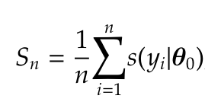
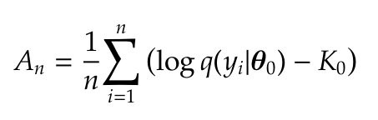
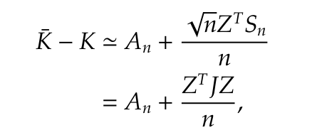
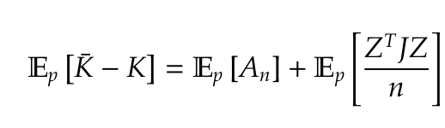
Akaike Information Criterion (AIC): Proof

Slide 22
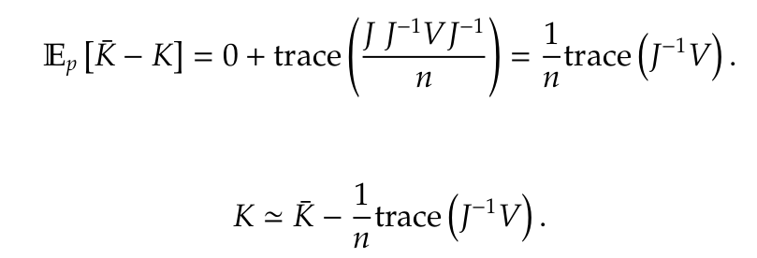

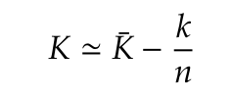
Akaike Information Criterion (AIC): Proof
In the limit of a correct model:

Slide 23
Review
Maximum Likelihood Estimation (MLE)
A powerful method to estimate the ideal fitting parameters of a model.
Exponential distribution, a simple but useful example.
Linear Regression Model as a special paradigm of MLE implementation.
Model Selection & Information Criteria
KL-divergence quantifies the “distance” between the fitting model and the “real” distribution.
KL-divergence justifies the MLE and is used for model comparison.
AIC: Estimates the number of model parameters and protects from overfitting.

Slide 24
Advanced Section 2: Model Selection & Information Criteria
Thank you
Office hours are:
Monday 6-7:30 (Marios)
Tuesday 6:30-8 (Trevor)

