Slide 1
Advanced Section #5: Generalized Linear Models: Logistic Regression and Beyond
Marios Mattheakis and Pavlos Protopapas

Slide 2
Outline
Generalized Linear Models (GLMs):
Motivation.
Linear Regression Model (Recap): jumping-off point
Generalize the Linear Model:
Generalization of random component (Error Distribution).
Generalization of systematic component (Link Function).
Maximum Likelihood Estimation in this General Framework:
Canonical Links.
General Links.

Slide 3
Motivation
Ordinary Linear Regression (OLS) is a great model … but cannot describe all the situations.
OLS assumes:
Normal distributed observations.
Expectation that linearly depends on predictors.
Many real-world observations do not follow these assumptions, e.g.:
Binary data: Bernoulli or Binomial distributions.
Positive data: Exponential or Gamma distributions.

Slide 4
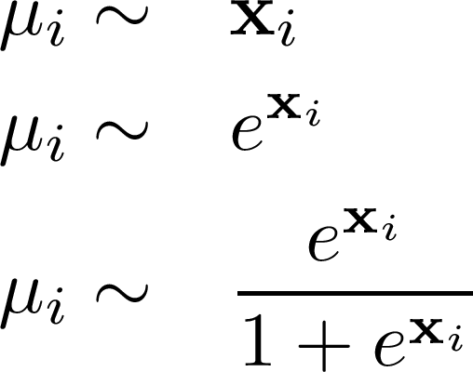

GLMs formulations: Overview
Error distribution:
Normal
Poisson
Bernoulli
...more
Exponential Family Distributions
Generalized Linear Models
Regression Model
Link Function
...more

Slide 5






Regression Models
Suppose a dataset with n training points
In a Regression model we are looking for:
is some fixed but unknown function.
a random error term.

Slide 6
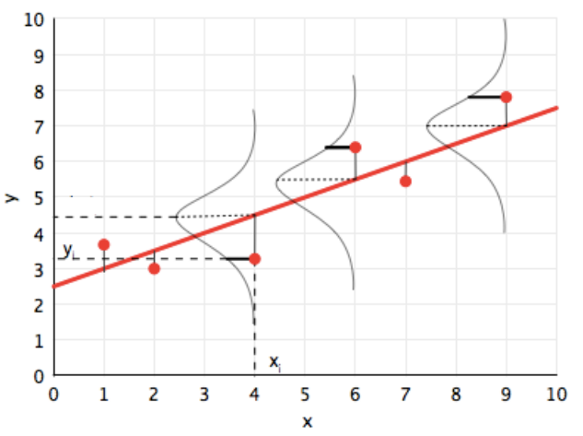

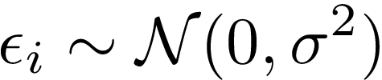
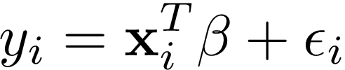
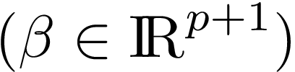
Linear Regression Model
The observations are independently distributed about: A linear predictor
with a Normal distribution.
Linear Model:

Slide 7
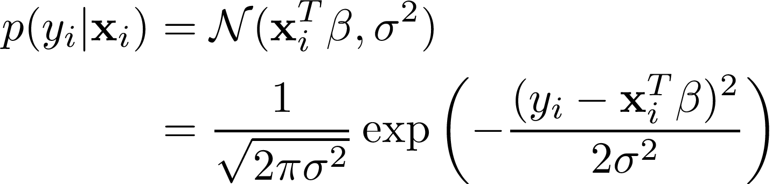
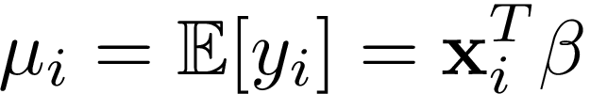
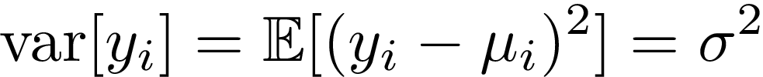
Linear Regression Model
The conditional on the predictor distribution:

Slide 8
GLMs formulation

Slide 9
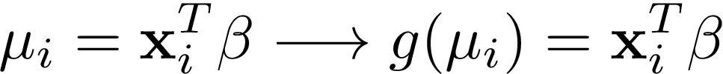
GLMs formulation
This will be a two-step generalization of simple linear regression.
Random Component:
Systematic Component:

Slide 10
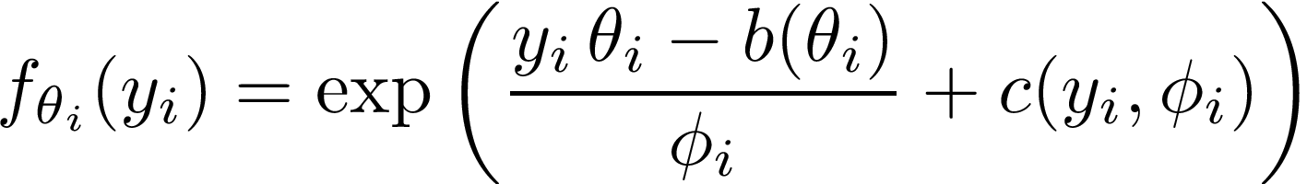




Exponential Family of Distributions
A wide range of distributions that includes a special cases the Normal,
exponential, Gamma, Poisson, Bernoulli, binomial, and many others.
: canonical parameter and is the parameter of interest.
: dispersion parameter and is a scale parameter relative to variance.
: cumulant function and completely characterizes the distribution.
: normalization factor.
Notes:
The parameters vary by the observation

Slide 11
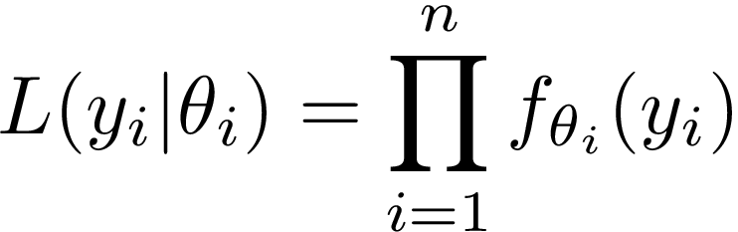
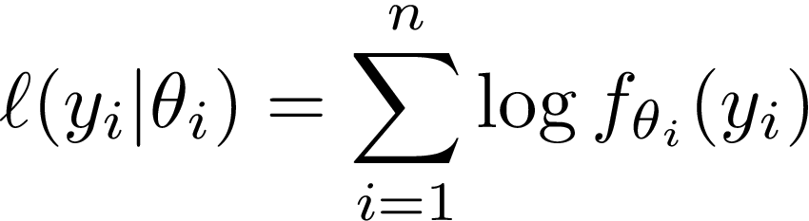
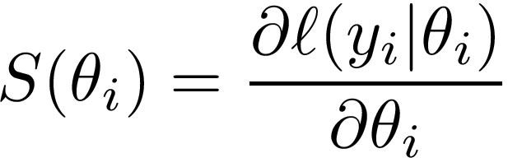
Likelihood and Score function
Likelihood:
log-likelihood:
easier and numerically more stable
Score function:

Slide 12
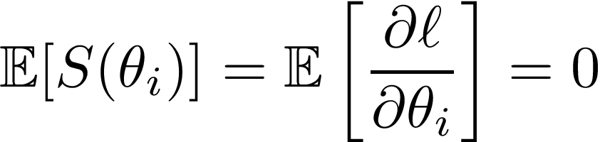
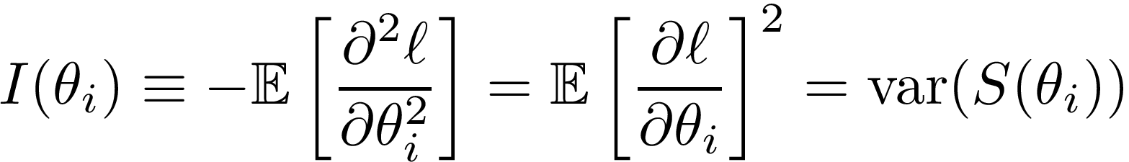


Two General Identities
is the called Fisher information matrix.
denotes the ν moment.

Slide 13
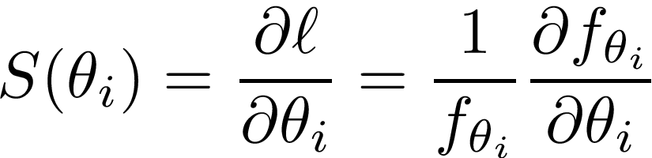
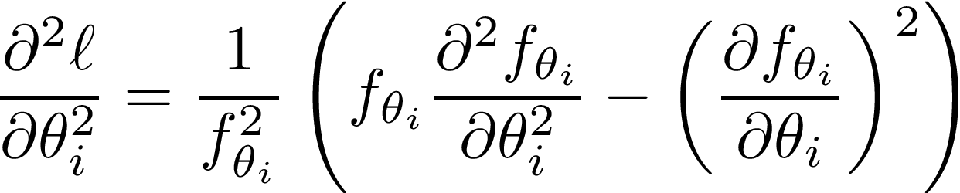
Some derivatives before the proofs
First derivative of log-likelihood:
Second derivative of log-likelihood:

Slide 14
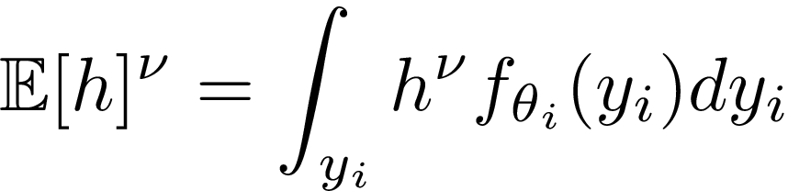
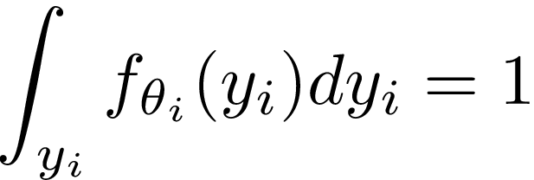
Some useful relations before the proofs
The ν moment of an arbitrary function:
Since the observations are assumed independent of each other:
For a well defined probability density:

Slide 15
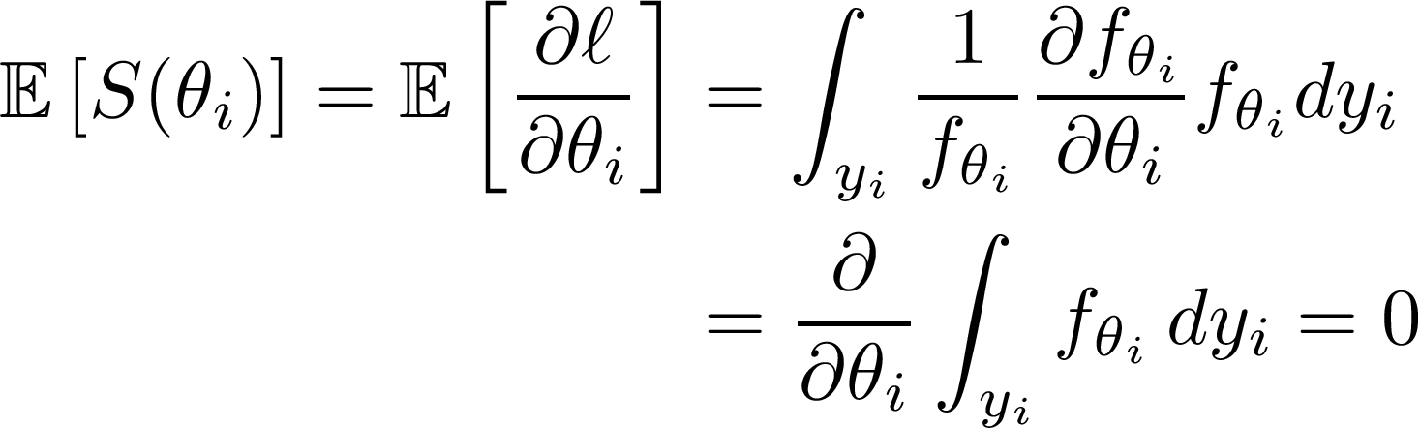
Proof of Identity I
Proof:
the regularity condition takes the derivative out of the integral.

Slide 16
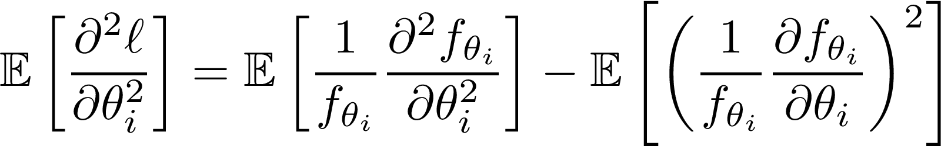
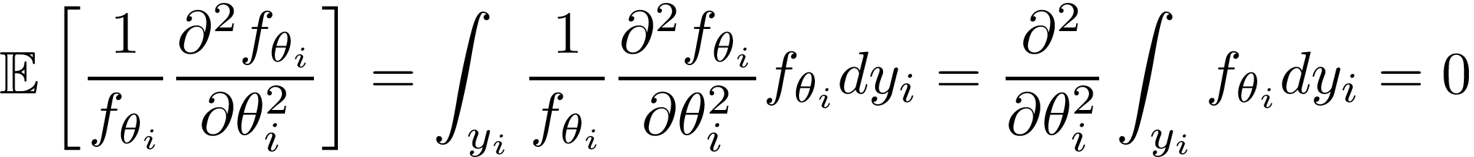
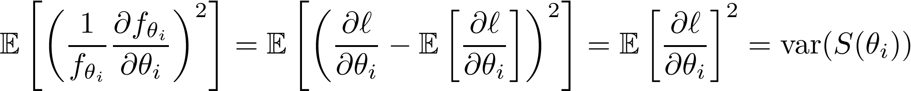

Proof of Identity II
Proof
1st term:
2nd term:

Slide 17

Mean & Variance Formulas in the Exponential Family
where primes denote derivatives w.r.t. canonical parameter
is the cumulant function of the distribution, since it completely determines the first two moments.

Slide 18
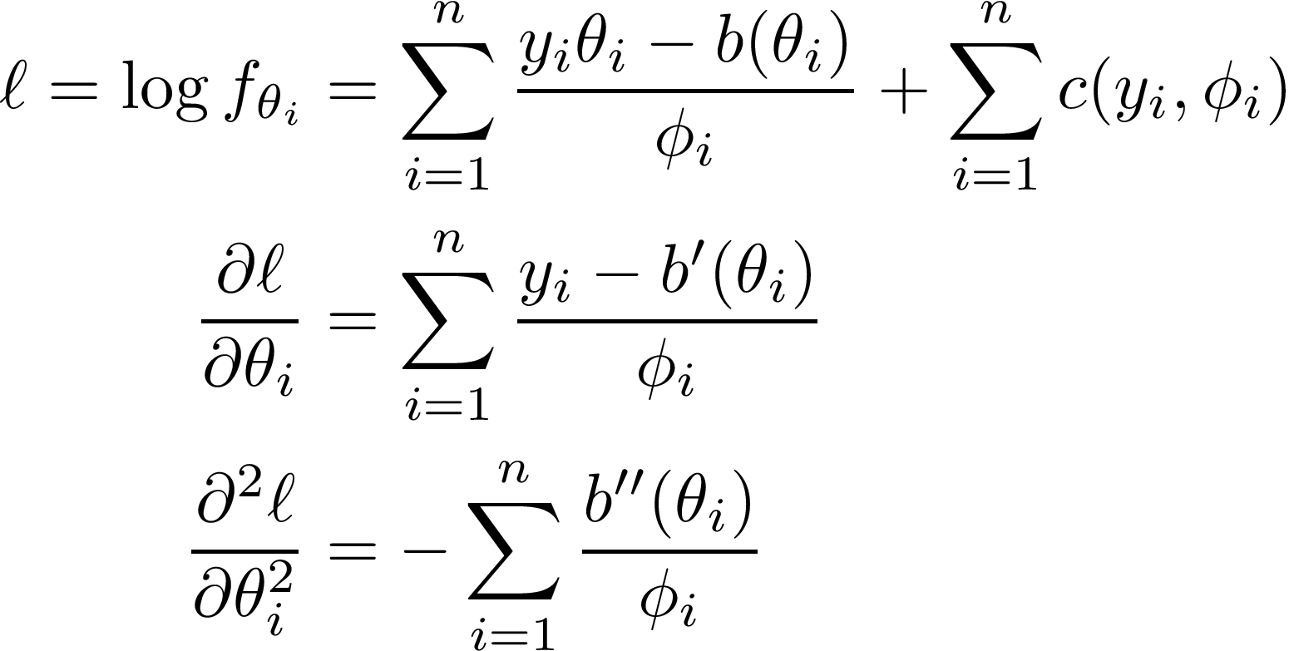
Some derivatives before the proofs

Slide 19
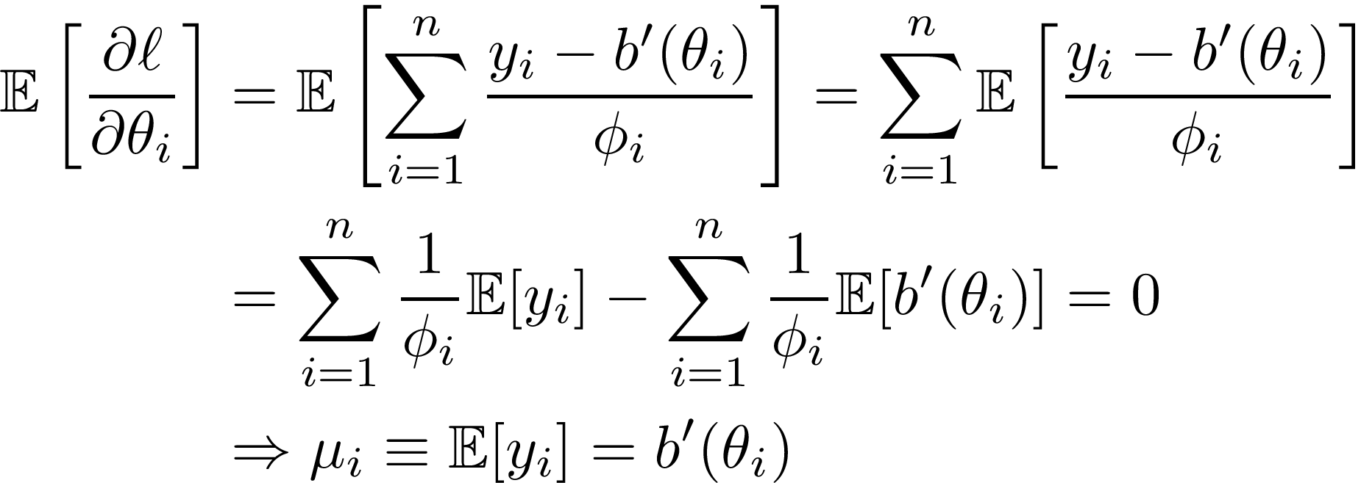
Proof of mean formula
Proof

Slide 20
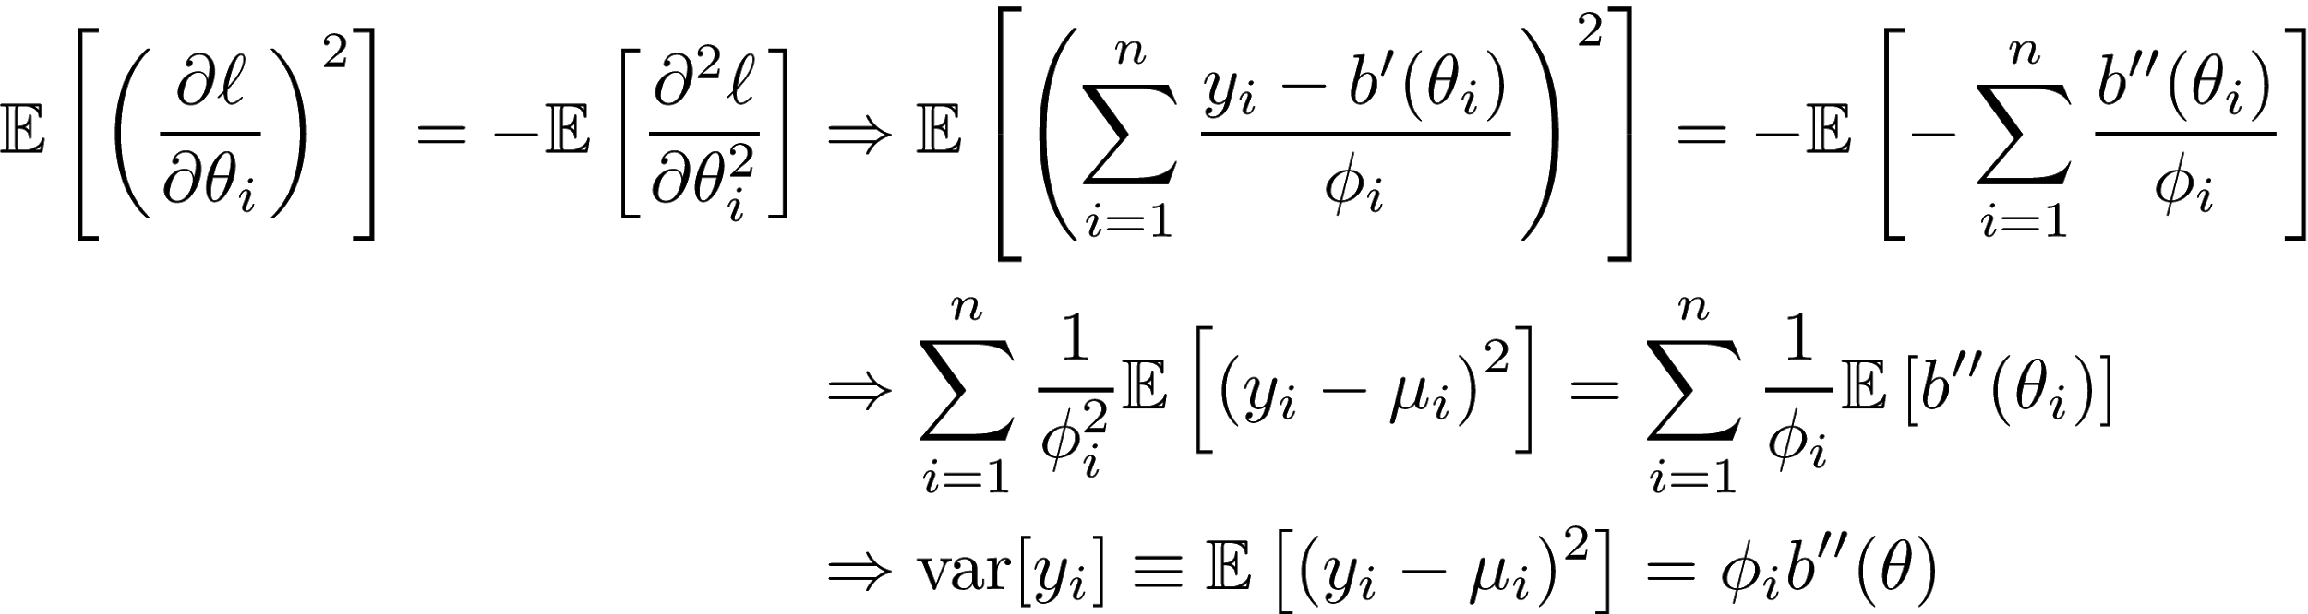
Proof of Variance formula
Proof

Slide 21
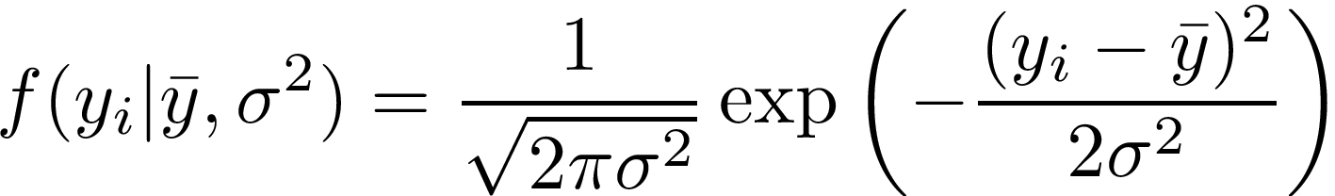
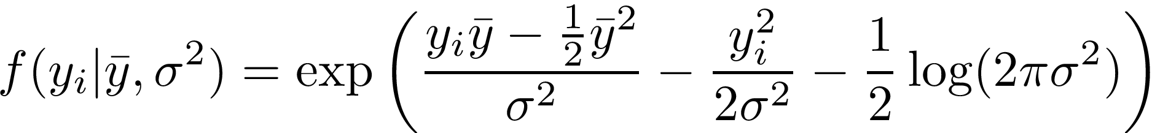

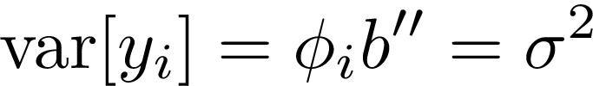
Normal Distribution: Example
Probability density in Normal distribution:
Notes:
identity link

Slide 22
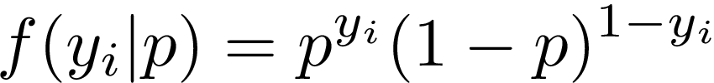
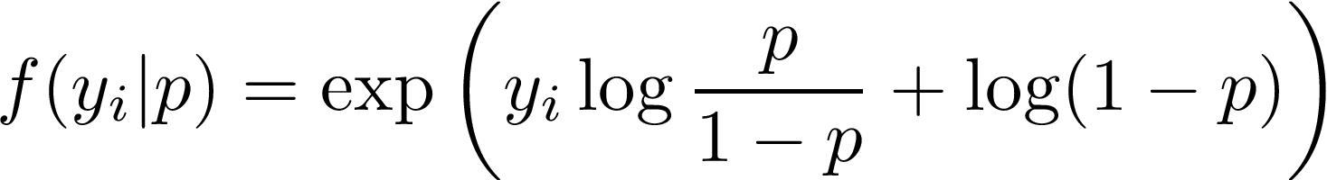
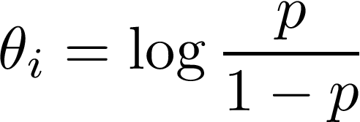
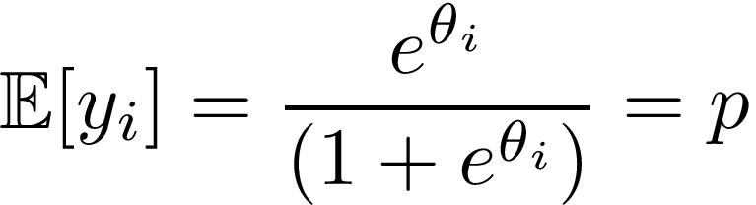
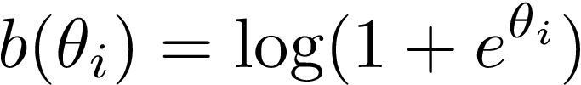
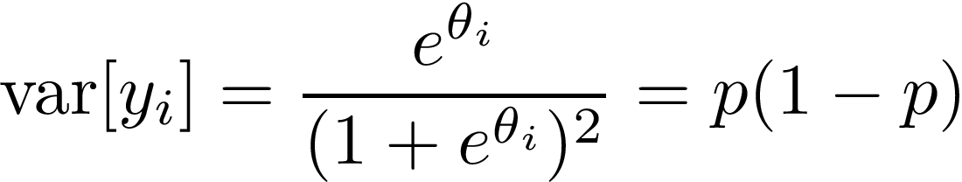
Bernoulli distribution: Example
It is a discrete probability distribution of a random binary variable:

Slide 23
Second step of GLMs formulation: Link Function
Systematic Component:

Slide 24

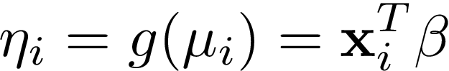

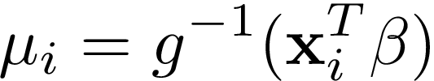


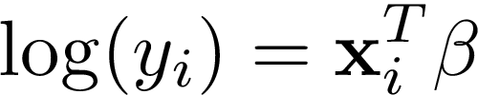

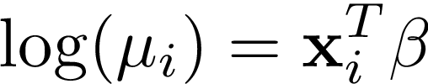
Link Function
A link function is a one-to-one differentiable transformation that transforms the expectation values to be linear with the predictors
is called linear predictor.
One-to-one function, so we can invert to get
The link transforms the expectation NOT the observations. For instance, for the link

Slide 25

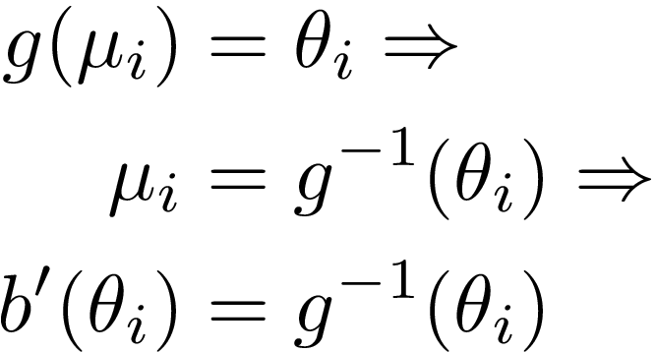
Canonical Links
A Canonical Link makes the linear predictor equal to the canonical parameter
A Canonical Transformation is relative to the cumulant function
So, the cumulant function must be invertible

Slide 26

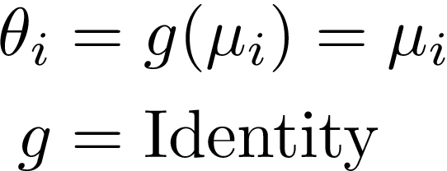
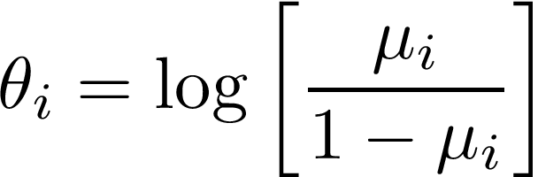
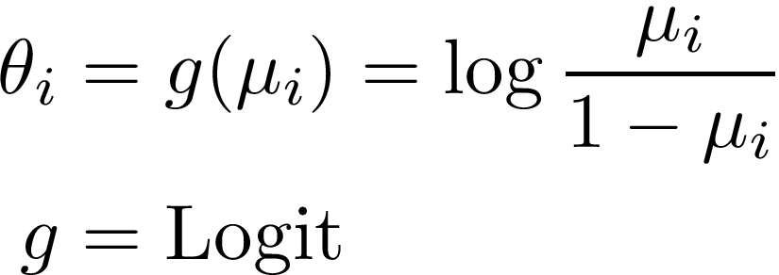
Normal and Bernoulli distributions: Examples
Normal Distribution:
We found earlier:
Hence,
Bernoulli Distribution:
We found earlier:
Hence,

Slide 27
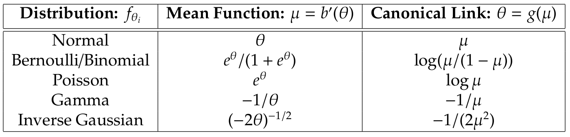
Data Distribution and Canonical Links

Slide 28
GLMs: A general framework
We found that linear, logistic and other regression models are special cases of the GMLs.
Working in such a general framework is a great advantage. There is general theory that can be applied afterwards in any specific distribution and regression model.
For instance, we have the general Likelihood and we can derive to general equations that Maximize the Likelihood.

Slide 29
Maximum Likelihood Estimation (MLE)

Slide 30
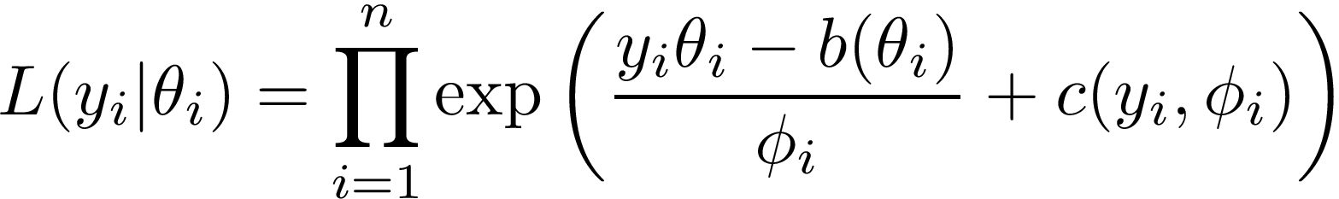
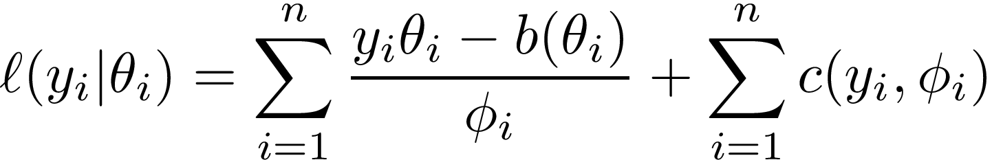
Maximum Likelihood Estimation (MLE)
Likelihood in the Exponential Family:
Log-likelihood in the Exponential Family:

Slide 31
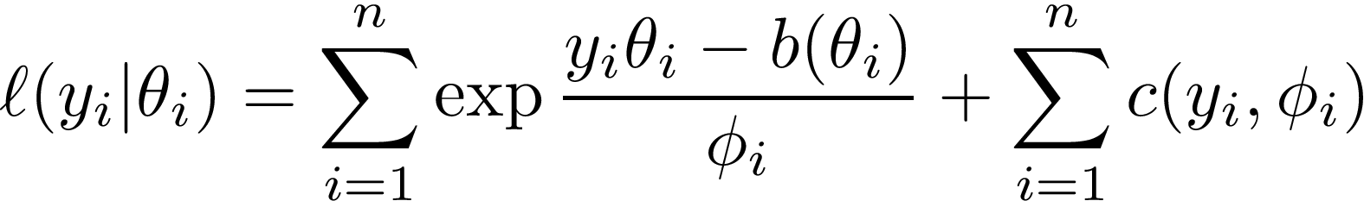
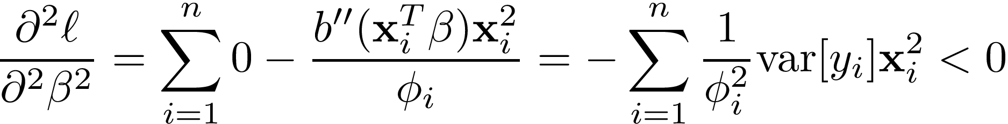
log-likelihood is a strictly concave function
hence, it can be maximized.

Slide 32
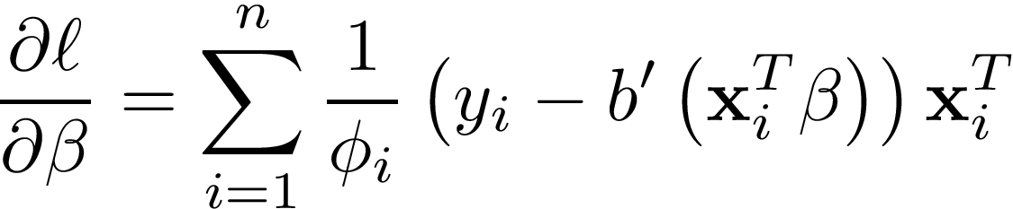
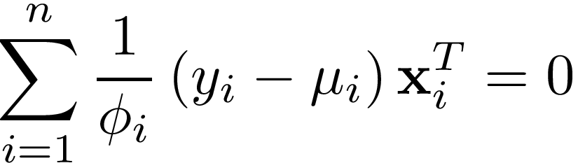

MLE for Canonical Links
Normal Equations for MLE
Solving Normal Equations we estimate the coefficients

Slide 33




MLE Examples
Normal Distribution: Link = Identity
Bernoulli Distribution: Link = Logit

Slide 34


MLE for General Links
Sometimes we may use non-Canonical links. For instance, for algorithmic purposes such in the Bayesian probit regression.
Generalizing Estimating Equations:

Slide 35
Summary
Generalized Linear Models:
Motivation: OLS cannot describe everything. Good jumping-off.
Formulation:
Generalization of Random Component (error distribution).
Generalization of Systematic Component (Link function).
Normal & Bernoulli distributions: Examples.
Maximum Likelihood Estimation (MLE)
General Framework: One theory for many regression models.
Normal Equations for MLE (Canonical Links).
Linear & Logistic Regression examples.
Generalized Estimating Equations (General Links).

Slide 36
Advanced Section 5: Generalized Linear Models
Questions ??
Office hours for Adv. Sec.
Monday 6:00-7:30 pm
Tuesday 6:30-8:00 pm

Slide 37



General Equations: Proof
Using the chain rule:
hence

