Slide 1
雲端運算
105年第二學期期中報告
0524817 陳以浩

Slide 2
分類法：Passive Aggressive Classifier
簡介
PAC函式
程式流程說明
F1 value and confusion matrix

Slide 3
簡介
Passive Aggressive Classifier
中文翻譯：被動進取分類法
精要(引用網友說法)：Passive: if correct classification, keep the model; Aggressive: if incorrect classification, update to adjust to this misclassified example.
In my mind, in passive, the information hidden in the example is not enough for updating; in aggressive, the information shows that at lest this time you are wrong, a better model should modify this mistake. (https://www.quora.com/Classification-machine-learning-What-is-an-intuitive-explanation-of-the-Passive-Aggressive-classifier)

Slide 4
PAC函式
from sklearn.linear_model import PassiveAggressiveClassifier
classifier = PassiveAggressiveClassifier(random_state=None)
classifier.fit(train,t_train)
classifier.score(test,t_test) the mean accuracy
classifier.predict(test) 和t_test搭配組成confusion matrix
(http://scikit-learn.org/stable/modules/generated/sklearn.linear_model.PassiveAggressiveClassifier.html#sklearn.linear_model.PassiveAggressiveClassifier)
Iris的前4個欄位
第5個欄位
(recall的平均值)

Slide 5
程式流程說明
線上下載iris.csv(py2、py3函式庫及語法有差異) ※
讀入iris資料(分組，第2組花名重新編碼)※
呼叫PAC函式
資料訓練與驗證(test_size=0.4)
列印confusion_matrix、classification_report
※下載及讀入iris更簡潔的方式，不用手動分組：
from sklearn import datasets
iris = datasets.load_iris()
X = iris.data
y = iris.target
(http://scikit-learn.org/stable/datasets/index.html#toy-datasets)

Slide 6
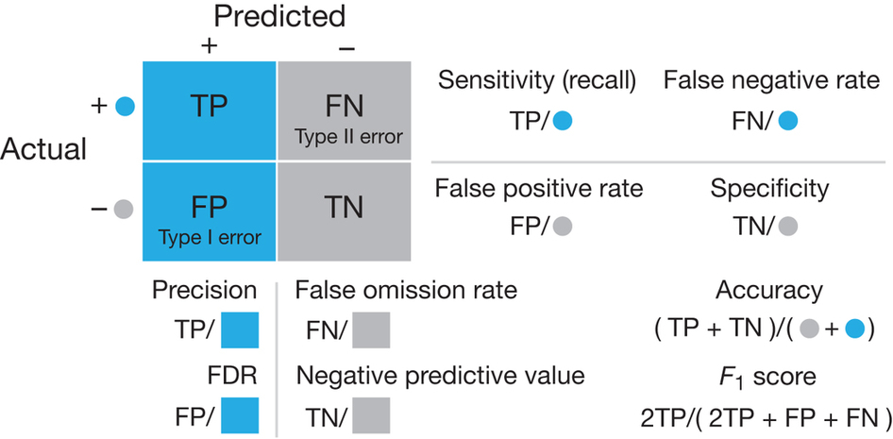
F1 value and confusion matrix (1)

Slide 7
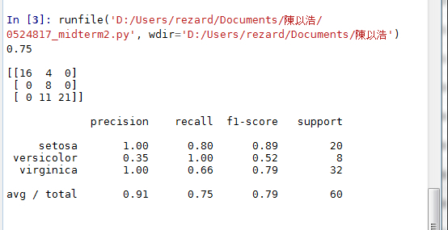
F1 value and confusion matrix (2)
16 | 4 | 0
0 | 8 | 0
0 | 11 | 21

Slide 8
F1 value and confusion matrix (3)
setosa
16 | 4
0 | 0
TP
FN
FP
TN
precision：TP/(TP+FP)=16/(16+0)=1.00
recall：TP/(TP+FN)=16/(16+4)=0.80
F1：2TP/(2TP+FP+FN)=32/(32+0+4)=0.89

Slide 9
F1 value and confusion matrix (4)
versicolor
8 | 0
4+11 | 0
TP
FN
FP
TN
precision：TP/(TP+FP)=8/(8+15)=0.35
recall：TP/(TP+FN)=8/(8+0)=1.00
F1：2TP/(2TP+FP+FN)=16/(16+15+0)=0.52

Slide 10
F1 value and confusion matrix (5)
virginica
21 | 11
0 | 0
TP
FN
FP
TN
precision：TP/(TP+FP)=21/(21+0)=1.00
recall：TP/(TP+FN)=21/(21+11)=0.66
F1：2TP/(2TP+FP+FN)=42/(42+0+11)=0.79

Slide 11
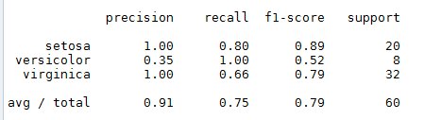
F1 value and confusion matrix (6)
precision平均值：((1.00*20)+(0.35*8)+(1.00*32))/60=0.91
recall平均值：((0.80*20)+(1.00*8)+(0.66*32))/60=0.75
F1平均值：((0.89*20)+(0.52*8)+(0.79*32))/60=0.79

