Slide 1


SEUPD@CLEF: TEAM CLOSE Temporal persistence of IR systems’ performance
Gianluca Antolini Nicola Boscolo Cegion Mirco Cazzaro
Marco Martinelli Seyedreza Safavi Farzad Shami
Search Engines a.y. 2022/2023
Master Degree in Computer Engineering

Slide 2
TABLE OF CONTENTS
01
02
03
INTRODUCTION
COLLECTION
OUR SYSTEM
Problem, task & goal, collection
Description of the provided data
Detailed information about our system: Parser, Analyzer, Searcher and Indexer
04
05
RESULTS
CONCLUSIONS
Evaluation measures and results
Conclusions and future work

Slide 3
01 INTRODUCTION
PROBLEM
TASK
GOAL
Performance of IR systems can deteriorate over time because web contents and user search preferences change.
Develop an efficient IR system and training it using Qwant training data (French & English): user searches web documents
Test and measure the system’s performance, ensuring that it doesn’t decline with data coming from different/distant timestamps

Slide 4
02 COLLECTION
Data Source: Qwant (search engine) search logs
Queries: Filtered for spam and low document count
Documents: Relevant documents extracted from SERPs, non-relevant documents randomly sampled from Qwant index
Relevance Estimates: Obtained through user implicit feedback using a click model

Slide 5
COLLECTION
Training Data: 672 queries with 9,656 assessments
Heldout Data: 98 queries with 1,420 assessments
Document Corpus: 1,570,734 web pages
Relevance Distribution: 73% non-relevant, 21% relevant, 6% highly relevant
Test Collections:
Short-term Persistence Sub-task: 1,593,376 documents, 882 queries
Long-term Persistence Sub-task: 1,081,334 documents, 923 queries

Slide 6
03 OUR SYSTEM
Analyzer
Searcher
Analyzing parsed documents using techniques such as tokenization, stemming, …
Searching through indexed documents, retrieving and ranking them based on relevance
Indexer
Parser
Indexing documents keeping necessary fields (id, body, preparing them for the search phase
Pre-processing the documents by cleaning them and removing noise

Slide 7
PARSER
Custom ClefParser class implemented to remove various types of noises present in the documents.
Trial and error workflow/methodology (considering improvements in MAP):
Examination of large statistical sample size of collection documents in the collection to decide types of noises to be removed.
Implementation and run of the parser.
Results stored and sample of parsed documents analyzed to restart the procedure.
Final Parsed Document structure:
id : document identifier
body : parsed content of document

Slide 8
PARSER
Types of noises identified and removed:
JavaScript scripts
HTTP and HTTPS URIs
HTML tags and CSS stylesheets
XML and JSON codes
Meta tags and document properties
Navigation menus
Advertisements
Footers
Social media handlers
Hashtags and mentions
Word patterns (e.g. word1_word2 or word11.word2 or word1:word2)

Slide 9

GSON
Integration of Gson Library to parse a JSON file containing documents.
Advantages:
Efficient parsing of JSON files.
Seamless conversion of JSON data into Java objects.
Effortless manipulation and integration of the query expansions into the application.
This ensured an overall increase in the system’s performance

Slide 10
ANALYZER
Fully customizable class to analyze documents using different approaches.
Based on experiment results with different parameters and by trying both English and French dataset, the following are the parameters used to get the best results:
• French dataset • Minimum token length: 2
• FrenchLightStemFilter • Maximum token length: 15
• StandardTokenizer
• LowerCaseFilter
• French word stoplist (662 French words): built upon popular French stoplist and most frequent stopwords in the collection.

Slide 11
INDEXER
Invokes Parser and Analyzer, processes the documents with both, and then indexes them as a ParsedTextDocument objects (defined in the Parser).
It takes the following inputs:
• Analyzer • DocsPath • DpCls
• Similarity • Extension
• RamBufferSizeMB • CharsetName
• IndexPath • ExpectedDocs

Slide 12
SEARCHER
Query Expansion
Query Boosting
Document Re-Ranking
Retrieve relevant information by analyzing user queries and searching through indexed documents, returning a ranked list of matching documents.

Slide 13

QUERY EXPANSION
During the search function, Query Expansion performed by generating new queries from the original ones.
Python script that utilizes OpenAI's Text Completion Endpoints to generate expanded terms for each query.
Expansions stored in a .json file called "result."
We used the DaVinci model with a temperature parameter of 0.6 for optimal results.

Slide 14
QUERY BOOSTING
To assign higher relevance to specific query terms or queries.
Our approach consists of constructing BooleanQueries in the search function:
• Each query has query expansions added with SHOULD clause.
• A main query with the MUST clause.
• Main query boosted using Lucene's BoostQuery with tuned boost value * number of expansions.
• Boost value fine-tuned to 14.68 through a trial and error for parameter optimization.

Slide 15

DOCUMENT RE-RANKING
• Rank documents retrieved by the Searcher using all-MiniLM-L6-v2, a 384-dimensional Sentence Transformer model.
• Initialize Re-Ranker in the Searcher's constructor and create a predictor for inference.
• During search function, embeddings created for documents using predictor, similarity calculated between query and documents.
• Scores multiplied by document's BM25Similarity and cosine similarity.
• Tested parameter combinations and determined that multiplying document's score by BM25Similarity with cosine similarity yields the best results.

Slide 16
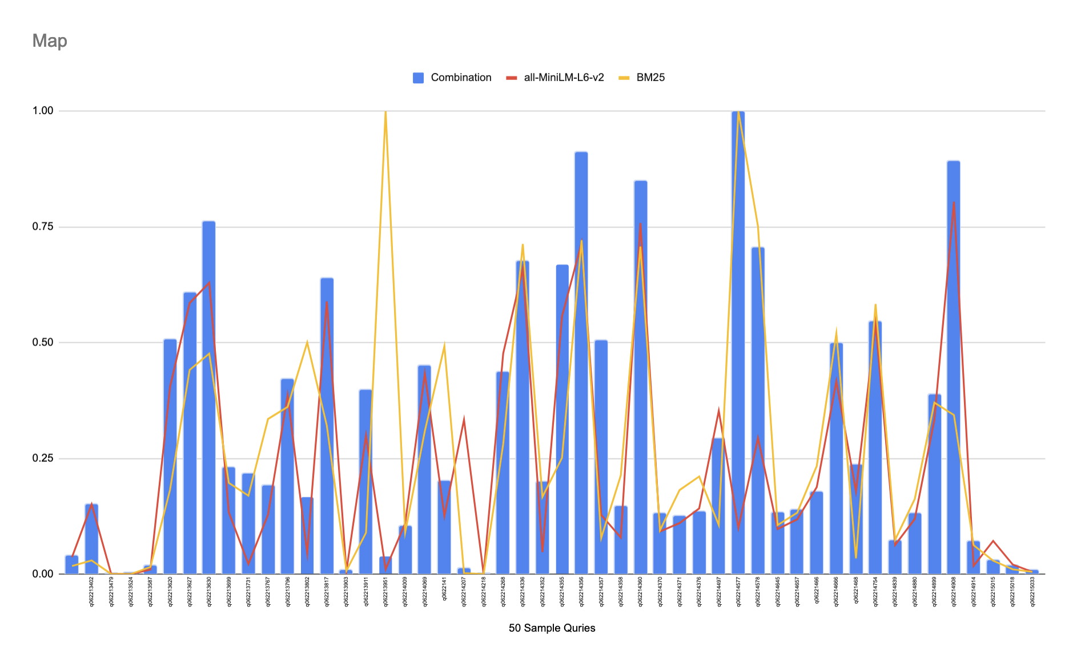
DOCUMENT RE-RANKING
Re-Ranking performed on a sample of 50 queries (MAP scores).

Slide 17
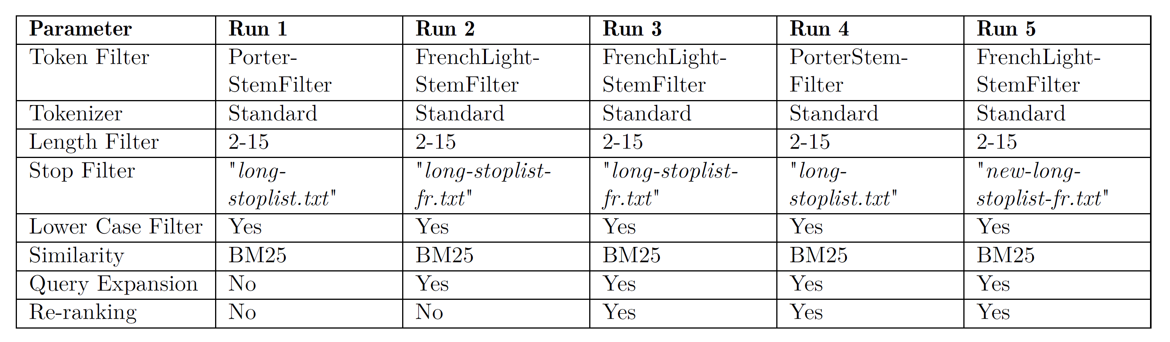
04 RESULTS
The following slides provide the results of our best performing runs, with both French and English dataset

Slide 18
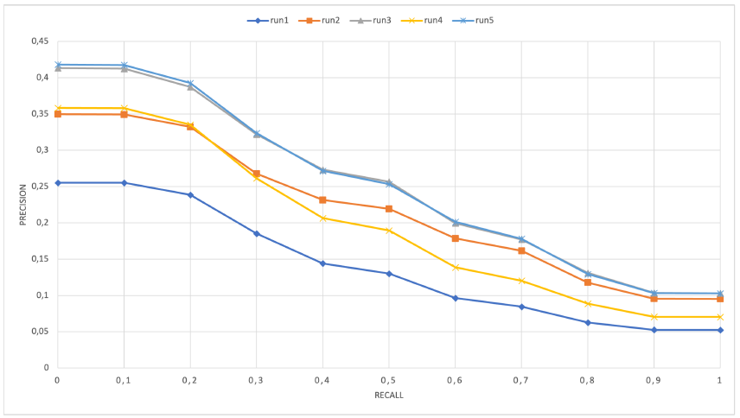
RESULTS

Slide 19
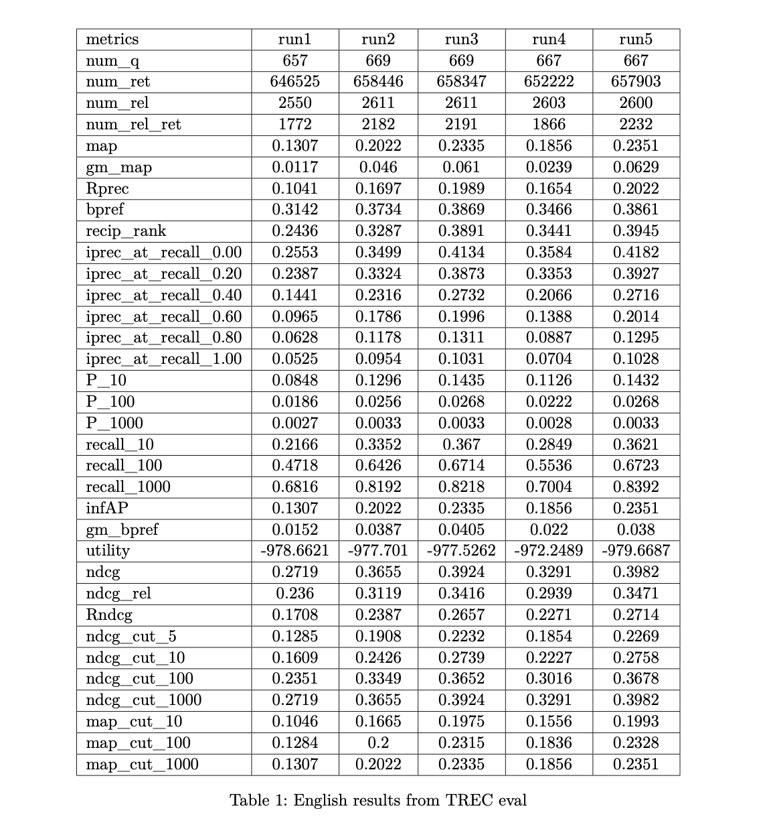
RESULTS

Slide 20
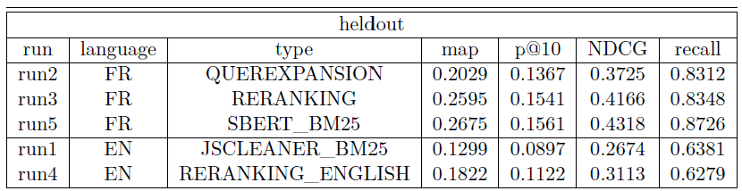
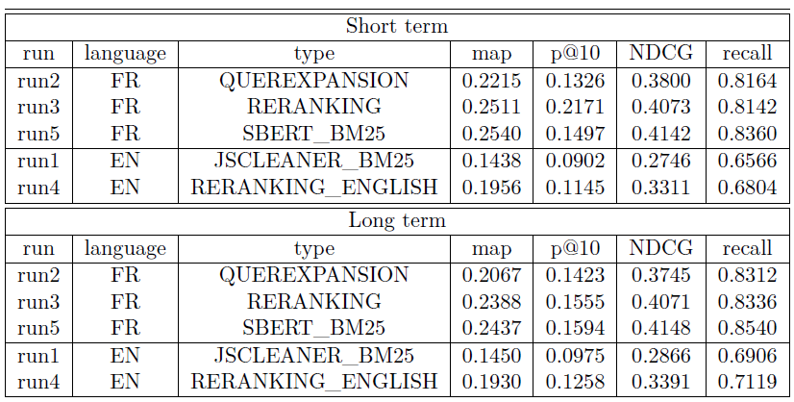
RESULTS

Slide 21
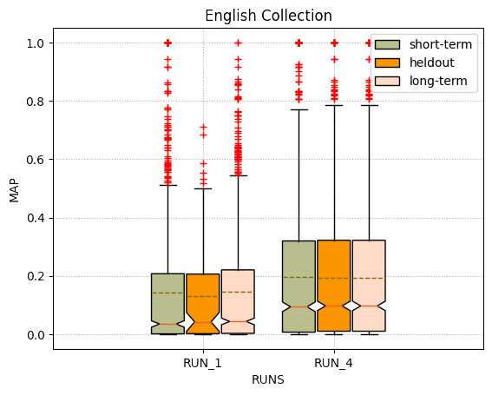
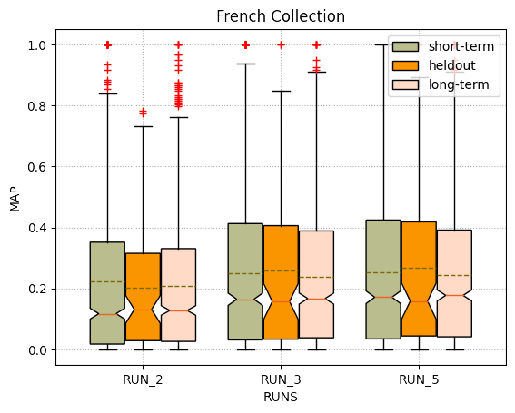
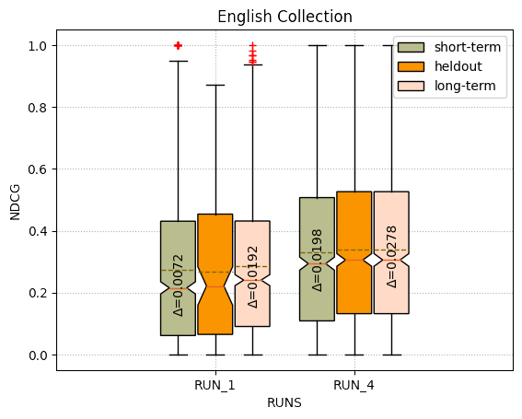
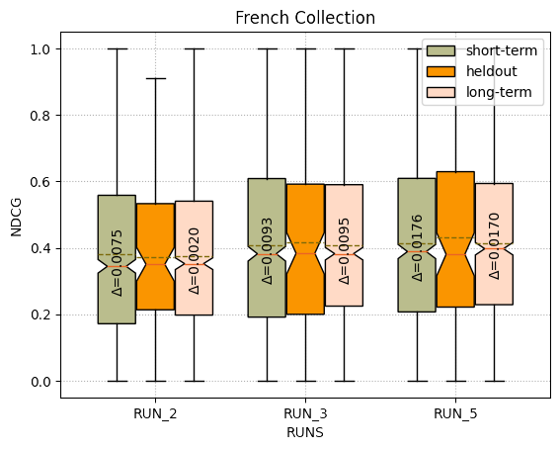
Statistical Analysis

Slide 22
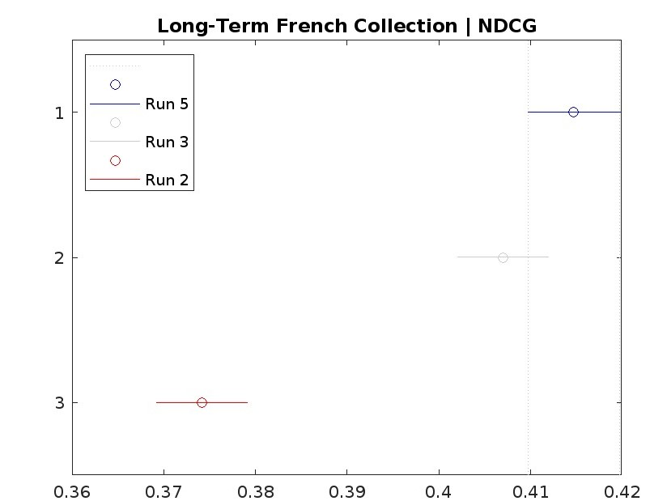
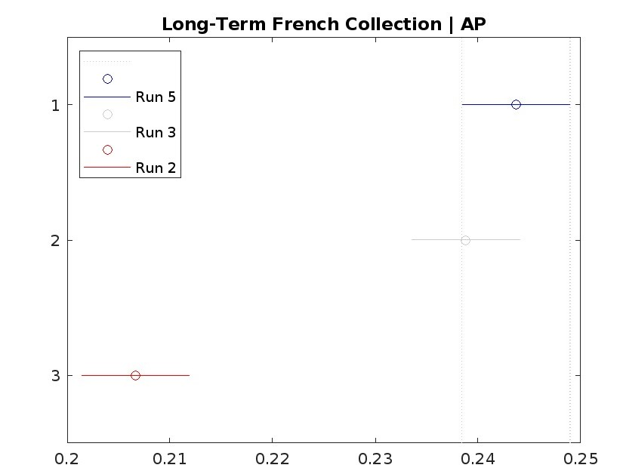
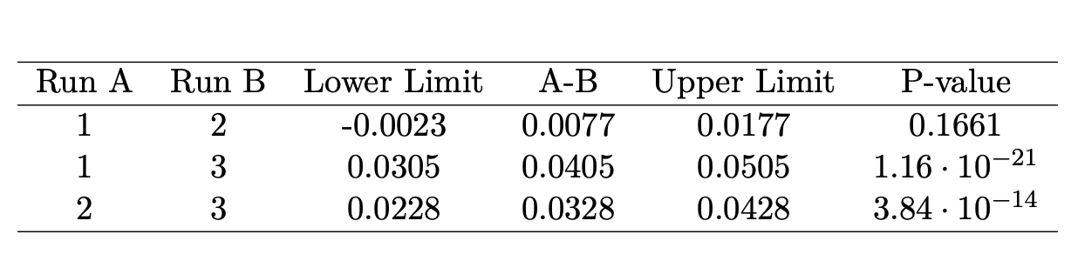
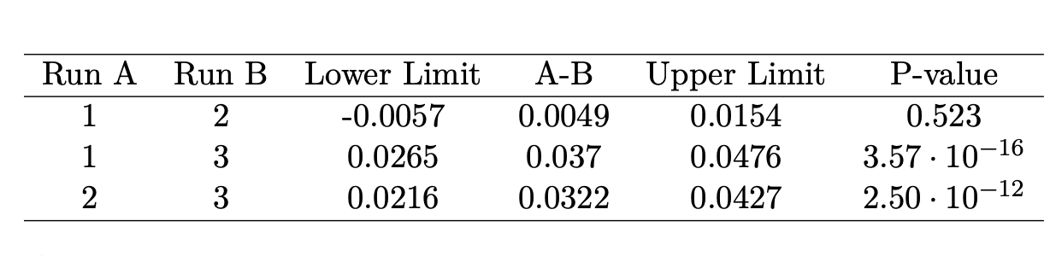
Statistical Analysis | FR

Slide 23
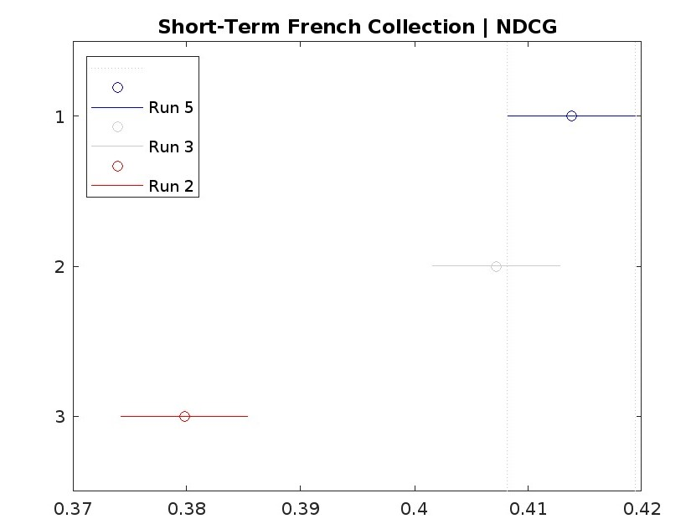
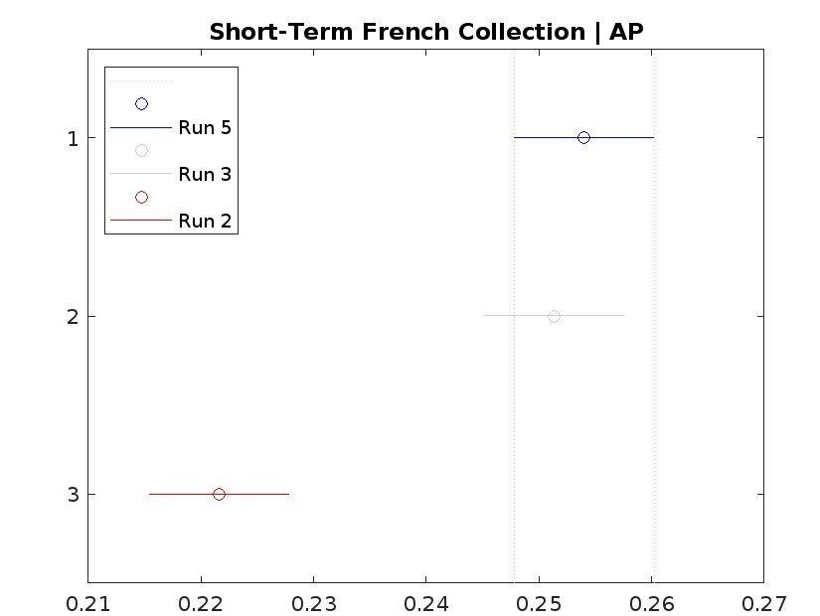
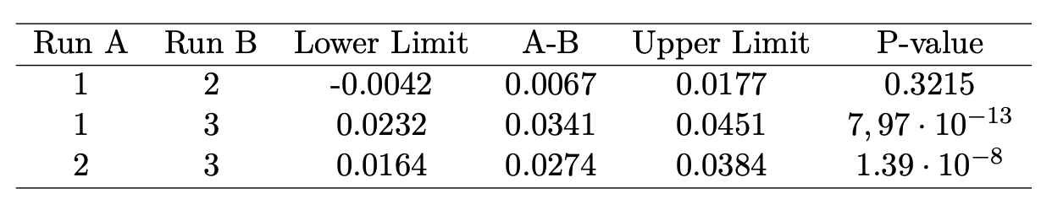
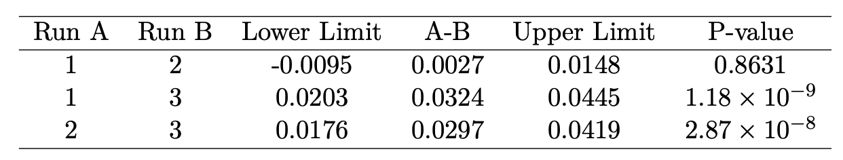
Statistical Analysis | FR

Slide 24
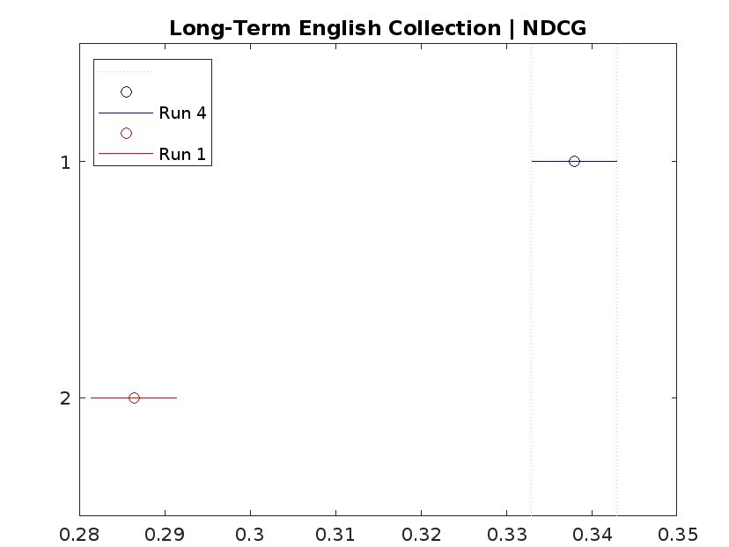
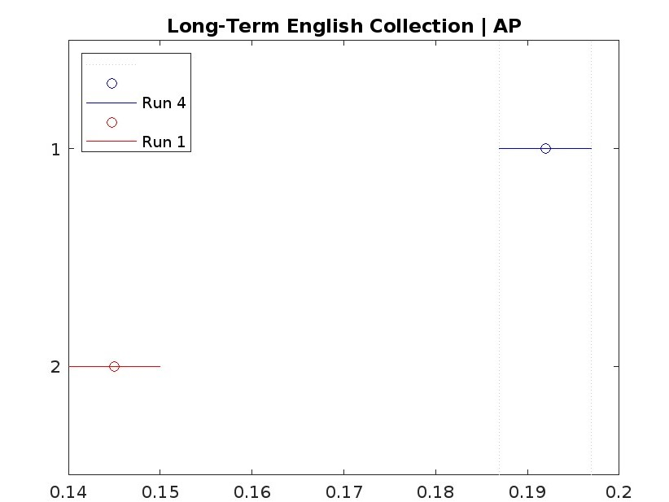
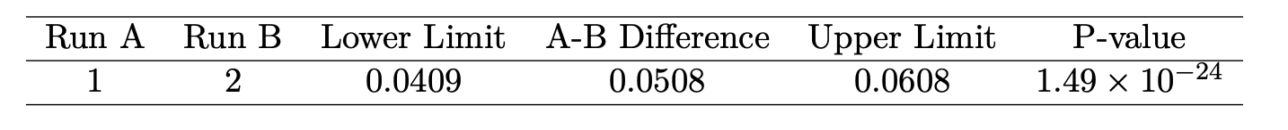
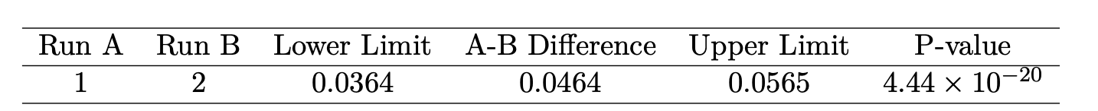
Statistical Analysis | EN

Slide 25
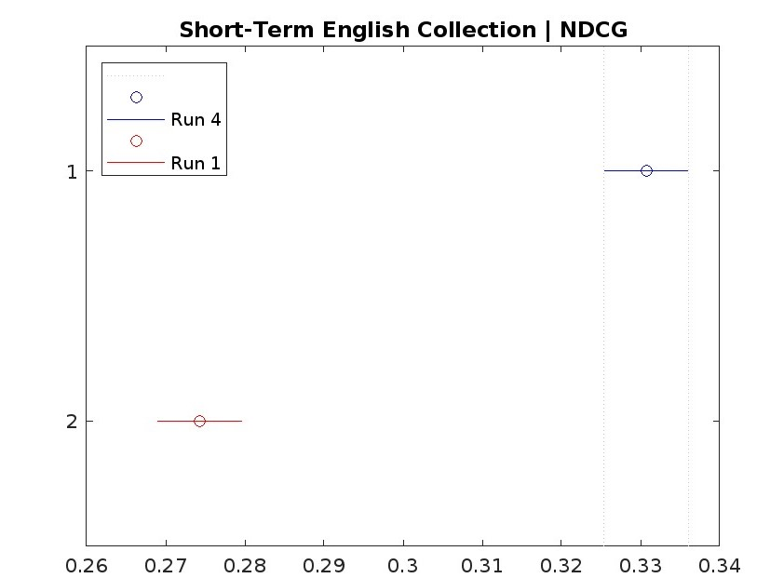
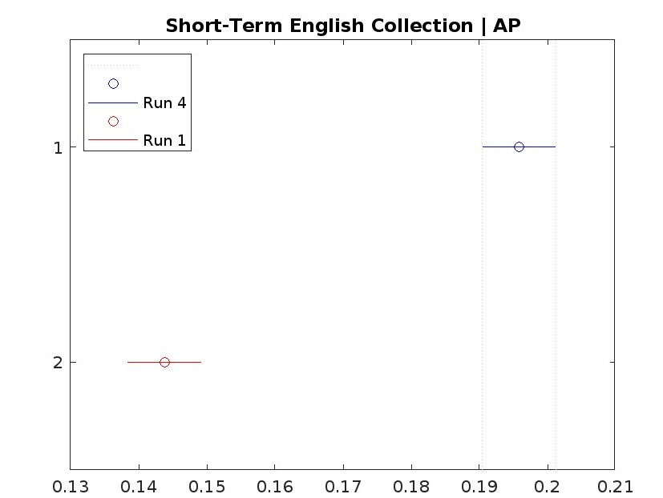
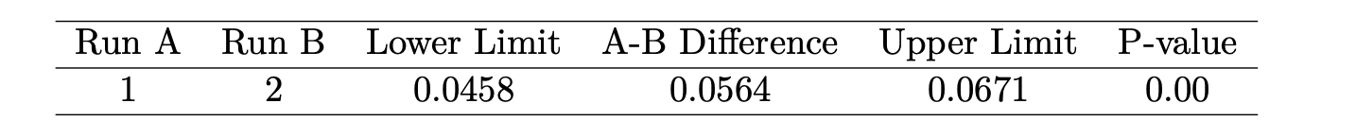
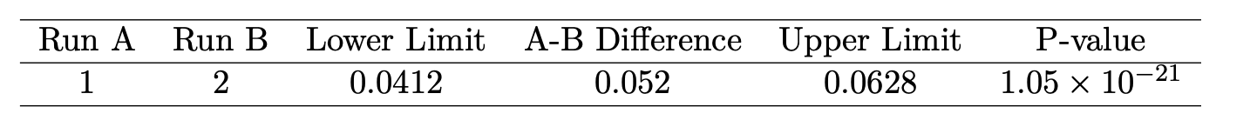
Statistical Analysis | EN

Slide 26
05 CONCLUSIONS & FUTURE WORK
Improving Re-ranking
Enhancing Query Expansion
Diversify scores, explore BERT models, fine-tune SBERT for relevance and document retrieval enhancement.
Better ChatGPT prompts and explore alternative Large Language Models techniques.
Utilizing Document Links
Vector-based Document Indexing
Enhance search results with link details and domain authority from URL keywords.
Investigate indexing documents as vectors for faster re-ranking, sacrificing one score in the process.
I
E
U
V

Slide 27
THANKS!
Do you have any questions?

