Slide 1
Options for ASR experiments in the Research Master Thesis
Research Master ASR

Slide 2
Experiments and thesis
In the Research Master, each student is assessed based on an individual thesis
Thesis is usually based on an experiment
but may also be theoretical
Experiments may be carried out in groups or individually
See link to excel sheet in BrightSpace

Slide 3
Set-up Thesis
1) Introduction
Problem
Background (literature overview)
Research Question, Hypotheses, intro to Experiment
2) Method
methodology, types of analyses, selection of the method
3) Set-up
selection of the speech data, description of the data, tuning/adaptation model parameters, hyperparameters
types of experiments (generalizations to which unseen conditions etc)
3) Experiments
4) Analysis & Results
5) Discussion
6) Conclusion
7) Authors’ statement
8) References, …

Slide 4
Set-up Thesis status Mid April
1) Introduction
Problem
Background (literature overview)
Research Question, Hypotheses, intro to Experiment
2) Method
methodology, types of analyses, selection of the method
3) Set-up
selection of the speech data, description of the data, tuning/adaptation model parameters, hyperparameters
types of experiments (generalizations to which unseen conditions etc)
3) Experiments
4) Analysis & Results
5) Discussion
6) Conclusion
7) Authors’ statement
8) References, …

Slide 5
Your thesis topic
Guiding is a research question
see slides below for suggestions
use link in BrightSpace to indicate your preference & group
Examples:
What is the best network topology for achieving a certain accuracy
How to optimize robustness against noise
Dependency on #bottleneck features…

Slide 6
Time Course Experimental Projects Phase
February: intro, essential background, concepts
Feb, last week: discussion experimental projects
March, first week: choice of experimental projects, Ponyland accounts
Mid March: data and research question(s) settled
Mid March-end of May: experiment time. All ASR REMA slots will be available for special topics and discussions
End of May: prefinal version of individual thesis ready
Mid June: deadline final version of individual thesis
Extension possible in special cases (tbd)

Slide 7
Which computation platform?
Your own system/PC
Ponyland machines (‘ponies’) @<machine>.science.ru.nl
account to the linux ponyland machines (‘ponies’) required
ask Wessel Stoop, w.stoop@let.ru.nl
provide name, s-number, email address

Slide 8
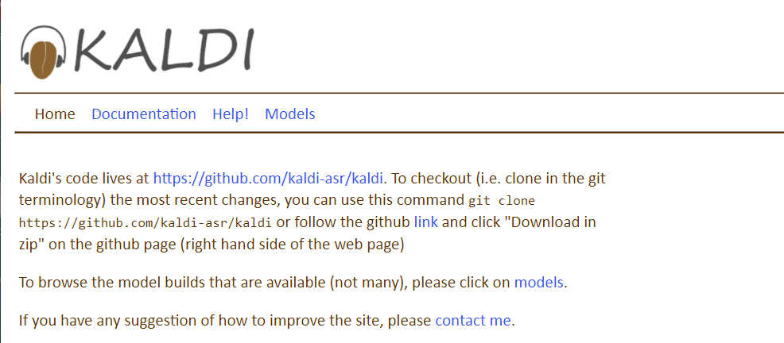
ASR software: KALDI
For all information about KALDI in general see kaldi-asr.org
For project 2 see Jurriaans’ github (see further down)

Slide 9
KALDI for Dutch Large Vocabulary ASR
KALDI for Dutch Large Vocabulary ASR:
install (ubuntu) linux (e.g. in Virtual Machine) or go to the pony machines (via Wessel Stoop)
download KALDI from kaldi-asr.org, compile
github.com/opensource-spraakherkenning-nl/Kaldi_NL
Kaldi_NL is useful for Dutch ASR tests, not for training
different precooked lexicon/grammar combinations available
changing the lexicon and the grammar is possible in principle but a longer route! See next slides

Slide 10
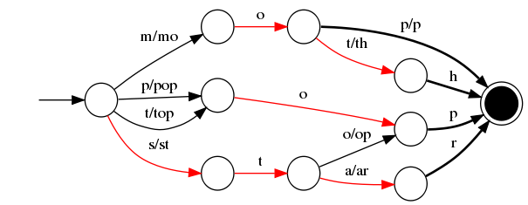
For those using KALDI: you need to know about FSTs
In case of using KALDI, make yourself familiar with Finite State Transducers (FSTs)

Slide 11
KALDI, FST
Each arc contains score, input label, output label
FSTs can be manipulated with functions
See www.openFST.org
http://www.openfst.org/twiki/bin/view/FST/FstExamples
Compose ·
Determinize, Minimize
And many more -- like algebraic objects

Slide 12
KALDI Example: a lexicon as FST (L.fst)
Lexicon:
cat k E t
can k E n
FST:
0 1 cat k 0.0
1 2 <eps> E 0.0
2 3 <eps> t 0.0
3 0.0
0 4 can k 0.0
4 5 <eps> E 0.0
5 6 <eps> n 0.0
6 0.0

Slide 13
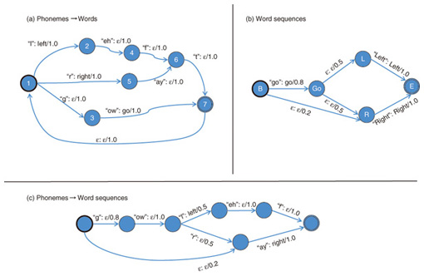
Examples of FSTs

Slide 14
KALDI, FST
In KALDI used in two ways:
They span the search space
are used to represent the ASR output
Can be used for postprocessing, e.g. by refining the ASR output lattice by a refined LM (“lattice rescoring”)

Slide 15
KALDI, FST
https://white.ucc.asn.au/Kaldi-Notes/fst-example/
http://kaldi-asr.org/doc/fst_algo.html
Used in KALDI to represent the ASR search space
compose(H·C·L·G) → HCLG.fst

Slide 16
ASR and Deep Learning
Textbooks (Holmes etc.)
very useful for background but not for novelties
outdated rapidly
Papers
very useful for recent advancements (journal, conference proceedings, Interspeech)
Websites
e.g. https://medium.com/@ageitgey/machine-learning-is-fun-part-6-how-to-do-speech-recognition-with-deep-learning-28293c162f7a

Slide 17
ASR software, alternative: HTK
Hidden Markov Model Toolkit (HTK)
http://htk.eng.cam.ac.uk/
Available on ponies
Toolkit for building and manipulating HMMs
Modular and flexible
Getting obsolete, now superseded by KALDI
Still very useful for low-scale ASR
and for special cases: This year we built a personalized ASR system for one single person with a very specific speech production pathology (broadcasting BNNVARA March 2021)

Slide 18
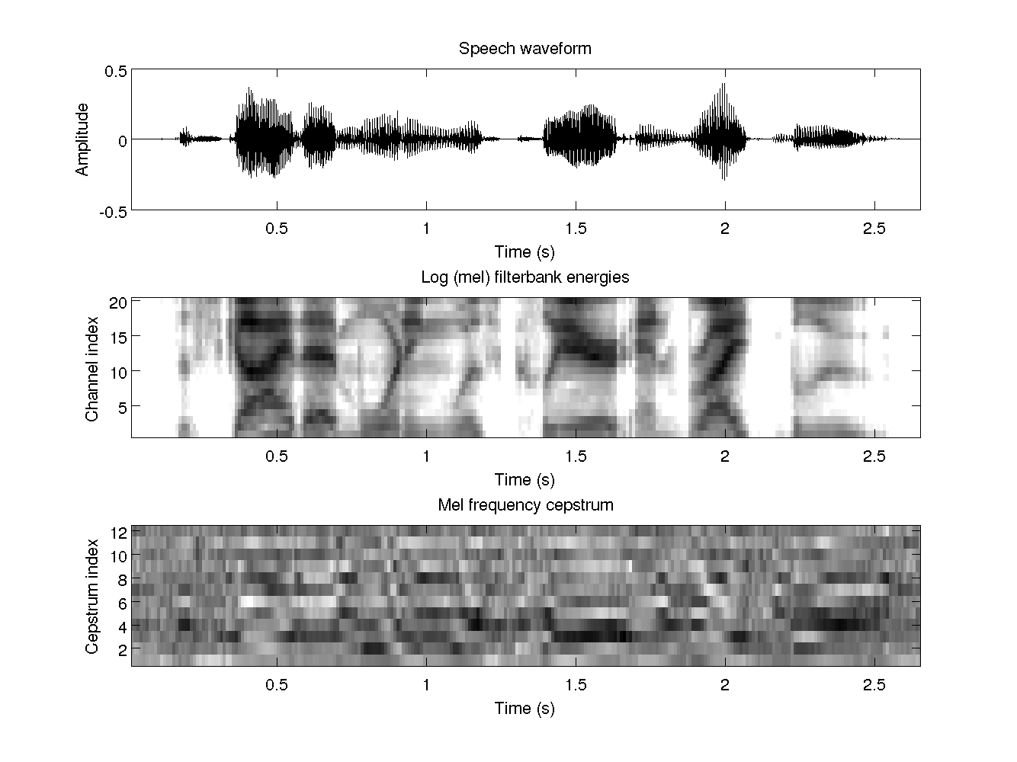
ASR related software (cont’d)
Matlab. Scripts available:
MFCCs from wavs
Viterbi
DTW (dynamic time warping)
Python
Nowadays the most flexible option. Many websites.
DTW: https://pypi.org/project/dtw-python/
MFCC:
https://python-speech-features.readthedocs.io/en/latest/
Can be used in combination with Tensorflow, Keras, etc.

Slide 19
Dynamic Programming: Viterbi algorithm, DTW
These algorithms provide the best alignment between input and reference sequences → alignment path
DTW-score: total score along alignment path
“search space”
+ + + + + + + + + + + + + + +
+ + + + + + + + + + + + + + +
+ + + + + + + + + + + + + + +
+ + + + + + + + + + + + + + +
+ + + + + + + + + + + + + + +
+ + + + + + + + + + + + + + +
+ + + + + + + + + + + + + + +
+ + + + + + + + + + + + + + +
+ + + + + + + + + + + + + + +
+ + + + + + + + + + + + + + +
reference (11 frames)
+ + + + + + + + + + + + + + +
reference (11 frames)
+ + + + + + + + + + + + + + +
+ + + + + + + + + + + + + + +
+ + + + + + + + + + + + + + +
+ + + + + + + + + + + + + + +
+ + + + + + + + + + + + + + +
+ + + + + + + + + + + + + + +
+ + + + + + + + + + + + + + +
+ + + + + + + + + + + + + + +
+ + + + + + + + + + + + + + +
+ + + + + + + + + + + + + + +
+ + + + + + + + + + + + + + +
input (15 frames)
Input (15 frames)

Slide 20
ASR related web services
CLST ASR webservices available at https://webservices.cls.ru.nl
E.g.:
https://webservices.cls.ru.nl/oralhistory
https://webservices.cls.ru.nl/spreek2schrijf
Signup required: https://webservices-lst.science.ru.nl/register/
Open Source spraakherkenning for Dutch:
https://github.com/opensource-spraakherkenning-nl/Kaldi_NL
(developed at Univ Twente: see http://www.opensource-spraakherkenning.nl)

Slide 21
Useful audio data: links, locations
TIMIT:
cls.ru.nl/~ltenbosch/TIMIT.tar.gz (456 MB)
AURORA2 (< 1 GB):
cls.ru.nl/~ltenbosch/AURORA2_train.tar.gz
cls.ru.nl/~ltenbosch/AURORA2_test_a.tar.gz
cls.ru.nl/~ltenbosch/AURORA2_test_b.tar.gz
CGN (Dutch): data via ponyland machines (science.ru.nl)
Librispeech: https://www.openslr.org/12
Google Speech Command dataset:
https://storage.cloud.google.com/download.tensorflow.org/data/speech_commands_v0.02.tar.gz Specific for Keyword Spotting. Paper: https://arxiv.org/pdf/1804.03209.pdf

Slide 22
TIMIT data organisation
.wav: wavfiles
.phn: segmentation files
American English, clean recording conditions
7+1 dialect regions, few tens of speakers per dialect
10 sentences per speaker, of which two are the same for all speakers (calibration)
Ideal for structure discovery on the phone level
Not suited for word recognition (too little variation)
Often used in ASR papers (benchmarking)

Slide 23
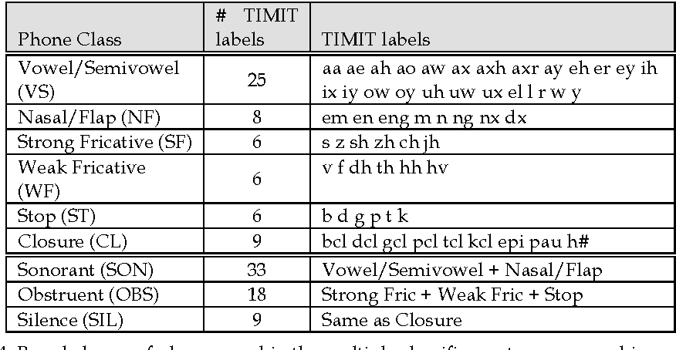
TIMIT LABELS

Slide 24
TIMIT labels are abundant, downmapping desirable
TIMIT has many labels
Example: the phoneme /p/ (linguistic unit) is described as a sequence of a closuse (TIMIT label: ‘pcl’) followed by a burst (TIMIT label: ‘p’). Same for t, k, b, d, g. So be careful. The TIMIT labels describe events, not necessarily phones or phonemes.
Downmapping {pcl, p} → p etc. makes sense
See tabel 2 in https://www.mdpi.com/2076-3417/11/1/428/pdf
Table 3 in http://cdn.intechopen.com/pdfs/15948/InTech-Phoneme_recognition_on_the_timit_database.pdf

Slide 25
AURORA 2
For experiments with speech in noisy conditions
train set: train/clean/*, train/multi/*
test sets: testA, testB
In train:
train/clean/*: clean condition only (8440 files)
train/multi/*: mixed condition (four noise types, 5 SNR levels)
clean{1,2,3,4}
N{1,2,3,4}_SNR{20,15,10,5,0}
422 files per condition

Slide 26
AURORA 2
AURORA2 test sets:
testset A: 4 known noise types, same as used in multi condition training set
testset B: 4 unknown noise types
Notation of file content in filename:
WAVS: FAB_Z0123A .wav
orthography: in filename

Slide 27
Starting points for projects and thesis
Research Question: keep it feasible!
There are about 12 weeks available in total
Literature
Read the ASR chapters in Holmes and Holmes for essential background
Browse through papers on BrightSpace to get ideas
Additional papers largely depend on your topic
Lot of info is on the web (also see links given further in these slides)

Slide 28
List of proposed experimental projects (those proposed by individual students not mentioned here):
Phone classification
ASR (audio → text) for command and control (Dutch) (github Jurriaan)
Keyword spotting (Tara Sainath papers)
ASR-HSR: EARSHOT (Magnuson et al., 2020) (github Pepijn)
Estimation of #talkers in multi-talker audio input (audio → {0,1,2,3,…})
Isomorphisms between latent structures in DNNs (X-H-Y, X-H2-Y)
Relation between acoustic and symbolic distance (log prob score and levenshtein distance, e.g. bull – bill – ball, morse – horse – force)
Automatic improvement readability of ASR output (punctuation)
Voice morphing and unmorphing (teams Alice, Bob, Marc)
Audio glueing (continuity constraints)

Slide 29
Project 1
Phone classification + labelling
Use
python + DNNs in e.g. TensorFlow, own PC/laptop
Data: TIMIT (wavs + phn files, available via download link)
Choose feature vectors (e.g., mfcc)
Choose feature stacking size (e.g., [-3..3])
Create your own training + test set division
Possible RQs:
generalization to other dialects (train on a few dialects, test on the held-out dialects, etc.)
Generalization to other speakers
Generalization to opposite gender

Slide 30
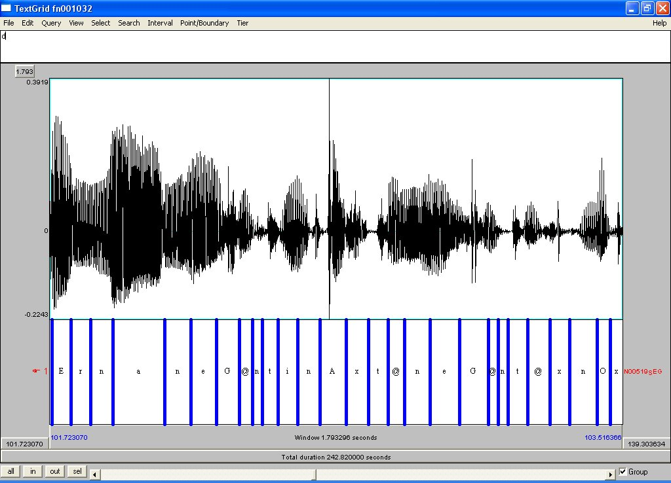

Slide 31
Project 1: to-dos (proposal)
Read literature. Many papers are available, e.g. http://cdn.intechopen.com/pdfs/15948/InTech-Phoneme_recognition_on_the_timit_database.pdf
Download TIMIT
Use mfccs in combination with .phn
Use phn info to define training samples as input (small sequences of mfcc vectors)
Apply DNN to map audio chunks to downscaled TIMIT labels

Slide 32
Project 2
ASR for command and control, KALDI based (so read st about FSTs)
IN: spoken commands
OUT: text
RQs (for example):
Stability and robustness against noise
Stability and robustness against using insertions and OOVs
Context: Nijmegen NIFTI project: public transportation CS-campus using a magnetic rail
https://www.ru.nl/honoursacademy/honourslabs/vm/radical-new-transportation-idea/
Collaboration with Jurriaan ten Brinke

Slide 33
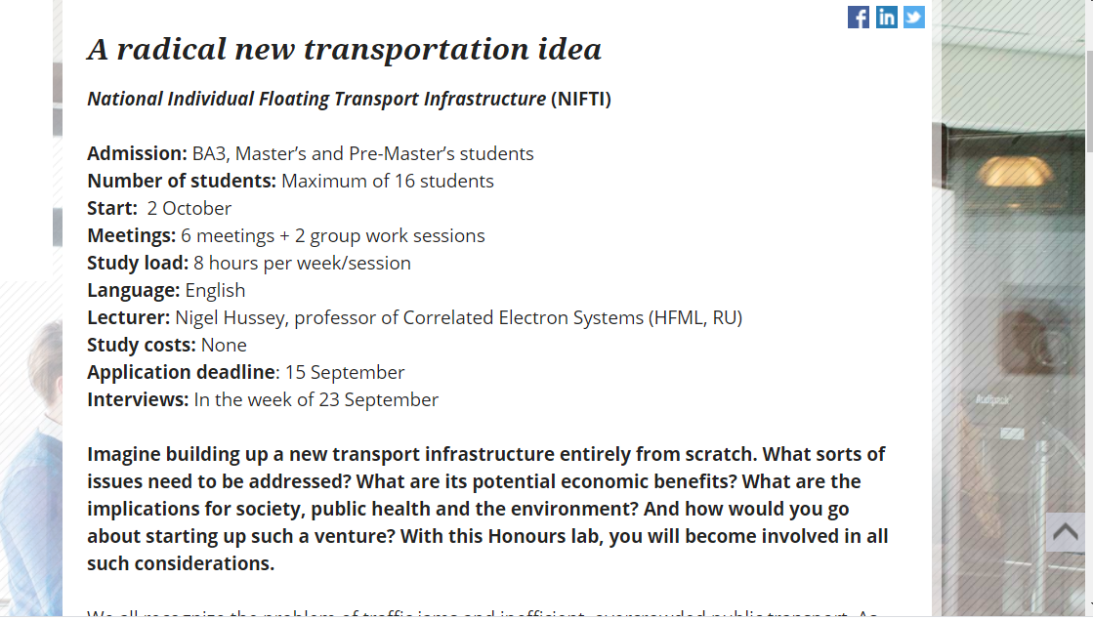
Project 2 background

Slide 34
Project 2: more info, source code
Github Jurriaan: https://github.com/JtenBrinke/nifti-dedicon
KALDI info by Daniel Povey
http://danielpovey.com/kaldi-lectures.html.
I’ll mail all students interested in project 2 with cc to Jurriaan.
Possible RQs:
Robustness of system in terms of grammatical freedom by users, based on own recordings
improving flexibility
False Accepts/False Alarms in natural conditions

Slide 35
Project 3 (keyword spotting)
There are many papers with code bases, see e.g.
https://paperswithcode.com/paper/speech-commands-a-dataset-for-limited
https://paperswithcode.com/task/keyword-spotting
https://github.com/nitinvwaran/UrbanSound8K-audio-classification-with-ResNet
Possible RQs:
Robustness of system as function of #keywords
The performance of the keyword spotter as function of the topology of the CNN (or other DNN)
Portability to Dutch

Slide 36
Project 3: Keyword Spotting (English data sets)
UrbanSound 8K Dataset https://urbansounddataset.weebly.com/urbansound8k.html This dataset contains 8732 labeled sound excerpts (<=4s) of urban sounds from 10 classes: air_conditioner, car_horn, children_playing, dog_bark, …
Google Speech Commands DataSet
Info given earlier in this file

Slide 37
Project 4
Narrowing the gap between ASR and HSR
DATA: BALDEY, https://mirjamernestus.nl/Ernestus/Baldey/index.php
(or another speech database with isolated words)
IN: audio (spoken word), audio[0:T]
OUT: for each time step 0:0.01:T, an ordered list of words with their activations
Potential RQs
RQ1: how can we describe the word competition as function of time
RQ2: idem for entropy as function of time

Slide 38
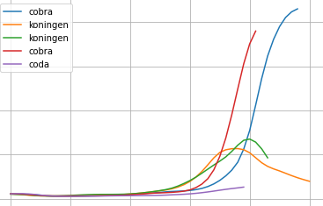
Project 4
Figure by
Pepijn van Teeffelen
EARSHOT model
time

Slide 39
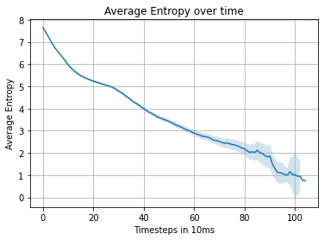
Pepijn van Teeffelen
EARSHOT model

Slide 40
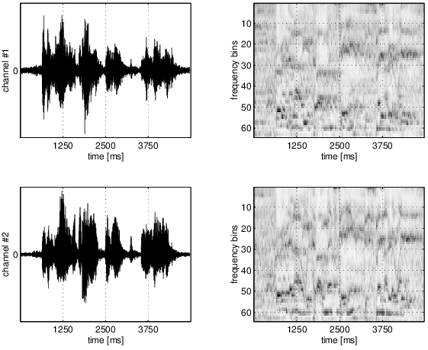
Project 5 : estimation of #speakers
Estimation of #simultaneous talkers in a mono channel
IN: audio from TIMIT (or CGN)
OUT: estimation of #talkers in audio[T:T+1]
RQs:
How good is this estimation?
Robustness?
Challenge: which features must be used?
Input audio: to be created, starting from e.g. TIMIT

Slide 41
Project 5 : possible start
Take TIMIT or other dataset
Produce wav files with N speakers (simultaneous talkels, N=1..20)
Motivate your choice of the audio features to be used for classifier. Starting point: mfcc
Take audio stretches of fixed length (e.g. 1 sec)
Apply DNN or similar
Possible regimes
Training on 70dB, test 70dB
Training 70dB, test variable
Training variable, test variable

Slide 42
Bottleneck representations: project 6
Platform+software: PC + python + DNN/RNN TensorFlow (e.g.)
Data: TIMIT.
Idea
Choose a multi layer DNN with bottleneck
Train the same network multiple times (different instantiations)
RQ:
Do we see the “same” structure in the bottleneck representation appearing?
Is “knowledge” represented in different ways?
Papers:
DNN_whatcanwelearn*.pdf on BrightSpace
Papers by Tishby on BrightSpace, e.g. New Theory Cracks Open the Black Box of Deep Learning

Slide 43

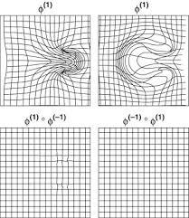
Project 6
RQ: is “knowledge” represented in different ways?
Same = morpheable
Different = not morpheable

Slide 44
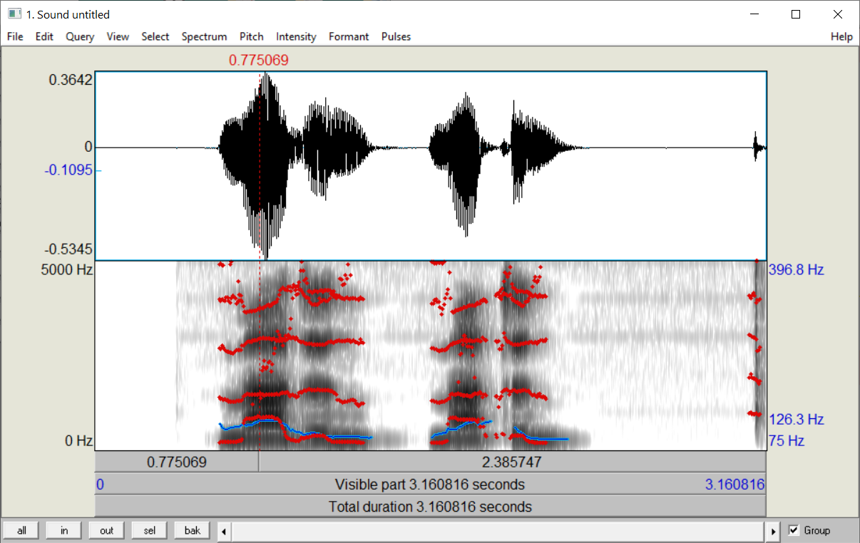
Project 7
example word pair: maden maten
m a d @ n m a t @ n
levenshtein distance = 1
acoustic distance = DTW(MFCC1, MFCC2)
correlation over millions of word pairs (CGN)
Relating audio with symbols for improving weighted Levensthein distance

Slide 45
Project 7: symbolic distance versus acoustic distance
Prerequisites: understanding DTW, Levenshtein
Data: TIMIT, or CGN (ponyland, via Tim Zee)
Python:
Read audio
Use PHN
DTW on segmented portions of the audio
Aim: Relate DTW scores with symbolic match/mismatch
RQs:
Find a weighted Levenshtein scheme for American English or Dutch

Slide 46
Project 7: symbolic distance versus acoustic distance
To do (proposal)
Fetch data (CGN or TIMIT)
Using the segmentation, (administratively) collect all audio chunks for all relevant phones: in this way we get K classes of audio chunks
Compute DTW alignment scores between and within all these classes
Build KxK matrix with mean and variances of DTW alignment scores

Slide 47
Project 8
learning the most common english phrases is the best way to start learning the language the english dialogues for beginners course presents key english vocabulary in a funny and engaging way from day one you will learn many popular english expressions and will see that our method is effective this basic english conversation course will include twenty five dialogues and exercises to help you remember english words and phrases all audio recordings have been prepared by professional voice artists

Slide 48
Project 8. Adding punctuation
learning the most common English phrases is the best way to start learning the language the English dialogues
Idea: learning the language the english → learning the language. the english
Use LM building tools such as SRILM (on the Ponyland machines)
See http://www.speech.sri.com/projects/srilm/
Given any correct text, build an LM with lowercase, unpunctuated text in the history and a unnormalized form as output, e.g.:

Slide 49
Project 8. Cleaning up ASR output
Literature: see
https://arxiv.org/pdf/1802.02607.pdf and references therein
way to start learning the language → learning
to start learning the language the → the
start learning the language the english → language.
learning the language the english dialogues → The
the language the english dialogues for → English
…
DATA: Any collection of normal punctuated texts, e.g. CGN news bulletins (on Ponyland machines)
For Dutch: Twents Nieuws Corpus: https://surfdrive.surf.nl/files/index.php/apps/files/?dir=/Shared/Data&fileid=7829473425

Slide 50
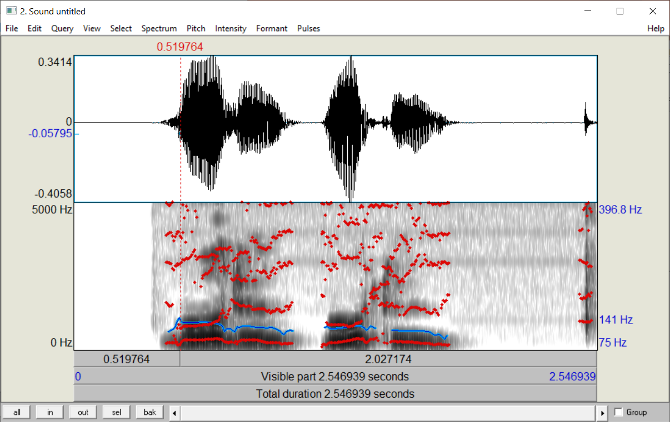
Project 9 voice morphing
Suppose we morph speech, not to create artificial voices or deep fake,
but for making speech natural but unintelligible. Can we unmorph?
Morph
Unmorph

Slide 51
Project 9: Voice morphing, more info
The central idea is:
to morph a speech signal (e.g., using a DNN) into a new “speech like audio signal”
that new speech like signal should have the property that it can be unmorphed, e.g. using another DNN, to the original audio file (or close).
RQs:
exploratory character: investigate to what extent this is possible
to what extent is the middle wav file indeed not intelligible at all
can an AE-type of learning be used?
can the method be scaled up, and how?
Litt: various papers on Autoencoding, use of bottleneck dimensions, audio morphing

Slide 52
What you could do… concrete idea 10 glueing
Glueing: From many sound chunks back to one complete waveform
….
cutting glueing
(thousands)

Slide 53
Project 10. Continuity constraints?
Make use of fact that speech production is ‘slow’
it takes time for speech spectra to change over time
RQs:
How powerful are these constraints?
What is the optimal glueing criterion as a function of gap duration?
see e.g.:
https://www.researchgate.net/publication/266649133_NMF_based_speech_and_music_separation_in_monaural_speech_recordings_with_sparseness_and_temporal_continuity_constraints

Slide 54
Project 10: more info
How to glue together (reassemble) audio snippets?
Underlying idea:
make smart use of continuity constraints in the speech signal, as for example extensively used in concatenative speech synthesis
development of an appropriate ‘join score’
https://www.researchgate.net/publication/221488819_Feature_extraction_for_spectral_continuity_measures_in_concatenative_speech_synthesis
https://ieeexplore.ieee.org/abstract/document/4123956?section=abstract
https://www.semanticscholar.org/paper/Feature-extraction-for-spectral-continuity-measures-Kirkpatrick-O%27Brien/0f6c93d29d2c79fa76f61156557c391f4910ffff
https://www.researchgate.net/publication/266649133_NMF_based_speech_and_music_separation_in_monaural_speech_recordings_with_sparseness_and_temporal_continuity_constraints

Slide 55
Remaining ideas….
Build an ASR system using python
https://realpython.com/python-speech-recognition/
RQs: ease, flexibility, AM and LM
Speaker diarization
https://towardsdatascience.com/speaker-diarization-with-kaldi-e30301b05cc8

Slide 56
Code snippets (python)
Read wav and sample frequency:
import librosa
X, sample_rate = librosa.load(<file name>, sr=None, offset=0)
Create spectrogram:
spect = librosa.feature.melspectrogram(y=X, sr=sample_rate, hop_length=sample_rate/100)
https://librosa.org/doc/main/generated/librosa.feature.melspectrogram.html Create MFCC matrix:
https://librosa.org/doc/main/generated/librosa.feature.mfcc.html

Slide 57
Loudness and Signal-to-Noise ratio (SNR)
Loudness
Load a (mono) wave file. You get an array (s) and a sampling frequency (sf)
Compute loudness of s, by
10*log10(sum(s.*s)/(length(s)*4*10^(-10))); # sum(s.*s) energy of signal
length(s): number of samples in s
s.*s: array of squares of samples in s
SNR: #signal to noise ratio
If you add s1 (foreground) and s2 (background) to create a single (noisified) signal s, then
SNR of s = loudness of s1 – loudness of s2 #loudness is a log of energy
Make sure you also avoid clipping in the resulting file, by overall scaling. Overall scaling will not change the SNR of the file.
Puzzle for those who like math: you can compute a weight factor lambda exactly such that the SNR of s1+lambda*s2 equals a certain prespecified SNR value. Figure out how.

