Slide 2
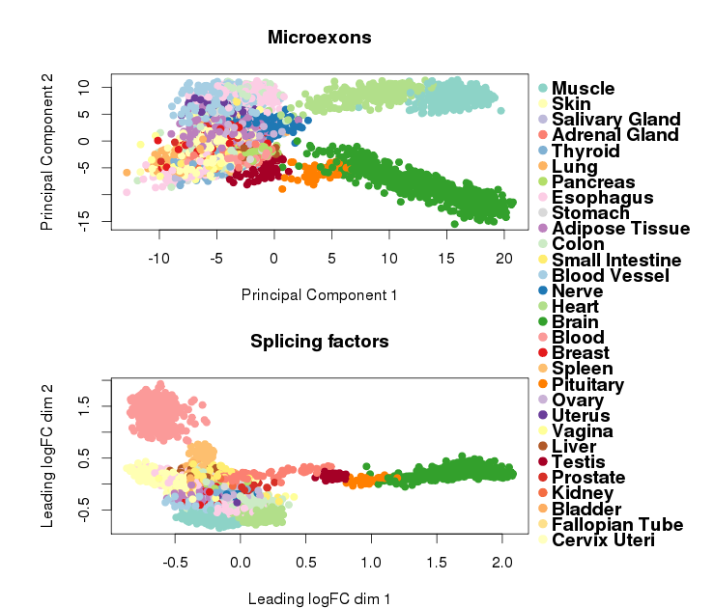
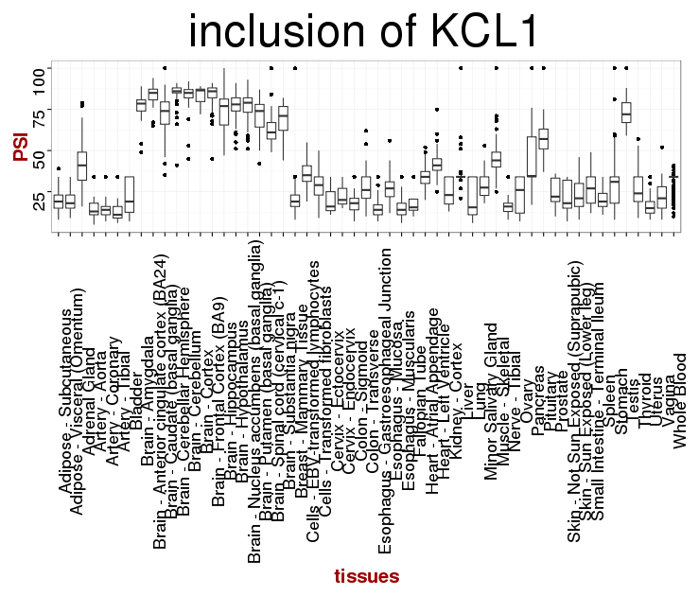
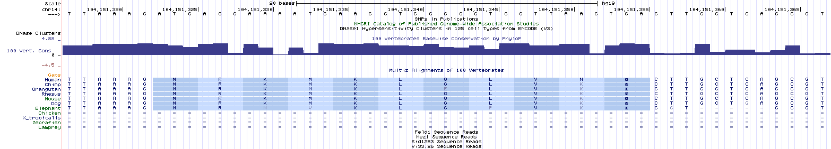
A
C
microexons are the exons that have the length smaller than 51 bp. Previous studies showed their abnormal regulation in people with neurodevelopmental diseases. They are very conserved among vertebrates. Here we wanted to see if the microexons inclusion is affected by the pattern of transcription in different tissues. As you can see in figure A, the pattern of inclusion of 663 microexons is different in muscle, heart and brain. In figure B, you see that the pattern of expression of 434 splicing factors is different in brain, pituitary , blood, and testis. We found 24 brain specific microexons, one of them is shown here in figure C. This microexons has a human specific substitution in aminoacid sequence(arrow). We still do not know the role of this microexons but the gene is important in axonal guidance and neural development. This microexon may play a role in human unique cognitive abilities.
B
D

