Slide 1
Bahasa Inggris
SD Kelas 4

Slide 2
M1
TELLING TIME

Slide 3
M1
TELLING TIME
A quarter = seperempat (15 menit)
A half = setengah (30 menit)
Kalimat yang biasa digunakan yang berhubungan dengan telling the time :
What time is it?
What time is it now?
It is ten o’clock.
What time do you usually wake up?
I wake up at five o’clock.

Slide 4
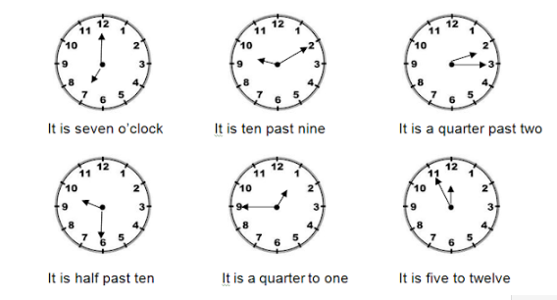
M1
TELLING TIME

Slide 5
M2
DAYS, DATE, AND MONTH

Slide 6
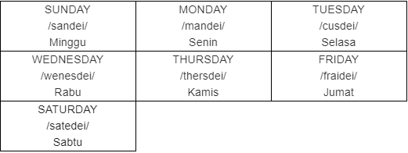
M2
DAYS, DATE, AND MONTH
Days in a week

Slide 7
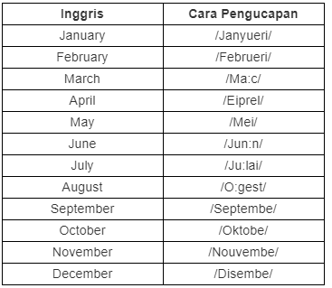
M2
DAYS, DATE, AND MONTH
Month

Slide 8
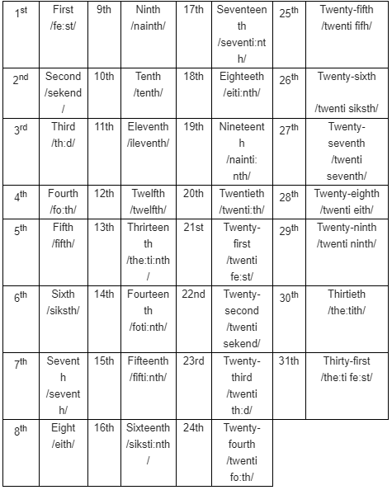
M2
DAYS, DATE, AND MONTH
Dates

Slide 9
M3
FAMILY

Slide 10
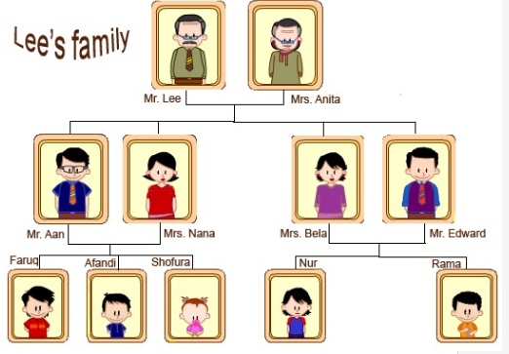
M3
FAMILY

Slide 11
M3
FAMILY
Nama-nama anggota keluarga:
Father = ayah - husband = suami
Mother = ibu - wife = istri
Parents = orang tua - grandfather = kakek
Brother = kakak kandung laki-laki - grandmother = nenek
Sister = kakak kandung perempuan - children = anak – anak
Son = anak laki-laki
Daughther = anak kandung perempuan
Aunt = tante (bibi)
Uncle = paman

Slide 12
M4
PHYSICAL APPEARANCE

Slide 13
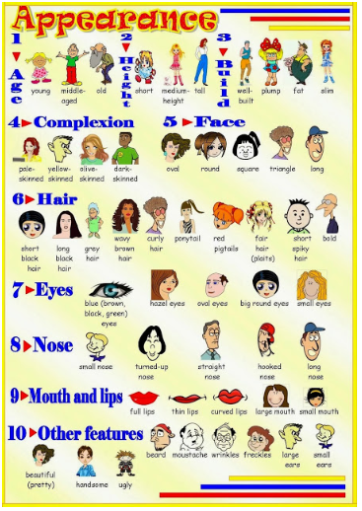
M4

Slide 14
M5
HUMAN FEELING

Slide 15

M5

Slide 16
M6
OCCUPATION

Slide 17
M6
OCCUPATION
Accountant - Burglar - Doctor
Actor - Butcher - Editor
Actress - Carpenter - Farmer
Athlete - Chauffeur - Lawyer
Author - Chef - Pilot
Baker - Clerk - Nurse
Banker - Coach - Sailor
Barber - Crook - Soldier
Beautican - Criminal - Policeman
Broker - Dentist - Teacher

