Slide 1
Bahasa Inggris
SD Kelas 4

Slide 2

M1
WH-Question
Expamle :
Sleep
Where do you sleep?
I sleep at home.

Slide 3
M1
WH-Question
Exercise:
Eat Study Save money
………………………………………… - ………………………………….. -…………………………
………………………………………….. -……………………………………. -…………………………..
Have a picnic Talk to a doctor See statues
…………………………………………….. -………………………………………. -……………………………..
…………………………………………. -……………………………………… -…………………………….

Slide 4
M2
Reading Comprehension
Read the text below!
Amanda
Amanda is my classmate. She is my best friend. She is thirteen years old.She lives in Margahayu. She is tall. She has beautiful hair.
She is very smart and nice. She likes helping her friends. Every afternoon,Amanda plays with her friends. After playing, she does her homework at home.
Amanda has many hobbies. Amanda likes reading, riding a bike and playing guitar. Amanda cannot swim. She does not like swimming.

Slide 5
M2
Reading Comprehension
B. Circle True or False!
Amanda is NOT my best friends True False
Amanda does not live in Margahayu. True False
Amanda is short. True False
Amanda is NOT short. True False
Amanda is very smart. True False

Slide 6
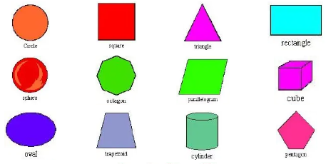
M3
Shape

Slide 7
M3
Let’s Sing!!!
I’m a square. I have four sides.
I’m a square. I have four sides.
We are squares. We have four sides.
1 2 3 4 we are squares
I’m a circle. I go round and round.
I’m a circle. I go round and round.
We are circles. We go round and round.
Round and round we are circles.
I’m a triangle. I have three sides.
I’m a triangle. I have three sides.
We are triangles. We have three sides.
1 2 3 we are triangles.
We are shapes. You see us everywhere.
We are shapes. You see us everywhere.
We are shapes. You see us everywhere.J
ust look around we are everywhere.

Slide 8
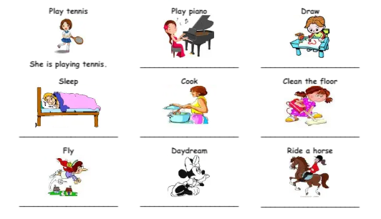
M4
Action
What is she doing?

Slide 9
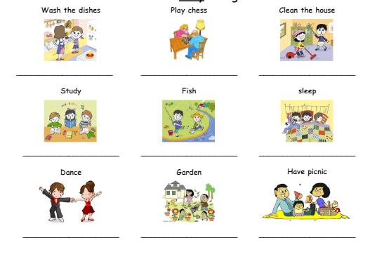
M4
Action
What are they doing?

Slide 10
M5
Action
Telling Time
Asking for the time
What time is it?
What’s the time?
Do you know what the time is
Excuse me, have you got the time please?
Sorry, do you have the time please?
Sorry, could you tell me the time, please?

Slide 11
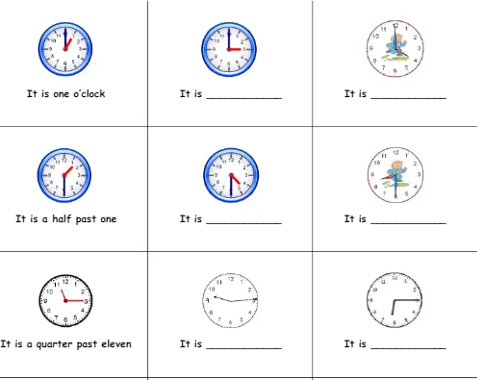
M5
Action
Telling Time
B. Write the time!

Slide 12
M6
Asking Personal Information
Read the conversation below!
A : Hello, how are you?
B : I’m fine, thanks.
A : What is your name?
B :My name is Adelia.
A : Where do you come from?
B : I come from Jakarta
A : What is your religion?
B : I am a moslem.

Slide 13
M6
Asking Personal Information
Answer the questions with your personal information!
A : Hello, how are you?
B : ……………………………………………
A : What is your name?
B : ………………………………………….
A : Where do you come from?
B : …………………………………………..
A : What is your religion?
B : ………………………………………………

Slide 14
M6
Daftar pustaka :
English Bok, Elementary School, Grade 4. Link akses
https://www.academia.edu/37217715/BUKU_BAHASA_INGGRIS_SD_KELAS_4_1

