Slide 1
Bahasa Inggris
SD Kelas 4

Slide 2
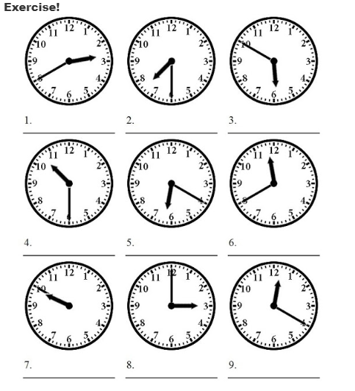
M1
TELLING TIME

Slide 3
M2
DAYS, DATE, AND MONTH
Treanslate into Indonesai!
Today is teusday = ………………………..
Tomorrow is Thursday = ………………………..
Yesterday was Saturday = …………………….
This month is march = …………………
Next mont is august = ………………..
Last month was october = ………….

Slide 4
M3
FAMILY
Exercise!
Fill the blanks by using “his” or “her”!
This is Hetty’s sister. ……………….. name is Lia.
This is Hetty’s uncle. ………………….. name is Wiguna.
This is Hetty’s brother. ………………….. name is Rizky
This is Hetty’s mother ………………….. name is Liju.
This is Hetty’s grandmother. ………………….. name is Inayah.

Slide 5
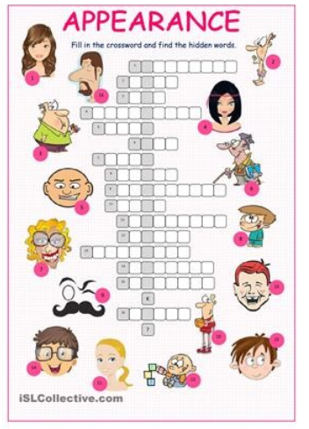
M4
PHYSICAL APPEARANCE
Exercise

Slide 6
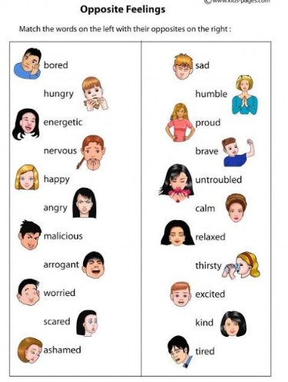
M5
HUMAN FEELING
Exercise

Slide 7
M6
OCCUPATION
Exercise!
Someone who performs is a …
Someone who plays the guitar is a …….
Someone who practice law is a ……
Someone who writes novels is a ……..
Someone eho is employed by someone is an …..

