Slide 1
Bahasa Inggris
SD Kelas 4

Slide 2
M1
DIRECTIONS AND LOCATION
Read the text carefully!
My name is Ani. I live on Jl.Dahlia. My house is near the post office. Today, my mother asks me to accompany her to the supermarket. The supermarket is on Jl.Anggrek. There are many public places along this street.
The park is in the corner, near the library.There is a bank across from the police station. There is also a cinema. It is beside the bakery. At last the supermarket itself. It is between the drugstore and the bus station.
Answer the questions based on the text!
1. Where does Ani live?
2. Where does her mother want to go?
3. Where is the bank?
4. Where is the cinema?
5. Where is the supermarket?

Slide 3
M2
OWNERSHIP (KEPEMILIKAN)
Terjemahkan kedalam bahasa inggris!
Saya mempunyai sebuah rumah
Rindi mempunyai sebuah buku cerita.
Bibi saya mempunyai seekor kucing
Kami mempunyai sebuah mobil baru
Alya memiliki laptop baru

Slide 4
M3
Reading Comprehension
Soal Latihan
I. Fill in the blanks with the words bellow!
a. emperor f. head of district
b. empire g. king
c. province h. president
d. village chief i. regency
e. major j. republic
1. A .... leads a kingdom
2. Joko Widodo is a ....
3. An .... leads a empire.
4. A .... leads a municipality.
5. A .... leads a village

Slide 5
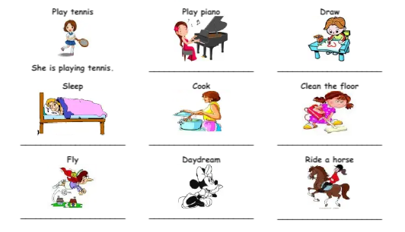
M4
Action
What is she doing?

Slide 6
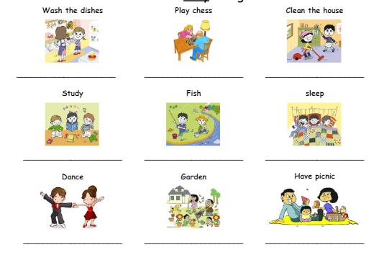
M4
Action
What are they doing?

Slide 7
M5
Action
Telling Time
Asking for the time
What time is it?
What’s the time?
Do you know what the time is
Excuse me, have you got the time please?
Sorry, do you have the time please?
Sorry, could you tell me the time, please?

Slide 8
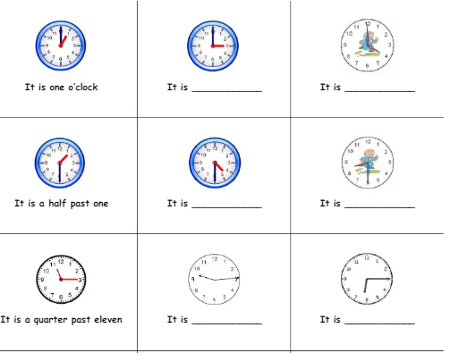
M5
Action
Telling Time
B. Write the time!

Slide 9
M6
Asking Personal Information
Read the conversation below!
A : Hello, how are you?
B : I’m fine, thanks.
A : What is your name?
B :My name is Adelia.
A : Where do you come from?
B : I come from Jakarta
A : What is your religion?
B : I am a moslem.

Slide 10
M6
Asking Personal Information
Answer the questions with your personal information!
A : Hello, how are you?
B : ……………………………………………
A : What is your name?
B : ………………………………………….
A : Where do you come from?
B : …………………………………………..
A : What is your religion?
B : ………………………………………………

Slide 11
M6
Daftar pustaka :
English Bok, Elementary School, Grade 4. Link akses
https://www.academia.edu/37217715/BUKU_BAHASA_INGGRIS_SD_KELAS_4_1

