Slide 1
Building a Comprehensive Protein Data System using MongoDB, Neo4j, and Python
Members: Atena Karimi, Reza Tashakkori
University of Luxembourg

Slide 2
Introduction
UniProt Knowledgebase (UniProtKB) is currently the largest and most comprehensive resource for protein sequence and annotation data
Feature Based Protein Protein Network i.e. GrAPFI

Slide 3
Project Overview
Aim: Analyze and annotate protein data using NoSQL databases and GUI interfaces.
Key Technologies:
MongoDB for document storage.
Neo4j for graph-based relationships.
Python for computations, GUI, and statistical analysis.

Slide 4
Project Tasks
Task 1: Importing protein data into MongoDB.
Task 2: Creating a relationship graph in Neo4j using Jaccard Similarity.
Task 3: Developing a GUI for querying and visualization.
Task 4: Annotating proteins without EC numbers using graph-based propagation.

Slide 5
Importing Protein Data
Protein data was stored in a CSV file.
Imported into MongoDB as a document database.
Key fields:
Entry: Protein ID.
InterPro: Domain information.
EC Number: Enzyme classification number.

Slide 6
Querying MongoDB
Developed queries for:
Searching proteins by ID, InterPro, or EC number.
Counting proteins matching specific criteria.
Streamlit GUI integrated to simplify querying.

Slide 7
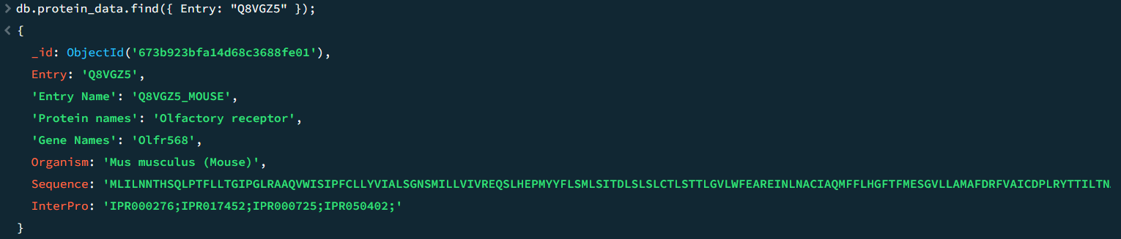
1. Find proteins by a specific Entry name:
Notes:
db.protein_data.find({ Entry: “Q8VGZ5” });

Slide 8
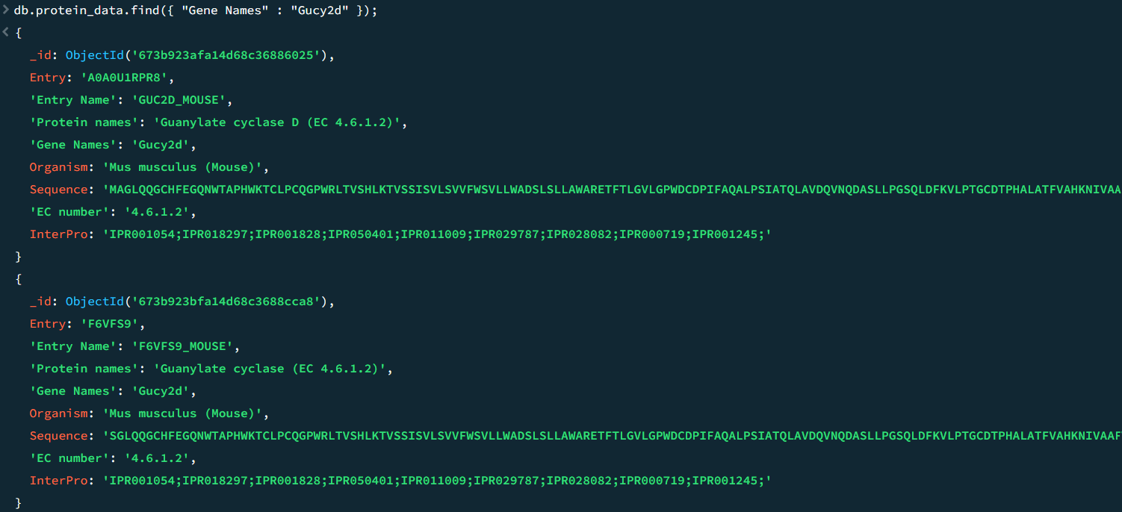
2. Find proteins by a specific Gene Names:

Slide 9
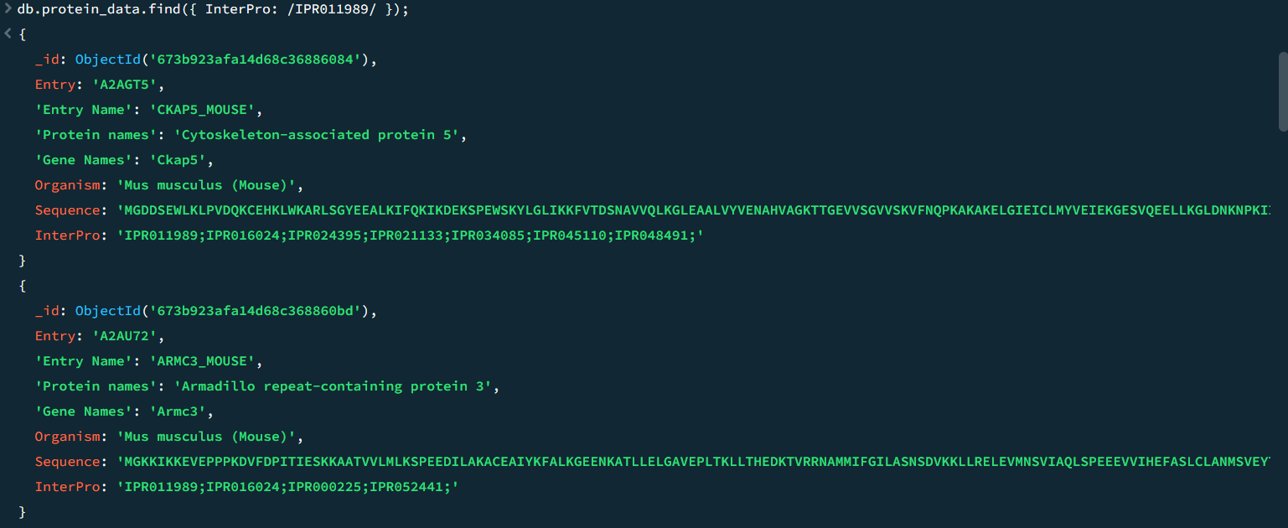
3. Search for proteins having specific InterPro ID

Slide 10
4. Number of proteins with multiple EC numbers

Slide 11
5. Number of proteins for a specific Gene name

Slide 12
6. Number of proteins that have EC number

Slide 13
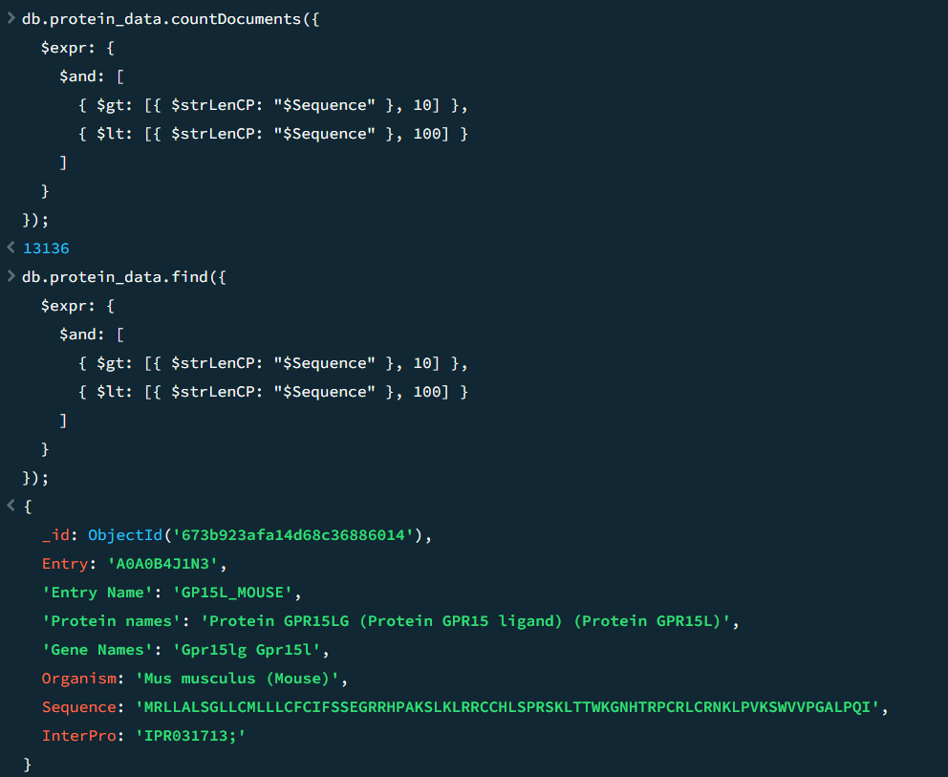
7. Number of proteins with sequences longer than 100 characters

Slide 14
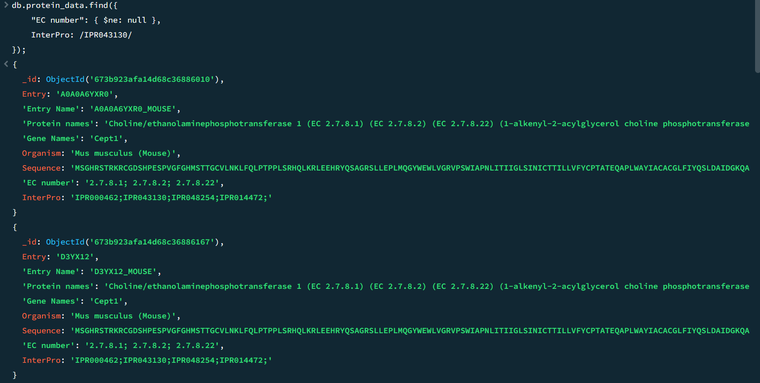
8. Combine filters for Complex Queries *

Slide 15
Protein Relationship Graph
Built a relationship dataset using Jaccard Similarity:
Measures domain-based similarity between proteins.
Imported the relationship dataset into Neo4j.
Nodes: Proteins.
Edges: Relationships with weights (Jaccard Similarity).

Slide 16
Protein Graph Visualization
Visualized protein relationships in Neo4j.
Nodes:
Green for core protein.
Red for neighbors.
Edges:
Blue lines representing relationship weights.

Slide 17
Computing Jaccard Similarity
Formula: ∣𝐴∩𝐵∣/∣𝐴∪𝐵∣∣A∩B∣/∣A∪B∣
Computed in Python for every protein pair.
Saved relationships with weights in an Excel file.
Example:Similarity(𝑃1,𝑃2)=0.66Similarity(P1,P2)=0.66

Slide 18
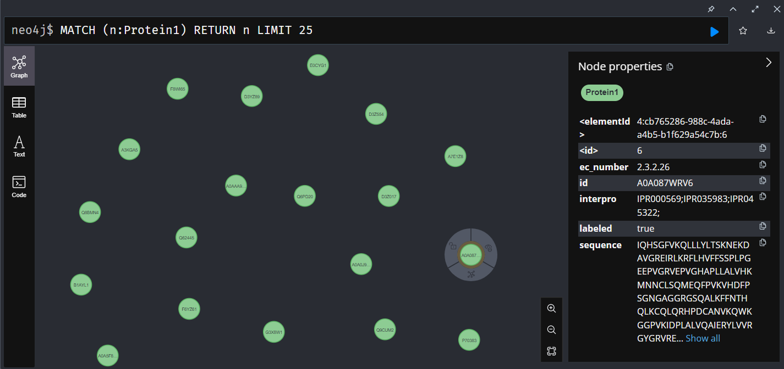
Nodes

Slide 19
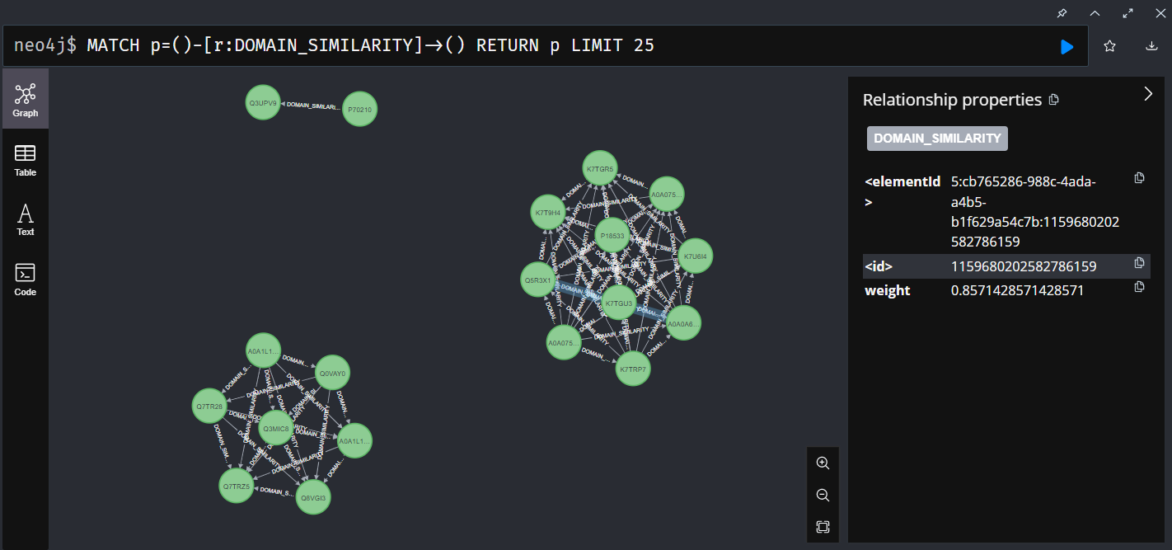
Relationship types

Slide 20
Graphical User Interface
Built using Python and Streamlit.
Features:
Search MongoDB by protein attributes.
Query Neo4j for protein neighbors.
Visualize protein graphs with weights.

Slide 21
Annotating Proteins without EC Numbers
Applied a label propagation algorithm.
Annotated proteins by:
Aggregating neighbor weights.
Ranking EC numbers by cumulative weight.
Added new annotated nodes in Neo4j.

Slide 22
Annotation Formula
Used graph-based propagation:
Weighted EC Score=∑(weight×neighbor’s EC)Weighted EC Score=∑(weight×neighbor’s EC)
Predicted EC numbers for unlabeled proteins.

Slide 23
Statistical Insights
EC Number Distribution:
Pie chart:
Proteins with no EC numbers.
Proteins with one EC number.
Proteins with multiple EC numbers.
Sequence Length Distribution:
Histogram for demonstrating protein sequence lengths.

Slide 24
Visualizing Protein Graphs
Visualized:
Protein nodes and neighbors.
Relationships with weights.
Used PyVis for rich graph representation.

Slide 25
Thank You

