Slide 1
Pricing Freddie Mac STACR 2026-DNA1 credit risk transfer notes
Deal structure, scenarios, a loan-level default and prepayment model, the waterfall, prices, and a check against the market for the A-1, M-1 and M-2 notes
Al Yazid Bensaid · Haocheng Sun · Coco Ma · Reza Zamani · Smarajit Paul Choudhury
MFE230M Asset-Backed Securities Markets · Prof. Nancy Wallace · UC Berkeley MFE · October 2026
Notes:
[Reza Zamani · about 30 seconds]
Good afternoon. Our project prices Freddie Mac's STACR 2026-DNA1, a credit risk transfer deal that closed in February 2026. We act as consultants to investors looking at the three offered classes: A-1, M-1 and M-2, which trades as M-2A and M-2B.
Five of us built it, and each of us will present our own part. Everything we show today runs from the September 2026 loan tape and is reproducible from our public repository.

Slide 2
Five parts, one pipeline from loan tape to price
AGENDA AND QUESTIONS
# | Part | Presenter | Time
1 | Deal structure, loss and principal rules | Al Yazid Bensaid | 3.5 min
2 | Loan data and cleaning | Haocheng Sun | 1.5 min
3 | Rate and house-price scenarios | Coco Ma | 2.5 min
4 | Default and prepayment model | Reza Zamani | 4 min
5 | Waterfall and pricing | Smarajit Paul Choudhury | 4 min
2 | Check against Bloomberg | Haocheng Sun | 1.5 min
3 | Verdicts and recommendations | Coco Ma | 1.5 min
What we set out to answer
How is the deal organized, and what protects investors?
How fast does the pool prepay and how much does it lose?
Do those losses reach A-1, M-1 or M-2? If not, what is the risk?
What are the notes' lives and prices across scenarios?
Do our lives and prices agree with Bloomberg?
Which investors should own which class?
About 20 minutes, then questions
Notes:
[Reza Zamani · about 1 minute]
Here is the plan. The parts follow our code pipeline. Al explains the deal and its rules. Haocheng cleans the loan tape. Coco builds the economic scenarios. I project the loans month by month under those scenarios. Smarajit runs the projected cash flows through the deal's waterfall and prices the notes. Then Haocheng comes back to check our results against Bloomberg, and Coco closes with our verdicts and recommendations. Each person keeps one part number, so Haocheng's two sections are both Part 2 and Coco's are both Part 3.
On the right are the six questions we set out to answer, from how the deal protects investors to who should own each class. We'll come back to each one at the end.

Slide 3
Investors buy notes from a trust, not mortgages
Closing Feb 17, 2026
Call from Feb 2031, or at 10% of cut-off
Maturity Feb 2046
Coupon 30-day avg SOFR + spread
STACR REMIC Trust
Delaware trust; holds note proceeds in short-term government assets (BlackRock, BNY Mellon)
Investors
QIBs and Reg S buyers of A-1, M-1, M-2
$627.5mm at closing
Spread (Transfer Amount)
Freddie Mac
Protection buyer, sponsor, administrator
SOFR + spread, principal
Write-downs (Return Amount)
Losses on the pool drive write-downs
Two risks for investors: credit risk on the reference pool, which drives pricing, and counterparty risk on Freddie Mac (in conservatorship since 2008) for the monthly spread.
Principal is ring-fenced in a bankruptcy-remote trust; noteholders never own the loans.
Reference pool
$22.78bn, 64,434 Freddie loans at cut-off
Notes:
[Al Yazid Bensaid · about 1.25 minutes]
The first thing to understand is that investors do not buy mortgages. They buy notes issued by the Freddie Mac STACR REMIC Trust, a Delaware statutory trust.
At closing, investors paid $627.5 million to the trust. The trust put that money into short-term government assets, managed by BlackRock and held by BNY Mellon. The trust then sells credit protection to Freddie Mac on a reference pool of $22.78 billion of Freddie Mac loans.
Each month, two things flow. Freddie Mac pays the spread over SOFR, called the Transfer Amount, and the SOFR part comes from earnings on the trust's investments. If loans in the pool have losses big enough to reach a note, the note is written down and the trust pays that amount back to Freddie Mac as the Return Amount.
So investors take two risks. The main one is credit risk on the reference pool, which drives almost all of the pricing. The second is counterparty risk on Freddie Mac, which has been in conservatorship since 2008, for the monthly spread. The principal itself sits in a bankruptcy-remote trust, and a Freddie Mac failure would most likely end the deal early rather than wipe out principal.
Key terms on the right: closing February 17, 2026; Freddie Mac can call the deal from February 2031 or when the pool falls to 10 percent of its cut-off balance; legal maturity is February 2046; and the notes pay 30-day average SOFR plus a spread.

Slide 4
The tranche stack: offered notes span 1.90–4.80%
Class | Original ($mm) | Attach | Detach | Coupon | Rating (S&P / DBRS) | Holder
A-H | 21,687.7 | 4.800% | 100.000% | n/a | n/a | Freddie Mac
A-1 | 275.9 | 3.525% | 4.800% | SOFR + 0.85% | A+ / A (low) | Investors
M-1 | 275.9 | 2.250% | 3.525% | SOFR + 1.00% | BBB+ / BBB (high) | Investors
M-2A | 37.85 | 2.075% | 2.250% | SOFR + 1.30% | BBB+ / BBB | Investors
M-2B | 37.85 | 1.900% | 2.075% | SOFR + 1.30% | BBB+ / BBB (low) | Investors
B-1H | 102.5 | 1.450% | 1.900% | n/a | n/a | Freddie Mac
B-2H | 273.4 | 0.250% | 1.450% | n/a | n/a | Freddie Mac
B-3H | 57.0 | 0.000% | 0.250% | n/a | n/a | Freddie Mac
After the Sep 2026 payment
A-1
$203.5mm
factor 0.7375
M-1
$157.8mm
factor 0.5720
M-2A
$37.85mm
factor 1.0000
M-2B
$37.85mm
factor 1.0000
September factors validated against Bloomberg; each H twin uses its class's factor and A-H is the residual. Pool: $19.25bn.
Each offered class has an "H" twin (about 5% of the band) that Freddie Mac keeps and that shares losses and principal pro rata. Source: PPM Table 3.
Notes:
[Al Yazid Bensaid · about 1 minute]
This is the full reference tranche stack. It sums exactly to the $22.78 billion cut-off balance, and each tranche's attach and detach points are its position in that stack as a percent of cut-off.
The offered notes are in blue. M-2B attaches at 1.90 percent, so the pool has to lose 1.90 percent of its original balance before any investor loses a dollar. M-2A covers 2.075 to 2.25, M-1 2.25 to 3.525, and A-1 3.525 to 4.80. Ratings follow that order: A-1 is A-plus at S&P, the M classes are BBB-plus. Spreads go from SOFR plus 85 basis points on A-1 to SOFR plus 130 on M-2.
Freddie Mac keeps everything else: the senior A-H piece, the three B tranches that absorb the first 1.90 percent of losses, and an "H" twin of about 5 percent in each offered band, which is its risk retention. Each twin shares losses and principal with its note pro rata.
On the right are today's balances after the September 2026 payment, which is where our waterfall starts. A-1 has paid down to a factor of about 0.74 on its fixed schedule, M-1 to about 0.57 because it gets all the subordinate principal first, and M-2A and M-2B haven't paid any principal yet. Haocheng checked these factors against Bloomberg, and together with Freddie Mac's pieces they add up to the $19.25 billion pool after the September payment.

Slide 5
Losses go bottom up; principal splits in two buckets
Triggers for M-1 and M-2 (all must pass)
Losses: bottom up
Principal: two buckets
Test | Passes if
Minimum credit enhancement | Subordinate share ≥ 3.525%
Cumulative net loss | Loss / cut-off ≤ 0.10% in year 1, +0.10% a year to 1.30%
Delinquency | 6-month avg distressed balance < 50% of subordinate cushion
Actual loss: credit-event UPB + missed interest + prior forgiveness − net liquidation proceeds (incl. MI)
Write-down order: B-3H, B-2H, B-1H, M-2B, M-2A, M-1, A-1
Modification losses cut interest first, then principal
Recoveries write classes back up, top down
Senior share = senior balances / pool; 96.475% at closing
A-1 fast-pay: 3.75% of its band a month in months 1–12, then 1.50% to month 36
Subordinate bucket pays M-1, then M-2A, then M-2B (sequential)
If any trigger fails, all principal goes senior
The minimum CE test passes with no cushion at closing, so any loss reaching the B tranches switches principal to senior
A-1 loses its fast-pay schedule for good if cumulative loss ever exceeds 1.00%
Notes:
[Al Yazid Bensaid · about 1.25 minutes]
These are the rules the waterfall has to implement.
Losses. STACR is an actual-loss deal. When a loan has a credit event, such as a short sale, foreclosure sale or REO sale, the loss is the balance plus missed interest plus prior forgiveness, minus net liquidation proceeds including mortgage insurance. Losses are written down from the bottom: B-3H, B-2H, B-1H, then M-2B, M-2A, M-1 and finally A-1. Modification losses, when a loan's rate is cut, reduce a class's interest first and then its principal. Recoveries write classes back up from the top.
Principal. Each month principal from the pool is split into a senior bucket and a subordinate bucket. The senior share was 96.475 percent at closing. Inside the senior bucket, A-1 has a fixed fast-pay schedule: 3.75 percent of its band per month for the first year, then 1.5 percent per month to month 36. The subordinate bucket pays the mezzanine notes sequentially: M-1 first, then M-2A, then M-2B.
Triggers. All three tests must pass for the mezzanine notes to get principal. The minimum credit enhancement test needs the subordinate share to stay at 3.525 percent or more, and it passes with zero cushion at closing, so any loss that hits the B tranches flips all principal to the senior classes. The cumulative net loss test has a schedule starting at 0.10 percent in year 1. The delinquency test compares distressed loans with half of the subordinate cushion. And A-1 permanently loses its fast-pay schedule if cumulative losses ever pass 1 percent.

Slide 6
Starting point: the September 2026 loan tape
56,433
$19.25bn
6.76%
759
70.5
0.79%
loans on the Sep 2026 tape (64,434 at cut-off)
pool after Sep 2026 ($22.78bn at cut-off)
WA coupon vs 7.28% PMMS today
WA FICO
WA current LTV (75.6 at origination; no MI)
of balance 30+ days late; DTI 38.5
1
Load
2
Clean
3
Class factors
4
Hand-off
Newest dated tape: Freddie Mac disclosure in the Bloomberg layout, matched to Bloomberg CLP
Standardize field names, units and dates; balance-weighted pool statistics; written to data/processed
September factors for every class, checked against Bloomberg; A-H is the residual
Loans already 60+ days late (about $52mm) start in the liquidation pipeline
Notes:
[Haocheng Sun · about 1.5 minutes]
My first job was the data. The deal discloses the reference pool loan by loan every month. We start from the tape after the September 2026 payment: 56,433 loans and $19.25 billion, down from 64,434 loans and $22.78 billion at cut-off. We use Freddie Mac's disclosure converted to the Bloomberg layout, and it matches Bloomberg's own pool screen.
The pool is strong credit. Weighted-average FICO is 759, the current LTV is about 70, and DTI is 38.5. Every loan had an original LTV between 61 and 80, so none has mortgage insurance. The average coupon is 6.76 percent against a 7.28 percent market rate, so borrowers have no reason to refinance today. And 0.79 percent of the balance is already 30 or more days late.
The cleaning has four steps: load the newest tape, standardize the fields and compute balance-weighted statistics, set the September factor for every note class and check it against Bloomberg, and hand the loans to Reza's model. Loans already 60 or more days late, about $52 million, go straight into the liquidation pipeline. That detail comes back in Smarajit's part.

Slide 7
Two methods: simulation and historical stress replays
20,000
53
319
5
simulated paths
monthly steps to the Feb 2031 call
months of calibration data (2000–2026)
factors moved jointly
Good and base: simulation
Moderate and severe: history
AR(1) for each factor: short rate, 2y and 10y Treasury, mortgage spread, HPI growth
Residuals bootstrapped in 6-month blocks, all factors from the same months, so co-movement is kept
Paths ranked by house-price outcome: good = 75–85th percentile, base = 45–55th; each scenario is the band's average path
Replay 53-month windows of joint rate and HPI changes from 2000–2026 (266 candidate windows)
Moderate: 10th-percentile HPI window, Dec 2005 – May 2010
Severe: worst window, Mar 2007 – Aug 2011
Changes re-anchored to today's rates
Notes:
[Coco Ma · about 1.25 minutes]
Our scenario model produces joint paths for mortgage rates, SOFR and house prices, month by month from today to the February 2031 call, which is 53 steps.
It uses two methods. For the good and base cases, it fits a first-order autoregressive model to five factors: the short rate, the 2-year and 10-year Treasury yields, the mortgage spread over the 10-year, and monthly house-price growth. It is calibrated on 319 months of FRED data from 2000 to mid-2026. It then simulates 20,000 paths by bootstrapping the model's residuals in 6-month blocks, taking all five factors from the same historical months so their co-movement is preserved. The paths are ranked by their house-price outcome: the good scenario is the average of paths between the 75th and 85th percentiles, and the base is the average around the median.
A simulation like that rarely produces a real housing crash, so for the stress cases we replay history instead. We looked at 266 overlapping 53-month windows. Moderate is the window at the 10th percentile of house-price returns, December 2005 to May 2010. Severe is the worst window, March 2007 to August 2011. The historical rate changes are re-anchored to today's rate levels.
One caveat from the metadata: these are physical-measure scenarios, not a risk-neutral curve, and the ranks of the historical windows are not probabilities.

Slide 8
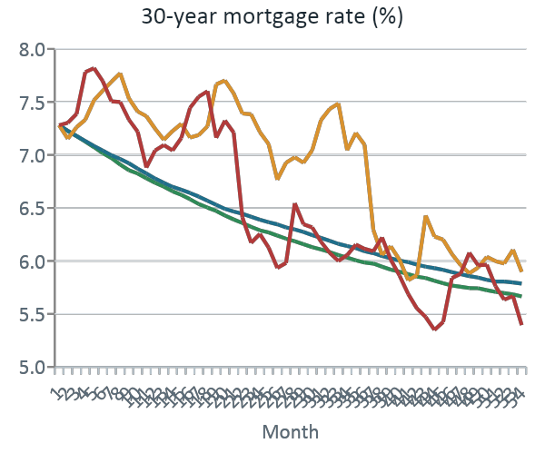
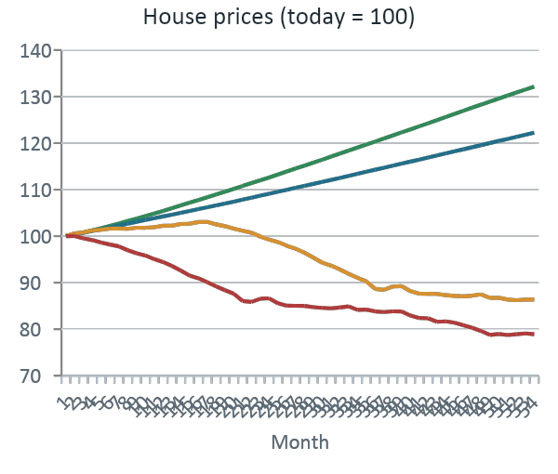
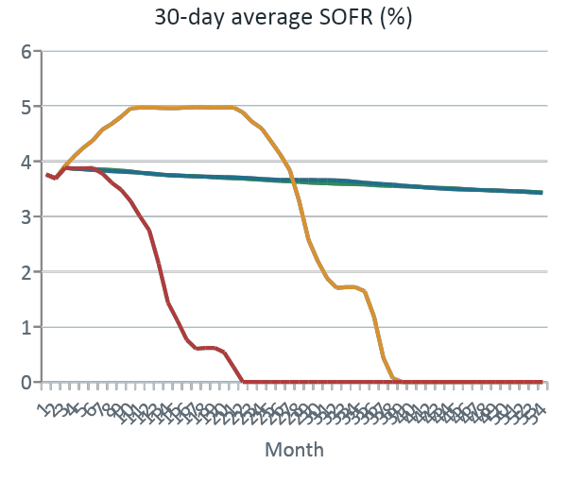
All paths start at today's 7.28% rate; house prices split
Scenario | Method | HPI change by call | Mortgage rate at call | SOFR at call
Good | Simulation, 75–85th pct | +32.1% | 5.67% | 3.42%
Base | Simulation, 45–55th pct | +22.3% | 5.79% | 3.41%
Moderate | Replay Dec 2005 – May 2010 | −13.7% | 5.90% | 0.00%
Severe | Replay Mar 2007 – Aug 2011 | −21.1% | 5.39% | 0.00%
Notes:
[Coco Ma · about 1.25 minutes]
Here are the four paths. Every path starts from the market on October 3, 2026: a 7.28 percent 30-year mortgage rate and 30-day average SOFR of about 3.76 percent.
Mortgage rates, on the left, drift down in good and base to about 5.7 to 5.8 percent by the call. The replays are bumpier: moderate keeps rates above 7 percent for about three years before falling, and severe jumps first and then falls to 5.39 percent.
House prices, in the middle, end 32 percent higher in good and 22 percent higher in base. Moderate falls about 14 percent and severe about 21 percent, which is close to the national decline after 2007.
SOFR, on the right, matters for the note coupons. In good and base it stays around 3.4 to 3.8 percent. In both replays it drops to zero, because the Fed cut to zero in the crisis, and the floor binds. The table summarizes where each path ends at the call. The SOFR resets and discount factors for each payment date are in data/scenarios/pricing_rates.csv for the waterfall and pricing.

Slide 9
Three behaviors, applied loan by loan each month
Prepayment
Default
Liquidation and loss
CPR = ramp × [turnover + refi max × S(coupon − PMMS) − burnout]
Poisson GLM for the monthly default rate
Loss = UPB + missed interest + costs − sale proceeds − MI
Logistic S-curve in the refinancing incentive
Fitted: turnover 5.5%, refi add-on up to 41.4%, midpoint 0.71 pp, ramp about 6 months
CPR turned into a monthly SMM
Mark-to-market LTV (steeper above 80) moves with the scenario's house prices
FICO, DTI, investor status, recent 30-day delinquency, pre-2009 vintage
Loans 60+ days late on the tape start in the pipeline
About 19 months from default to credit event; no cures
Sale at a fitted 48% distressed discount to HPI value
57% of distressed loans modified (0.57 pp rate cut)
Each month defaults, then scheduled amortization, then prepayments. Output per scenario, months 1–53: scheduled principal, prepayments, credit events, losses, modification losses, distressed balance.
Notes:
[Reza Zamani · about 1 minute]
My part turns Haocheng's loans and Coco's scenarios into monthly pool cash flows. The model has three behaviors.
Prepayment is a seasoning ramp times a turnover floor plus an S-curve in the refinancing incentive, the loan's coupon minus the market mortgage rate, less burnout. Fitted, turnover is 5.5 percent a year and refinancing can add up to 41 percent once the incentive is well past 0.7 points.
Default is a Poisson GLM for the monthly default rate. The key driver is mark-to-market LTV, which moves with the scenario's house prices and gets steeper above 80, plus FICO, DTI, investor status and recent delinquency.
A defaulted loan then waits about 19 months before it becomes a credit event. The loss is built the way the deal defines it: balance plus missed interest plus costs, minus the sale proceeds at a 48 percent distressed discount. We assume no cures, which is conservative. Modifications cut the interest the notes receive, and we pass that through as well.

Slide 10
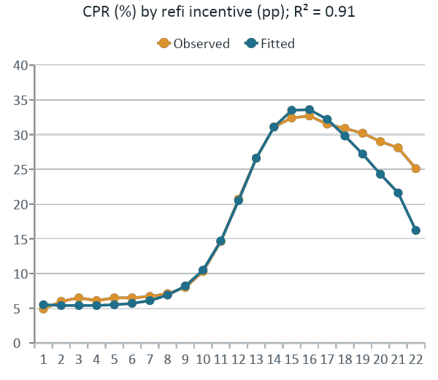
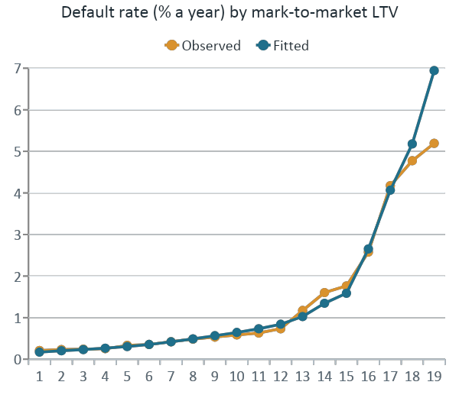
Calibrated on 48 million Freddie Mac loan-months
977,577
loans, 27 vintages (2000–2026)
19 mo
median time to credit event
48%
distressed-sale discount
45.5%
Prepayment: weighted least squares on observed speeds by incentive, age and burnout
Default: Poisson GLM on 38M loan-months and 22,598 default spells, every coefficient of the expected sign
model severity vs 44.4% observed
Notes:
[Reza Zamani · about 1.25 minutes]
Every parameter is fitted on Freddie Mac's Single-Family Loan-Level Dataset: 27 vintages from 2000 to 2026, about 978,000 thirty-year fixed loans and 48 million loan-months, matched with the PMMS rate and the FHFA house price index.
On the left, prepayment: observed speed against the refinancing incentive, with the fitted S-curve. It explains 91 percent of the dollar-weighted variation. Speeds sit around 5 to 6 percent when loans are out of the money and climb past 30 percent once borrowers can save more than a point.
In the middle, default: a Poisson GLM on 38 million loan-months and 22,598 default spells. Default rates rise gently up to LTV 80 and then more than triple between 80 and 100.
On the right, the liquidation side: a median of 19 months from first missed payment to credit event, and a 48 percent distressed-sale discount. With those, the model's average severity is 45.5 percent against 44.4 percent observed on 17,389 liquidations.

Slide 11
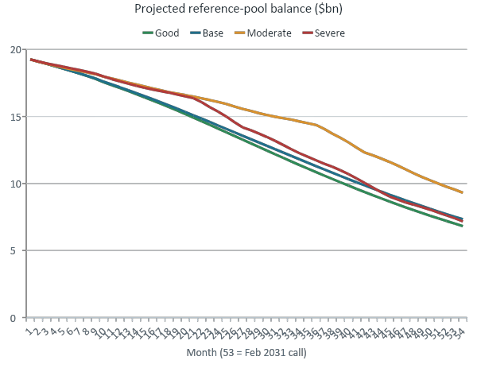
The pool pays down slowly until rates fall below its coupon
Scenario | Year-1 CPR | Month 24 | At the call | Half paid by
Good | 10.9% | $13.8bn | $6.83bn | month 40
Base | 10.6% | $14.1bn | $7.33bn | month 42
Moderate | 7.6% | $15.9bn | $9.30bn | month 52
Severe | 8.0% | $15.0bn | $7.17bn | month 43
Slow start. At 7.28% the pool is out of the money, so year-1 CPR is only 8–11%.
Then fast. Once rates fall below the coupon, CPR reaches about 24–31% by the call.
Most extension: moderate. 48% of today's pool is still outstanding at the call.
Notes:
[Reza Zamani · about 1 minute]
Running the full pool through Coco's four scenarios gives these balances.
For the first year all four look alike. Rates start at 7.28 percent, above the pool's 6.76 percent coupon, so year-1 CPR is only 8 to 11 percent. After that the paths split according to when rates fall below the coupon. Good and base speed up steadily and are half paid down around month 40 to 42. The severe path refinances heavily once its rates drop in month 21, so it ends almost level with base. Moderate keeps rates above 7 percent for three years, so 48 percent of today's pool is still outstanding at the call. That is the extension case for the notes.

Slide 12
Pool losses of 0.20–0.37% never reach A-1, M-1 or M-2
Tranche stack, % of cut-off
 | Good | Base | Moderate | Severe
HPI change to 2031 | +32% | +22% | −14% | −21%
Credit events | $121.8mm | $124.0mm | $136.0mm | $149.3mm
Liquidation losses | $46.4mm | $50.3mm | $68.6mm | $84.6mm
Loss, % of cut-off | 0.204% | 0.221% | 0.301% | 0.371%
Average severity | 38.1% | 40.6% | 50.4% | 56.7%
A-1 3.525–4.80%
M-1 2.25–3.525%
M-2A/B 1.90–2.25%
Good and base stay inside B-3H; moderate and severe run into B-2H. Freddie Mac keeps both.
M-2B attaches at 1.90%, about 5 times the severe-case loss. The worst case uses about a fifth of the cushion.
So the question for investors is not whether they lose principal but when they get it back.
B-1H 1.45–1.90%
Severe loss
0.371%
B-2H 0.25–1.45%
B-3H 0–0.25%
Offered notes in blue; grey is retained by Freddie Mac
Notes:
[Reza Zamani · about 1 minute]
This is the answer to the credit question. Pool losses to the 2031 call run from 0.20 percent of the cut-off balance in the good case to 0.37 percent in the severe case, where house prices fall 21 percent. Severity rises from 38 to 57 percent as house prices fall.
On the right is Al's tranche stack drawn to scale. Good and base losses stay inside B-3H, Freddie Mac's first-loss piece. Moderate and severe move into B-2H, which Freddie Mac also keeps. The red line is the severe loss. M-2B, the first offered note, only attaches at 1.90 percent, about five times higher.
So none of the offered notes is written down in any scenario. For these investors the risk is timing: when the principal comes back. That is what Smarajit's waterfall measures, so over to Smarajit.

Slide 13
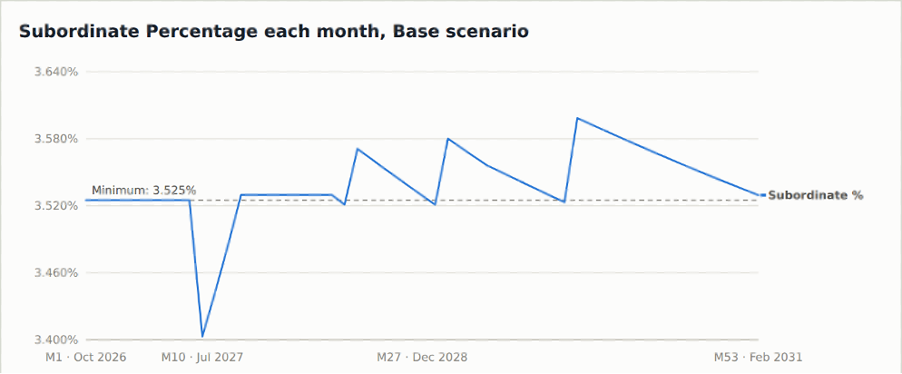
The deal sits on its trigger, so losses keep cutting off M-note principal
What happens
No cushion: the test needs a Subordinate Percentage of at least 3.525%, and the deal starts exactly there.
Pro rata holds it flat: while the test passes, the M notes get their pro-rata share of principal, so the share does not move.
Losses push it down: each loss, even one Freddie Mac absorbs in B-3H, lowers the share. Once it dips below 3.525%, all principal goes senior until it climbs back.
Month 9 is the biggest: the tape's delinquent loans liquidate together: a $23.31mm loss and a three-month lockout. One-date liquidation overstates it.
Scenario | Months failing (of 53) | Initial lockout
Good | 6 | Months 10–12
Base | 6 | Months 10–12
Moderate | 11 | Months 10–14
Severe | 10 | Months 10–13
The cumulative-loss and delinquency tests pass in every month; only minimum CE fails. Months counted to the assumed Feb 2031 call. Chart: base scenario.
For investors: M-note principal can stop for months at a time even when Freddie Mac absorbs the loss, so credit events show up as timing risk.
Notes:
[Smarajit Paul Choudhury · about 1.5 minutes]
My part is the waterfall: it applies the deal's rules from Al's section to Reza's pool cash flows, month by month, for every class, and then prices the notes.
The interesting result is the minimum credit enhancement trigger. The test requires the Subordinate Percentage, the share of the deal below A-1, to be at least 3.525 percent. This deal starts exactly on that line, with no cushion.
In month 9, the loans that were already delinquent on Haocheng's tape reach the end of the liquidation pipeline together. That produces a $23.31 million loss, which is written off B-3H only. The loss shrinks the subordinate share below 3.525 percent, so for months 10 to 12, in every scenario, all principal goes to the senior classes and M-1 and M-2 receive none. Senior-only paydown then rebuilds the share above the line and the M notes are paid again.
Every later loss does the same thing for a month or so, which is the table on the right: more failures in moderate and severe because they have more losses. The other two tests, cumulative loss and delinquency, pass throughout.
One caveat: the size of the month-9 lump is partly our simplification. Spreading those liquidations over several months would smooth it.

Slide 14
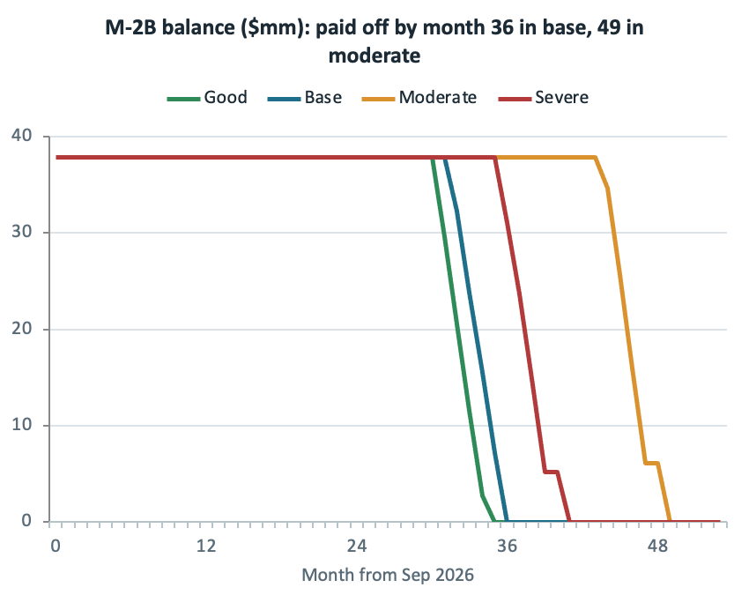
No write-downs; the risk is extension in the moderate case
WAL, yrs | Good | Base | Moderate | Severe | PPM
A-1 | 1.40 | 1.40 | 1.40 | 1.40 | 1.59
M-1 | 1.16 | 1.20 | 1.87 | 1.54 | 1.75
M-2A | 2.28 | 2.43 | 3.47 | 2.74 | 4.11
M-2B | 2.70 | 2.82 | 3.84 | 3.16 | 4.79
Write-down | 0 | 0 | 0 | 0
PPM: expected WAL at issue (Feb 2026), 10% CPR, no losses, called Feb 2031. Ours run from Sep 2026, so they are shorter by construction.
•A-1 is locked in: it takes only its fixed schedule until payment 37 (month 30), when it is retired: 1.40 years in every scenario.
•M notes extend about a year in moderate, where rates stay above the pool's 6.76% coupon for three years. M-2B's last payment moves from month 35 (good) to 49.
•Severe extends less because rates fall and refinancing picks up.
For investors: A-1 behaves like a 1.4-year cash instrument; an M-2B buyer should plan to hold for up to 4 years.
Notes:
[Smarajit Paul Choudhury · about 1.25 minutes]
Here are the results for the notes, measured from September 2026.
First, there are no write-downs for any offered class in any scenario. That confirms Reza's result at the note level.
Second, the lives. A-1 has a fixed pay-down schedule, so its weighted-average life is 1.40 years and its last payment is month 30 in every scenario. The M notes depend on the pool's speed. In the base case M-1 lives 1.2 years and M-2B 2.8 years. In the moderate case, where house prices fall but rates stay above the pool's coupon for three years, borrowers can't refinance and M-1 and M-2 extend by about a year; M-2B goes to 3.8 years. The chart shows that for M-2B: its balance stays at $37.85 million much longer in moderate. Severe extends less because rates fall and refinancing picks up.
All our lives are shorter than the PPM's pricing assumption at issue, mostly because we measure them from September 2026, seven months after closing.

Slide 15
Each 100 bp of spread moves a note by about its life in points
Base case | WAL (yrs) | DM 0 bp | DM 200 bp | Points per 100 bp
A-1 (85 bp) | 1.40 | 101.26 | 98.57 | 1.35
M-1 (100 bp) | 1.20 | 101.28 | 98.95 | 1.17
M-2A (130 bp) | 2.43 | 103.16 | 98.51 | 2.33
M-2B (130 bp) | 2.82 | 103.63 | 98.27 | 2.68
For investors: a 50 bp spread widening costs M-2B about 1.3 points in base and 1.7 in moderate; A-1 about 0.7.
Reading the prices
•Points ≈ life. Each 100 bp of DM moves a note's price by roughly its WAL in points, so longer notes swing more.
•M-2B is most exposed: 2.7 points per 100 bp in base and 3.6 in moderate, where its life stretches to 3.8 years.
•Engine check: at its own coupon spread every class prices at 100.10 (par plus accrued) in every scenario, as a floater should.
•DM from a price: we solve for the DM by bisection, which is how we compare with Bloomberg next.
M-2B by scenario | WAL (yrs) | Points per 100 bp | Cost of +50 bp
Good | 2.70 | 2.58 | −1.27
Base | 2.82 | 2.68 | −1.32
Moderate | 3.84 | 3.55 | −1.74
Severe | 3.16 | 3.06 | −1.50
For investors: a 50 bp spread widening costs M-2B about 1.3 points in base and 1.7 in moderate; A-1 about 0.7.
Full prices per 100 face incl. about 0.10 accrued since Sep 25, 2026; discounted at each scenario's SOFR path plus the DM. Points per 100 bp = (price at DM 0 − price at DM 200) / 2; cost of +50 bp is from the coupon spread.
Notes:
[Smarajit Paul Choudhury · about 1.25 minutes]
To price, I discount each class's monthly cash flows at the scenario's SOFR path plus a discount margin. These are full prices per 100 including about 0.10 of accrued interest.
The first table is the base case. When the discount margin equals the class's own coupon spread, every class is worth 100.10, which is par plus accrued. That is what a floater should do, and it is a good check on the code.
Away from that point, value is about timing. If investors demand less than the coupon spread, the notes trade at a premium, and the longer the life, the bigger it is. M-2B moves about 2.7 points per 100 basis points of discount margin in the base case.
The second table shows M-2B by scenario. In the moderate case the range between a 0 and 200 basis point DM widens to 7.1 points, because the note lives a year longer. So extension matters for price only when the note's spread differs from what the market wants.
Going the other way, from a market price to a discount margin, we solve by bisection. That is what Haocheng uses to compare our cash flows with Bloomberg.

Slide 16
Bloomberg agrees on credit; M-2 is priced for extension
Class | Factor | BBG WAL | Our base WAL (range) | BBG bid / ask | Ask DM | Coupon | Our base DM at ask | Our moderate DM
A-1 | 0.7375 | 1.39 | 1.40 (1.40–1.40) | 99.844 / 99.978 | 87 | 85 | 87 | 87
M-1 | 0.5720 | 1.23 | 1.20 (1.16–1.87) | 99.875 / 100.027 | 98 | 100 | 98 | 99
M-2A | 1.0000 | 2.78 | 2.43 (2.28–3.47) | 99.377 / 99.720 | 141 | 130 | 142 | 139
M-2B | 1.0000 | 3.48 | 2.82 (2.70–3.84) | 98.761 / 99.148 | 157 | 130 | 162 | 154
Bloomberg as of October 2, 2026; DMs in bp. "Our DM at ask" is the DM that makes our projected cash flows worth Bloomberg's ask price plus accrued.
Balances match
Timing is in range
Extension, not credit
M-2B looks fair
Bloomberg factors and balances equal the ones our waterfall uses for every class. 16 output tests pass.
Every Bloomberg WAL is inside our scenario range. A-1 and M-1 match our base; M-2 is near our moderate case.
M-2A and M-2B trade 11–27 bp over their 130 bp coupon. No scenario writes them down, so the extra spread is for slower paydown.
At the ask, M-2B earns 162 bp on our base cash flows and 154 bp on moderate, against 157 bp quoted.
Notes:
[Haocheng Sun · about 1.5 minutes]
My second job was to check the whole model against the market. I pulled Bloomberg's description, price and pool screens for every class as of October 2, and I wrote 16 automated tests on our outputs: the pool and every tranche balance reconcile month to month, nothing goes negative, no offered class is written down, and prices fall as the discount margin rises. All 16 pass.
The table compares us with Bloomberg. Balances match exactly. Bloomberg's weighted-average lives all fall inside our scenario range. For A-1 and M-1 they match our base case almost exactly, and both trade at their coupon spread, close to par.
M-2 is the interesting one. M-2A and M-2B trade at a discount, at 141 and 157 basis points, wider than their 130 basis point coupon. Bloomberg's lives for them, 2.8 and 3.5 years, are longer than our base and close to our moderate case. Since no scenario writes M-2 down, the extra spread is paying for extension risk, not credit risk.
Is M-2B cheap? If you buy it at the ask, our base cash flows earn 162 basis points, about 5 more than Bloomberg says, because we expect it back sooner at par. Our moderate cash flows earn 154. So it is slightly cheap on our base case and about fair if you believe the slower moderate path.

Slide 17
All five hypotheses hold, with a timing gap for M-2
# | We expected | We found
H1 | A strong pool loses well under 1% of cut-off, even in a 2008-style fall | Supported: losses of 0.20–0.37% across scenarios
H2 | The 1.90% below M-2B absorbs every projected loss | Supported: zero write-downs for every offered class in every scenario
H3 | Out-of-the-money loans prepay slowly, so extension is the main risk | Supported: year-1 CPR of 7.6–10.9%; M lives extend about a year in moderate
H4 | Floaters stay near par at their own spread | Supported: about 100.10 (par plus accrued) for every class
H5 | Our timing and prices agree with the market | Supported, with a gap: A-1 and M-1 match our base; the market prices M-2 near our moderate case
Notes:
[Coco Ma · about 45 seconds]
To close, our five hypotheses. We expected a strong pool to lose well under 1 percent; it loses 0.20 to 0.37 percent. We expected the 1.90 percent of subordination to absorb those losses; no offered class is written down in any scenario. We expected slow prepayments to make extension the main risk; year-one speeds are 8 to 11 percent and the M notes extend about a year in the moderate case. We expected the floaters to price at par at their own spread; they do. And we expected to agree with the market; we do on balances, credit and A-1 and M-1, while the market prices M-2 closer to our slower moderate case.

Slide 18
Who should own which class
A-1
1.40-year life in every scenario, 85 bp
Banks and money-market-style buyers who want a SOFR floater with little extension
Limitations
Starting delinquent loans liquidate on one date, which exaggerates the month-9 trigger failure
No cures; national, not regional, house prices
One Bloomberg snapshot (Oct 2, 2026), no price history
Assumes the February 2031 call is exercised
M-1
1.2 years, up to 1.9 in moderate; 100 bp
Insurers and asset managers who want extra spread with no projected loss
M-2A / M-2B
2.4–2.8 years, up to 3.8; 141–157 bp at the ask
Total-return credit funds and hedge funds that can hold through slower paydown
All three classes: no projected loss. Investors also take Freddie Mac counterparty risk on the monthly spread.
Thank you. Questions? Code and results: github.com/rezazamani2329/Asset-Backed-Security-Market--UC-Berkeley-MFE-program
Notes:
[Coco Ma · about 45 seconds]
Our recommendations follow from the timing risk. A-1 has the same 1.4-year life in every scenario, so it suits banks and money-market-style buyers who want a short SOFR floater. M-1 adds spread with modest extension, which suits insurers and asset managers. M-2A and M-2B pay the most, 141 to 157 basis points at the market ask, but can extend to almost four years, so they belong with credit funds and hedge funds that can hold through slower paydown. None of the classes has a projected loss.
The main limitations are on the right: the month-9 lump comes from liquidating the starting delinquent loans on one date, we assume no cures and national house prices, we have one Bloomberg snapshot, and we assume the 2031 call. Thank you, and we're happy to take questions.

